Slide 1
Update
27Aug2018
SCP CFSv2-45day
Making a daily lead time data
SCP CFSv2-45 day data is available on
/cpc/home/alima.diawara/CFSv2-data
Data structure is as follow
YEAR/YEARMONDAYHOUR/45 FORECAST (6 HOURLY=180 data)

Slide 2
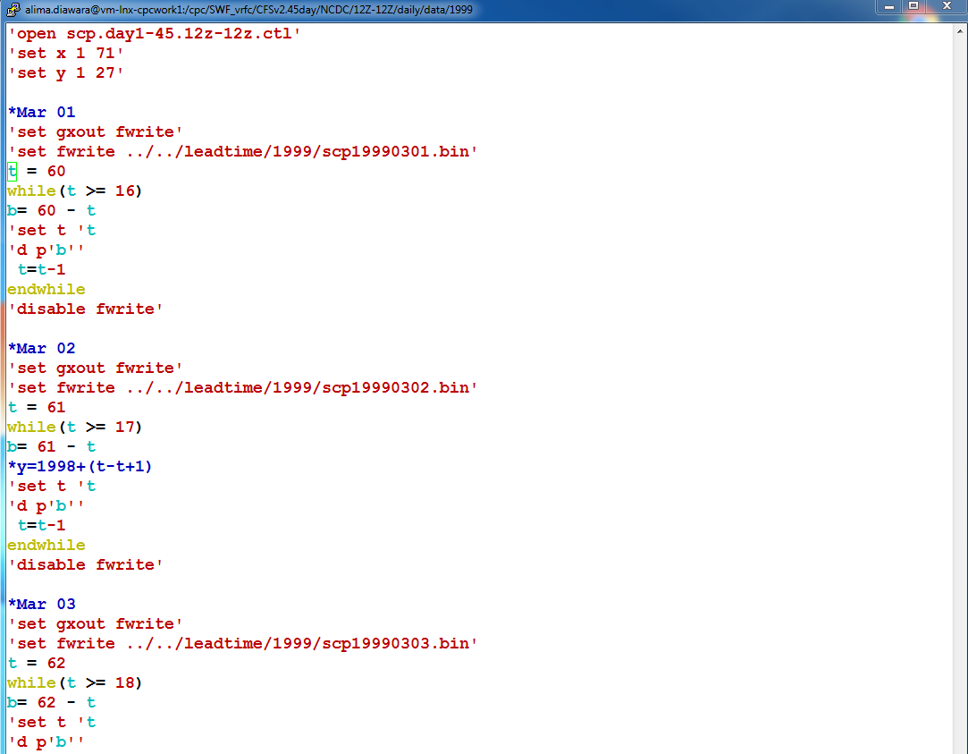
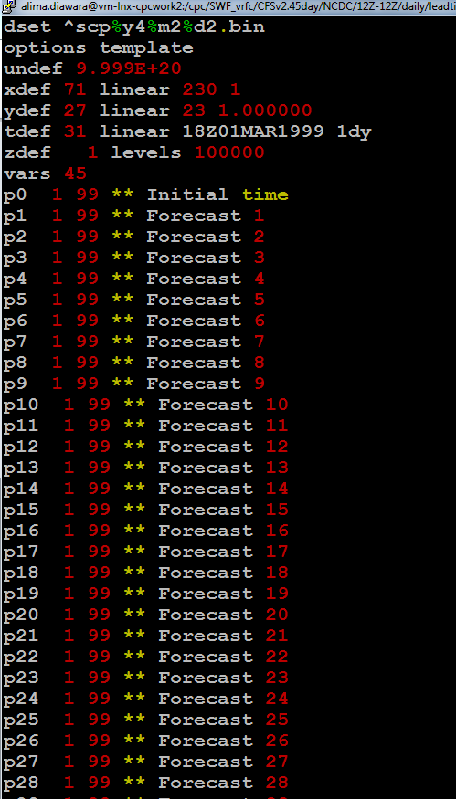
Ctl file
Leadtime.gs

Slide 3
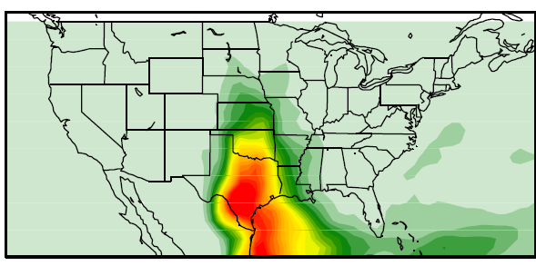
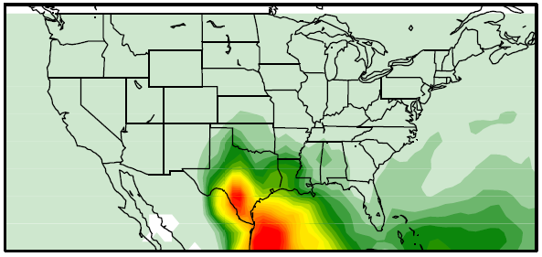
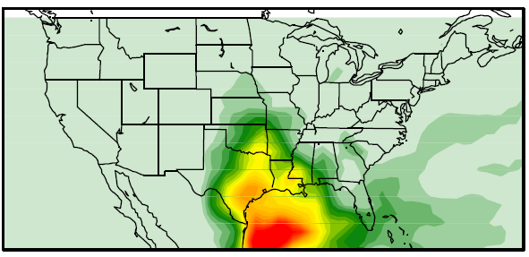
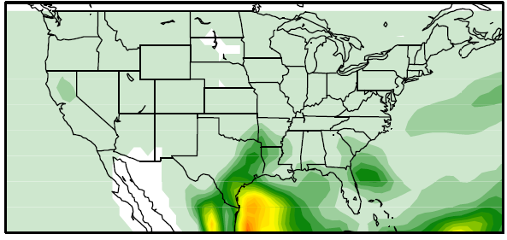
SCP CFSv2-45day Mars 20th 1999 Lead time
Week 1
Week 2
Week 3
Week 4

