Slide 1
CPC’s Week 3–4 Severe Weather Project
Hui Wang, Alima Diawara, Arun Kumar, David DeWitt
Acknowledgments:
CPC/OPB: Stephen Baxter, Jon Gottschalck, Daniel Harnos, Melissa Ou,
Brad Pugh, Matthew Rosencrans
EMC: Yuejian Zhu, Hong Guan
Week 3-4/GTH Group Meeting
22 March 2019

Slide 2
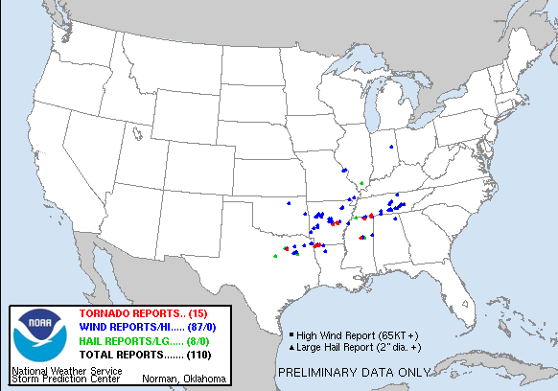
Severe Weather
NWS Local Storm Reports for 03/09/19
Local Storm Report
(LSR)
Tornado
Damaging wind
Hail
LSR3 = Total reports of tornadoes, wind and hail events
Project Goal:
Forecast: Weekly severe weather activity (LSR3)
Lead times: Week 2, Week 3, and Week 4

Slide 3
Subseasonal Severe Weather Project
Week 2
To develop forecast tools for week-2 severe weather
GEFS 16-day hindcast/forecast
Weeks 3–4
To apply the forecast tools for week 3-4 severe weather
CFSv2 45-day hindcast/forecast

Slide 4
Methodology
Severe weather
Small spatial scale
Short life time
Hybrid dynamical–statistical model
Using dynamical model predicted VAR as a predictor
Statistical relationship between model VAR and OBS LSR3
Hindcast Historical OBS
SCP (Supercell Composite Parameter)
SCP = (CAPE/1000 J kg⁻¹)×(SRH/50 m⁻² s⁻²)×(BWD/20 m s⁻¹)
CAPE: Convective available potential energy
SRH: Storm-relative helicity
BWD: Bulk wind difference
When SCP > 1, the chance for severe weather to occur is high.

Slide 5
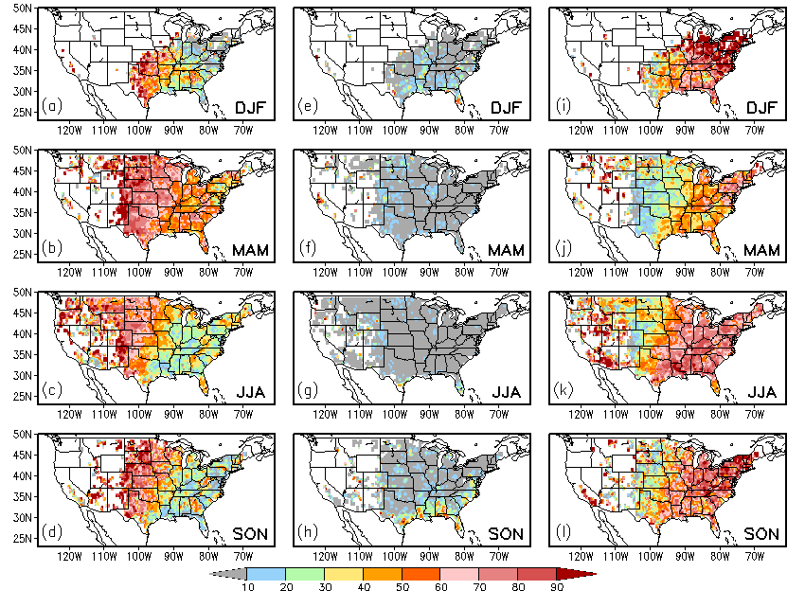
Climatology
LSR3 = Hail + Tornado + Damaging Wind
LSR3
Climatology
Contributions (%) to the LSR3 Climatology from
Hail Tornado Wind

Slide 6
Seasonality
OBS SCP (CFSR) OBS LSR3 GEFS SCP

Slide 7
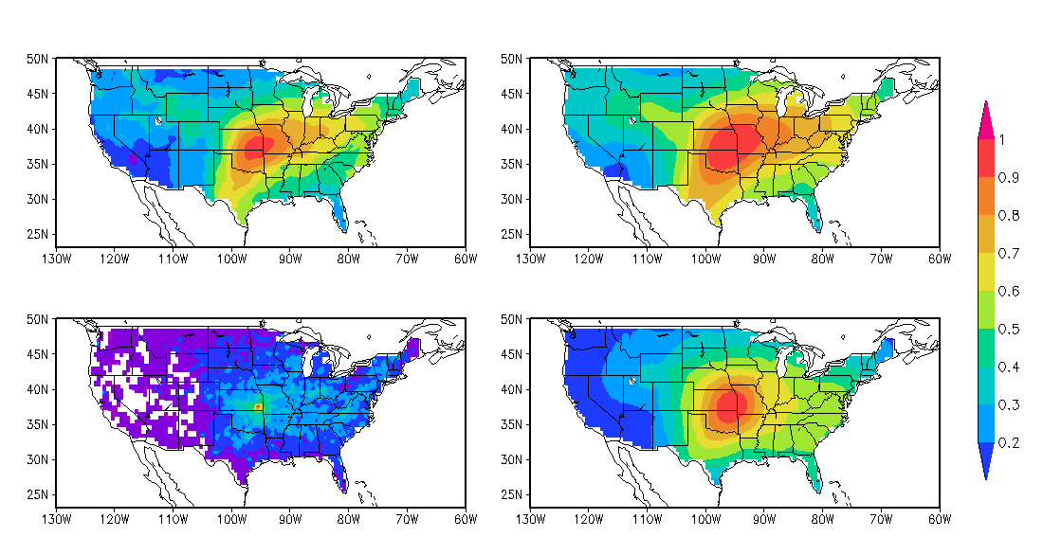
Spatial Covariation: SCP vs. LSR3
Weekly data
1996 – 2012
One-point Correlation (95.5ºW, 37.5ºN)
CFSR SCP
CFSR SCP
×
0.5º×0.5º
5º×5º
LSR3
LSR3
0.5º×0.5º
5º×5º
Higher spatial coherence
Forecasting weekly LSR3 over a large domain (5º×5º) may have a better skill than over a small area (0.5º×0.5º).

Slide 8
Relationship: SCP & LSR3
MAM 1996 – 2012
Correlation (GEFS SCP & OBS LSR3) AC Skill for LSR3
Cross-validation
Simple linear regression forecast model
5º×5º
5º×5º
0.5º×0.5º
0.5º×0.5º
Stronger relationship → Higher skill

Slide 9
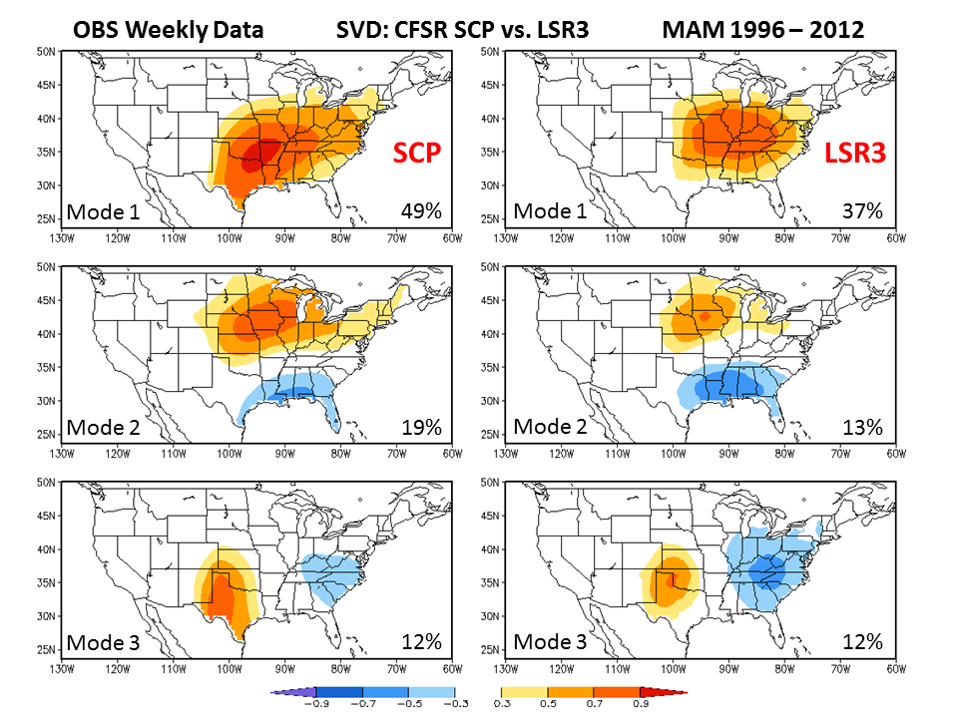
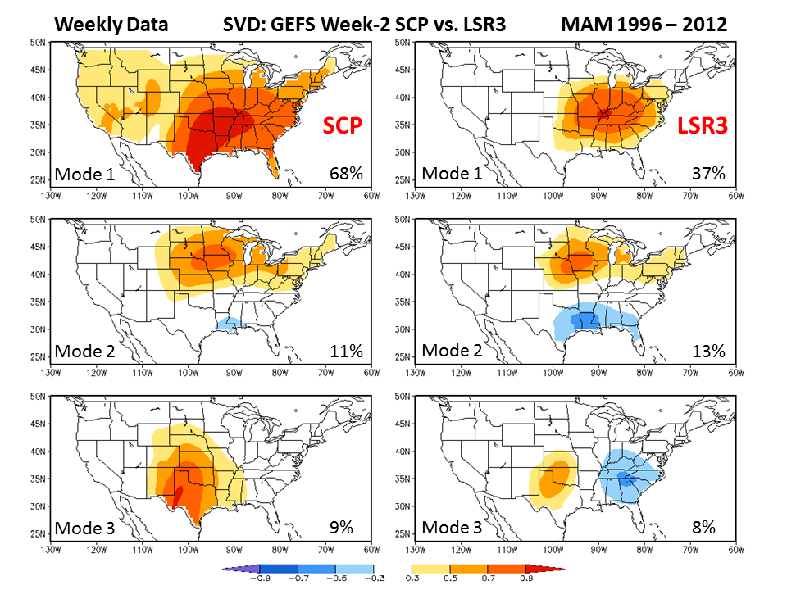
SVD: Spatial Covariation of
SCP and LSR3
OBS
12%
GEFS Week-2 FCST SCP and
OBS LSR3

Slide 10
Forecast Skill for Week-2 Severe Weather
Cross-validation over MAM 1996 – 2012
Simple linear regression model
SVD-based hybrid model
By considering the spatial covariations of both SCP and LSR3, the forecast skill can be significantly improved.

Slide 11
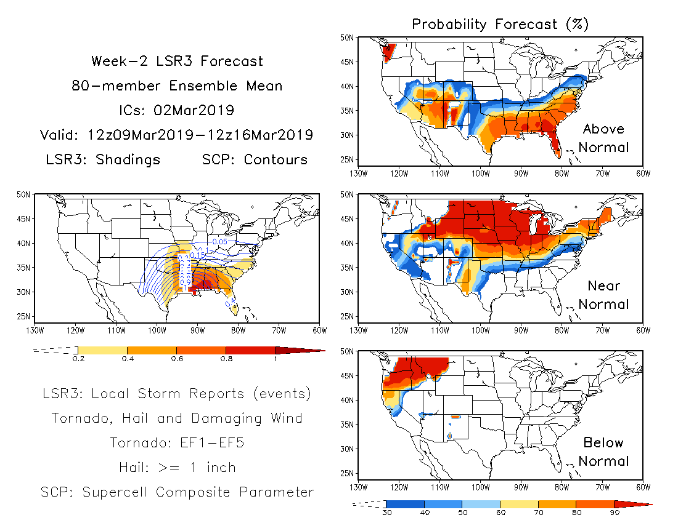
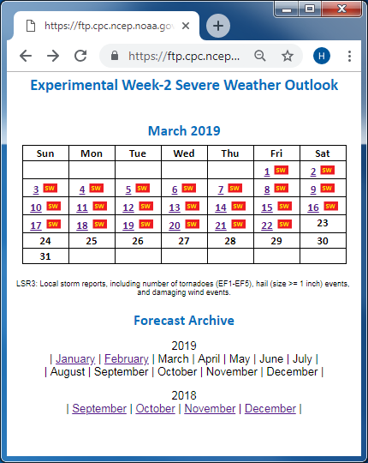
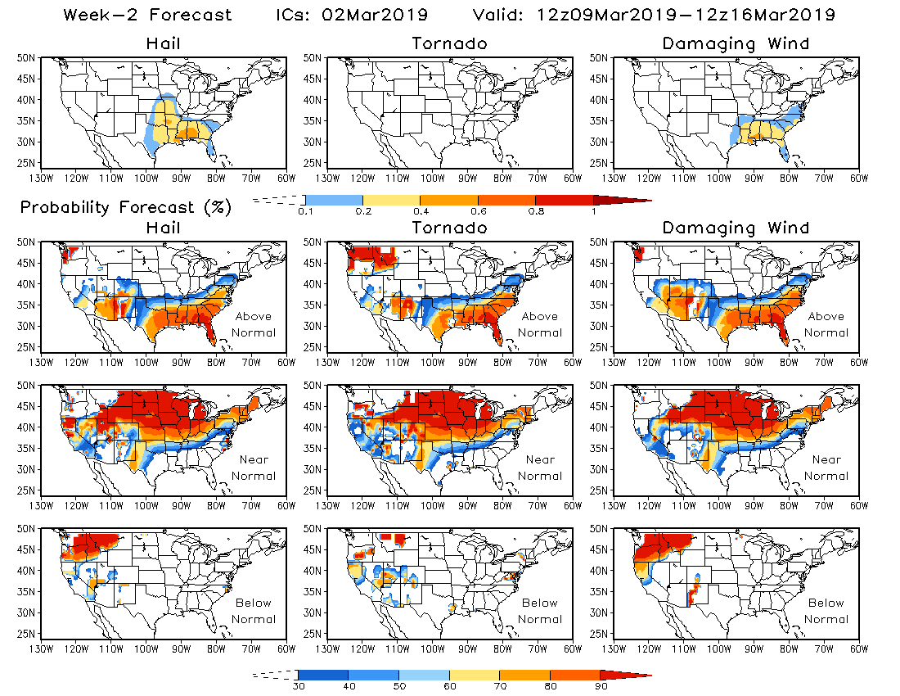
Experimental Real-time Forecast
CPC’s Week-2 U.S. Hazards Outlook

Slide 12
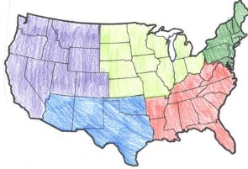
Future Work
Implement real-time week 3-4 severe weather outlooks with the CFSv2 45-day Forecast
SVD-based relationship between CFSv2 SCP and OBS LSR3
Regional forecasts for a larger domain
New predictors
Northeast
West
Midwest
Southeast
Southwest

