Slide 1
Update
18Jan2019
Forecast SW (LSR3)
Using 1º×1º and 5º×5º box-averaged anomaly
Each year anomaly has the rest years climatology calculated and removed from the target year)
Forecasts for MAM
Forecast skill assessed based on cross-validation
Anomaly Comparison between the skills with 5º×5º box-averaged and 1º×1º
Working on Experimental Severe Weather Forecast on daily basis page on http://ftp.cpc.ncep.noaa.gov/alima.diawara/
Sketch made
Has figure in daily basis for last week of Dec 2018
Need real time data for Jan 2019
Writing a paper summary of my work done “Possibility to predict Severe Weather using CFSv2-45day”

Slide 2
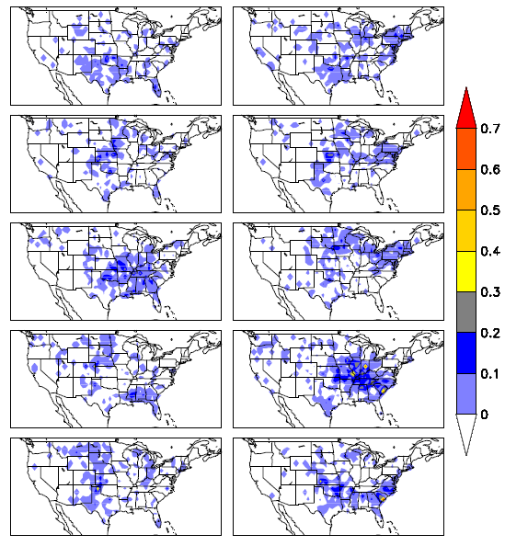
1999
2000
LSR3
Cross Validation MAM
1999-2008
Anomaly
2001
2002
2003
2004
2005
2006
2007
2008

Slide 3
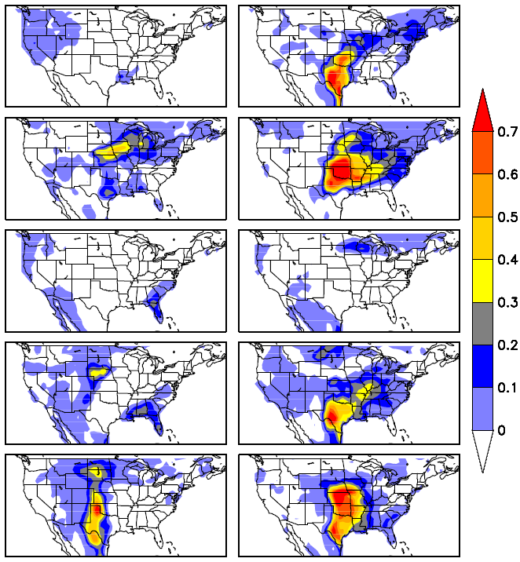
1999
2000
CFSv2
Cross Validation MAM
1999-2008
Anomaly
Week1
2001
2002
2003
2005
2006
2007
2008

Slide 4
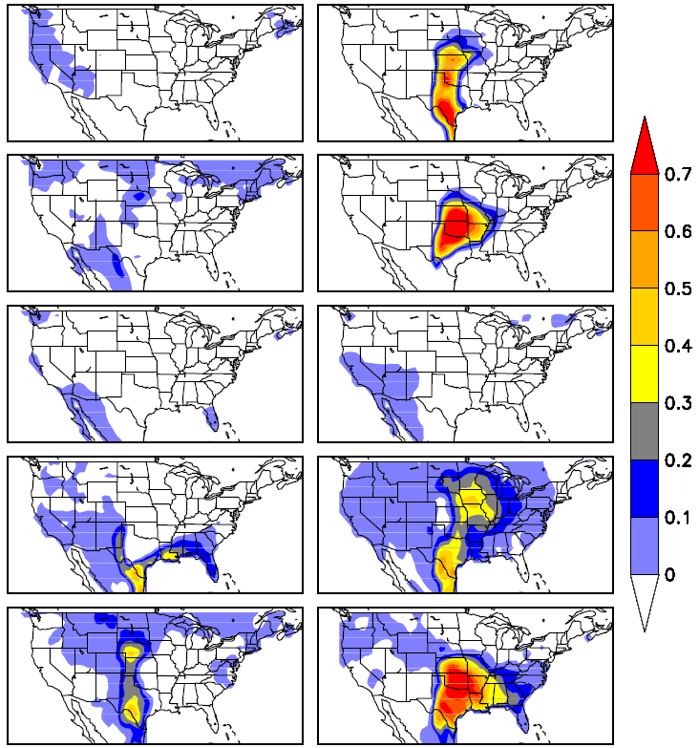
1999
2000
CFSv2
Cross Validation MAM
1999-2008
Anomaly
Week2
2001
2002
2003
2005
2006
2007
2008

Slide 5
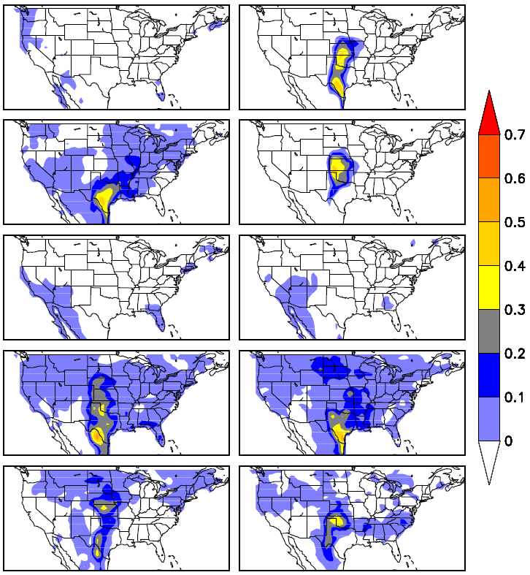
1999
2000
CFSv2
Cross Validation MAM
1999-2008
Anomaly
Week3
2001
2002
2003
2005
2006
2007
2008

Slide 6
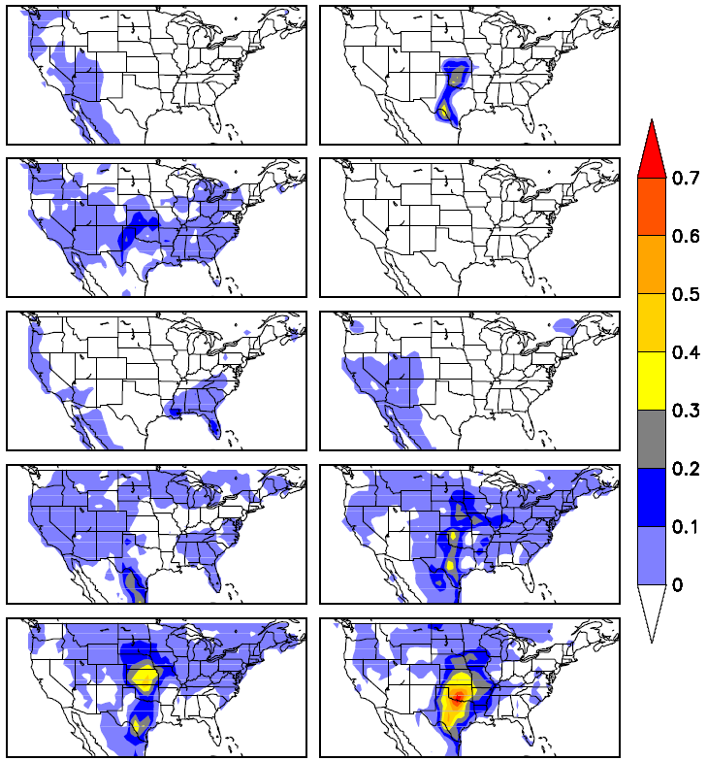
1999
2000
CFSv2
Cross Validation MAM
1999-2008
Anomaly
Week4
2001
2002
2003
2005
2006
2007
2008

Slide 7
Forecast Skill LSR3 MAM 1999-2010
CFSv2
GEFS
1°x1°
0.5°x0.5°

Slide 8
Forecast Skill LSR3 MAM 1999-2010
5°x5°
CFSv2
GEFS

