Slide 1
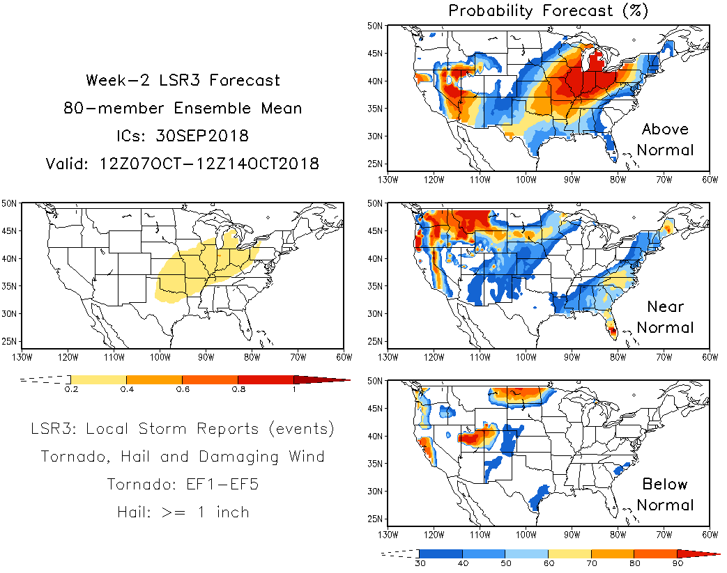
Update
31Jan2019
Experimental Week-2 Severe Weather Outlook
Hui Wang
Experimental Week-2
Severe Weather Outlook
Alima
Experimental Week-2
Severe Weather Outlook
Above Normal
GEFS
CFSv2
Near Normal
LSR3
GEFS
CFSv2
Below Normal
GEFS
CFSv2

