Slide 1
Update
18Jan2019
7-day mean forecast SCP vs. LSR3 Lead time: day 1 to day 8
Correction of Forecast Skill SCP LSR3
- Week 1
- week 2
Doing
Week-2 LSR3 Forecast
16 –member ensemble mean CFSv2-45day

Slide 2
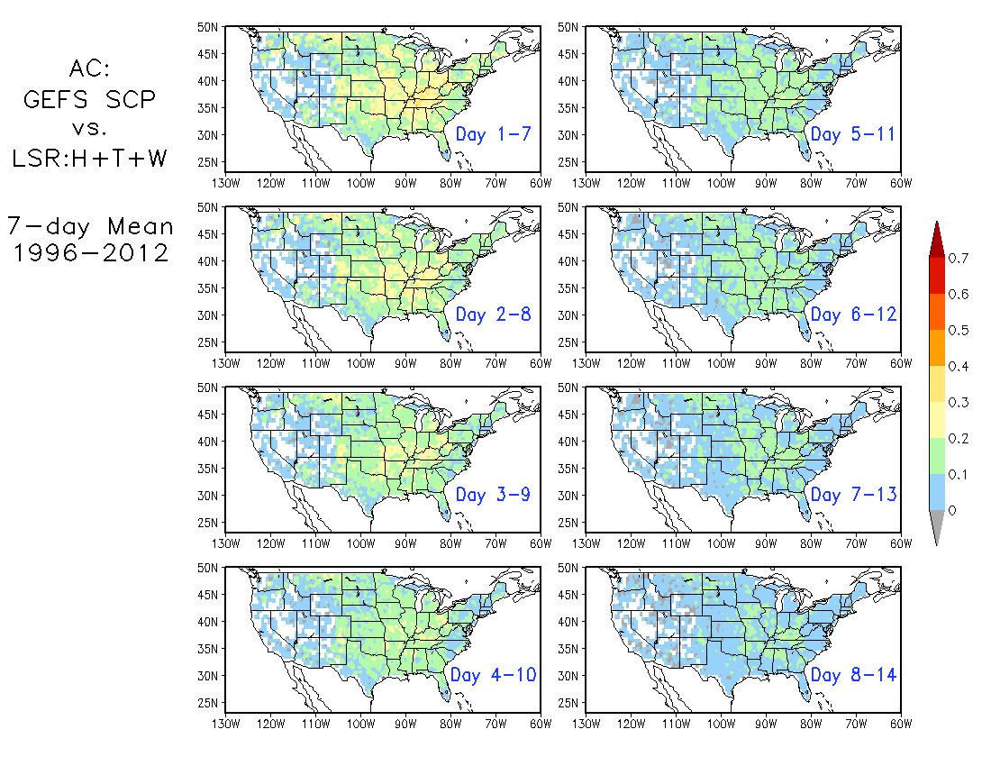
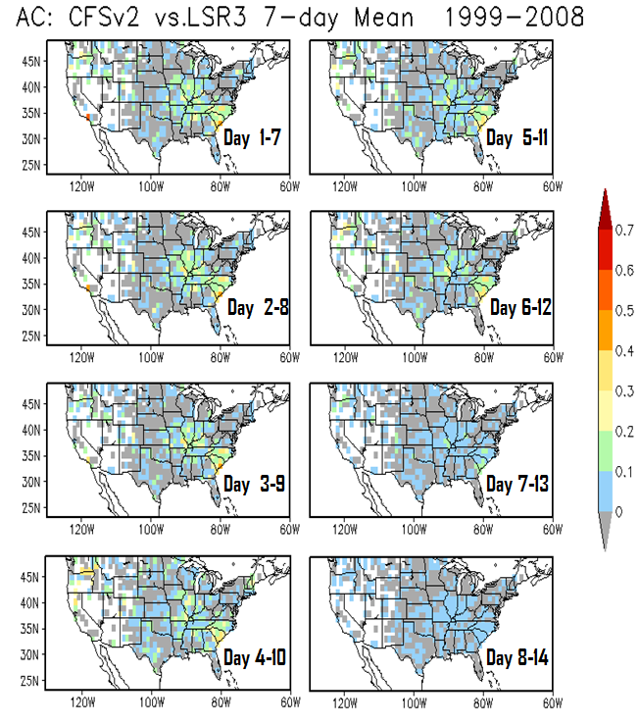
7-day mean forecast SCP vs. LSR3 Lead time: day 1 to day 8

Slide 3
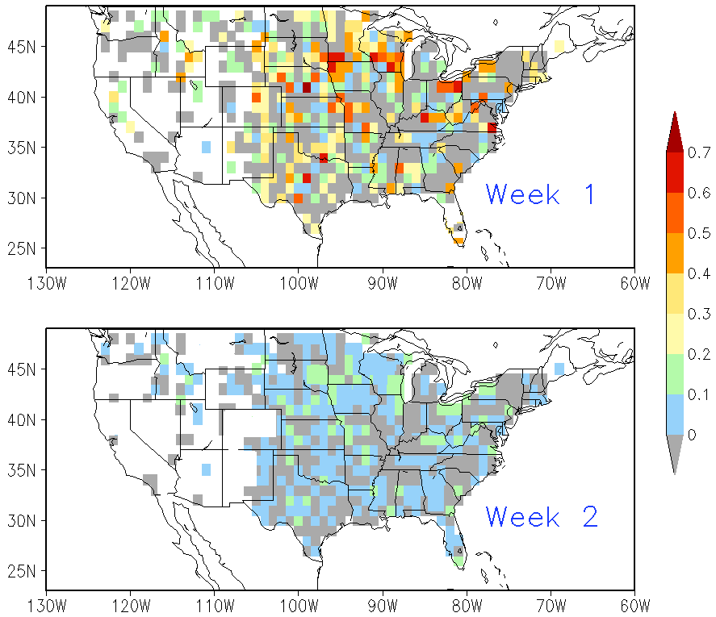
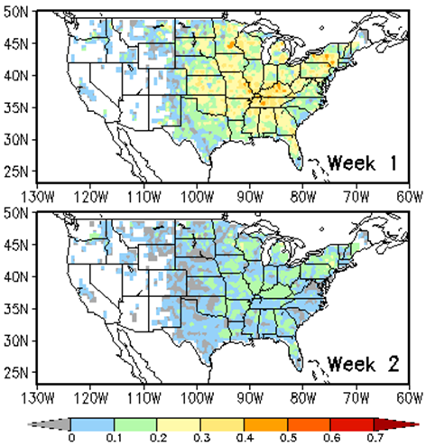
Forecast Skill LSR3 MAM 1999-2010
CFSv2
GEFS
1°x1°
0.5°x0.5°

Slide 4
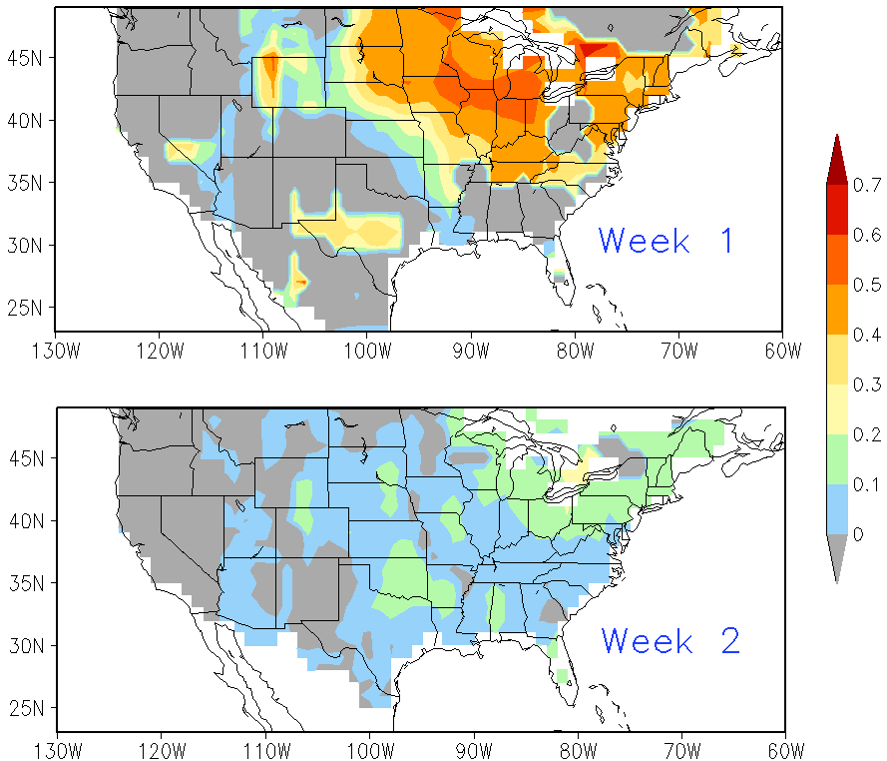
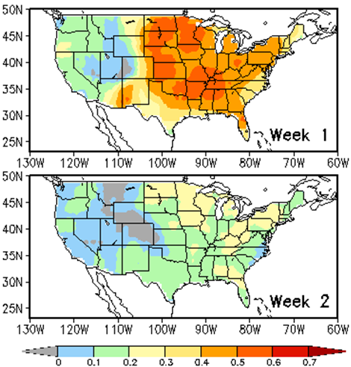
Forecast Skill LSR3 MAM 1999-2010
5°x5°
CFSv2
GEFS

