Slide 1
Update
15MAR2019
Week-2 LSR3 Forecast 16-member ensemble mean using CFSv2-45day as predictor
- Initial Condition= 03/13/2019
- Period predicted = 03/20-26/2019
Doing
Continue to extend from March 01 to now

Slide 2
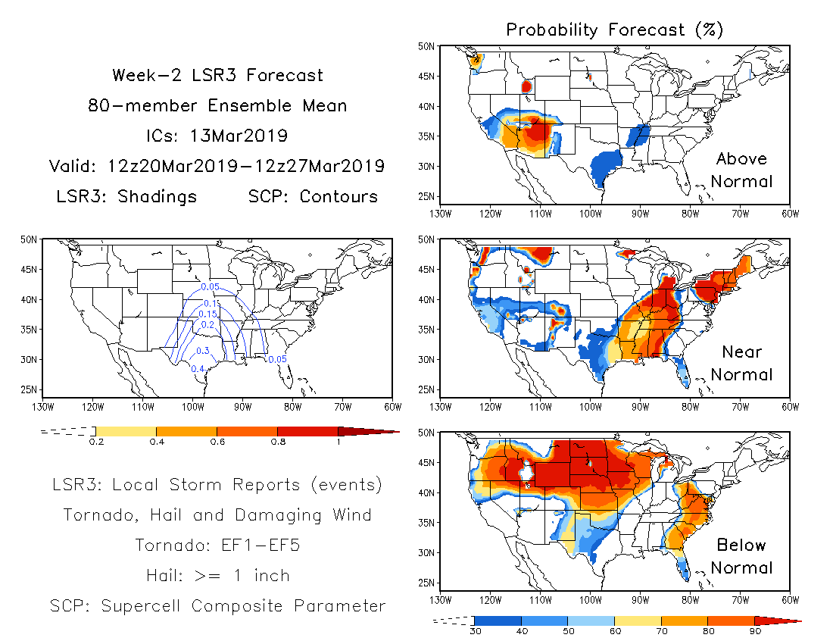

Slide 3
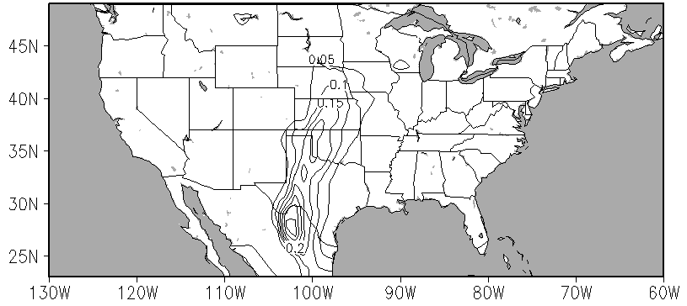
Week 2 LSR3 Forecast
32-member ensemble mean
ICs: 03/12-13/2019
Valid: 03/20/2019-03/26/2019

