Slide 1
May 2018 Experimental Sea Ice Outlook Climate Prediction Center, NCEP/NWS/NOAA
Acknowledgments: This work was supported by NOAA CPO Climate Variability and Predictability Program. Both hindcasts and forecasts were produced on NOAA GAEA computer.

Slide 2
Procedure
Use Climate Forecast System (CFS) coupled model initialized with CPC Sea Ice Initialization System (CSIS) initial sea ice conditions (20 initializations: May 21-25, 2018).
Correct biases using 2006-2016 mean error with respect to NSIDC observations
Present unbiased results
The following maps are included
SIE Monthly time series (mean and spread)
SIC Monthly forecast panels (Ensemble mean)
SIC Monthly standard deviation panels
Monthly ice cover probability
Mean first ice melt day/ standard deviation (Alaska region)
First ice melt day prediction difference from previous month

Slide 3
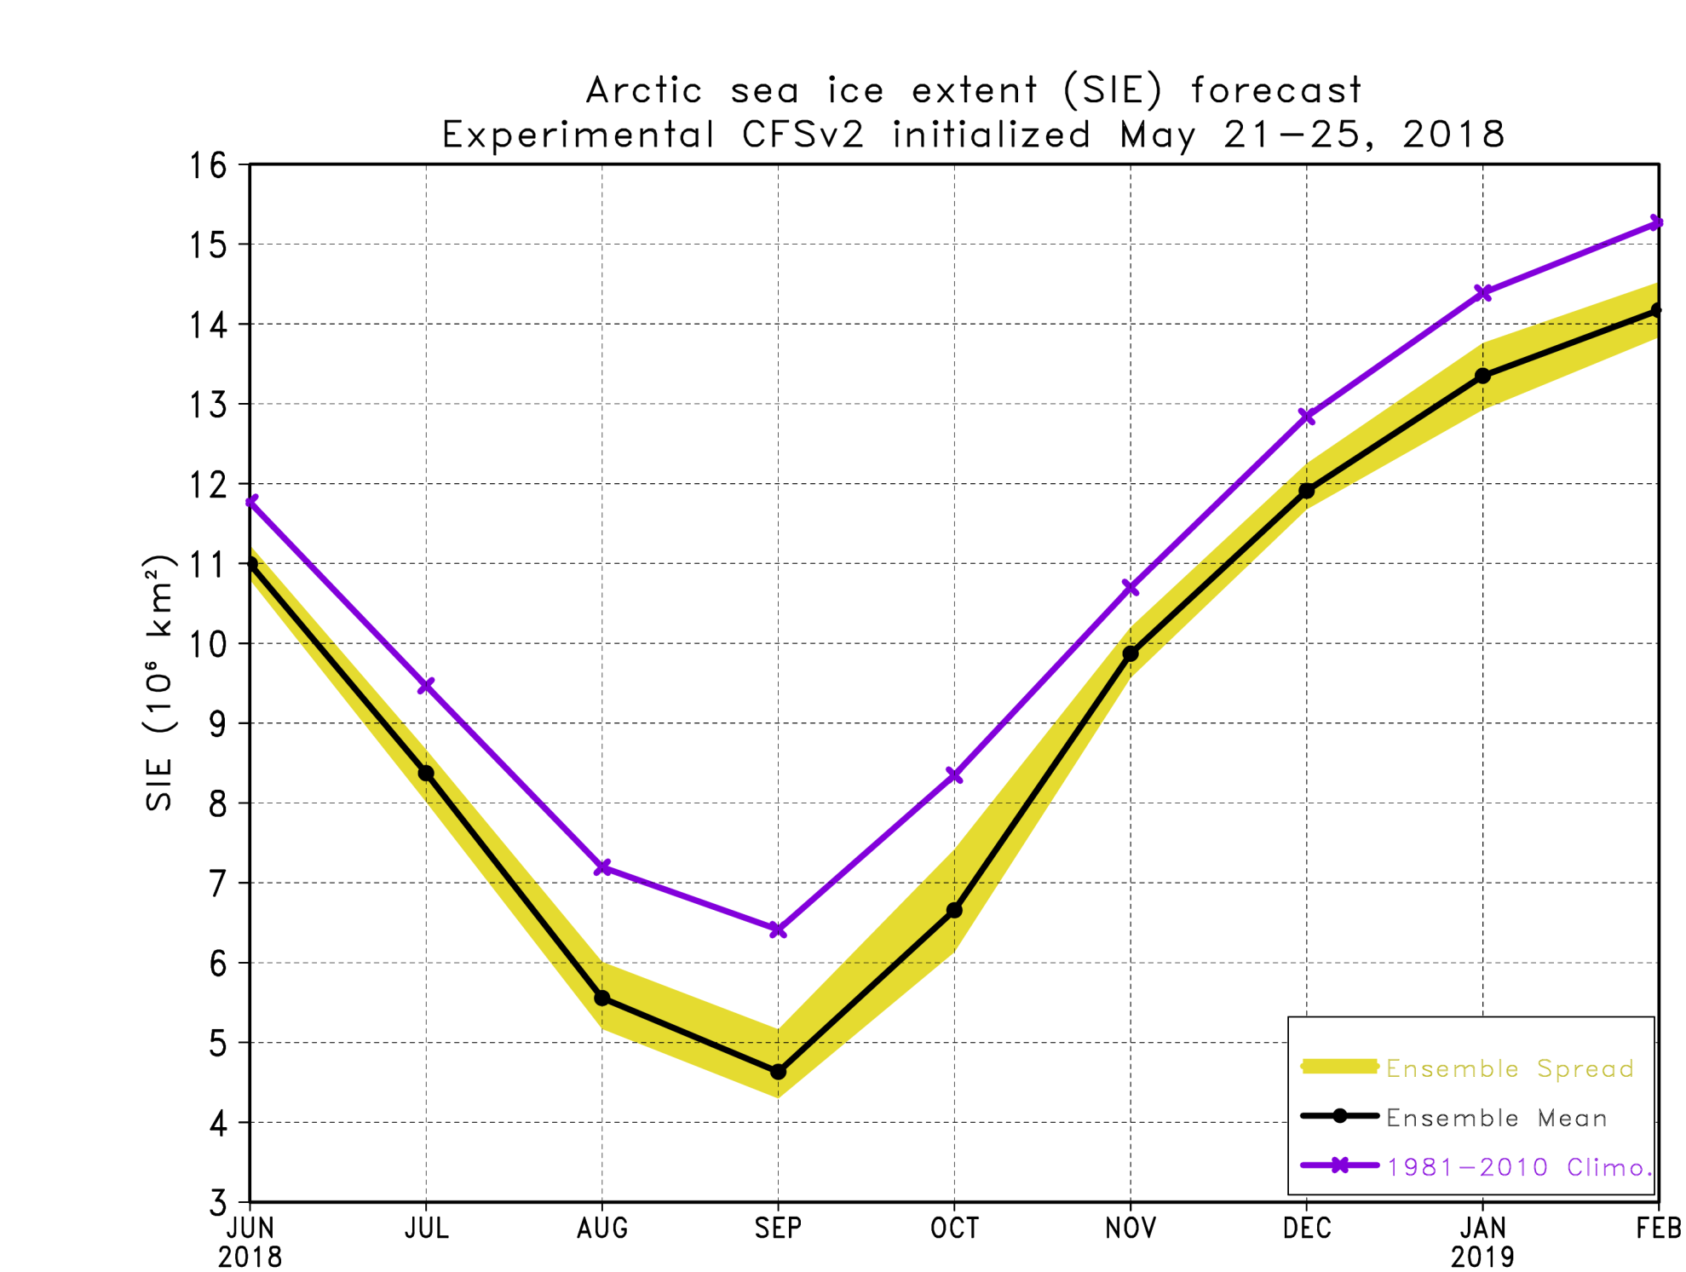
SIE Plot

Slide 4
September 2018 SIE forecast
Source | SIE Value (10⁶ km²)
NSIDC 1981-2010 Climatology | 6.41
NSIDC 2017 | 4.80
NSIDC 2012 (record low) | 3.57
Experimental CFSv2 2018 forecast | 4.63
Based on these simulations, the September 2018 sea ice extent minimum is forecasted to be below last year’s value but above the record minimum set in 2012.
Month to Month September Prediction for this year’s forecasts
Month | March | April | May | June | July | August
Ens. Mean | 4.44 | 4.50 | 4.63
Std. Dev. | 0.51 | 0.29 | 0.24

Slide 5
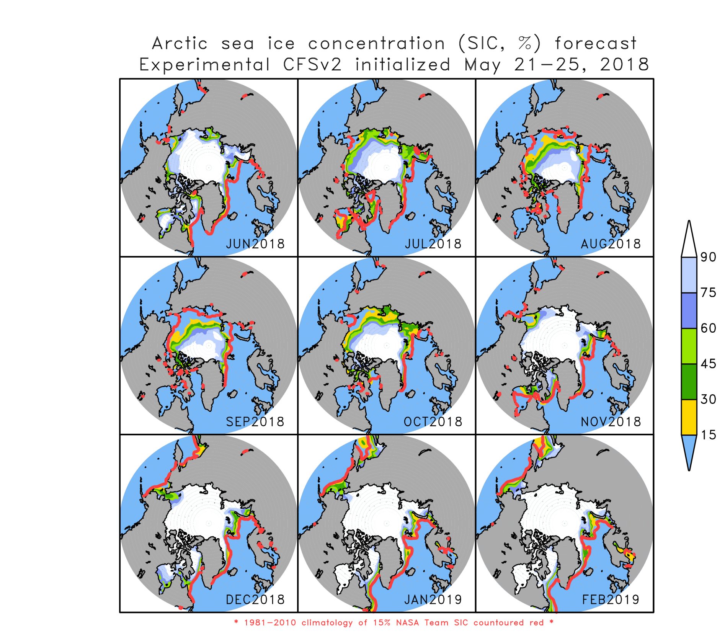

Slide 6
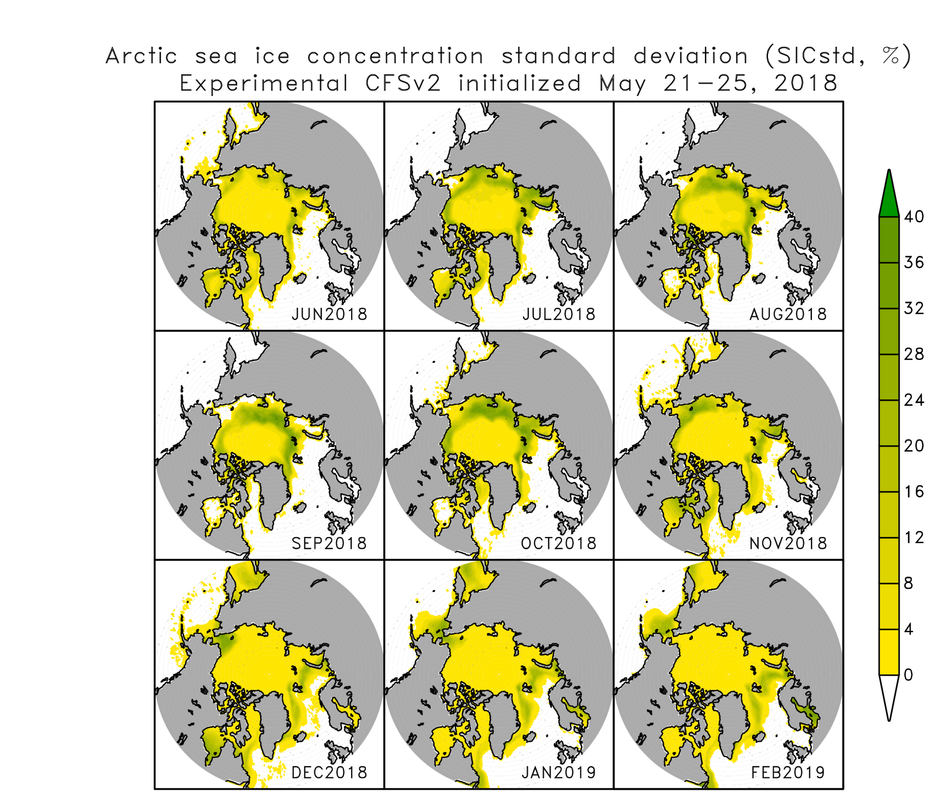
Sea ice concentration standard deviation

Slide 7
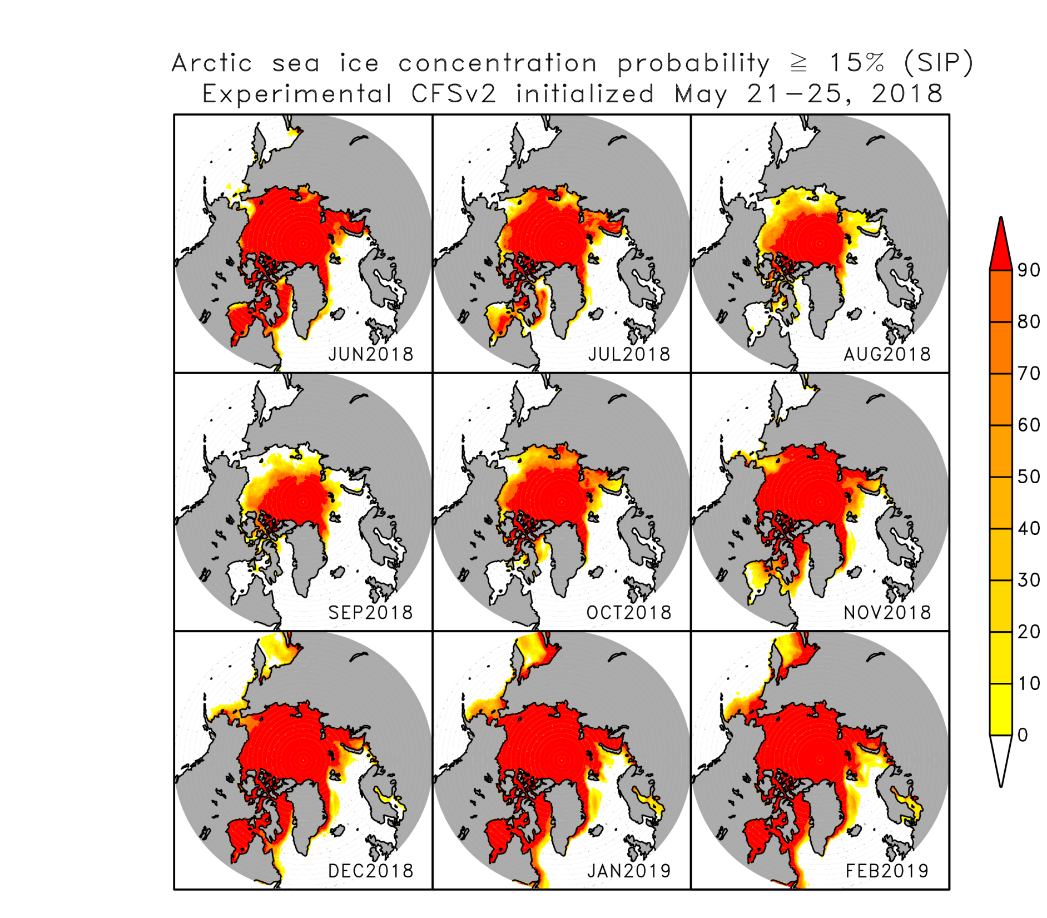

Slide 8
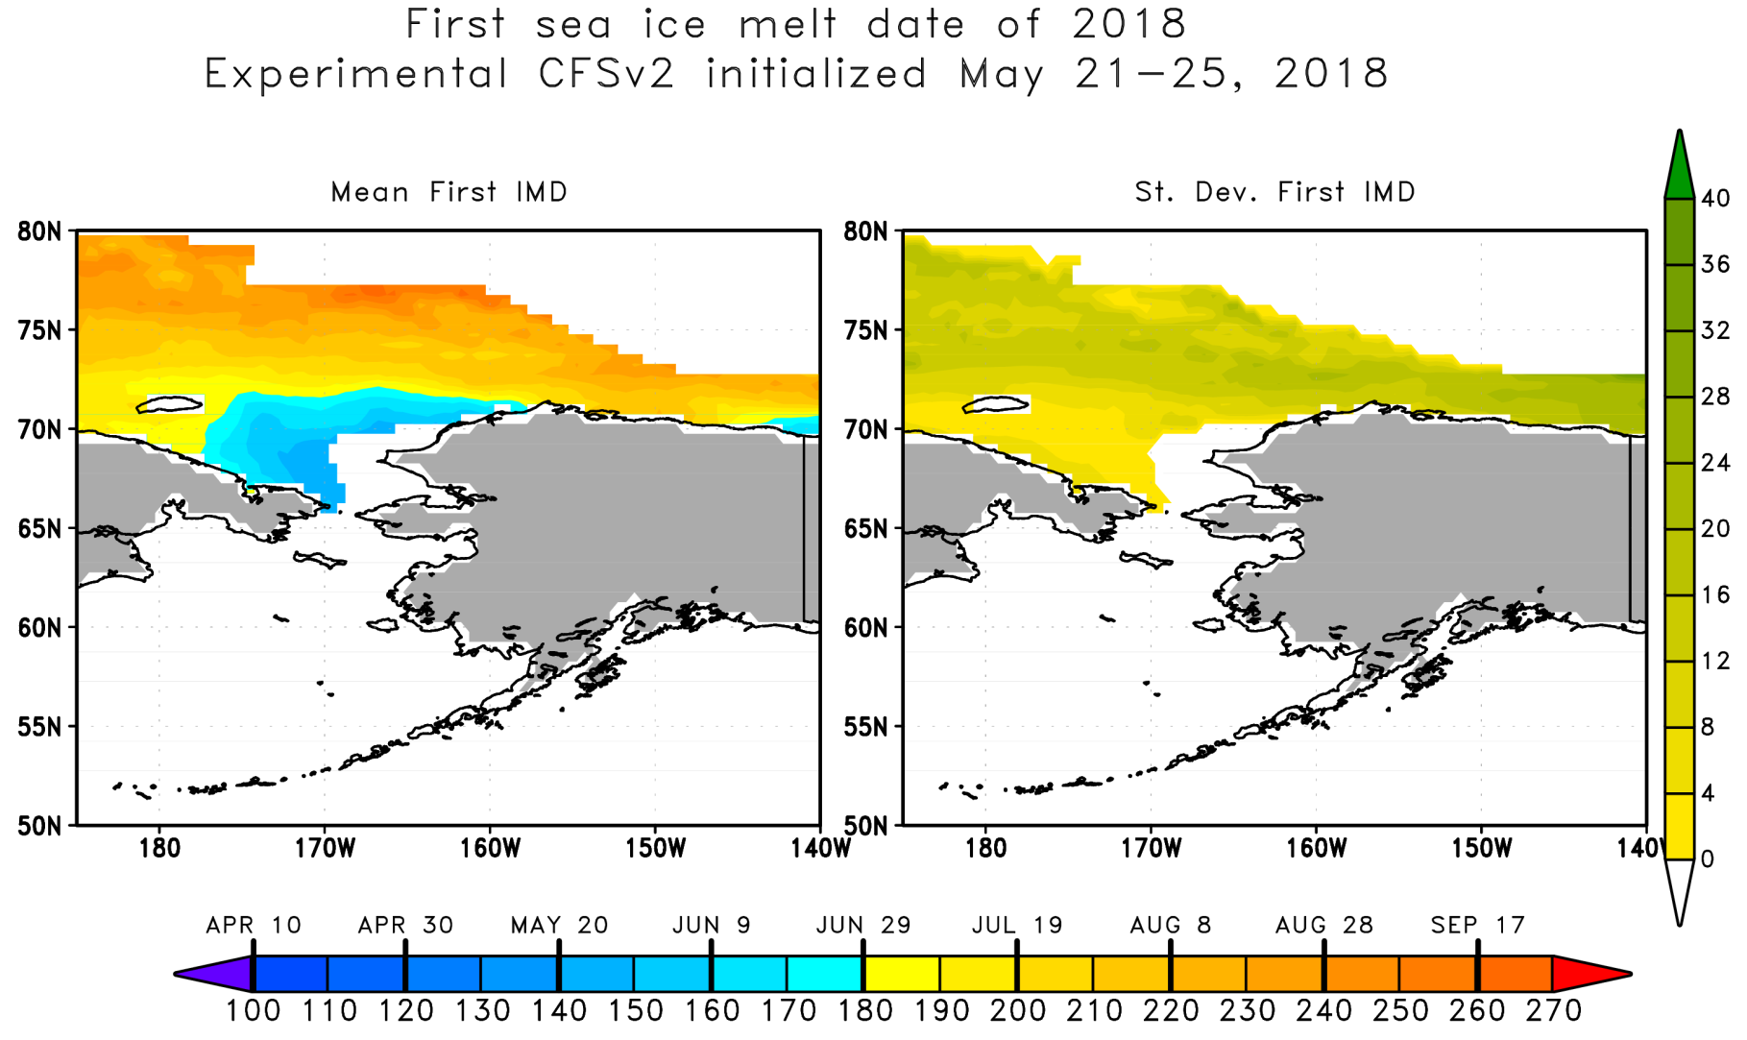
Time step is every 12 hours so 2 observations per day which are averaged to create a single daily observation. If one of the observations decreases below 15%, the value on the map reflects the day of year occurred. If ice is permanent or if there is never ice, the value is set to undefined.

Slide 9
