Slide 1
TRAINING SESSION
ON
USING THE
IRI CLIMATE PREDICTABILITY TOOL (CPT)
FOR
CANNONICAL CORRELATION ANALYSIS (CCA)

Slide 2
IN THIS INITIAL SESSION
EMPHASIS IS ON USING THE TOOL
NOT ON DEEP DISCUSSION OF THE RESULTS
FAMILIARISING WITH THE MENUS
SELECTING THE INPUT DATA
RUNNIG THE EXPERIMENTS
RUNNING THE FORECASTS
VIEWING THE RESULTS
SAVING THE PLOTS
FINALLY SAVING THE PROJECT
ALONG WITH THE INPUT DATA AND
THE OUTPUT DATA AND PLOTS

Slide 3
EXPERIMENT 1
GLOBAL TROPICAL OCEAN SST AS PREDICTOR
CPC PRECL PRECIP FOR MARITIME CONTINENT AS PREDICTAND

Slide 4
OPEN CPT SOFTWARE AND MAKE ABOVE SELECTION (Cannonical Correlation Analysis) AND CLICK

Slide 5
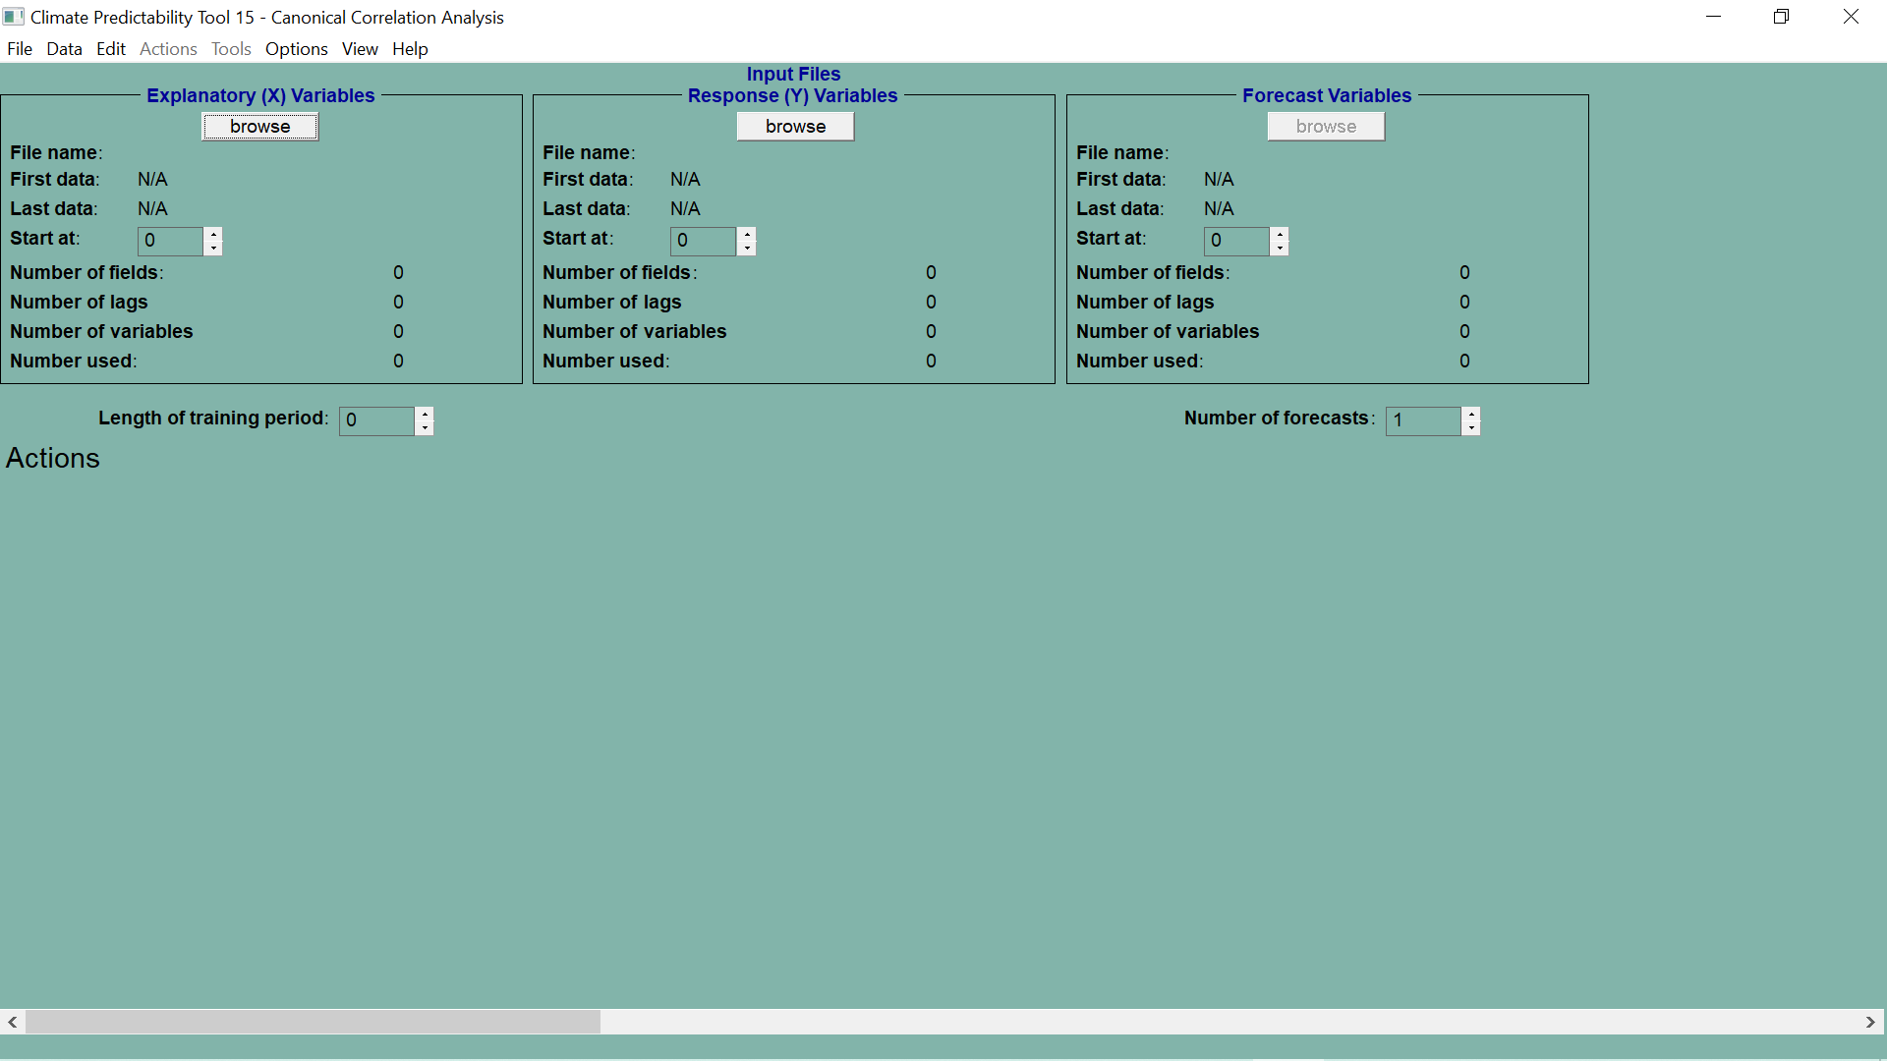
FOR SELECTING PREDICTOR DATA CLICK ON “BROWSE” BUTTON

Slide 6
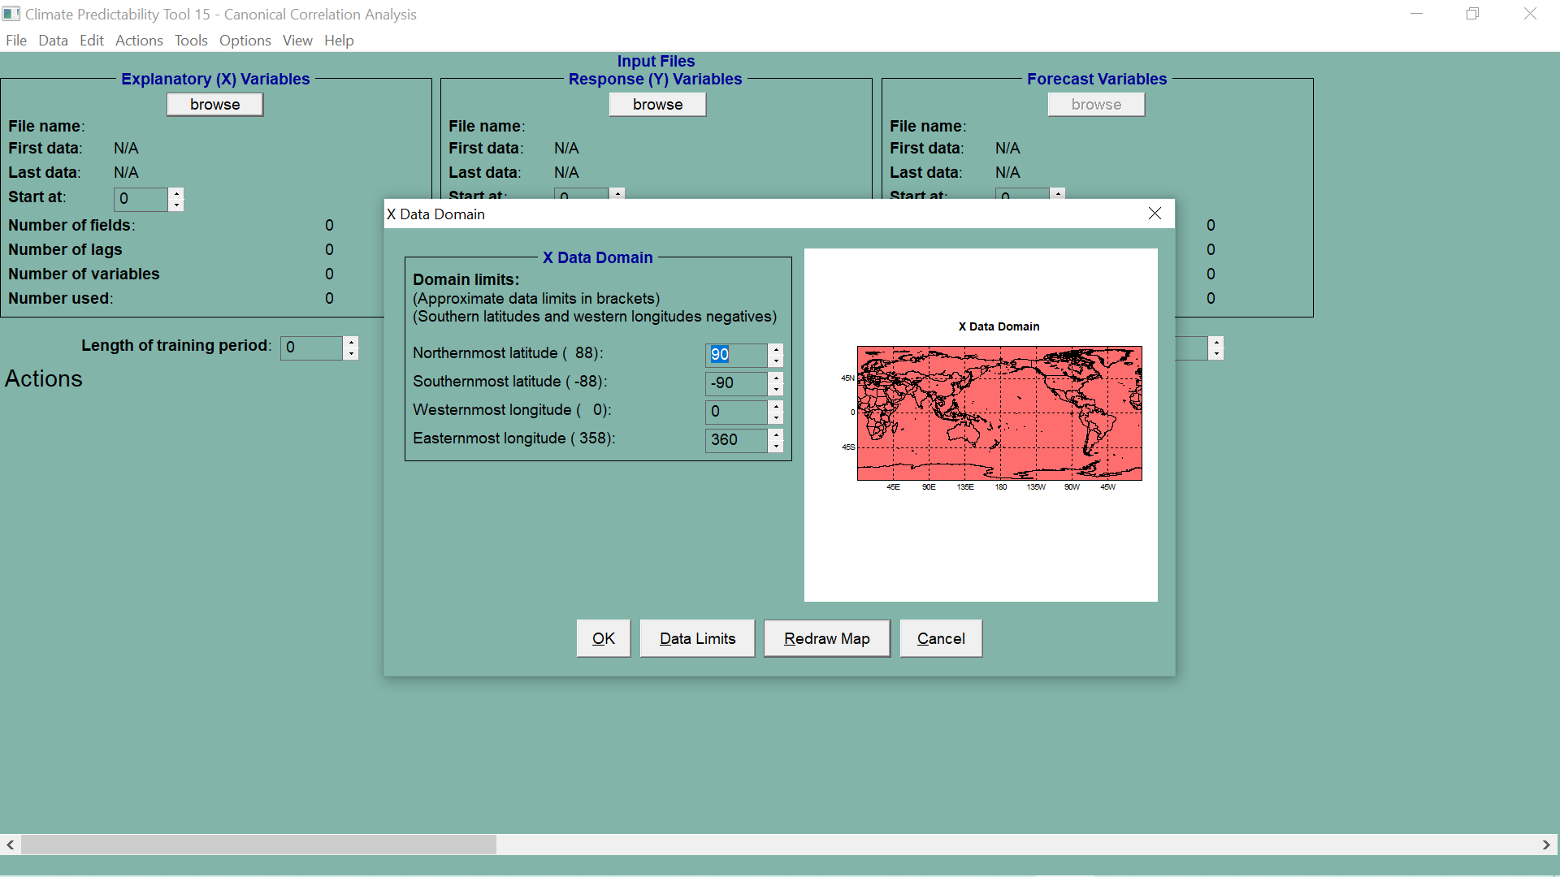

Slide 7
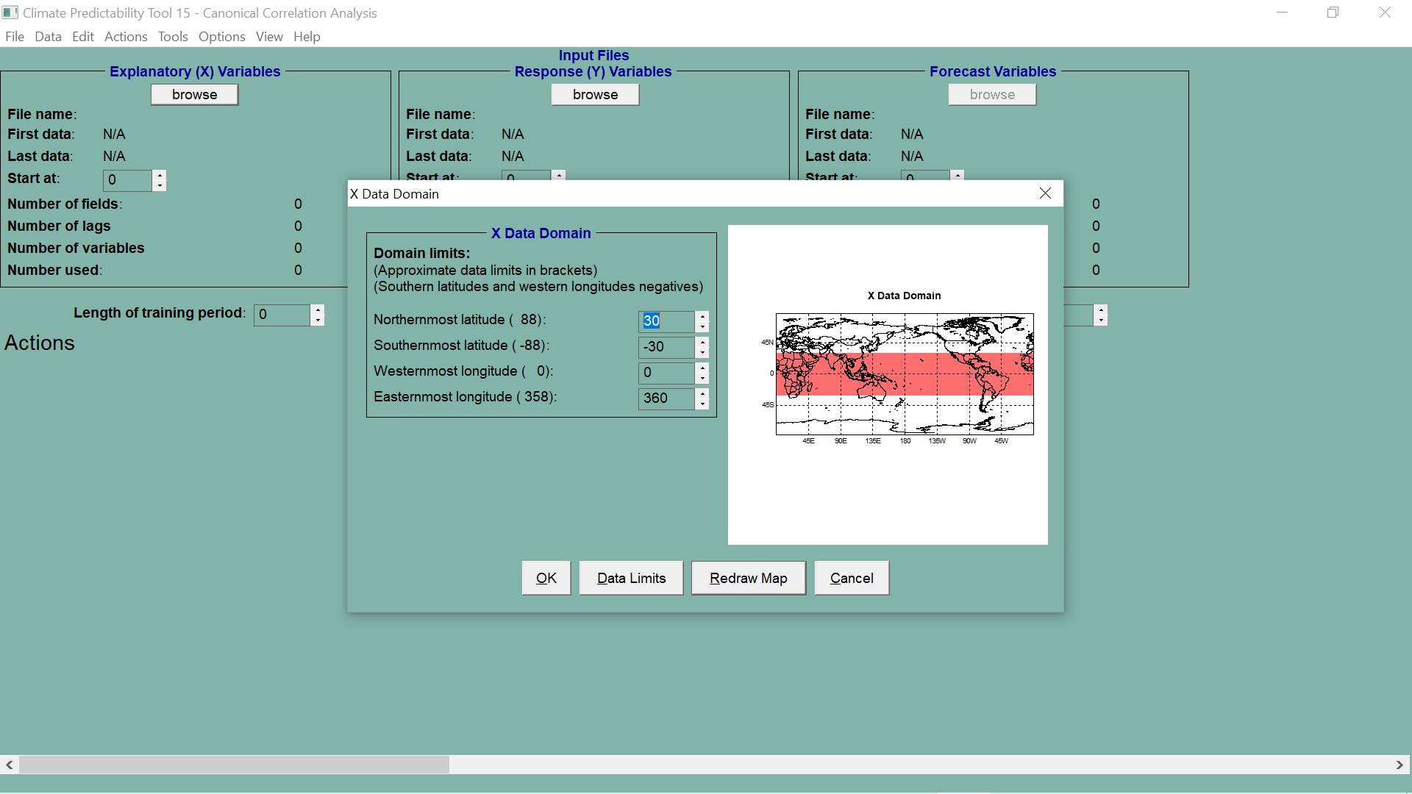

Slide 8
FOR SELECTING PREDICTAND DATA CLICK ON “BROWSE” BUTTON

Slide 9
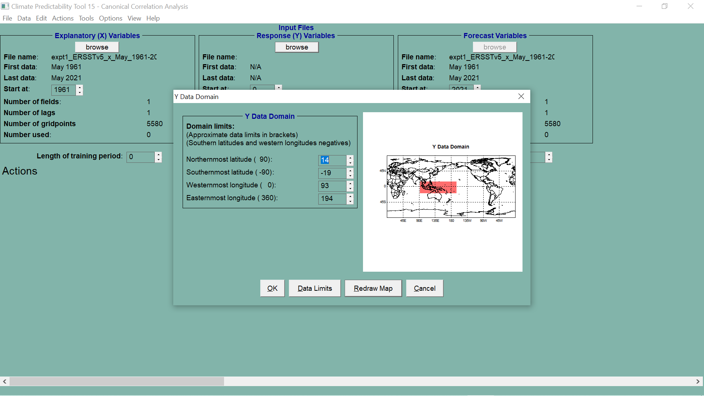
WITH RIGHT MOUSE BUTTON
DRAW RECTANGLE AND THEN
CLICK ON THE “REDRAW MAP” BUTTON

Slide 10
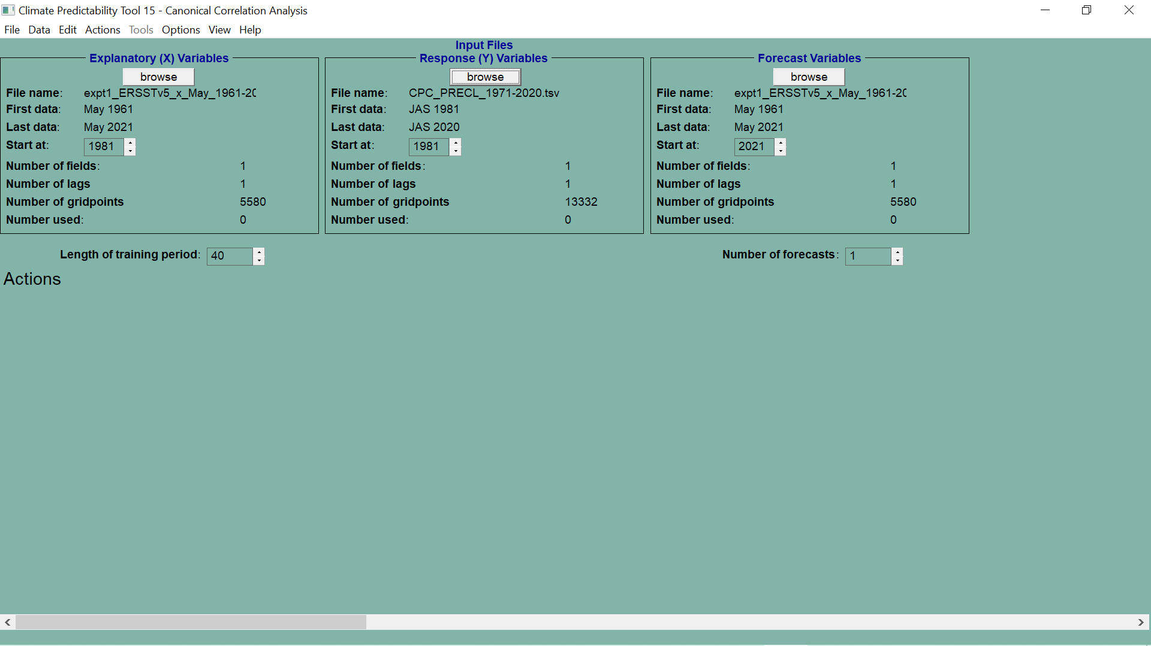

Slide 11
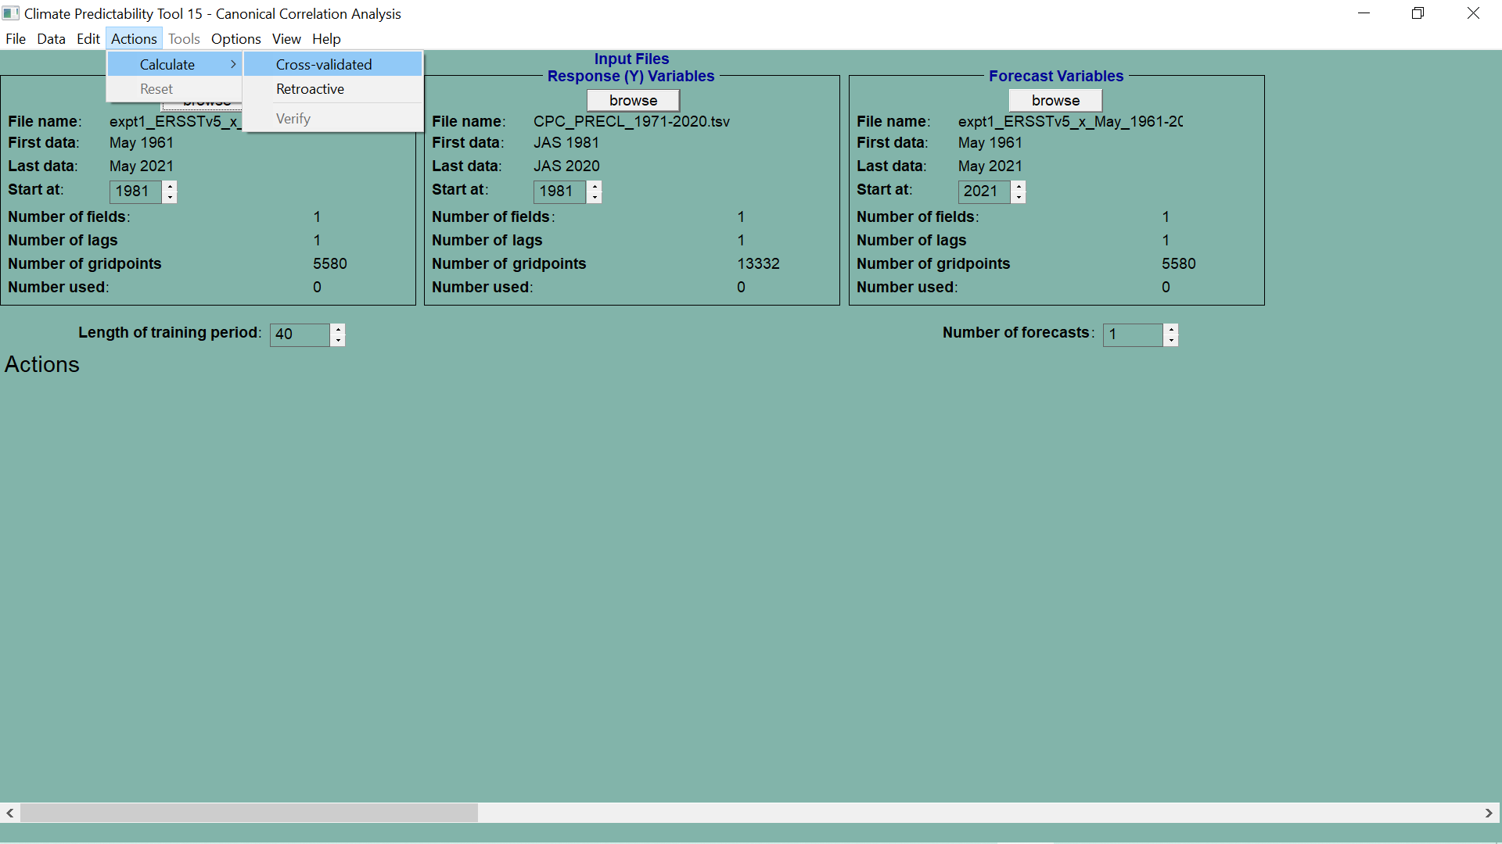
WHEN ALL THE INPUT DATA HAS BEEN SELECTED
SELECT “ACTIONS CALCULATE CROSS-VALIDATED” OPTION TO INVOKE CCA
COMPUTATION

Slide 12
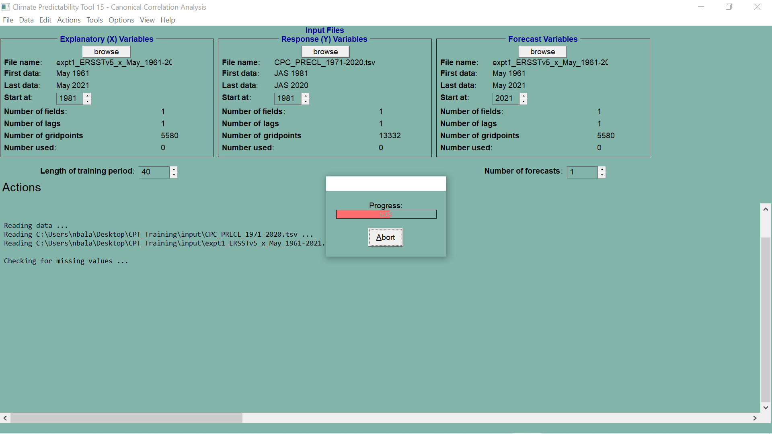

Slide 13
VIEW & EXPLORE RESULTS
SKILL MAPS

Slide 14
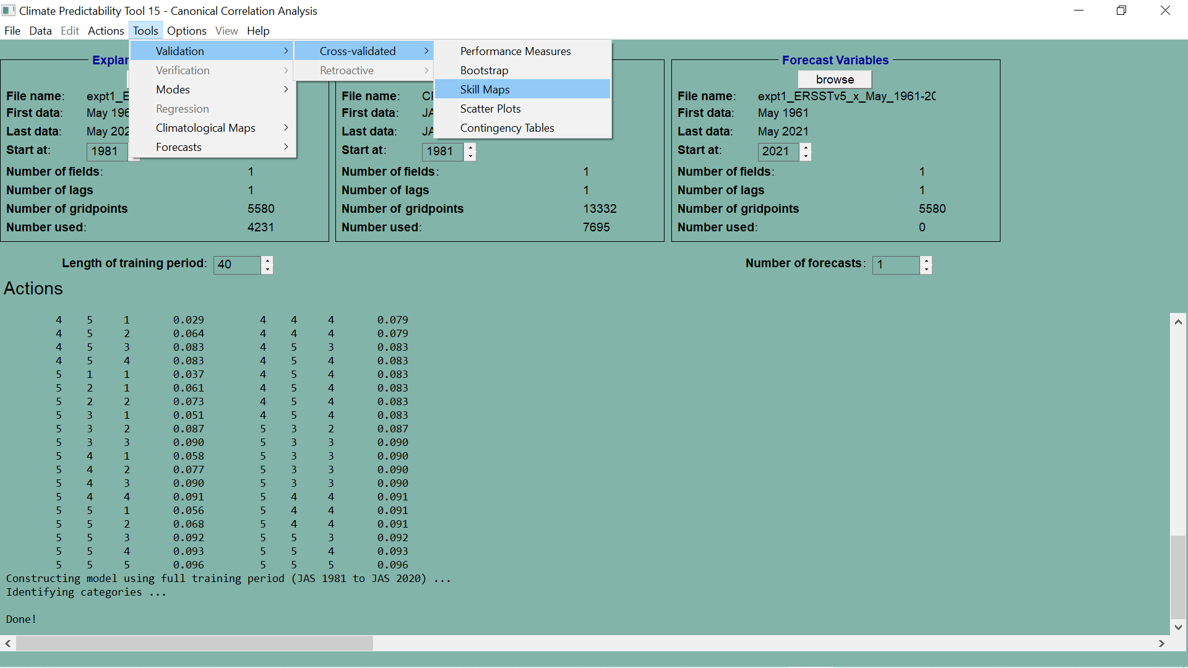
SELECT THIS OPTION TO VIEW SKILL MAPS

Slide 15
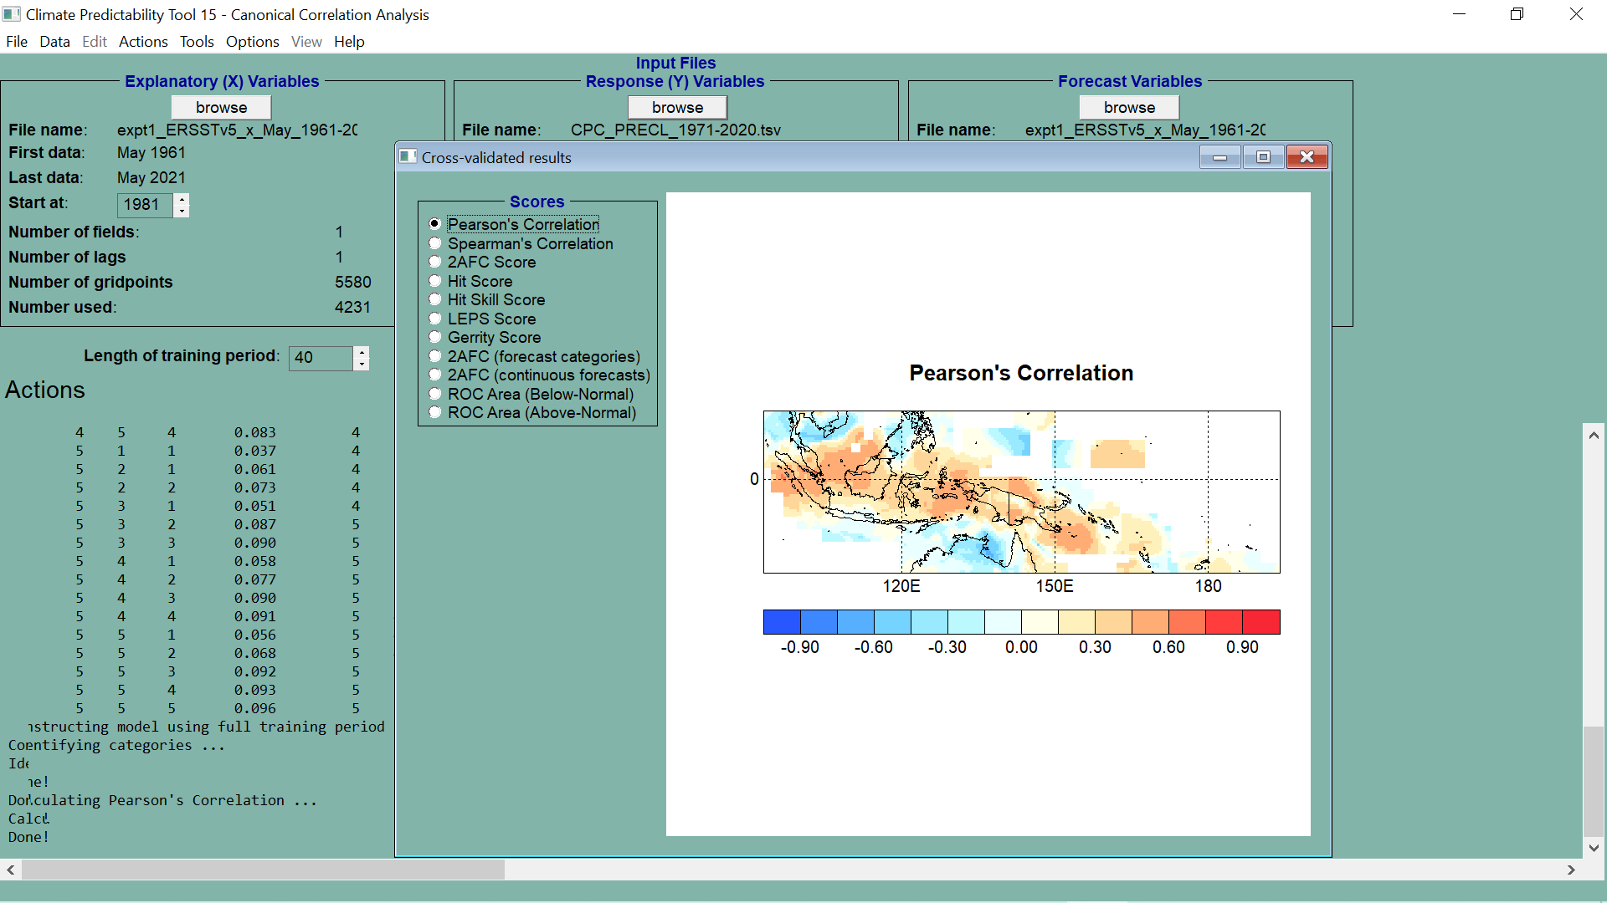

Slide 16
SAVING THE PLOTS

Slide 17
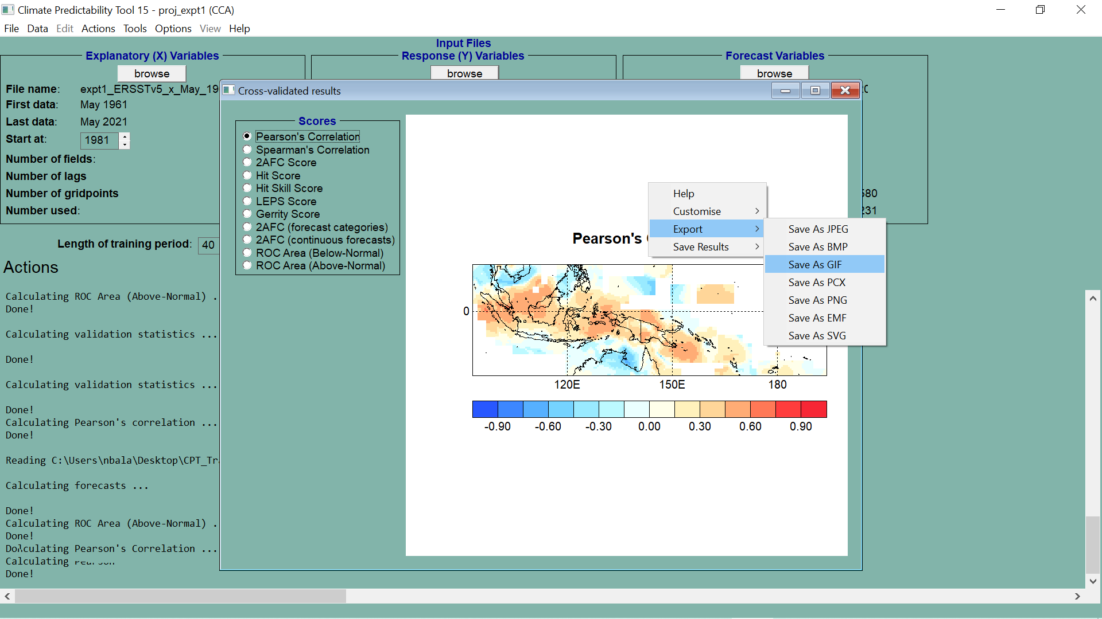
RIGHT CLICK AND
MAKE SELECTION

Slide 18
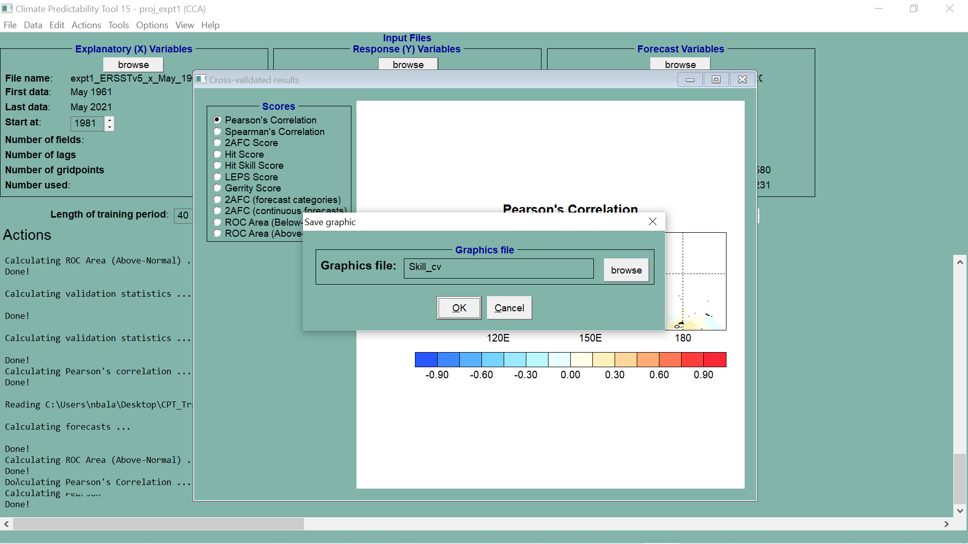
SELECT FOLDER

Slide 19
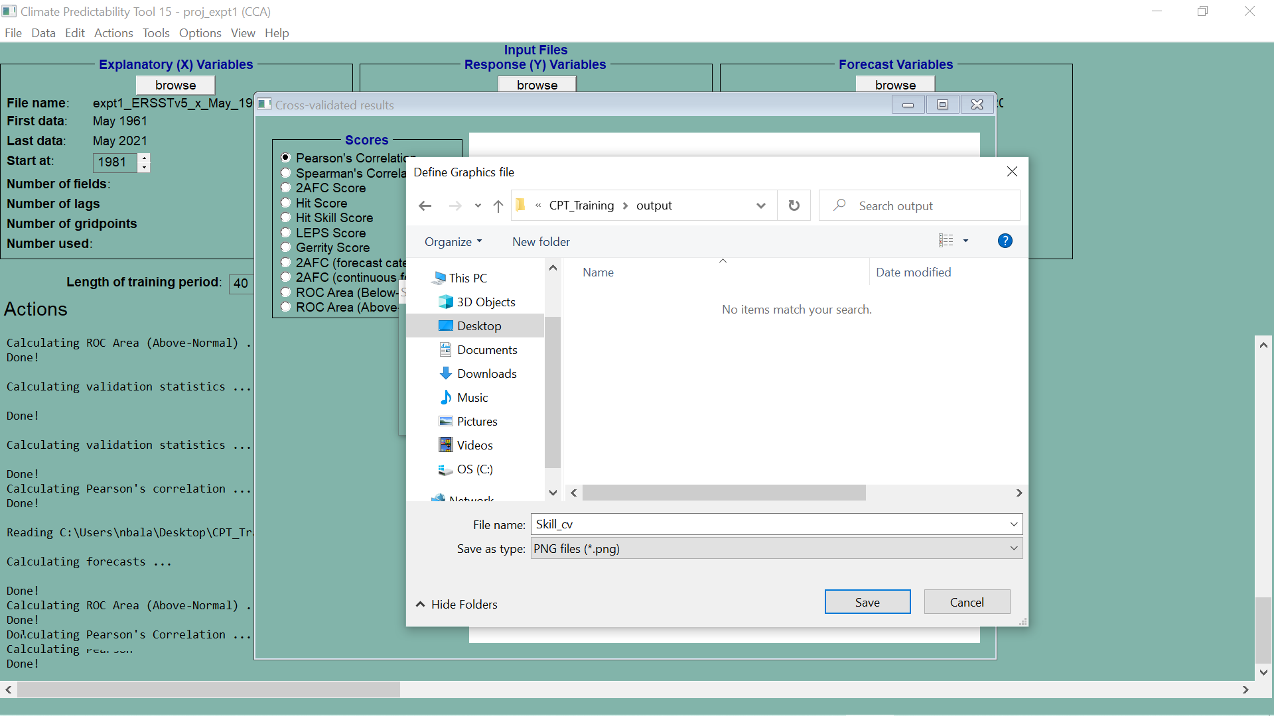
SAVE

Slide 21
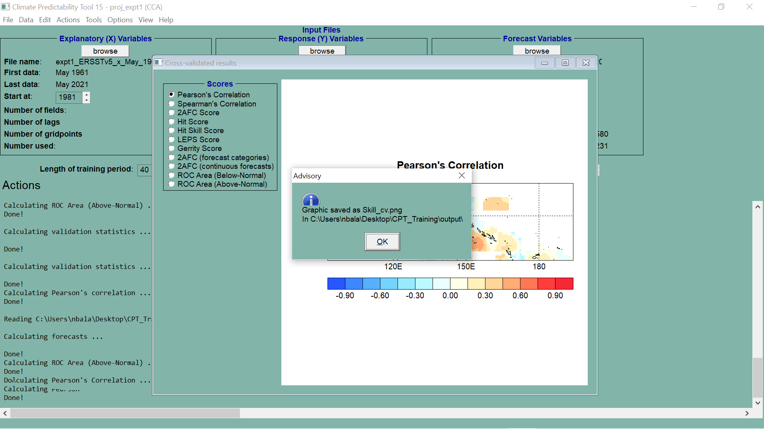

Slide 22
EXPLORE MORE RESULTS

Slide 24
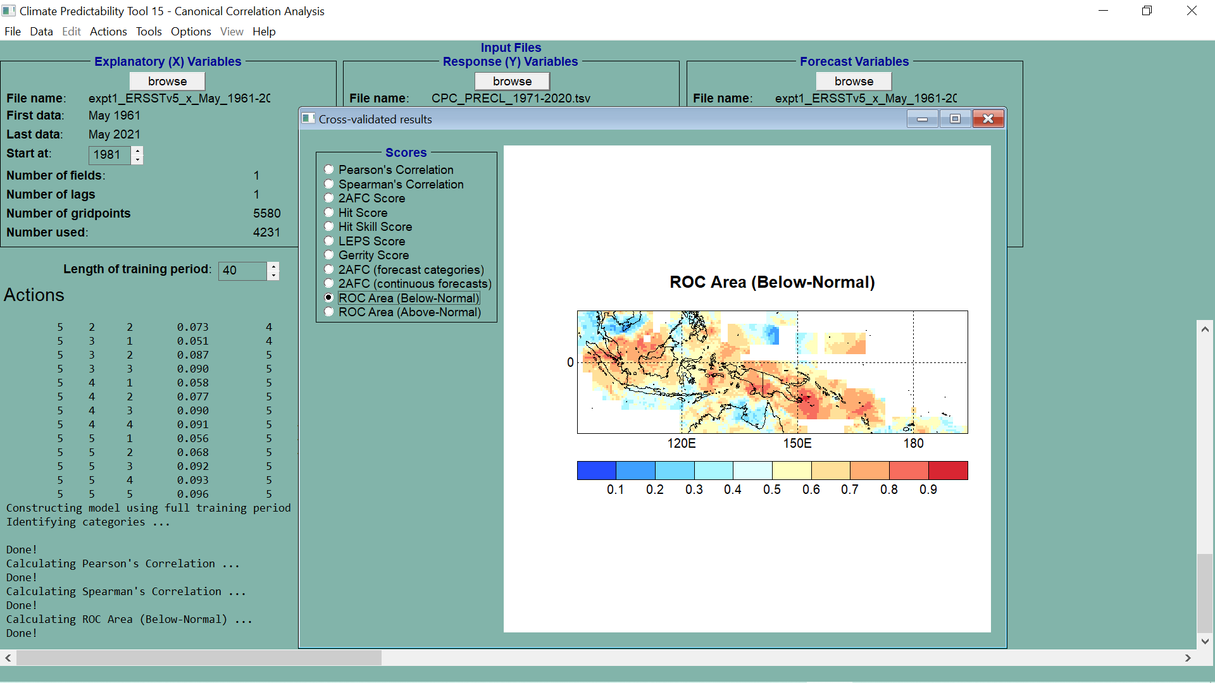
THIS MAP IS CLICKABLE FOR ROC CURVES

Slide 25
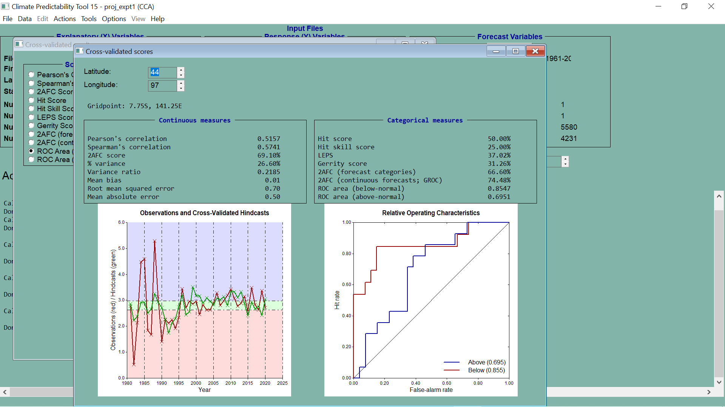

Slide 27
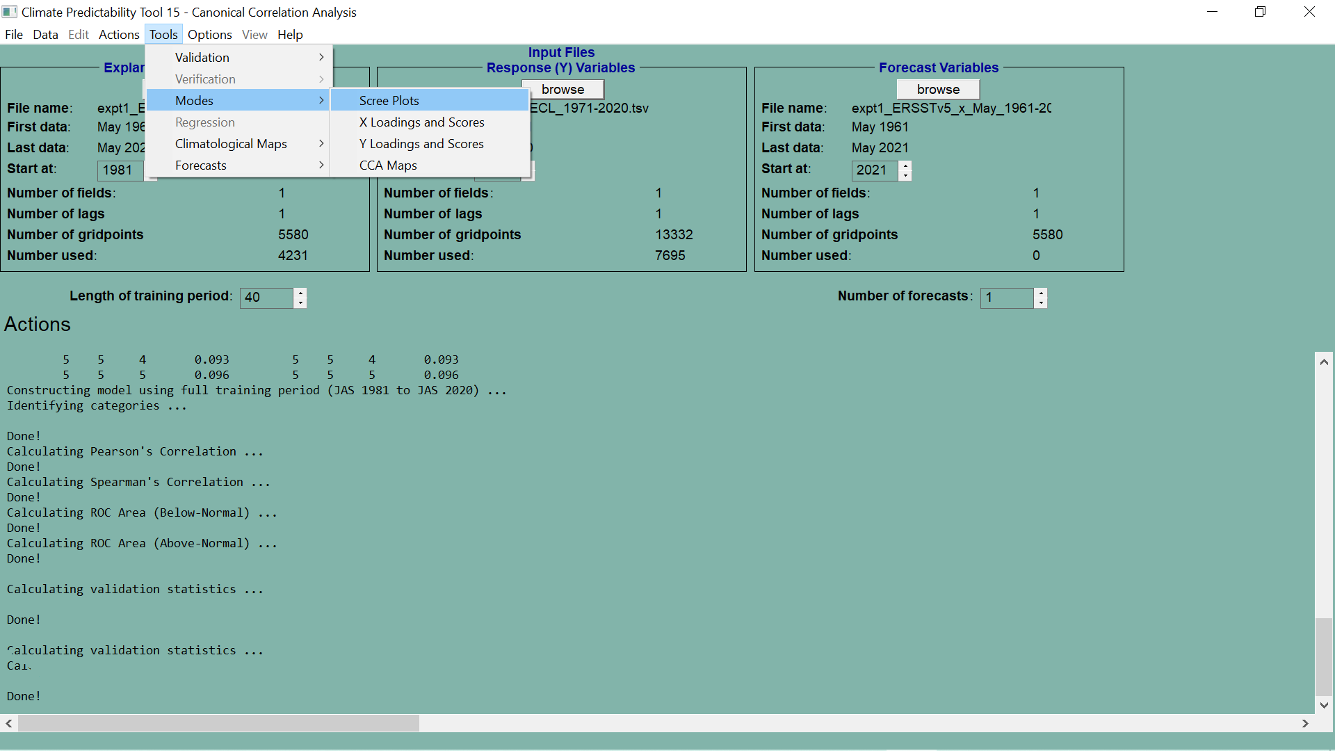

Slide 28
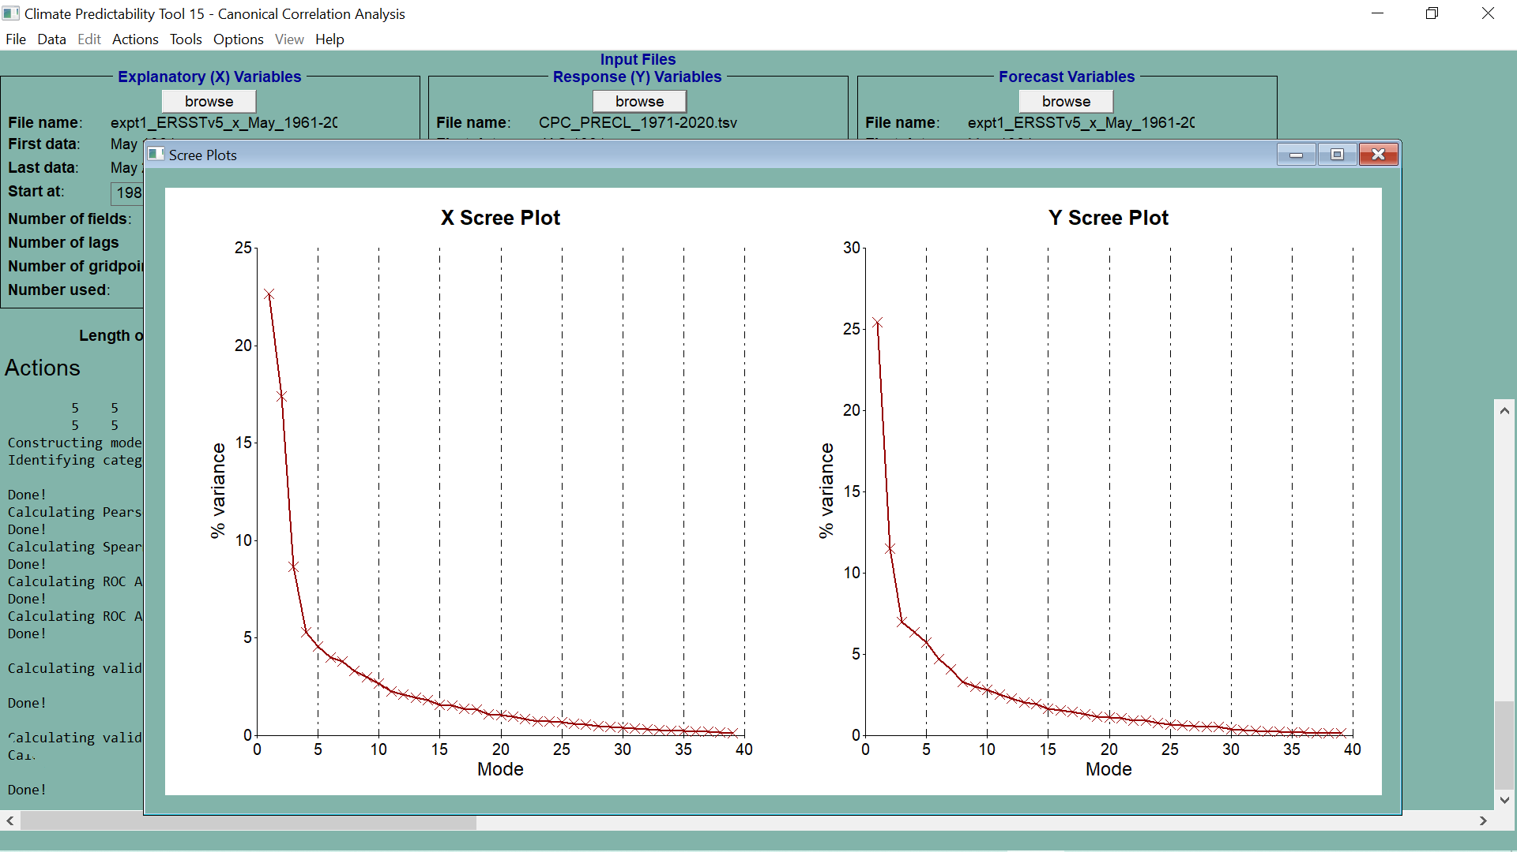

Slide 29
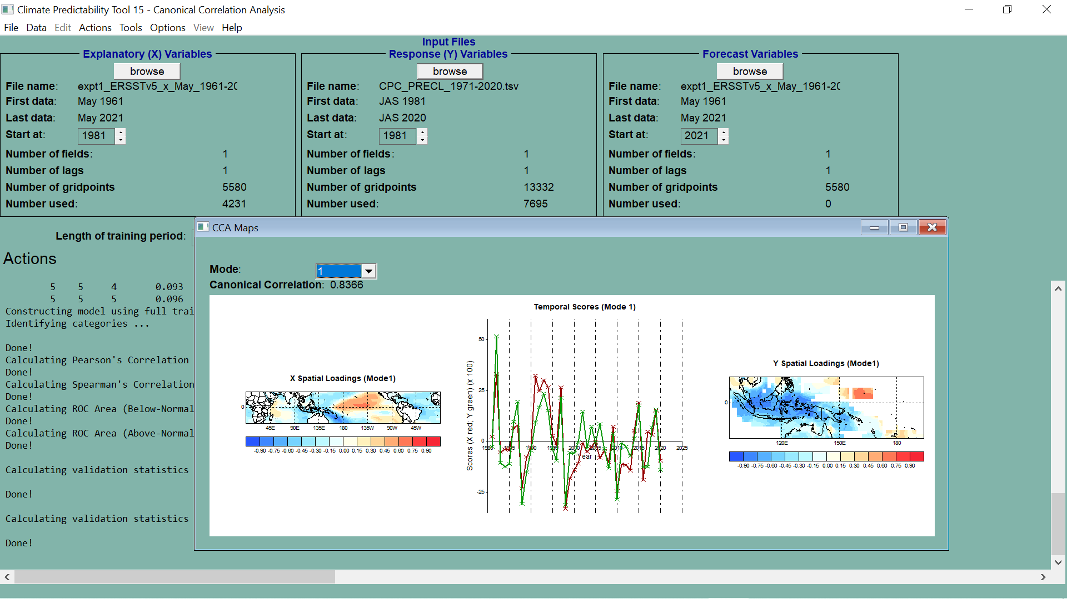

Slide 30
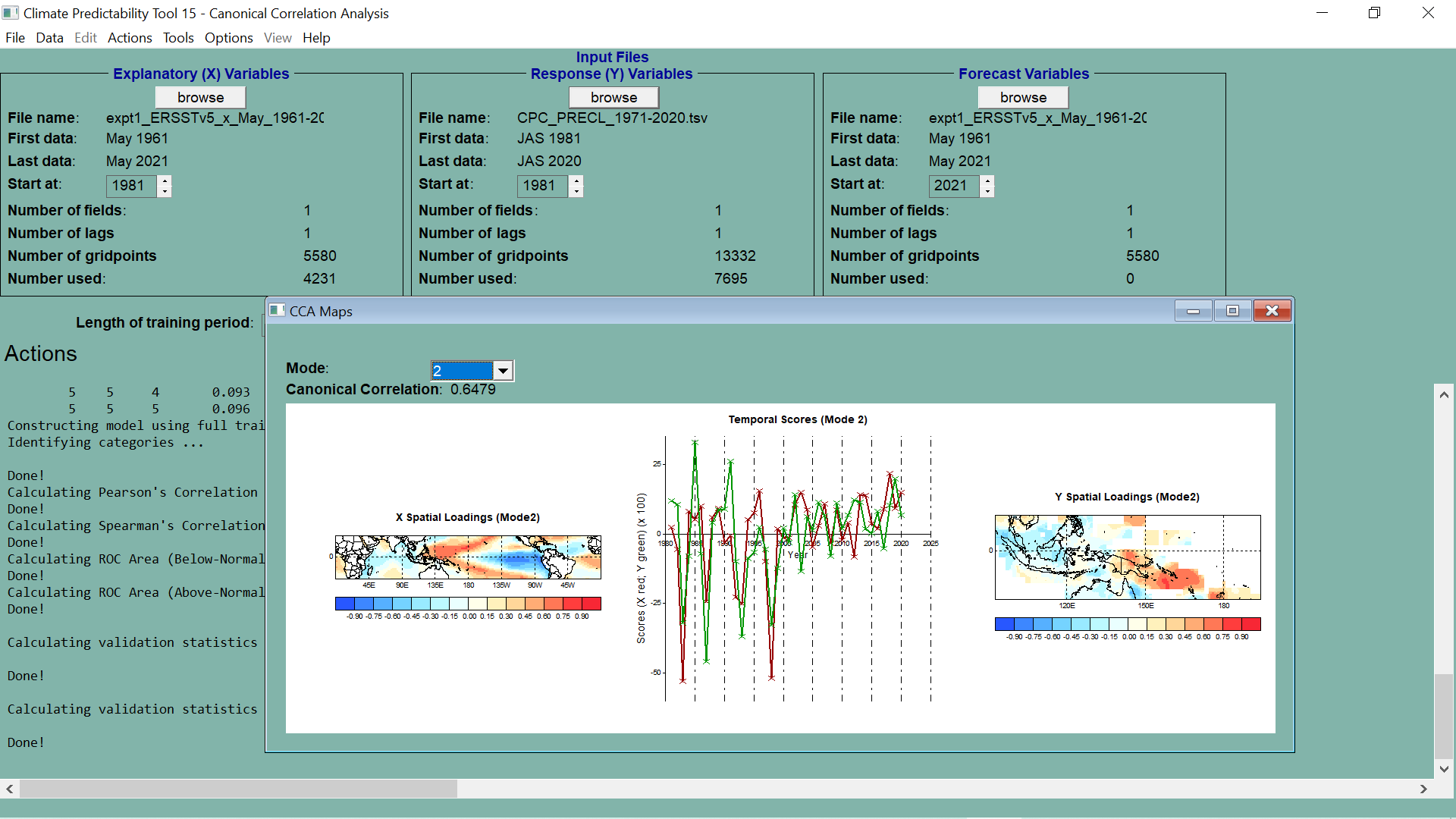

Slide 31
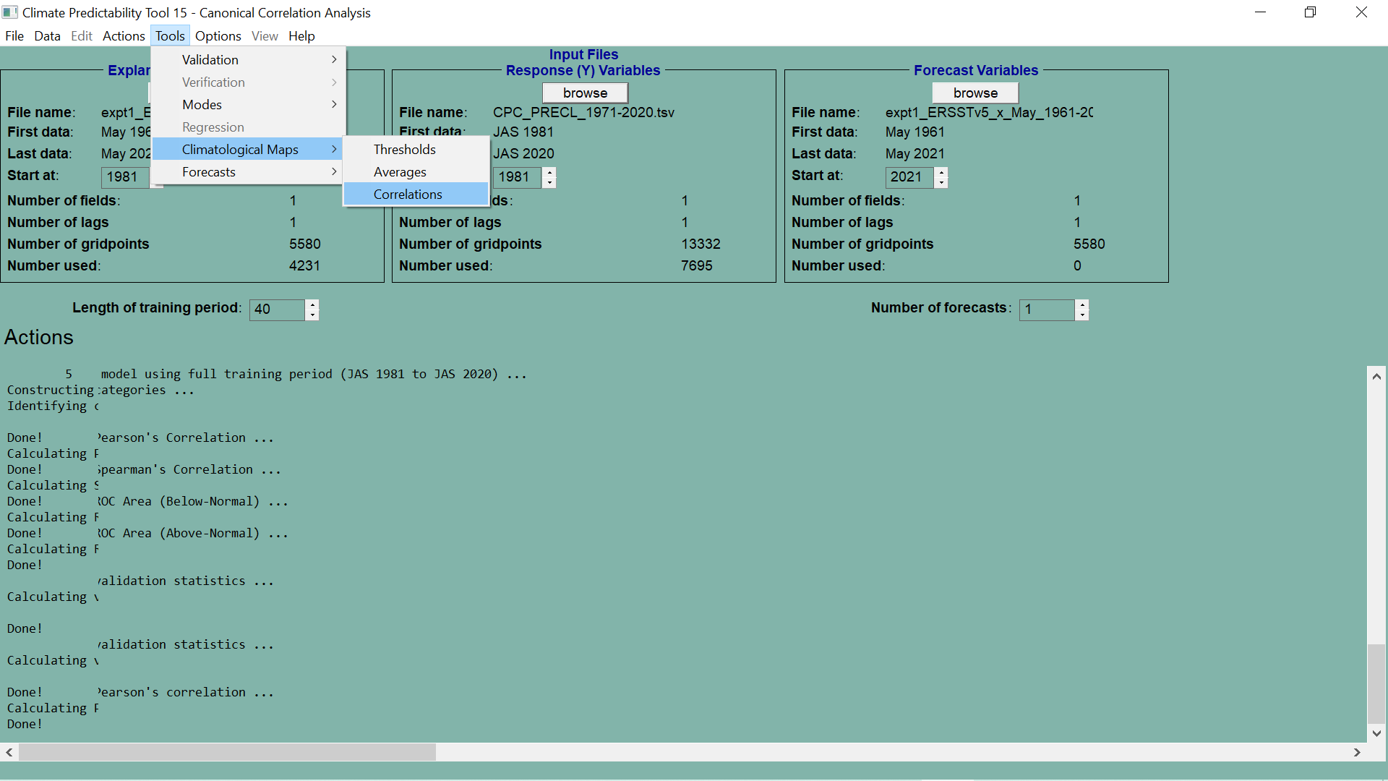

Slide 32
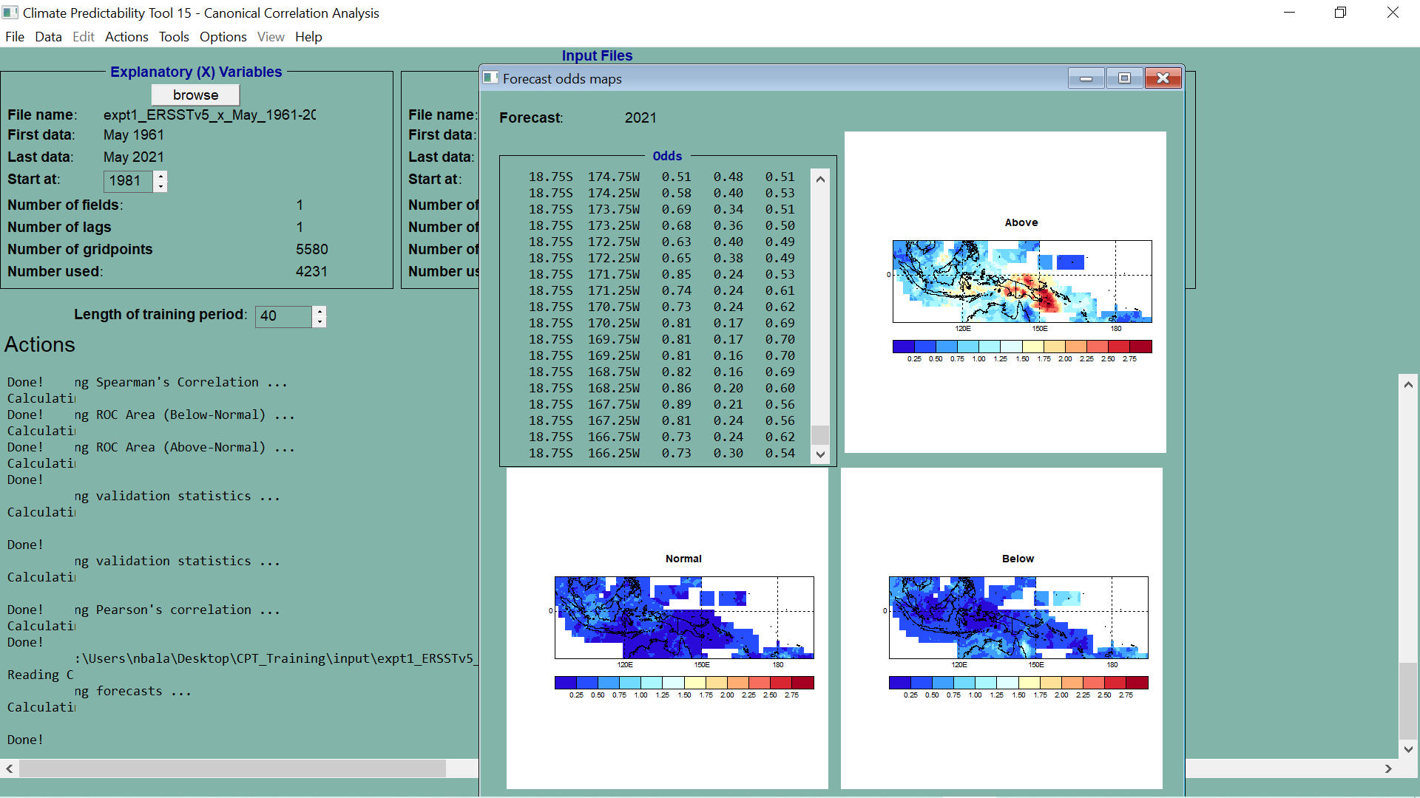

Slide 33
CLIMATOLOGIES
AVERAGES
CORRELATIONS

Slide 34
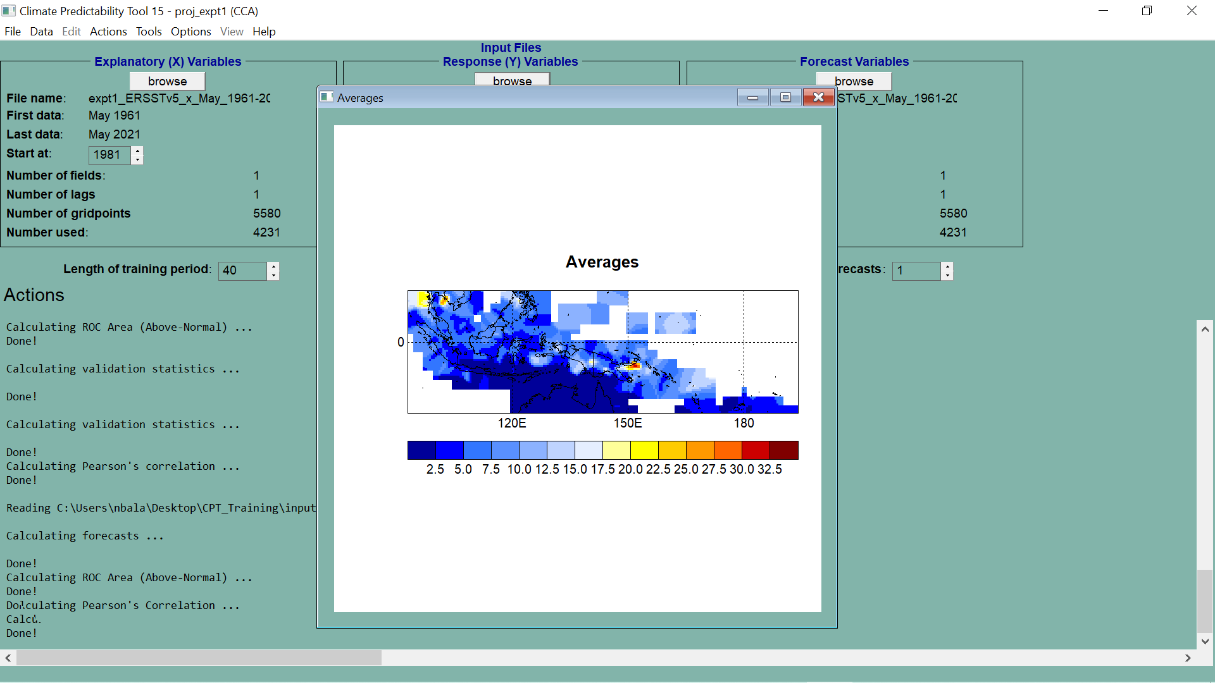

Slide 35
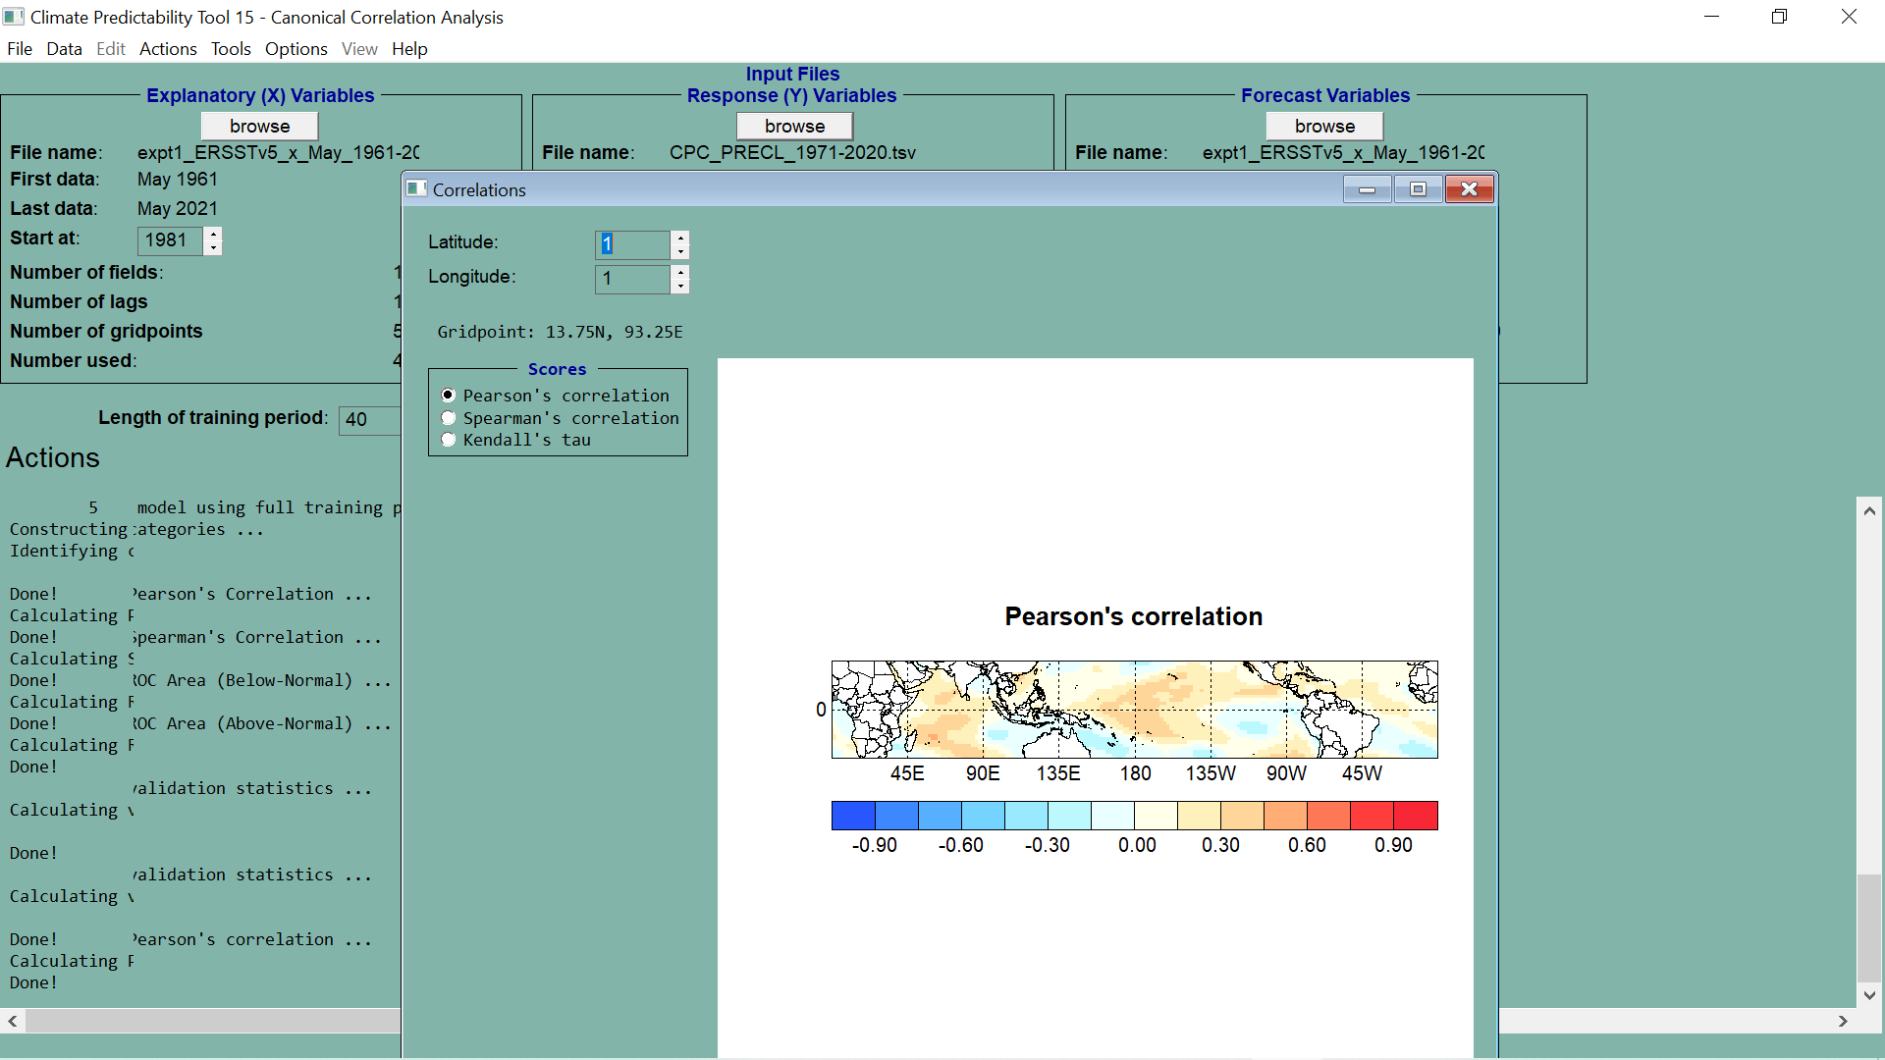

Slide 36
PROBABILISTIC MAPS

Slide 37
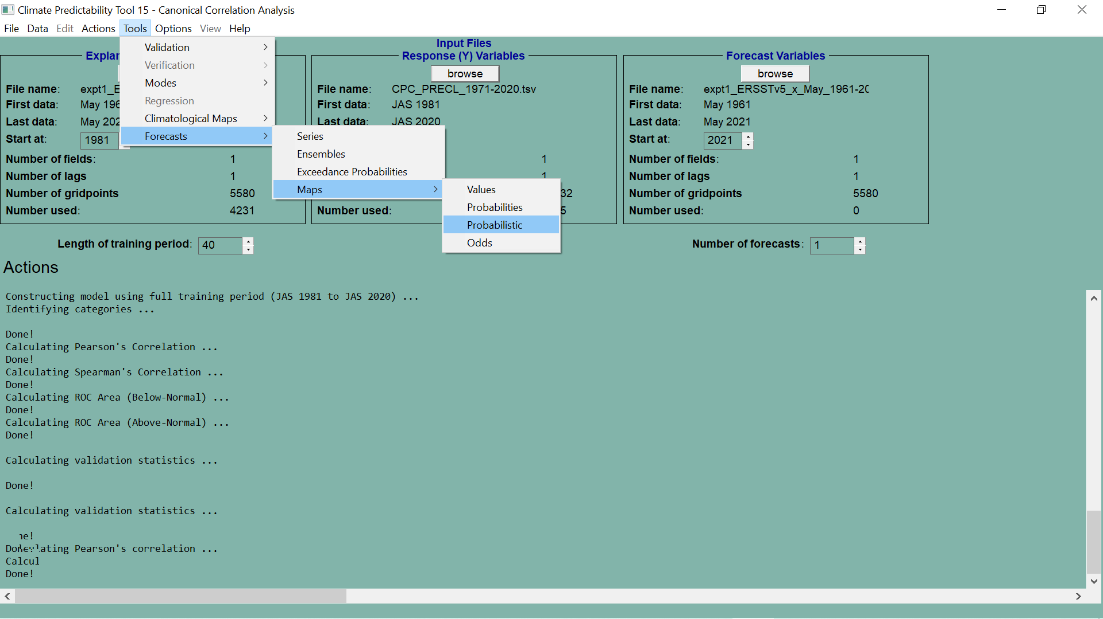

Slide 38
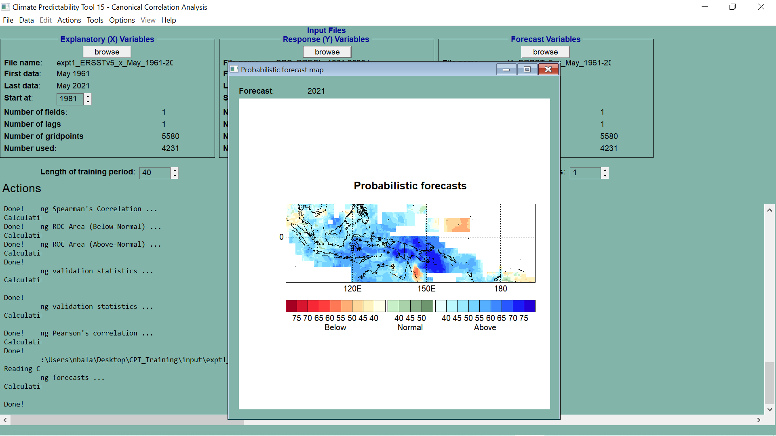

Slide 39
DATA DOWNLOADS

Slide 40
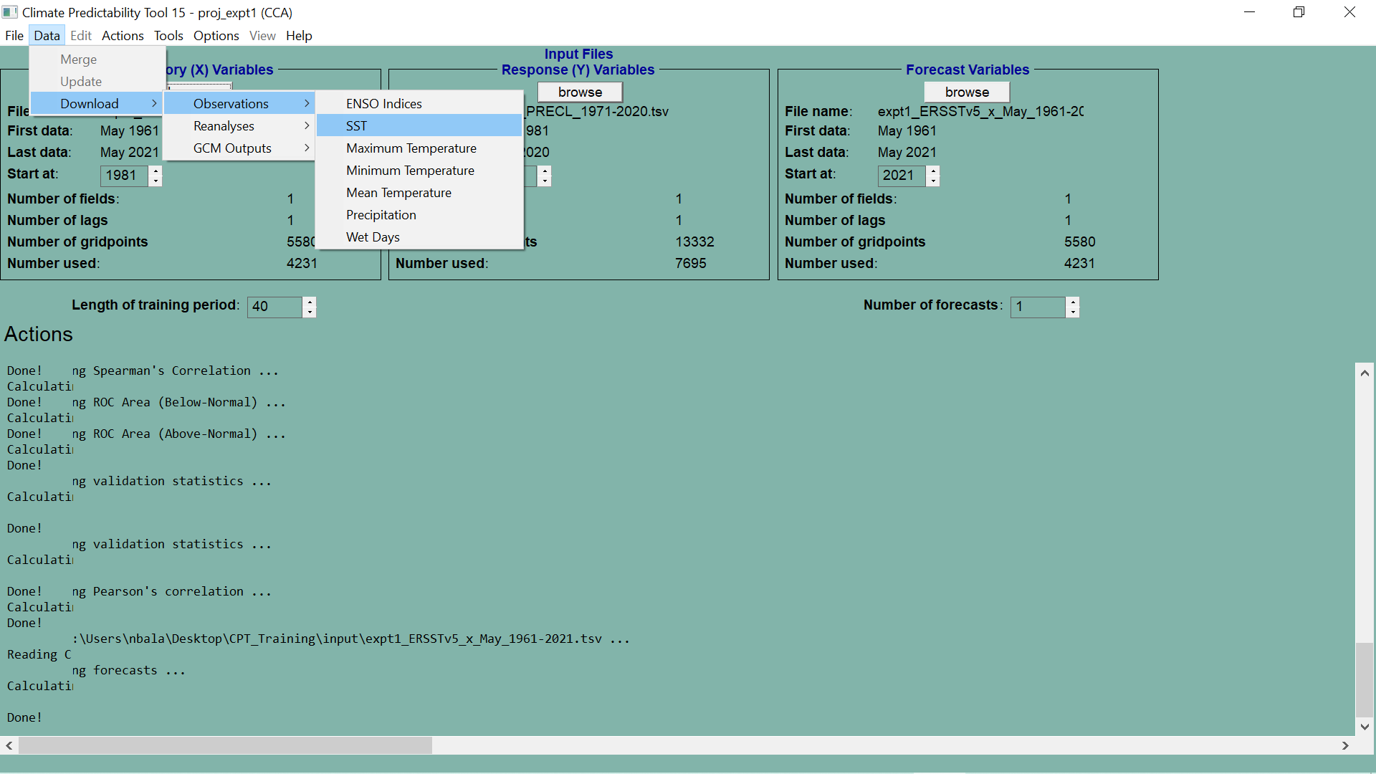

Slide 42
IRI DATA LIBRARY
DATA SELECTION AND SAVING

Slide 43
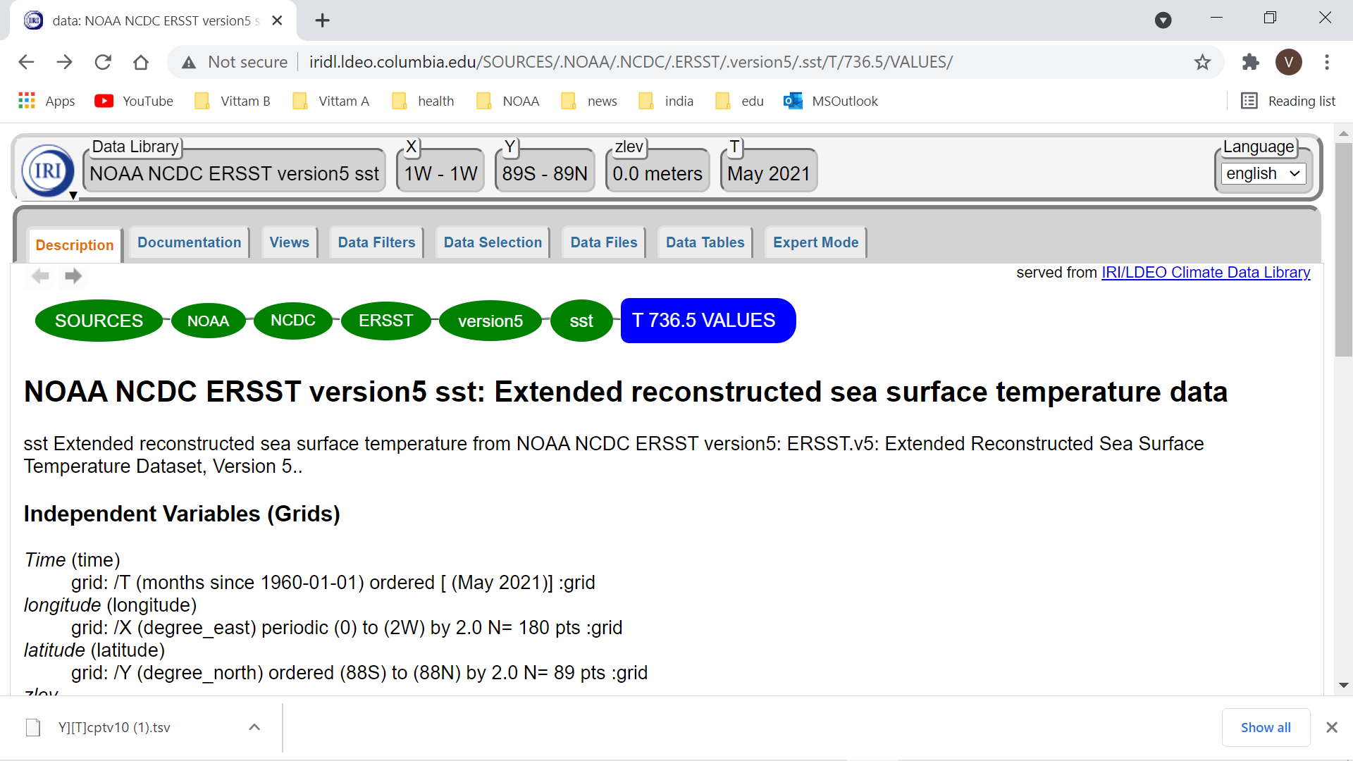

Slide 44
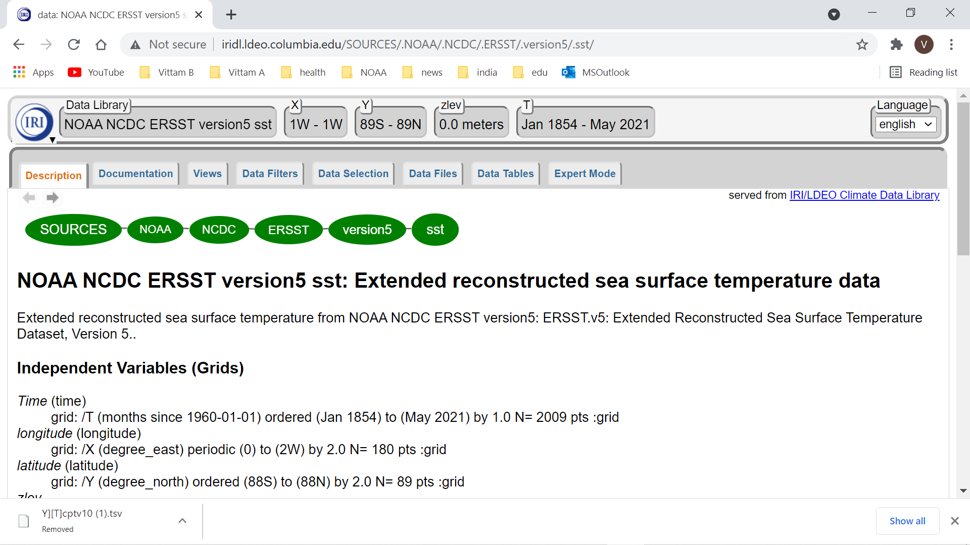

Slide 45
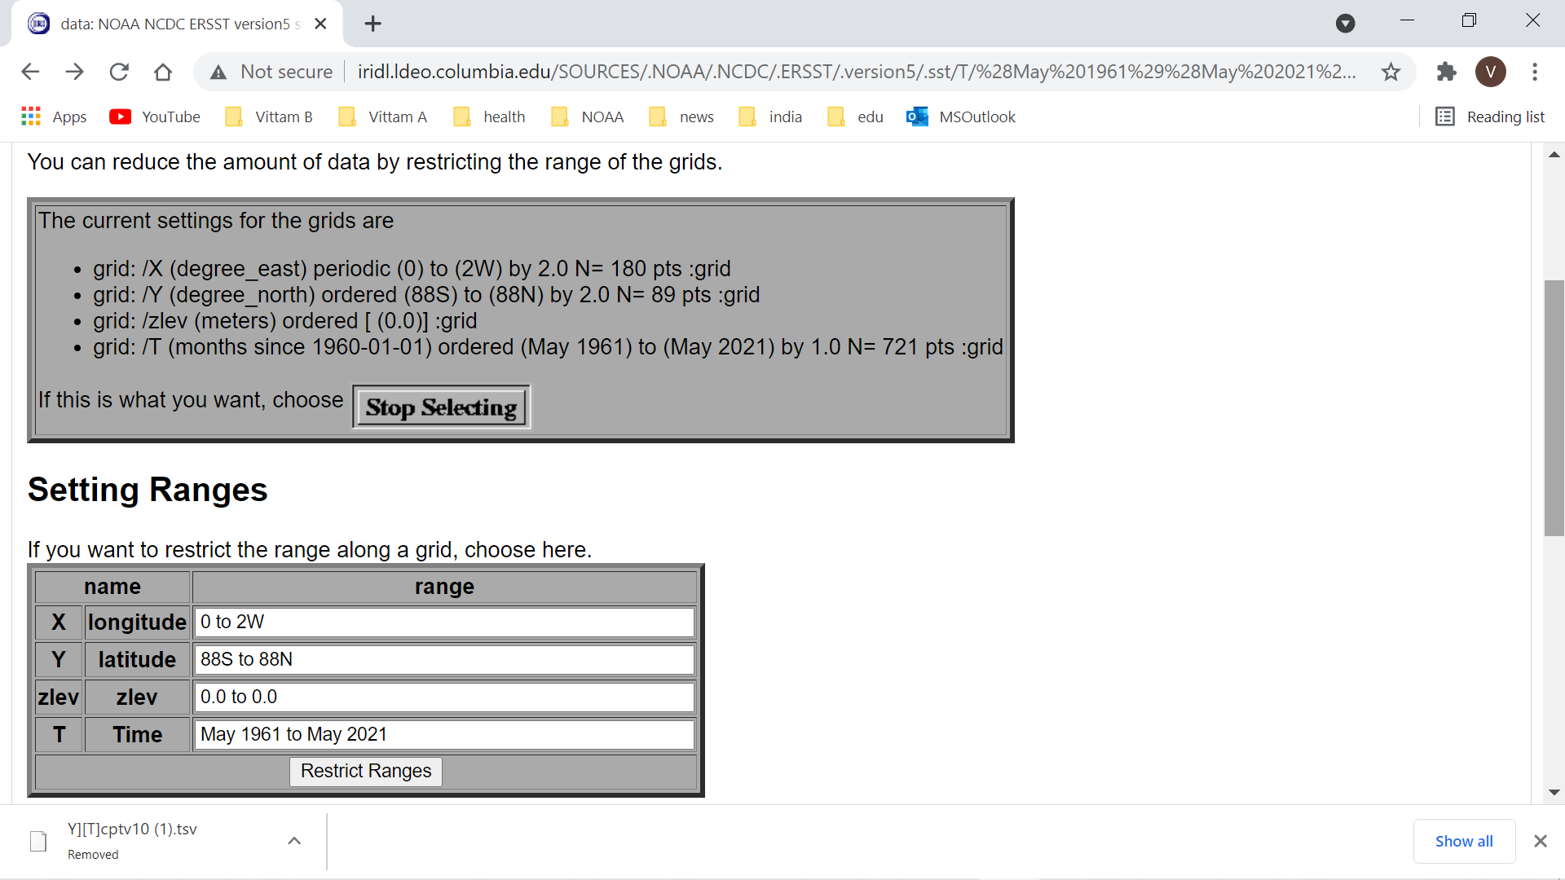

Slide 46
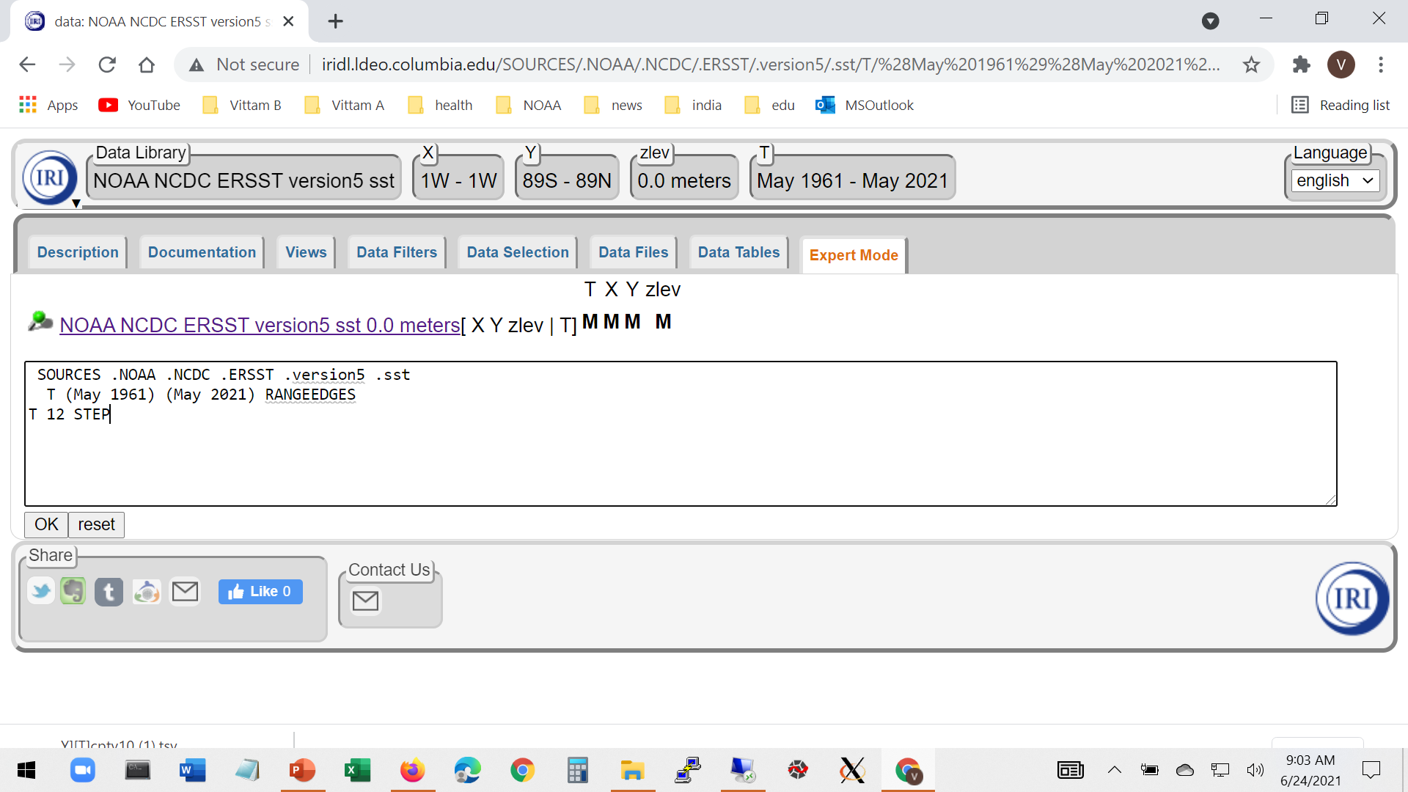

Slide 47
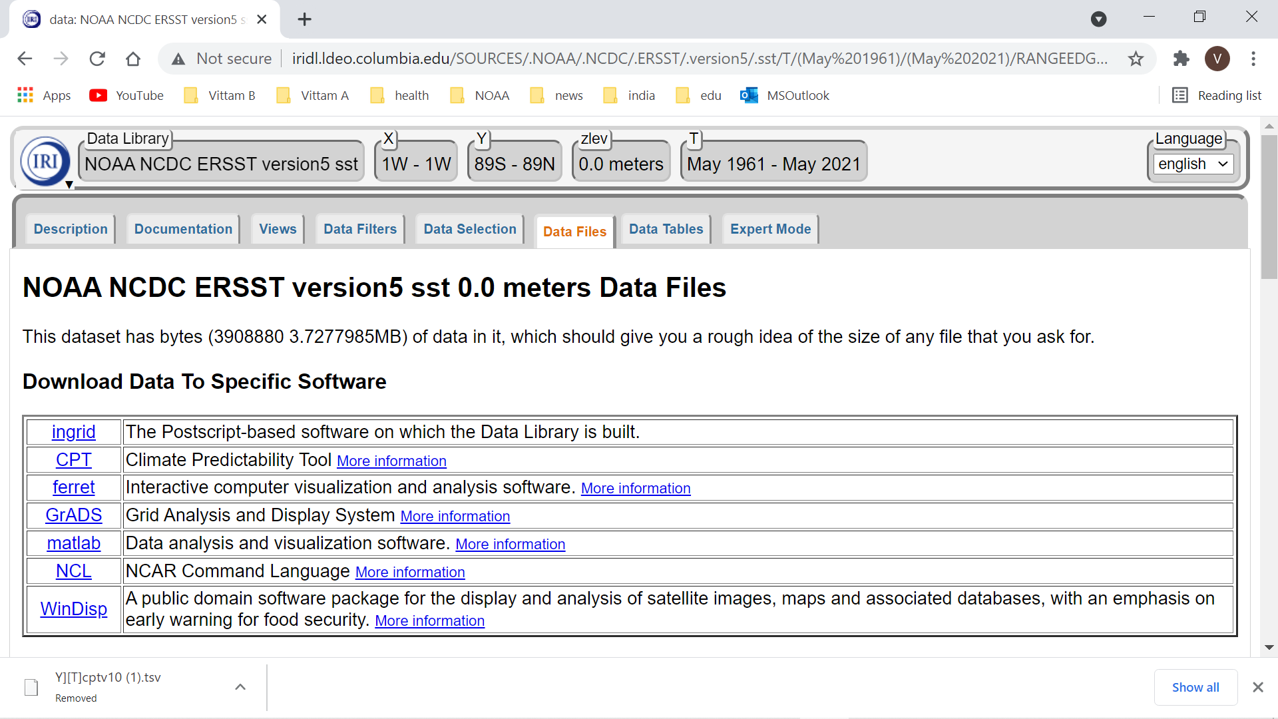

Slide 48
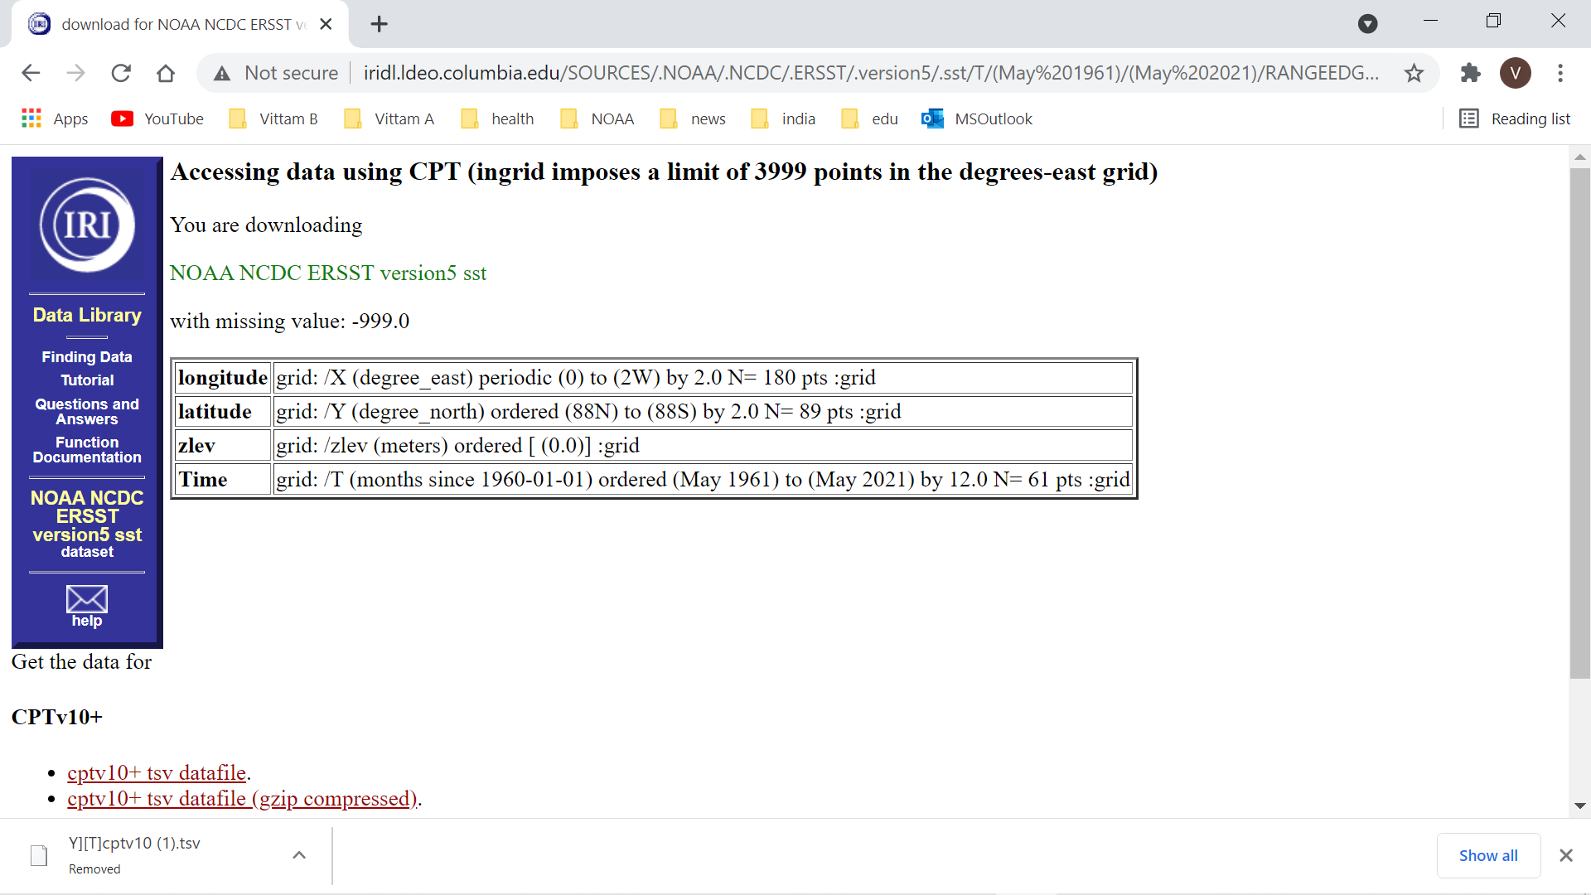

Slide 49
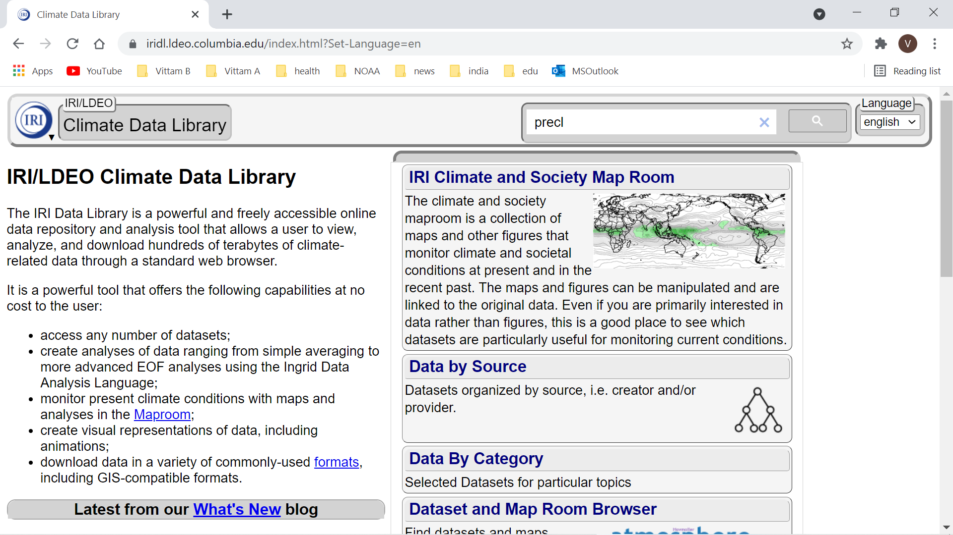

Slide 50
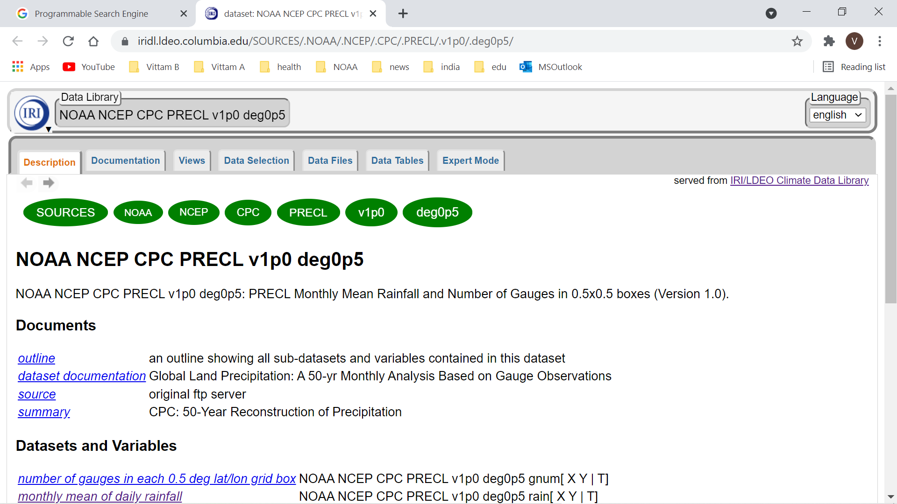

Slide 51
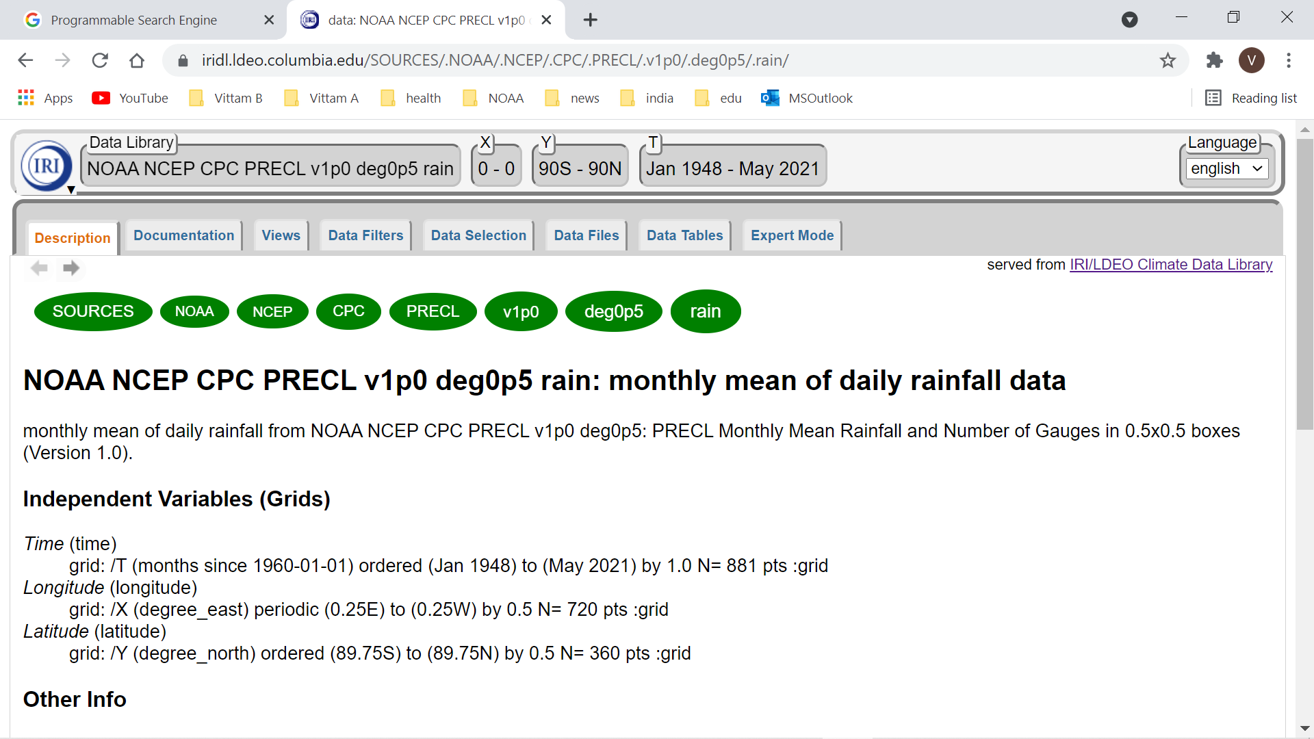

Slide 52
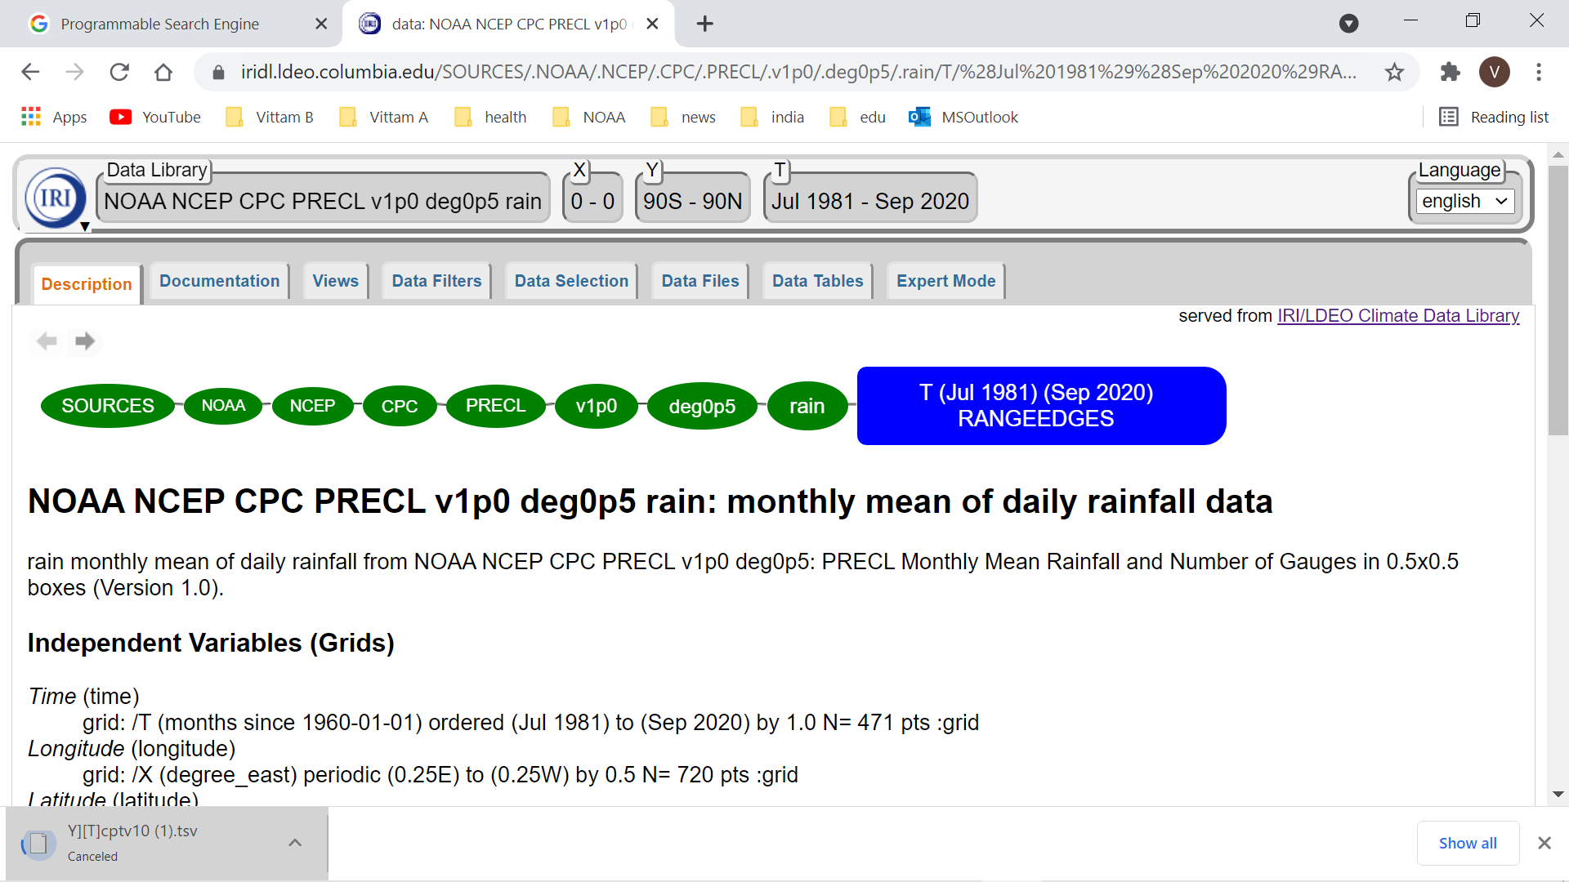

Slide 53
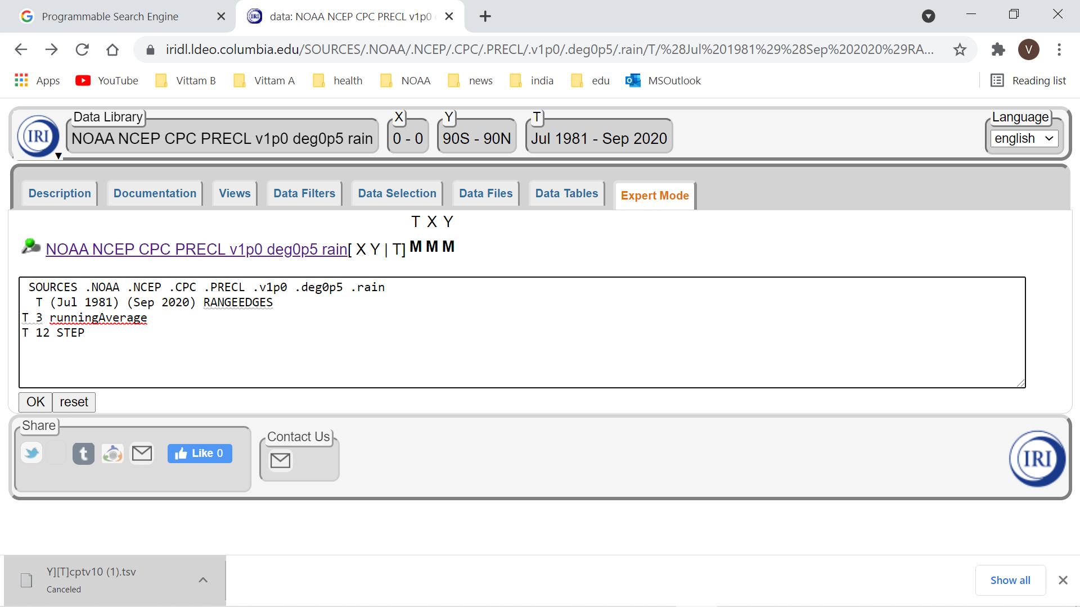

Slide 54
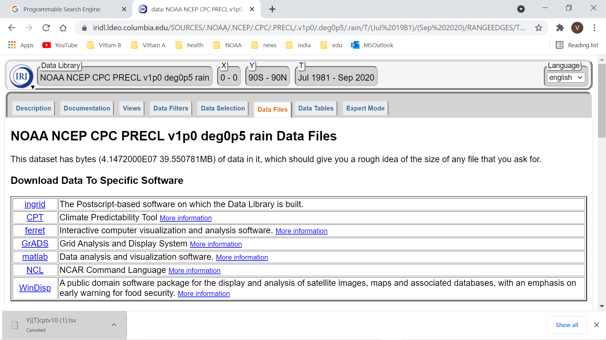

Slide 55
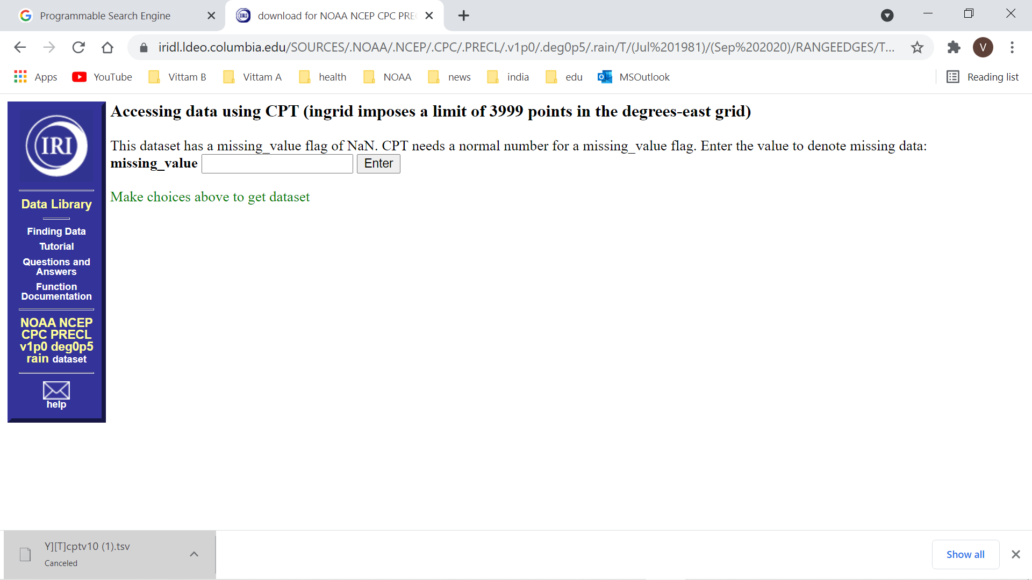

Slide 56
THANK YOU

