Slide 1
The Climate Prediction Center’s Degree Day Outlooks April 18, 2013 David Unger Climate Prediction Center NOAA/NWS/NCEP College Park, Maryland david.unger@noaa.gov
2013 Energy Fundamentals Forum: The NGL Heavyweights

Slide 2
Purpose
Summarize differences between climate and weather prediction.
Give a “Meteorologist’s eye view” of how seasonal prediction may be used by the energy sector.
Summarize how weather and climate forecasts are made.
Present information on temperature and degree day forecasts.
Show the skill of the forecasts.

Slide 3
Weather and Climate Prediction
Weather Bureau founded. Telegraph enabled weather observations
to be transmitted.
1920’s Aviation requires better upper air observations and prediction.
1940’s First Weather Bureau experiments in extended range prediction.
1950’s Computer models of the atmosphere become possible.
NOAA formed. Weather Bureau becomes the National Weather
Service .
The Climate Analysis Center formed. Satellites enable global
observations of elements important for climate prediction.
1982 El Nino brings about the modern era in climate prediction.
1990’s Computer advances enable ensemble forecasting.
1995 The Climate Analysis Center becomes the Climate Prediction Center.
Seasonal predictions made in the current format.

Slide 4
Climate Prediction Center
Monitors: Global conditions related to weather and climate
Sea Surface Temperatures
Stratospheric observations
Drought monitoring
Monitoring of climatic anomalies
Predictions
UV index
U.S. Hazards outlook (Days 3-14)
Seasonal Drought Outlook
Seasonal Temp. and Precip. Outlooks
Monthly Outlook (half-month lead and 0-lead update)
Extended range predictions (6-10 day mean, 8-14 day means)

Slide 5
fORECASTING: cLIMATE VS. WEATHER pART 1: wEATHER

Slide 6
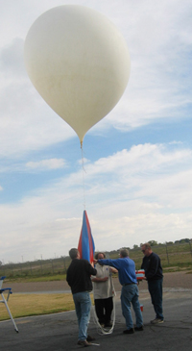
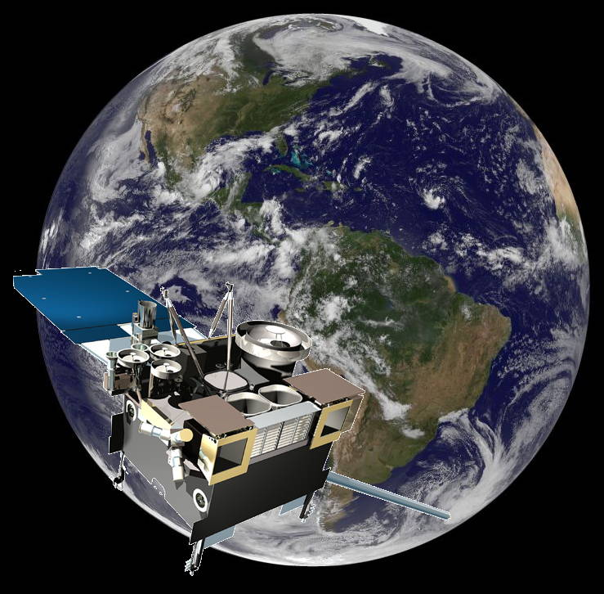
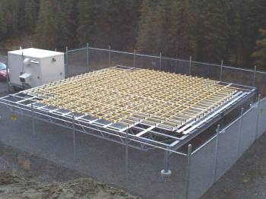
How Weather Forecasts are made 1. Observations, lots of them

Slide 7
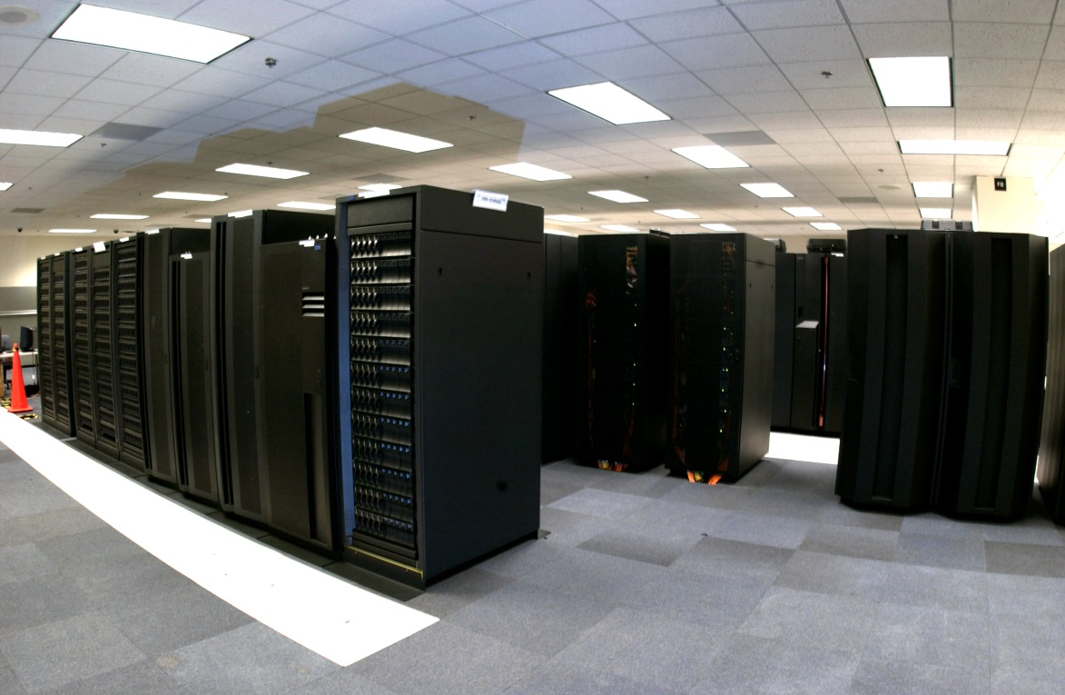
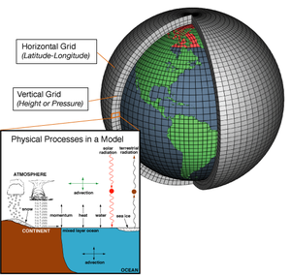
How Weather Forecasts are made 2) Models

Slide 8
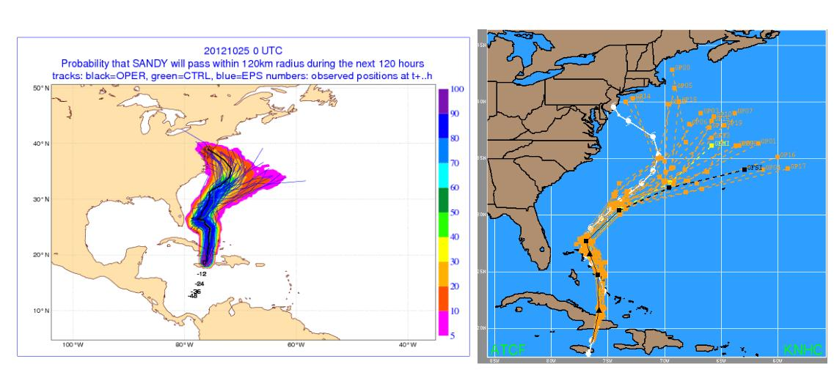
How Weather Forecasts are made 3) Ensemble Forecasts

Slide 9
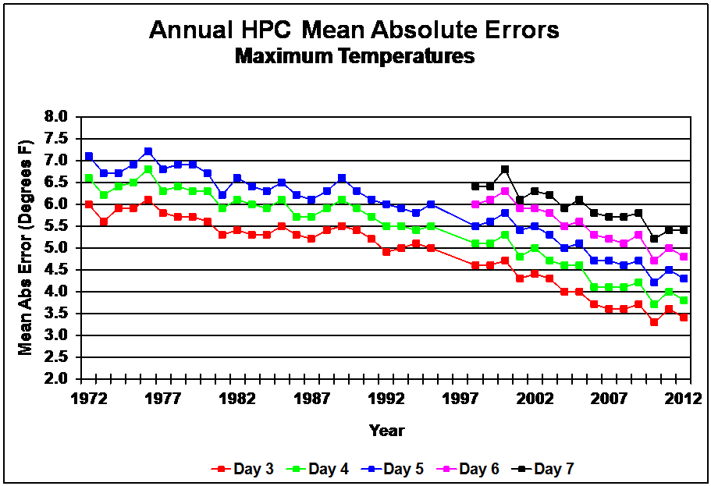
Weather Forecast Accuracy

Slide 10
fORECASTING: cLIMATE VS. WEATHER pART 2: cLIMATE

Slide 11
What Is Climate?
Climate is what you expect, weather is what you get.
- Robert Heinlein? - Mark Twain?
Climate is the range of weather events expected for a given time of year.
Adjusted for seasonality
Most conveniently expressed as averages.
More than just the averages. Ranges, Frequencies, Variability.

Slide 12
Weather Forecast vs. Climate Forecast
Weather Forecast
Climate Forecast
Predicts a specific event
Success is measured on the basis of a single case.
Probabilities represent forecaster confidence. Each weather event is unique
Depends on Initial conditions and boundary conditions.
0 – 15 Days , 20 days max?
Predicts a range of possibilities
Success can only be determined statistically.
Probabilities primarily represent the variability of weather events. (With some elements of forecaster confidence)
Depends on Boundary conditions.
Months or years

Slide 13
Meteorological Theory
Skillful prediction of Weather is possible to about 2 weeks
Small scale atmospheric disturbances influence large scales
Errors associated with inaccurate observations grow
Even neglecting a small puff of wind will eventually destroy the accuracy of a global prediction (The Butterfly Effect)
Skillful weather forecasts are possible only out to:
2 weeks with current methods.
Weather will probably NEVER be predictable more than a month.
Q. So what are the seasonal outlooks.
A. Climate forecasts, NOT Weather forecasts

Slide 14
Climate Forecasts
Boundary conditions influence the RANGE OF WEATHER CONDITIONS (aka. Climate) in a given location.
Changes in boundary conditions can affect local, regional, or even global climate.
A climate outlook predicts changes in the types and frequency of weather associated with the observed boundary conditions. It does NOT predict individual weather events.
Tools
Analogs and composites (Comparison with past events)
Statistical models
Dynamic models together with ensembles

Slide 15
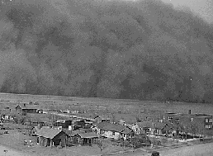
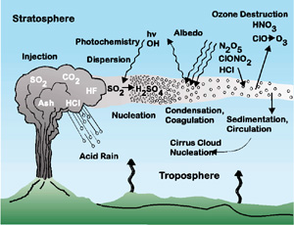
Climate Forecasts
Sea Surface Temperatures
Soil Moisture Conditions
CO2
Volcanic Aerosols
Changes in the Land Surface (Urbanization, Deforestation)
Persistent Large Scale Circulation Anomalies

Slide 16
Hurricane Weather Forecast

Slide 17
Climate forecast for Hurricanes
Run a good model that can simulate hurricanes many times per year with “Boundary conditions” for each year (1982-2008). Call this the MODEL CLIMATOLOGY.
A Model climatology differs slightly from the true climatology of the observations.
Run the model on the Boundary Conditions predicted THIS YEAR
Compare THIS YEAR’s prediction with the MODEL CLIMATE. Differences indicate the expected hurricanes this year.

Slide 18
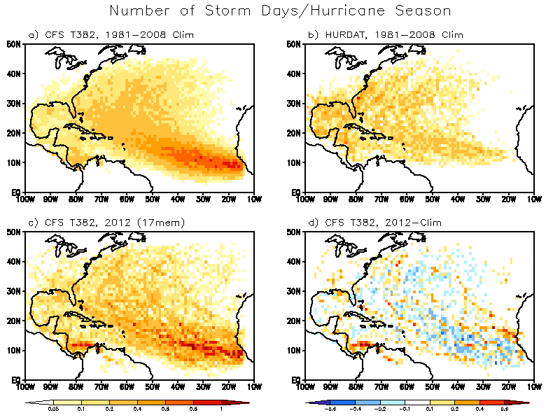
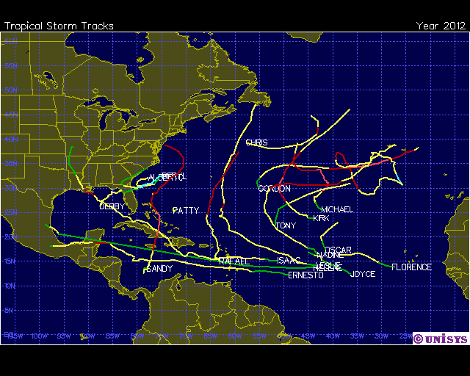
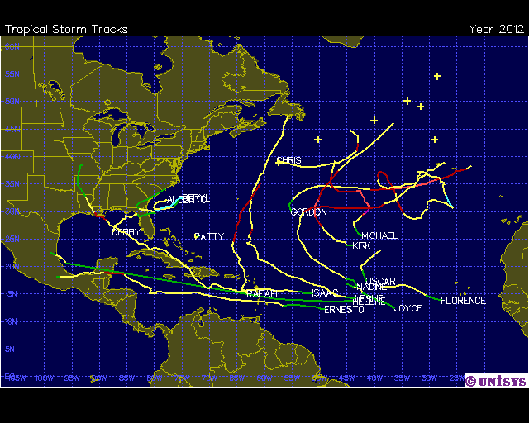
Atlantic Storm Track Density Distribution
2012 Obs. Tracks
2012 tracks
Notes:
18

Slide 19
Past Forecasts and Verification
Atlantic Basin
Tropical Storms
Hurricanes
ACE Index
(% of Median)
2009
Ensemble
7.4
2.6
82.8
Range
5-10
1-4
61-104
Verification
9
3
57
2010
Ensemble
21.5
10.5
262.3
Range
18-25
7-14
212-312
Verification
19
12
185
2011
Ensemble
13.9
5.0
144.6
Range
10-17
3-7
104-185
Verification
19
7
134
2012
Ensemble
12.4
3.7
124.4
Range
10-15
0-7
89-160
Verification
19
10
142

Slide 20
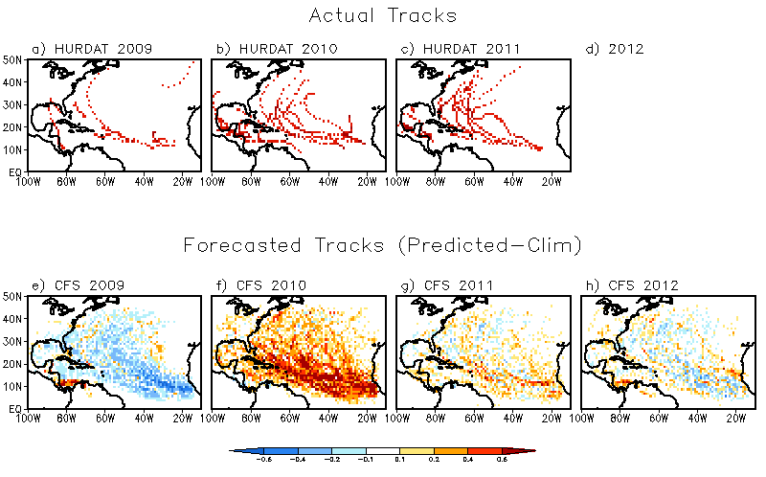
Track Prediction (Storm day density) for CFS)
Observed Actual Tracks
Anomalous Storm Day Density from CFS Forecasts

Slide 21
Climate Forecast Summary
Forecasts do not predict individual weather events
Forecasts are made in relation to climate normal (Above, Near, Below)
Forecasts can be interpreted in terms or ranges.

Slide 22
eNERGY RELATED Weather Information Degree Days

Slide 23
Degree Days - Defined
Degree Days are a simple tool to estimate weather related energy demand.
Definition
Mean Daily Temperature = t = .5*(Tmax+Tmin)
Heating is needed when t < 65 F
Cooling is needed when the t > 65 F.
Costs are approximately linearly related to degree days.

Slide 24
Houston Temperatures
65 Cooling degree days
Cooling Required
Heating Required
176 Heating degree days

Slide 25
Degree Days Vs. Gas Consumption
Reference: Relations between Temperature and Residential Natural Gas Consumption in the Central and Eastern U.S.
Journal of Applied Meteorology and Climatology, November, 2007 Authors. Reed Timmer and Peter J. Lamb
Results: Correlation with HDD is higher in the north(r=.9) than south (r=.6).
Optimum HDD base is lower than 65F in the north, somewhat higher in the south.
Other Elements: Wind – Not well predict at long ranges. Sunshine/ clouds – Already reflected in the temperatures
Humidity – More important for cooling than heating. Year-to-year variations not being predicted

Slide 26
Definitions

Slide 27
CPC’s Temperature and degree day outlooks

Slide 28
CPC Temperature Outlook
CPC “Forecast divisions”
Seasonal Outlooks
For each division divide the 1981-2010 mean seasonal temperatures into 3 classes
Below Normal = Lowest 1/3
Near Normal = Middle 1/3
Above Normal = Highest 1/3
(With assistance of an assumed distribution)

Slide 29
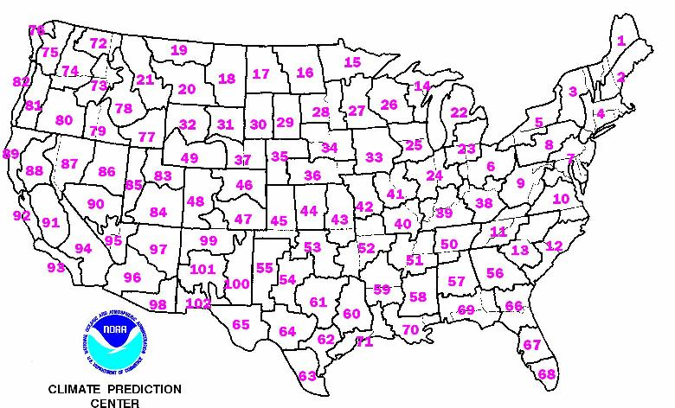
CPC POE Outlooks

Slide 30
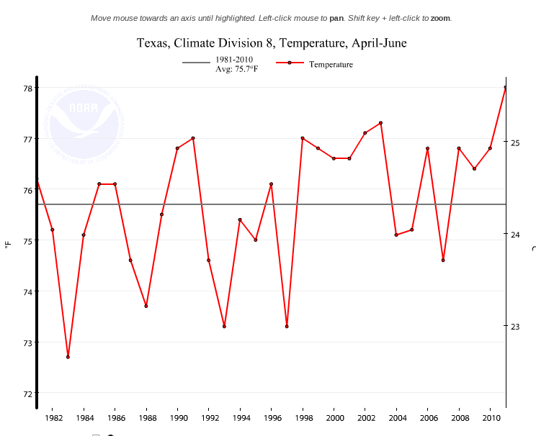
Temperatures for Houston area:
3-month Means for April - June
Above Normal
33%
Near Normal
33%
Below Normal
33%

Slide 31
Prediction Methods
CPC obtains forecasts from many tools
Estimated skill based on “Hindcasts” 1982-2012
Ensemble of forecasts are assembled
Outlooks are based on calibrated counts.
3-month seasonal means help emphasize climate over weather.
Issue once per month (3rd Thursday)
Monthly update on the last day of the month

Slide 32
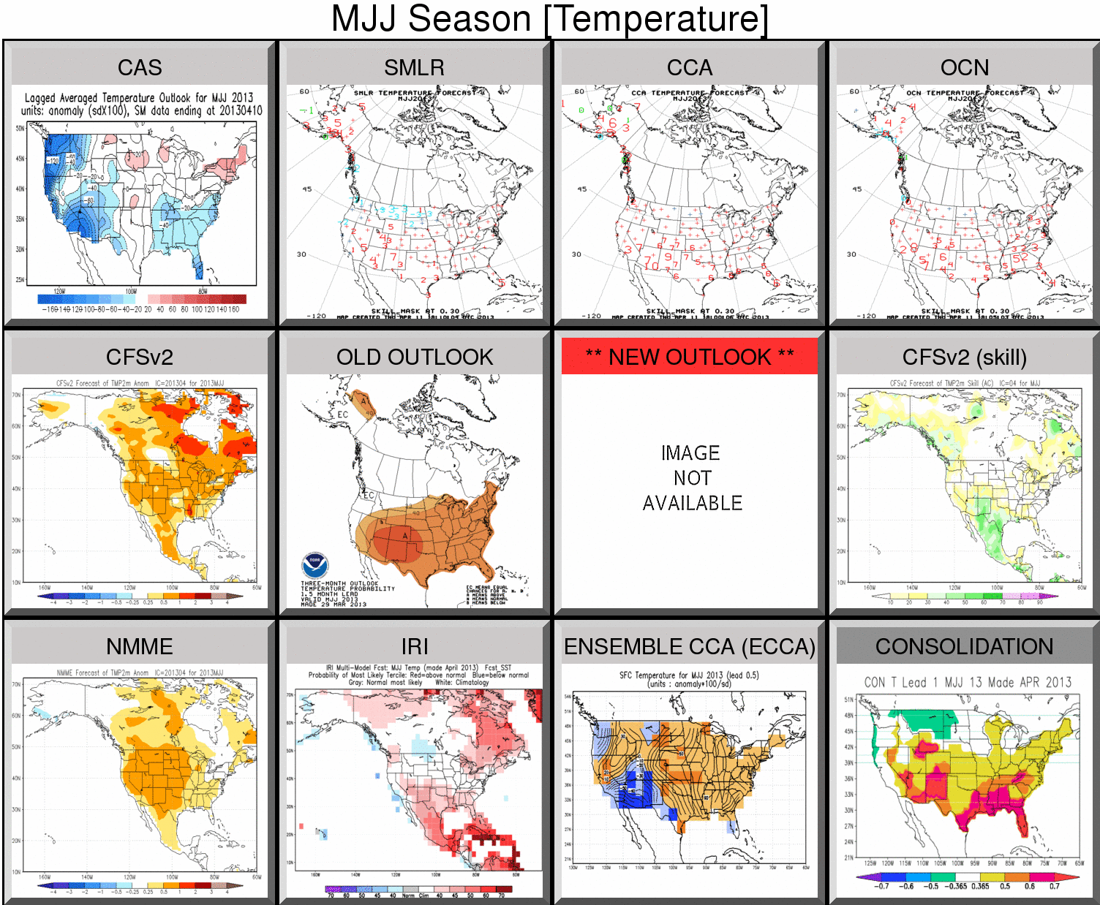

Slide 33
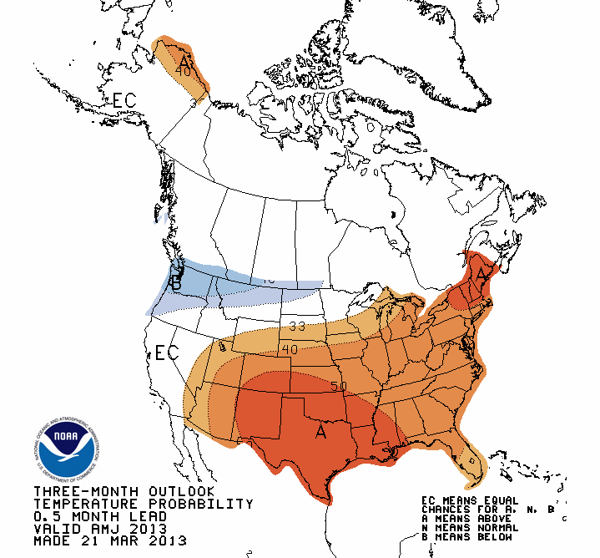
Final Forecast
A forecaster adjusts the forecast information to reflect judgment (Forecasters are mostly more cautious)
Final forecast is for the favored category only.

Slide 34
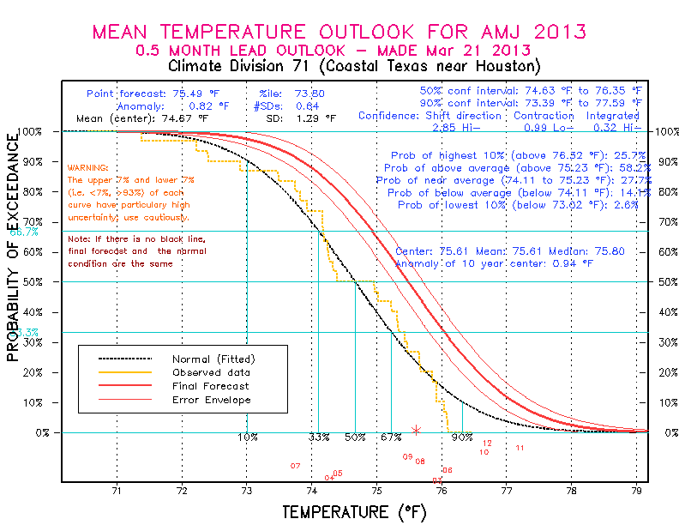
Translate forecast into a full temperature distribution

Slide 35
Degree Day Outlook
Based on the CPC Temperature Outlook
Mean relationship between monthly or seasonal temperature, and degree days.
Downscaled from CPC forecast divisions to NCDC climate divisions
Aggregated onto political boundaries – population weighted.
Population weighing reflects energy demand.

Slide 36
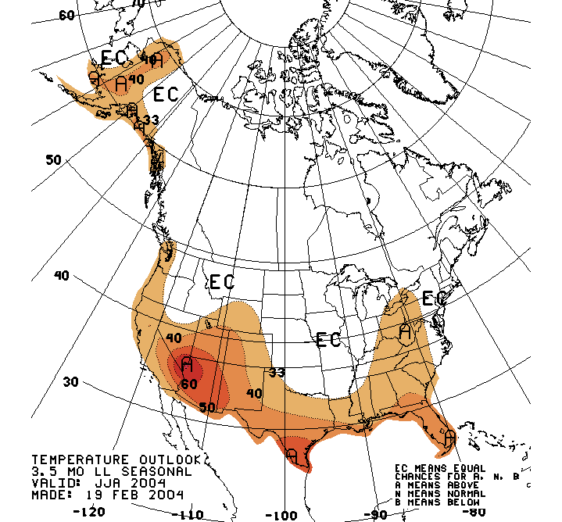
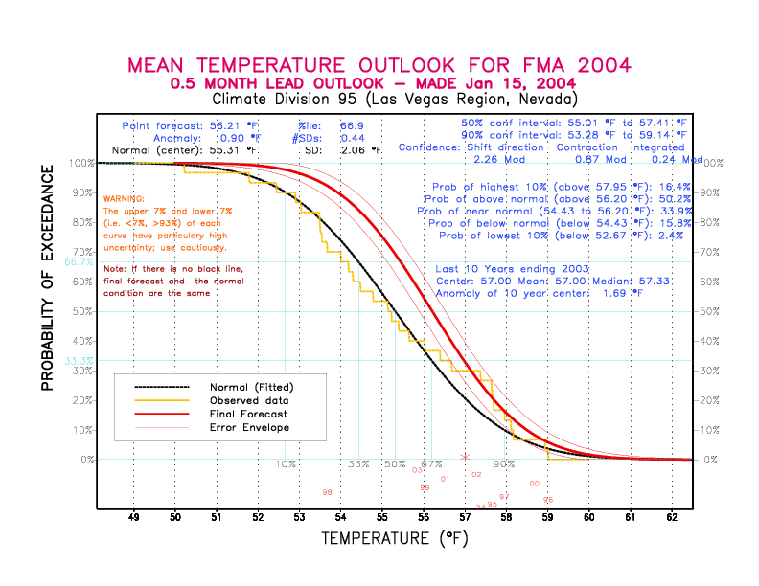
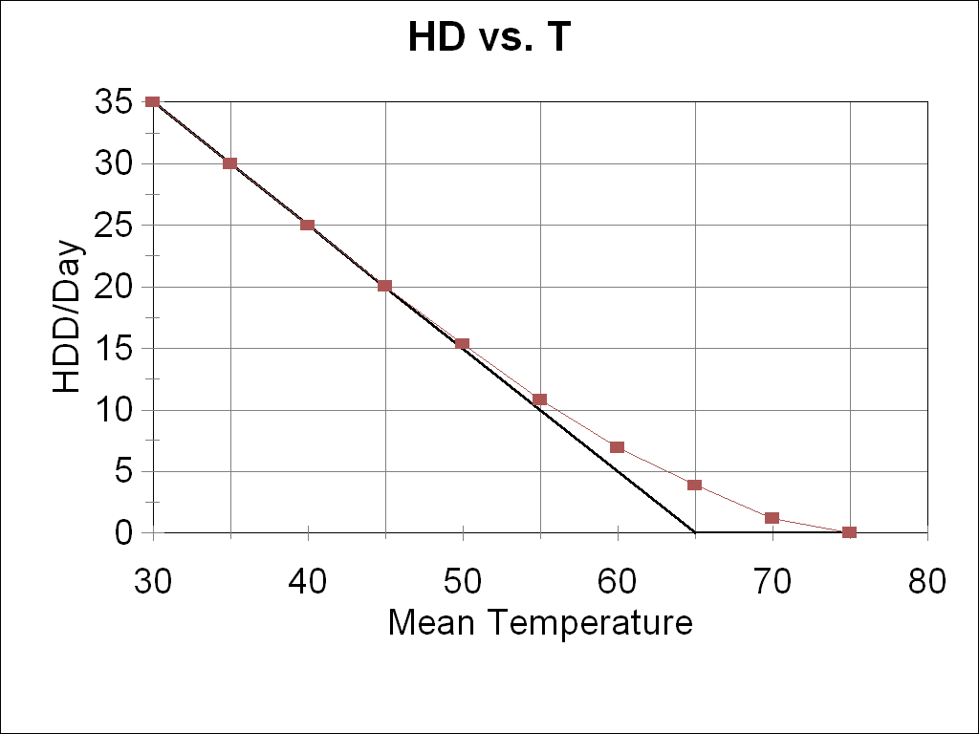
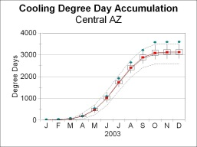
Overview
Tools
Forecaster Input
Temperature Fcst
Prob. Anom.For Tercile
(Above, Near, Below)
Model Skill, climatology
Temperature POE
Downscaling (Regression Relationships)
Temperature POE
Downscaled
Temperature to Degree Day (Climatological Relationships)
Degree Days
HDD CDD POE
Accumulation Algorithms
Degree Days
Flexible Regions, Seasons

Slide 37
Rescaling
Downscaling
FD Seasonal
CD Seasonal
Disaggregation
FD Monthly
CD Monthly

Slide 38
Downscaling
Regression
CD = a FD +b
Equation’s coefficients are “inflated”
(CD variance = climatological variance)

Slide 39
Disaggregation - Seasonal to Monthly
Tm = a Ts + b
Regression, inflated coefficients
Average 3 estimates
M JFM + M FMA + M MAM
3
M =

Slide 40
Temperature to Degree Days

Slide 41
CPC Outlook

Slide 42
Verification

Slide 43
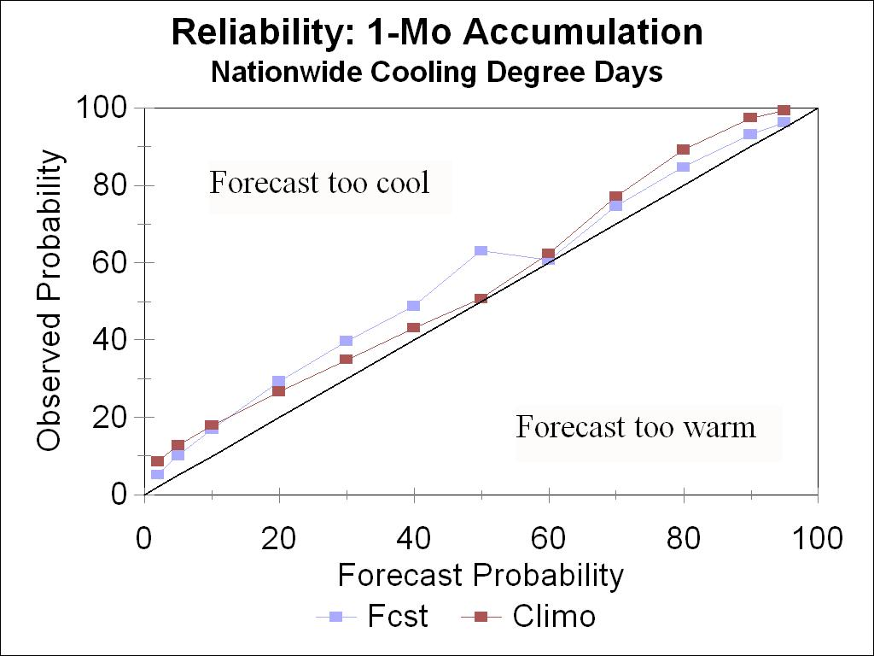
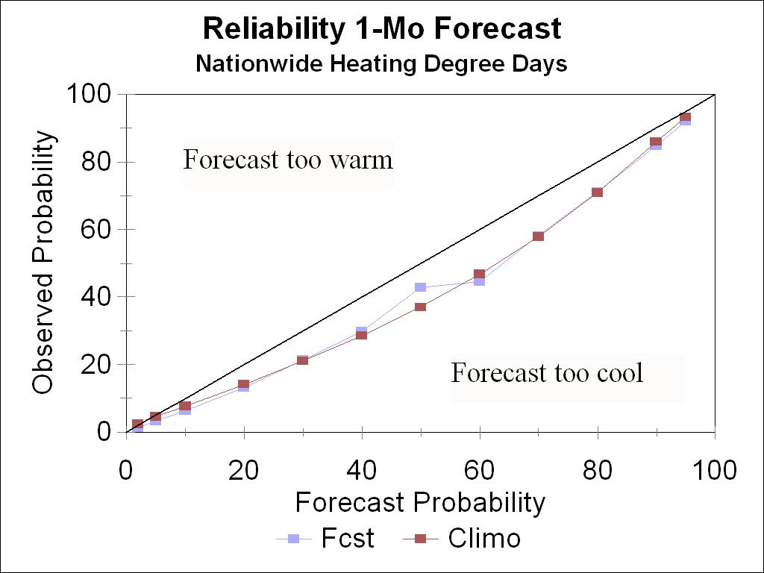
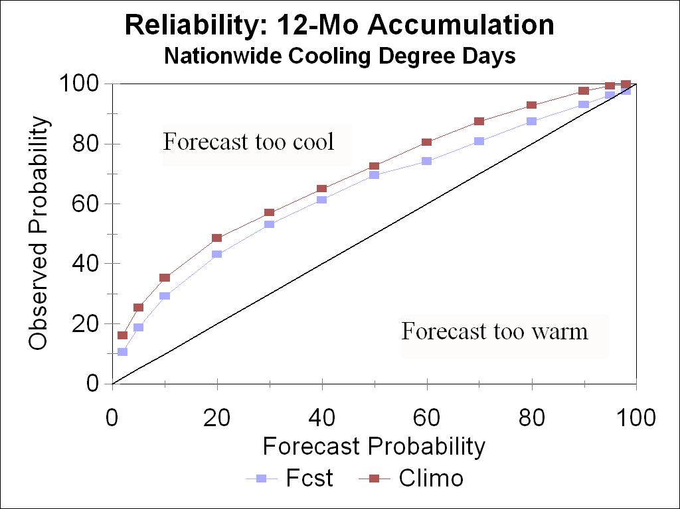
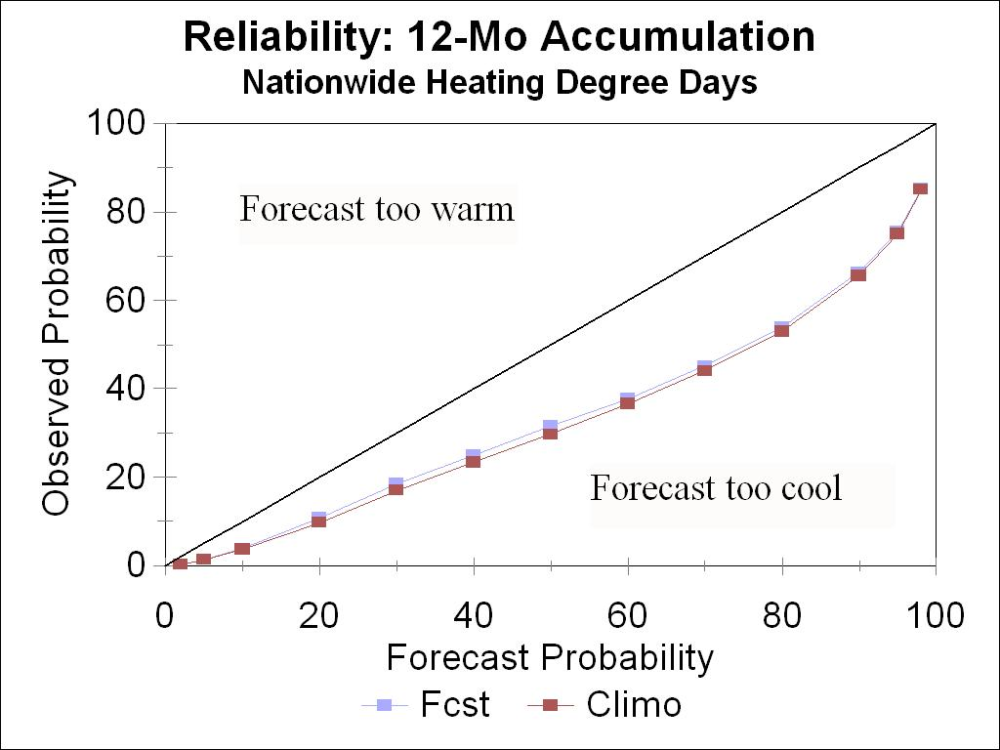
Reliability

Slide 44
Scoring a probabilistic forecast
Continuous Ranked Probability Score (CRPS)
Designed to reward reliable forecasts
Rewards confident forecasts
Assumes a linear loss function
Think of the CRPS as a cost of making a forecast.
- An up front cost to insure against losses due to errors – expressed as uncertainty
- Otherwise losses are proportional to the error magnitude.

Slide 45
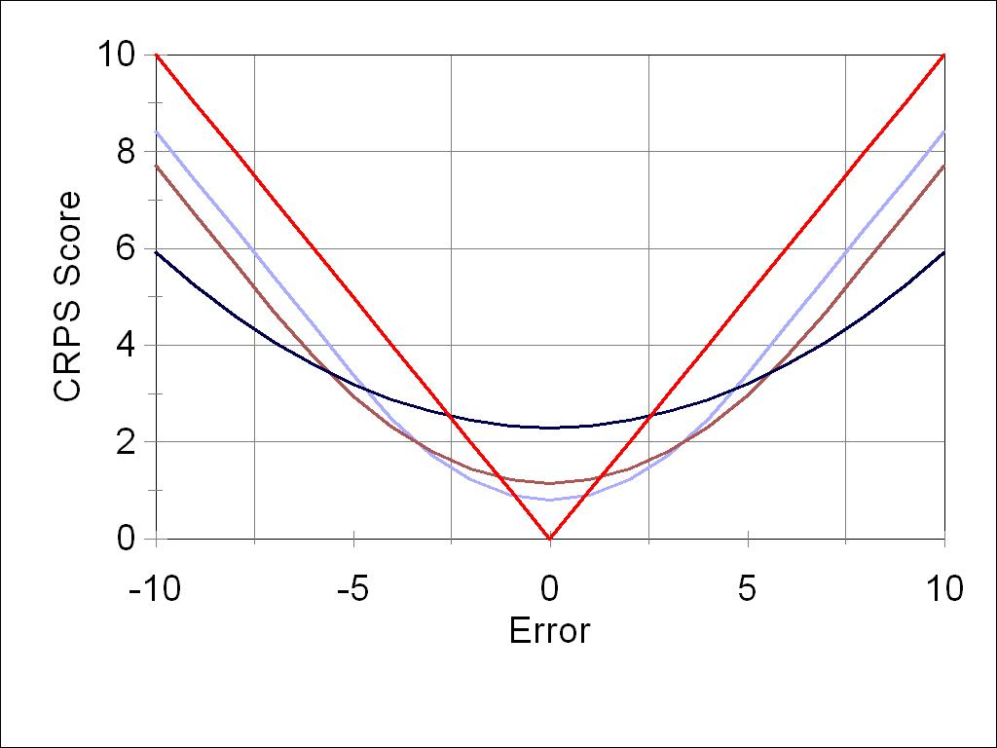
Continuous Ranked Probability Score
7 penalty points.
Forecast= Confident: There will be 100 degree days this month
Observation: 93
Error= Forecast-Obs = -7

Slide 46
Continuous Ranked Probability Score
4 penalty points.
Forecast= Less Confident: There is an 80% chance that this month will have between 90 and 110 degree days
Observation: 93
Error= Forecast-Obs = -7

Slide 47
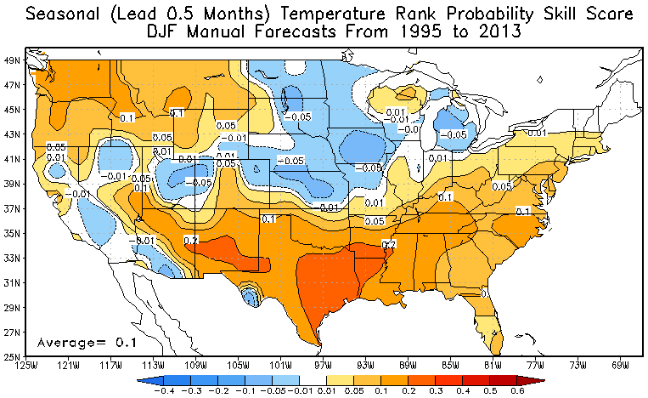
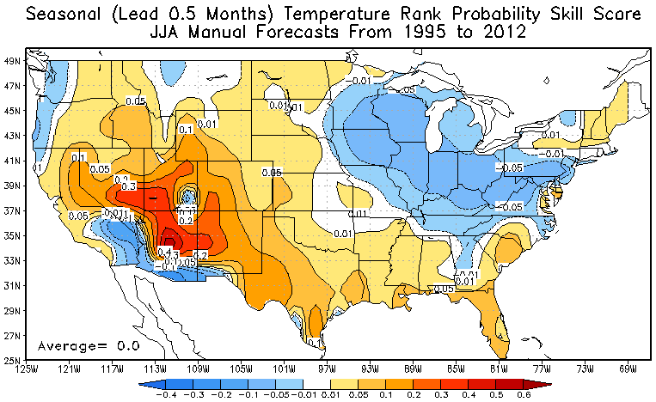
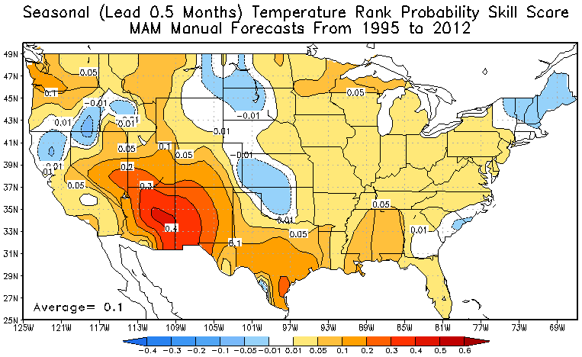
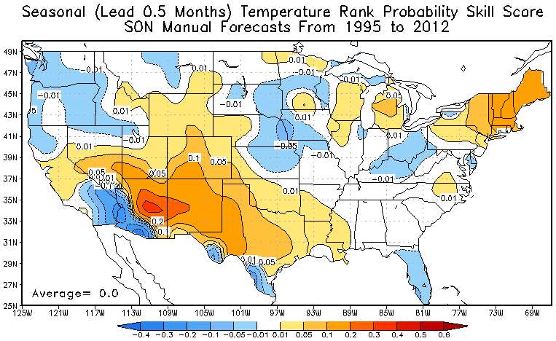
Skill of CPC Temperature Outlooks
Winter
Summer
Spring
Fall

Slide 48
CRPS Skill Scores: Heating and Cooling Degree Days
.122 | .000
.107 | -.061
.084 | .049
.036 | -.023
.053 | .000
.012 | .011
.000 | .015
.030 | .020
.054 | .000
.039 | -.065
.011 | -.012
.032 | -.004
.030 | .000
-.001 | -.010
.008 | -.005
-017 | .017
.024 | .000
.003 | -.051
.079 | .033
-.029 | .025
.059 | .000
.052 | .051
.219 | .055
.038 | .020
.161 | -.041
.268 | .112
.187 | .236
.129 | .187
Skill
.102 | .061
.070 | .093
.039 | .042
.065 | .033
.048 | -.008
.012 | .041
-.087 | .037
-.033 | .013
High
Moderate
Low
None
.10 +
.05 -.099 .
HDD
CDD
.02 ..0490
.081 | .024
.032 | .071
.125 | .059
.027 | .043
DJF
MAM
1 Month Lead
JJA
SON

Slide 49
Temperature and degree Day PRODUCT SUMMARY

Slide 50
Observations http://www.ncdc.noaa.gov/cag/
National Climate Data Center – Official observation. “Climate at a Glance”

Slide 51
Weekly forecasts and Short term forecasts http://www.cpc.ncep.noaa.gov/products/analysis_monitoring/cdus/degree_days/DDF_index.shtml
CPC Degree Day monitoring

Slide 52
Production of Short Term Products
Global Weather Prediction model. (GFS)
MOS or the NDFD
Put onto political Boundaries
Weight by population (% Gas, Oil, Electric)
Issued once per week on Mondays

Slide 53
Seasonal Products http://www.cpc.ncep.noaa.gov/pacdir/DDdir/NHOME3.shtml
CPC Seasonal Outlooks – States, Regions.
Issues on the third Thursday of each month.

Slide 54
Seasonal Products for Cities
CPC Seasonal Outlooks – States, Regions.

Slide 55
Local 3-month Temperature Outlook (L3MTO) http://www.nws.noaa.gov/climate/

Slide 56
Parting thought and conclusion

Slide 57
The Leap Year Paradox
Every 4 years we have an extra day of winter.
February 29.
It takes a lot money to heat an entire nation for a day. Where does that money come from?
Perhaps we should move Leap-day to the fall (September 15.5 – no heating, no cooling) We would save $$$!
What’s wrong with this picture?

Slide 58
Answer to the Leap Year Paradox
The fall before the leap year, the calendar behind the sun – Warmer than normal by a tiny amount.
The spring after a leap year, the calendar becomes ahead of the sun, hence is ALSO warmer than “normal”
Degree days accumulate, so in a leap year:
Fall Savings + Spring Savings = Feb 29 heating bill.
Moral of the story: Even a tiny climate variability can have an impact.
Challenge: Design a strategy to take advantage of climate variability

Slide 59
Conclusions
Much of climate variability is not predictable.
Even a small changes in climate lead to significant energy costs (or savings)
Evidence shows CPC forecasts show skill (Regionally varying) on the order of a few percent.
Challenge: Design a strategy to take advantage of the predictable part of climate variability.

