Slide 1
Monthly Climate Review
Once a month
April 2013 (FMA maps, a few)
Climate, CO2, MSU, OCN-updates, ENSO forecast (many tools)
Soil Moisture, CA-SST
Why –ve (N)AO? Quiz
Presenter: Huug van den Dool, May, 8, 2013

Slide 2
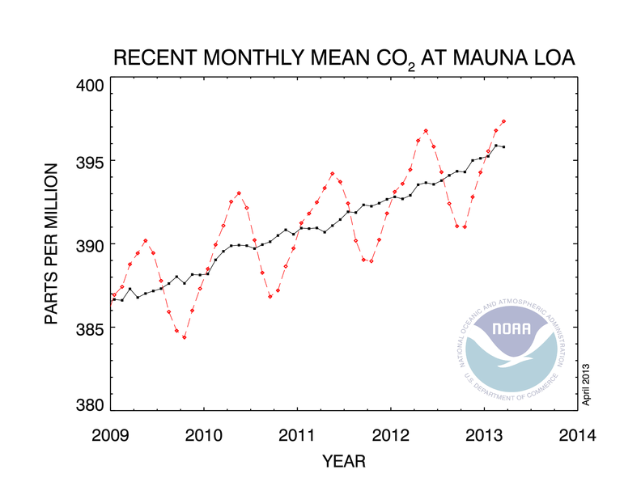
ESRL Boulder
Tans et al
March 2013: 397.34ppm
March 2012: 394.45

Slide 3
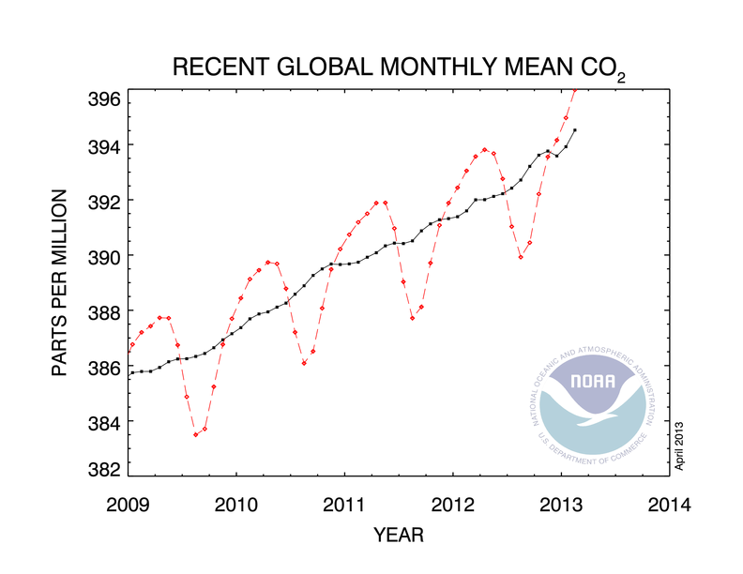
February 2013: 395.98 ppm
February 2012: 393.05

Slide 4
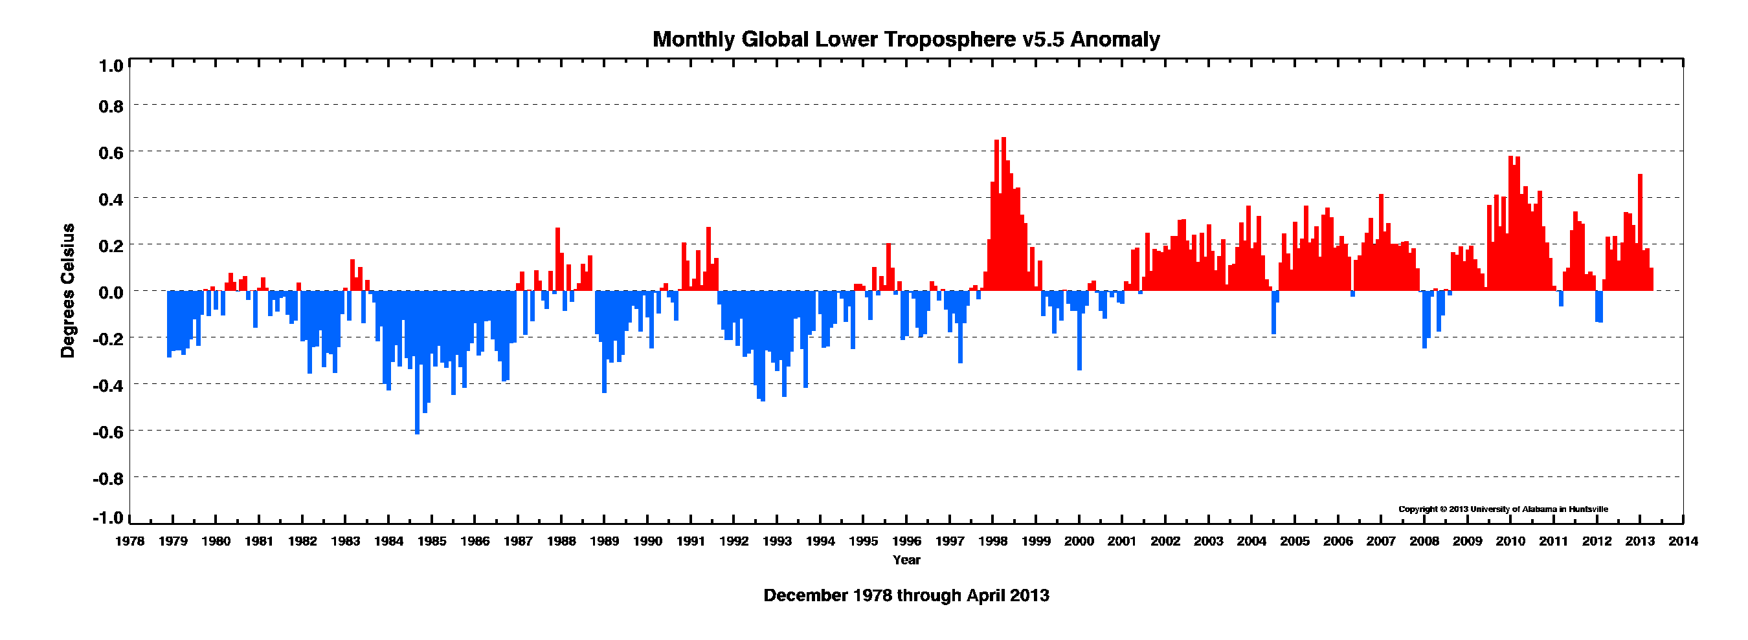
MSU Spencer and Christy, UoAlabama.

Slide 5
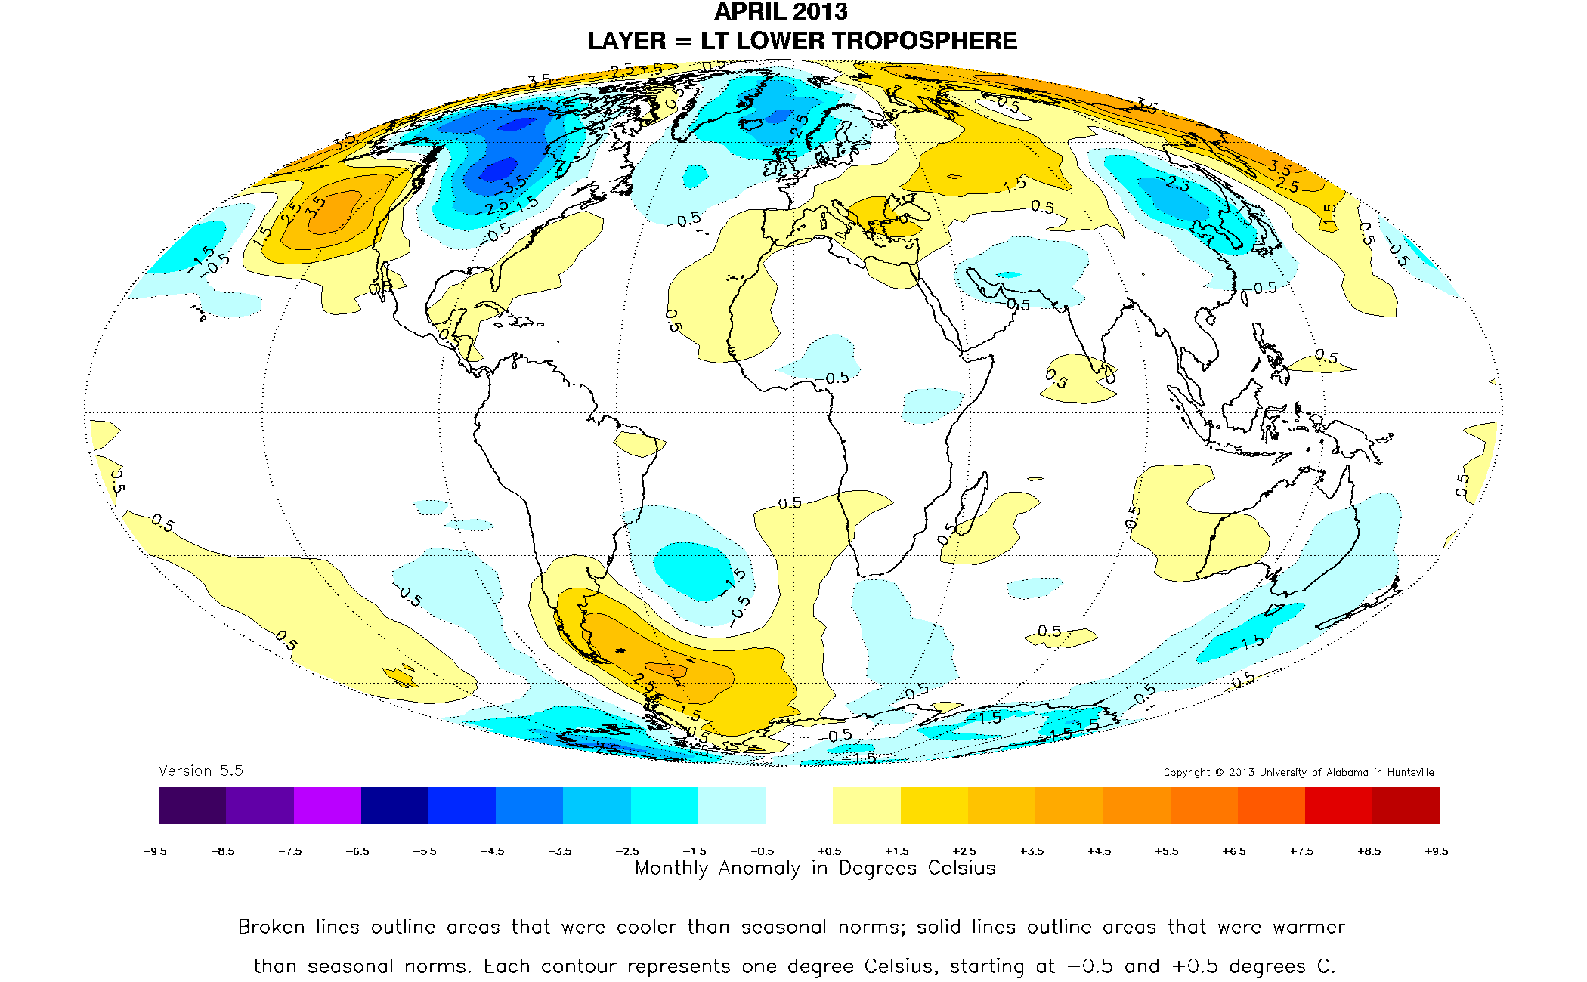
MSU Spencer and Christy

Slide 6
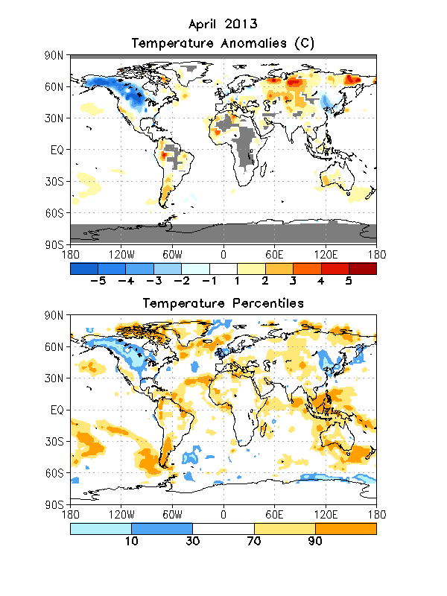
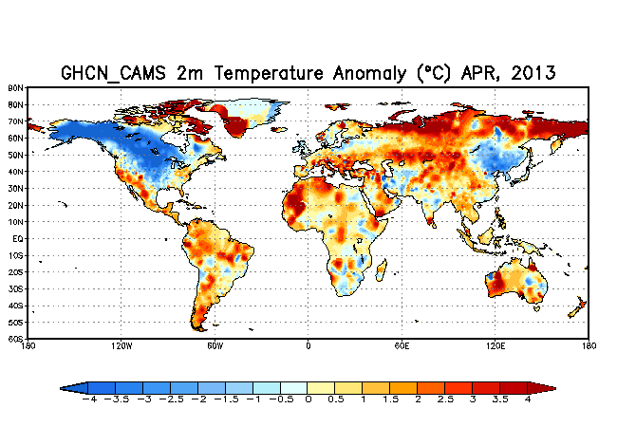
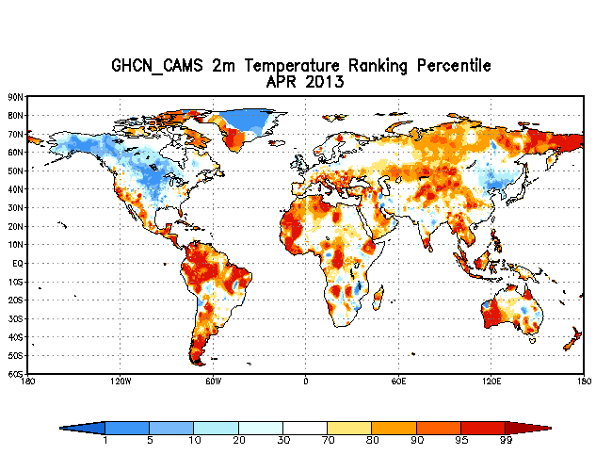

Slide 7
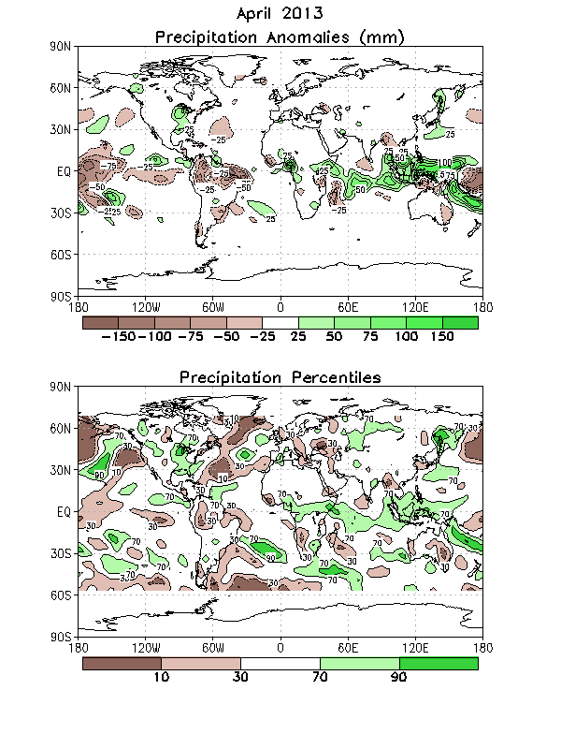

Slide 8
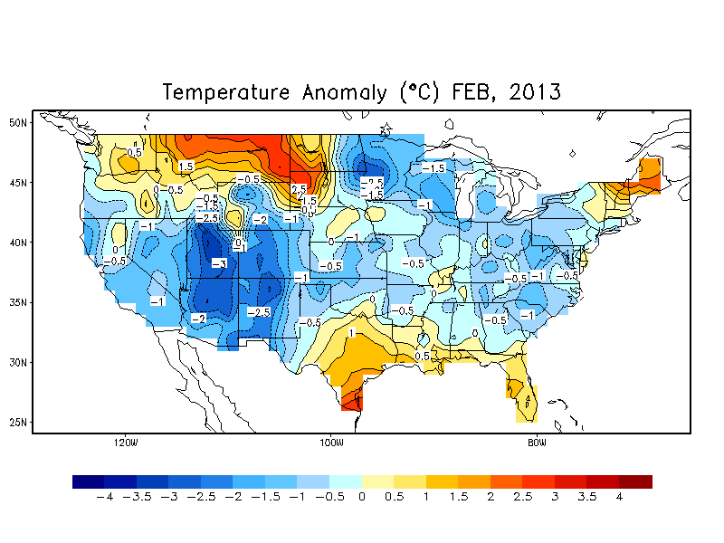
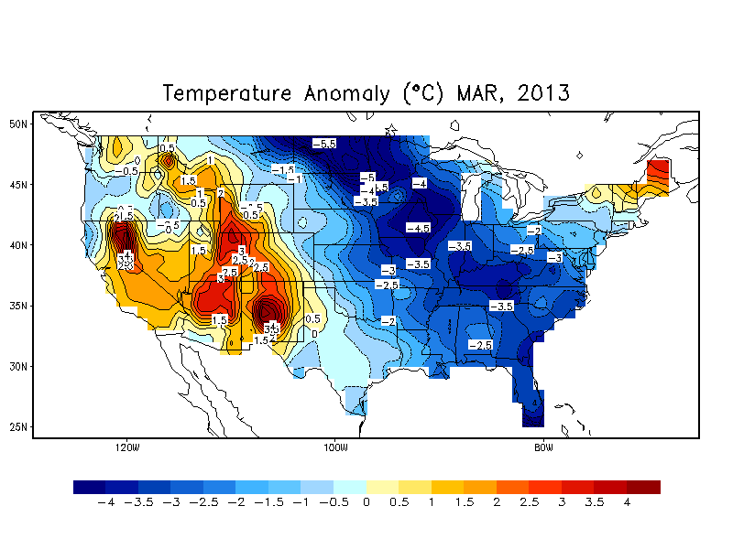
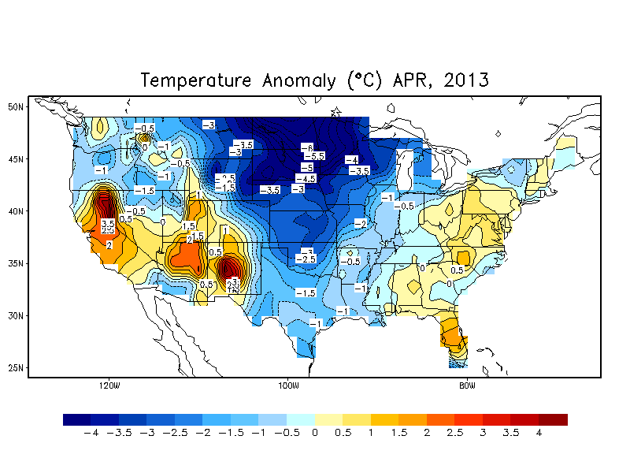
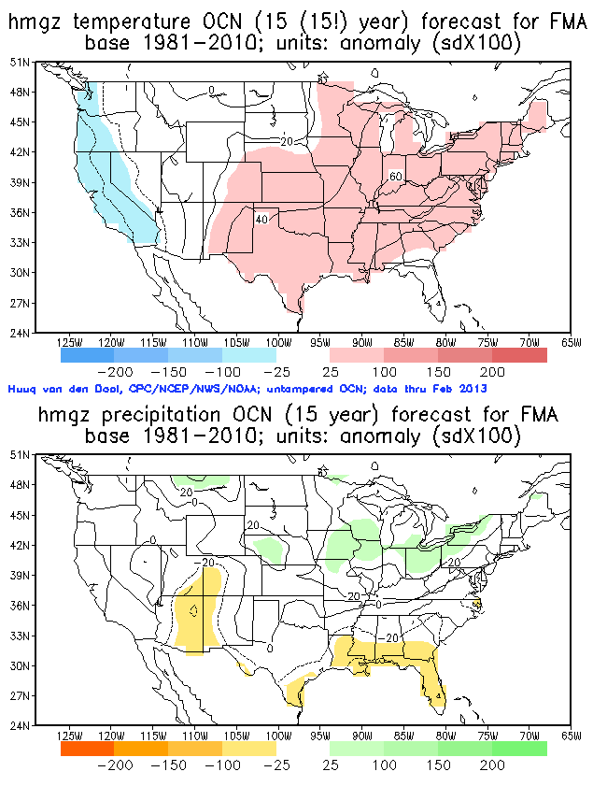

Slide 9
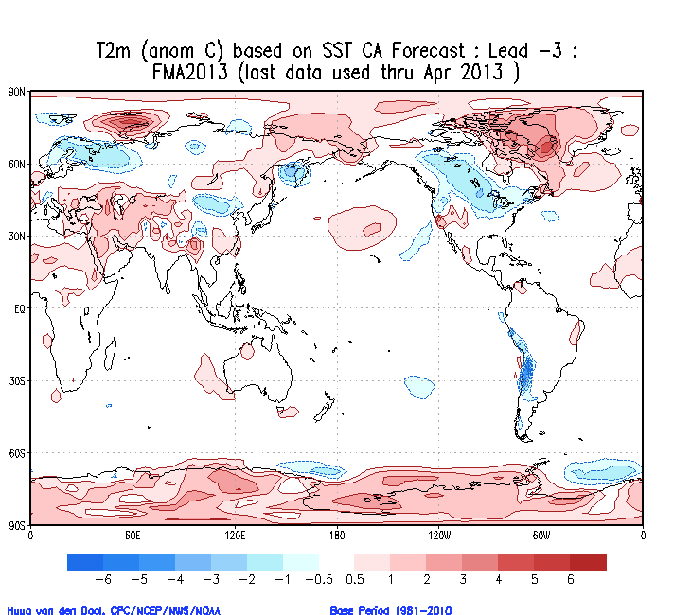
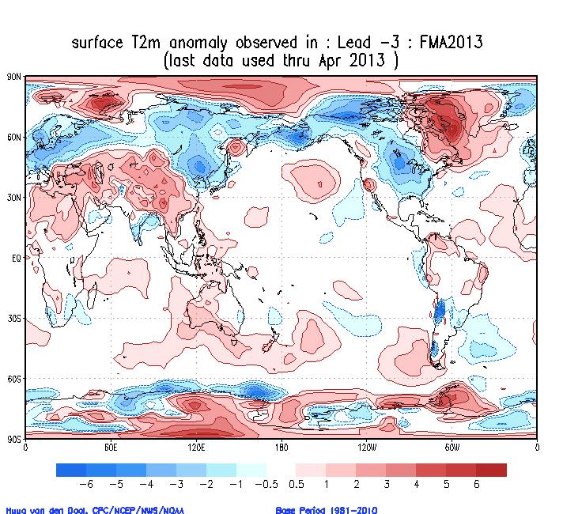
↑ CA-SST specified (lead -3) and observed (R1)↑

Slide 10
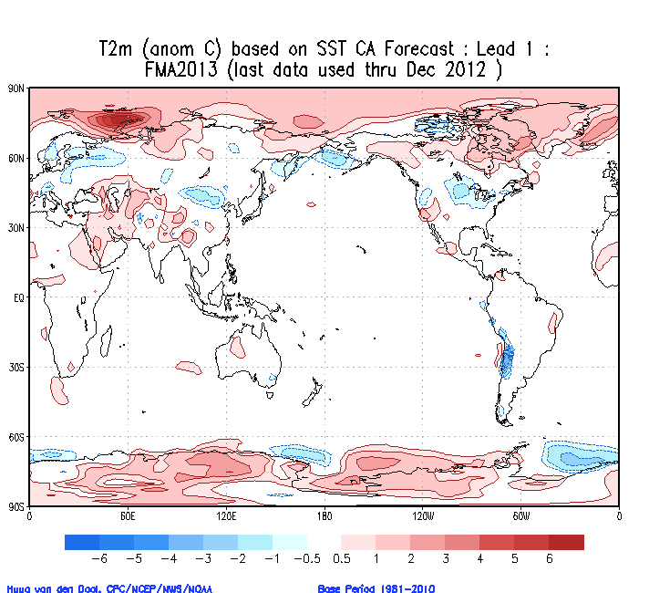
↑ CA-SST specified (lead 1) and observed (R1)↑

Slide 11
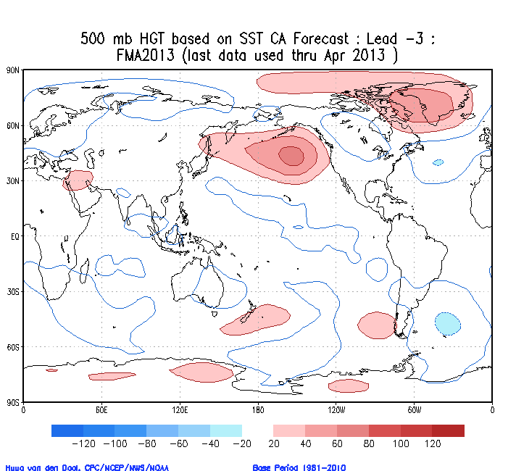
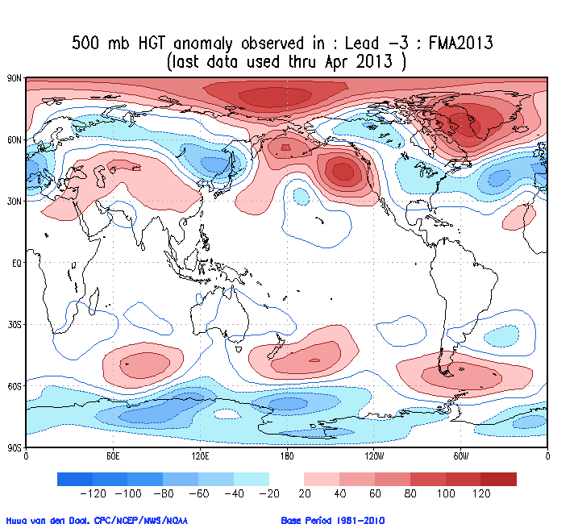
↑ CA-SST specified (lead -3) and observed (R1)↑

Slide 12
The weights(X100) in constructed analogue (CA-SST).
Data through April 2013
Year | Wgt | Year | Wgt | Year | Wgt | Year | Wgt | Year | Wgt | Year | Wgt
1956 | 0 | 1966 | 5 | 1976 | -3 | 1986 | -11 | 1996 | -7 | 2006 | 1
1957 | 5 | 1967 | 0 | 1977 | 1 | 1987 | -13 | 1997 | -7 | 2007 | 12
1958 | 0 | 1968 | 1 | 1978 | 5 | 1988 | 5 | 1998 | 1 | 2008 | 13
1959 | 1 | 1969 | -6 | 1979 | 7 | 1989 | -4 | 1999 | -1 | 2009 | 8
1960 | -5 | 1970 | 2 | 1980 | 2 | 1990 | 3 | 2000 | 2 | 2010 | 4
1961 | -6 | 1971 | -3 | 1981 | -2 | 1991 | -3 | 2001 | 4 | 2011 | -1
1962 | 9 | 1972 | 2 | 1982 | -3 | 1992 | -7 | 2002 | 8 | 2012 | 10
1963 | 5 | 1973 | -3 | 1983 | -5 | 1993 | -5 | 2003 | 8 | 2013 | NA
1964 | 4 | 1974 | -12 | 1984 | 5 | 1994 | -4 | 2004 | -4
1965 | 2 | 1975 | -5 | 1985 | 2 | 1995 | -2 | 2005 | 1
Weights are high +ve (>+0.10) for 2012, 2008,2007
Weights are high -ve (< - 0.10) for 1986,1987,1974 OCN flavor

Slide 13
Given an Initial Condition, SST^{IC} (s, t₀) at time t₀ . We express SST^{IC} (s, t₀) as a linear combination of all fields in the historical library, i.e.
2012
SST^{IC} (s, t₀) ~= SST^{CA}(s) = Σ α(t) SST(s,t) (1)
t=1956
(CA=constructed Analogue)
The determination of the weights α(t) is non-trivial, but except for some pathological cases, a set of (56/57) weights α(t) can always be found so as to satisfy the left hand side of (1), for any SST^{IC} , to within a tolerance ε.

Slide 14
Equation (1) is purely diagnostic. We now submit that given the initial condition we can make a forecast with some skill by
2012
X^{F} (s, t₀+Δt) = Σ α(t) X(s, t +Δt) (2)
t=1956
Where X is any variable (soil moisture, temperature, precipitation)
The calculation for (2) is trivial, the underlying assumptions are not. We ‘persist’ the weights α(t) resulting from (1) and linearly combine the X(s,t+Δt) so as to arrive at a forecast to which X^{IC} (s, t₀) will evolve over Δt.

Slide 15
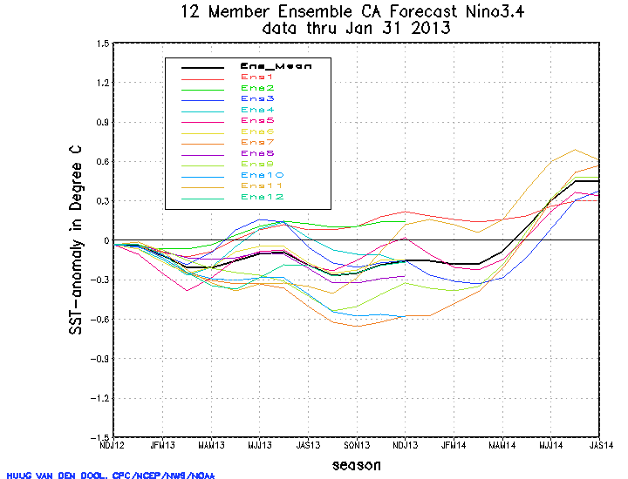
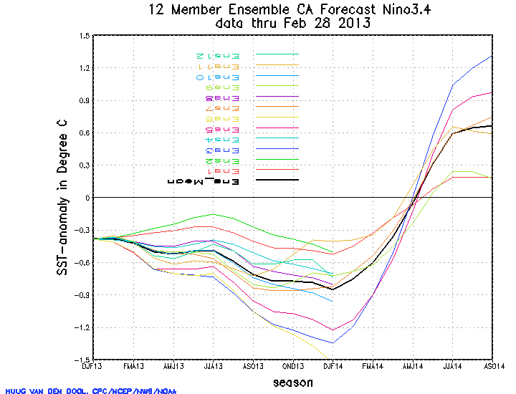
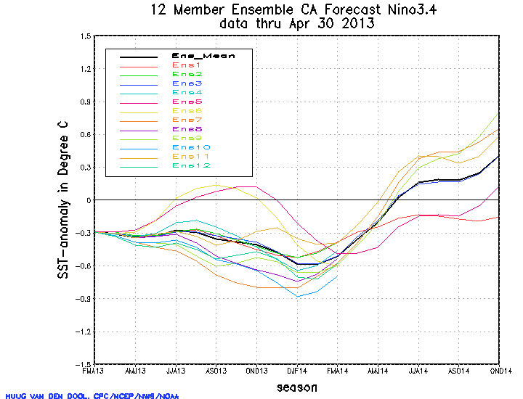
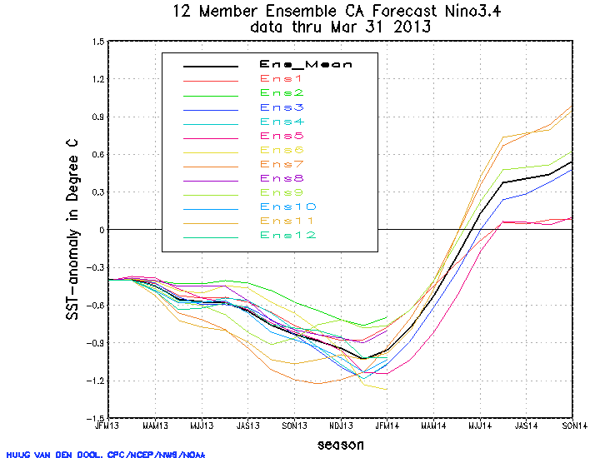

Slide 16
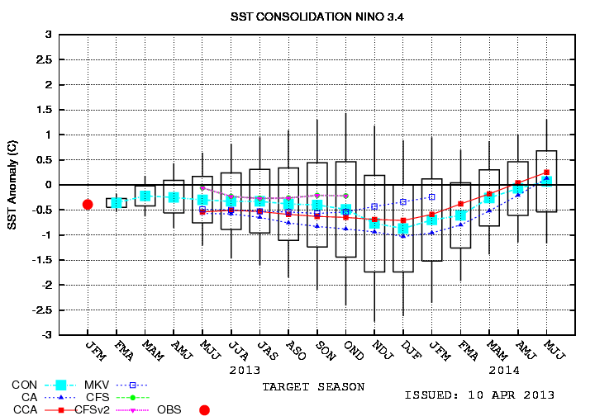
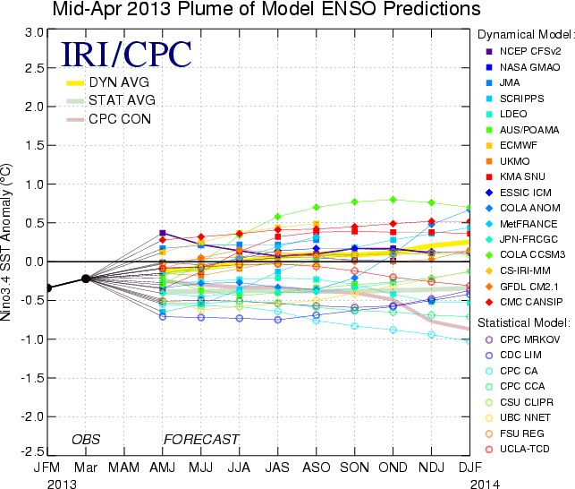
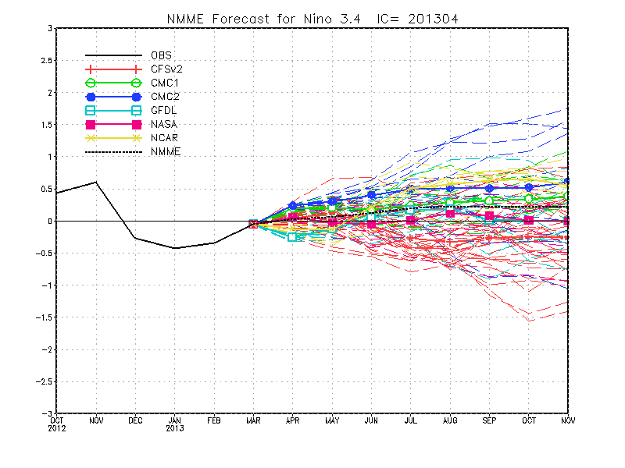
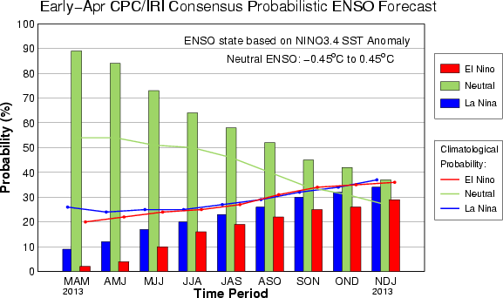

Slide 17
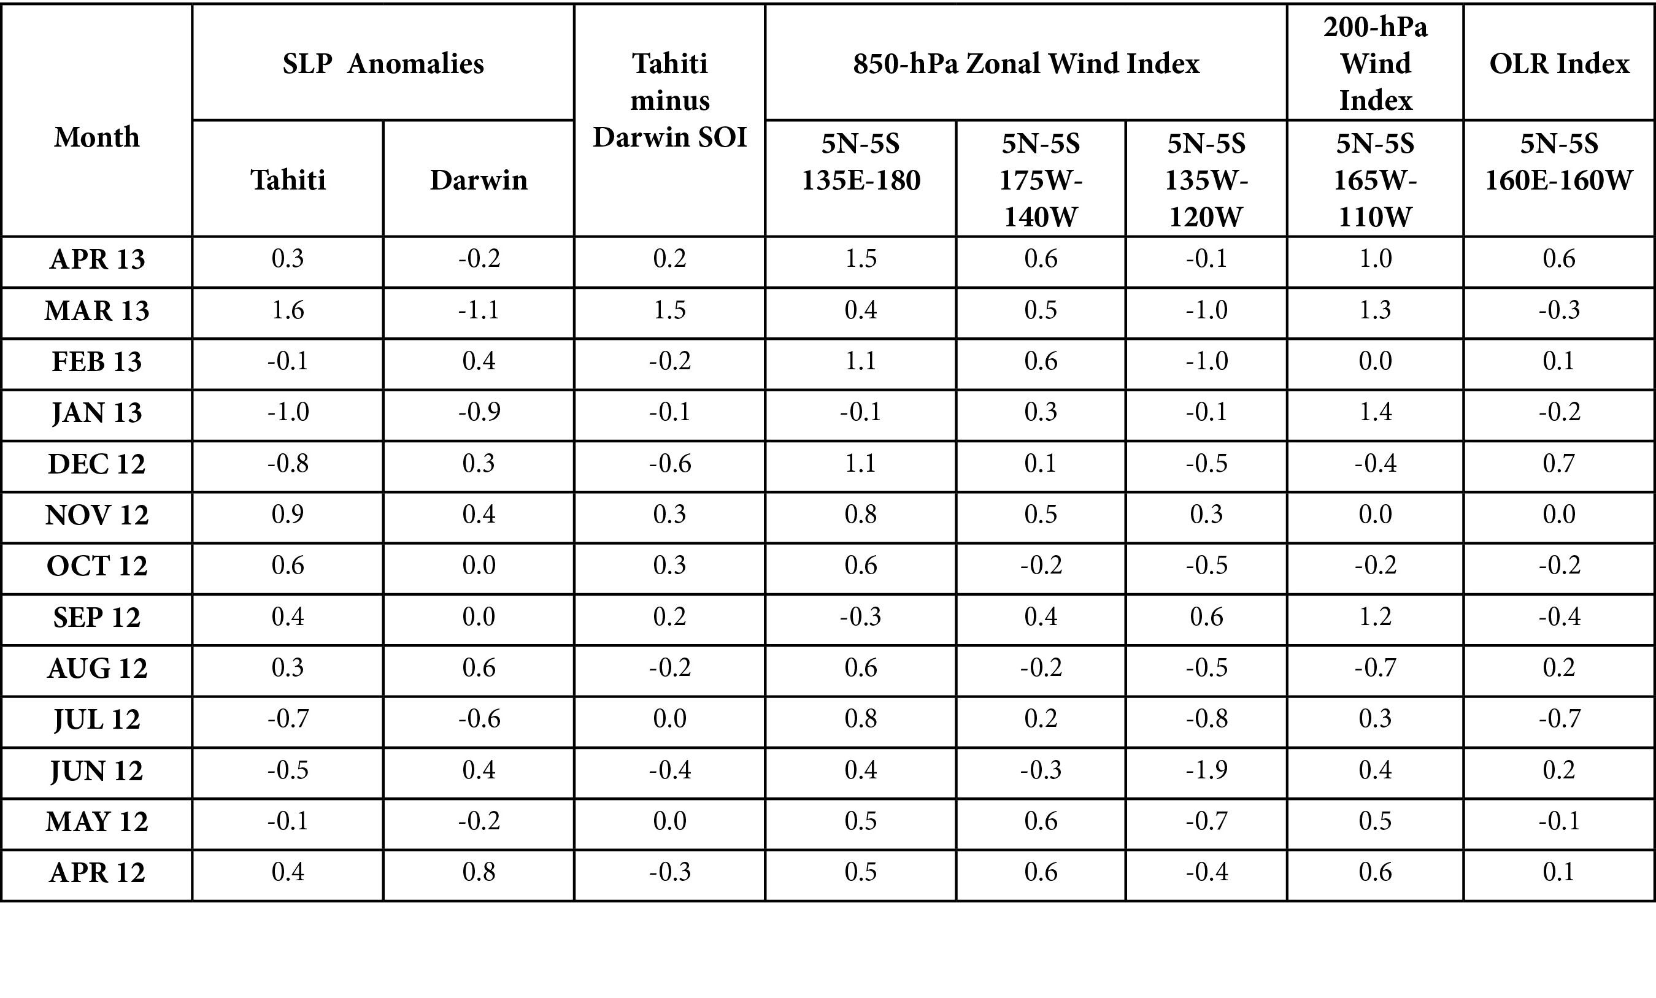

Slide 18
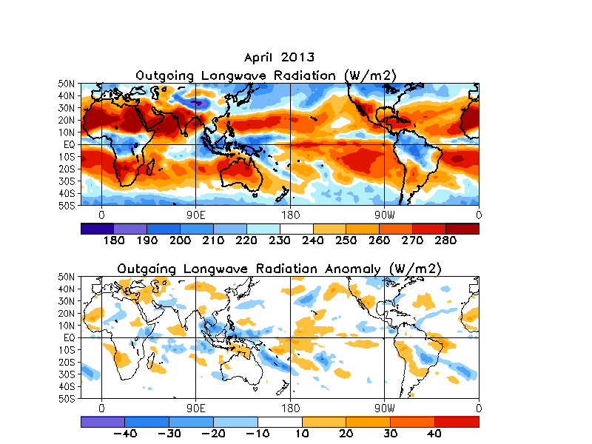

Slide 19
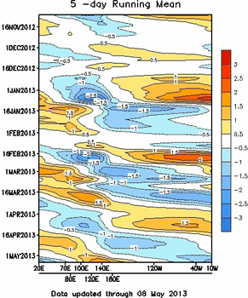
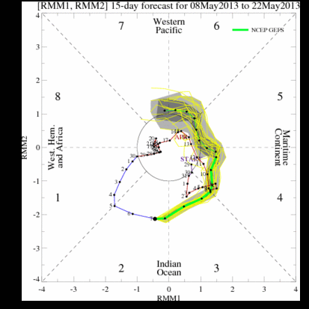

Slide 20
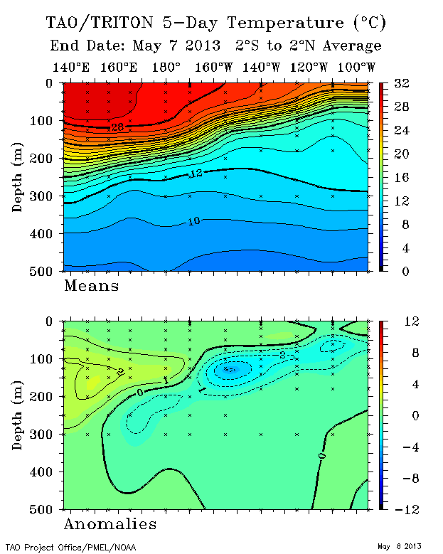
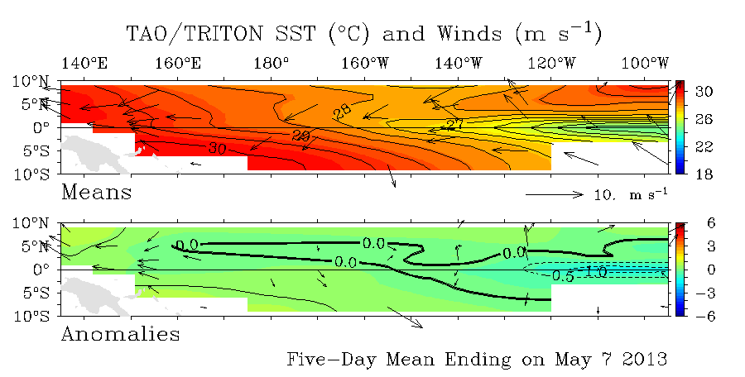

Slide 21
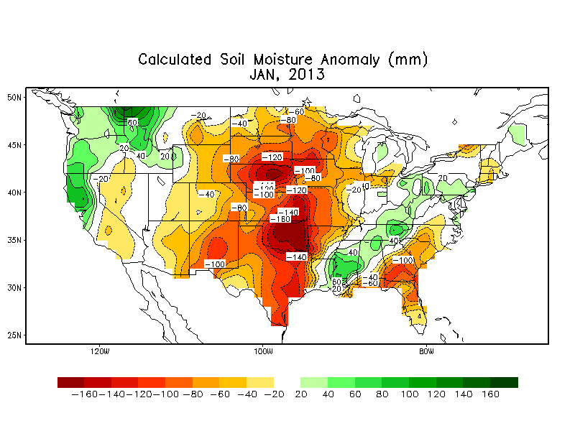

Slide 22
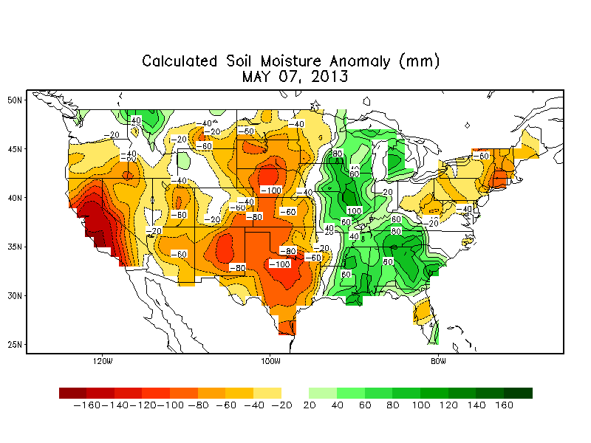

Slide 23
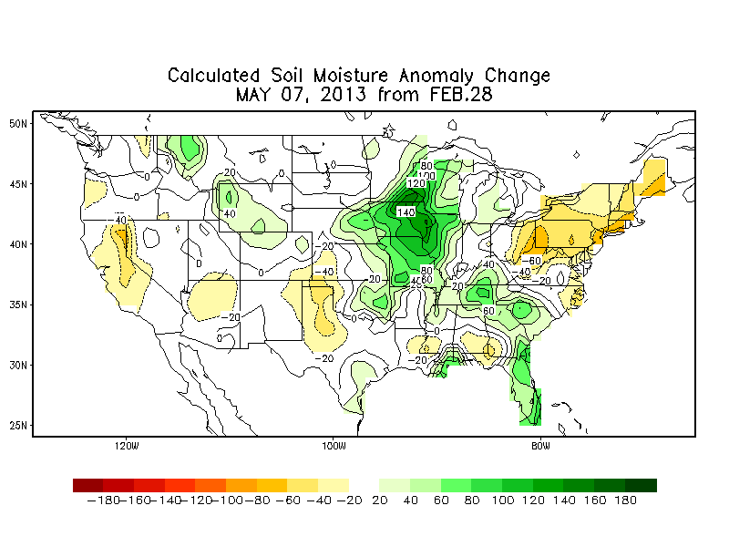

Slide 24
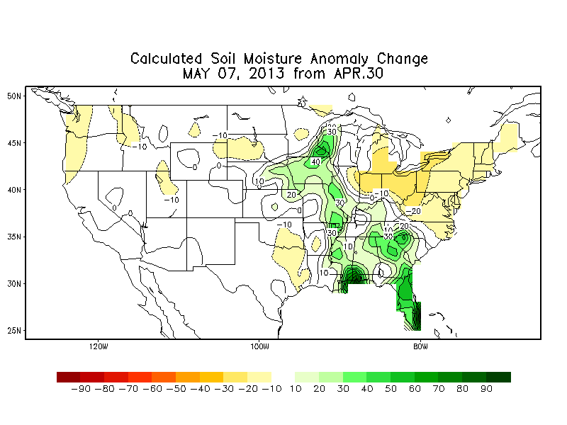
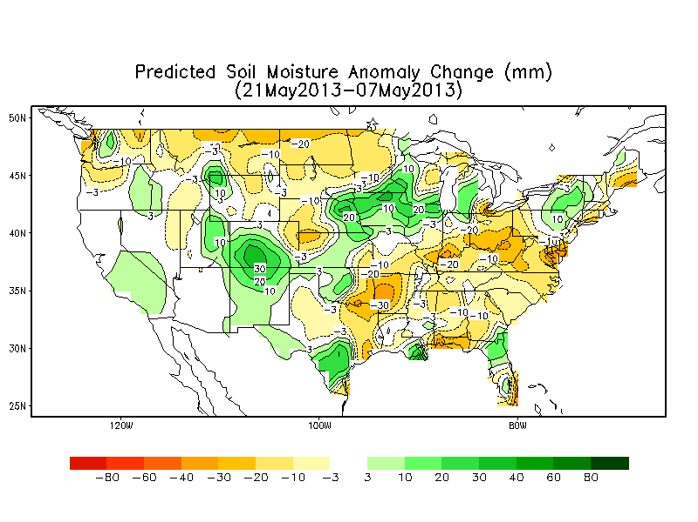

Slide 25
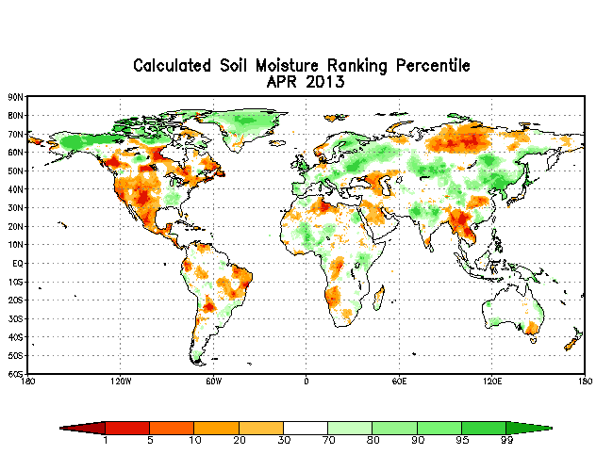

Slide 26
Potentially Big Changes in OCN
Regular annual update
Change-over to homogenized Climate Division Data (Vose et al 2013/14). (Not a small change)
OCN(K=10)→OCN(K=15), Wilks(2013)

Slide 27
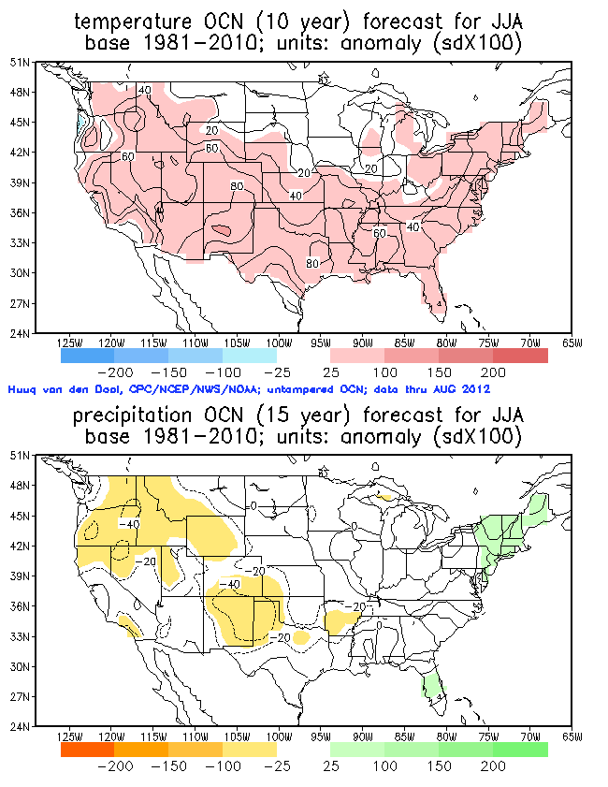
Data thru
early 2012

Slide 28
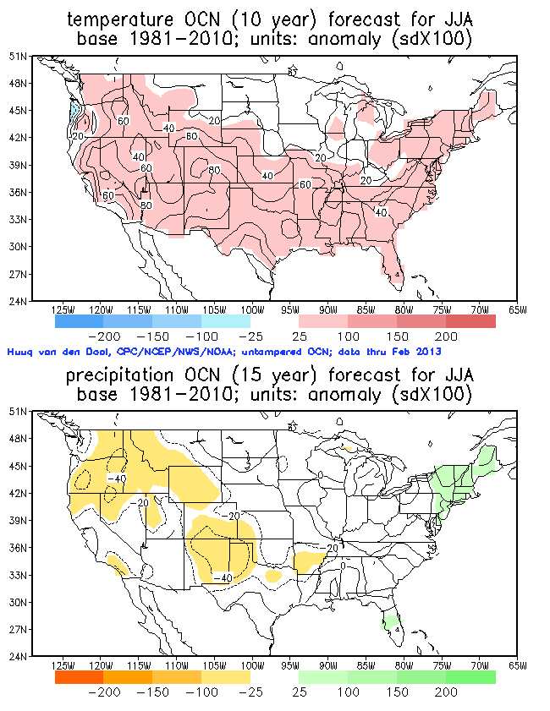
Data thru
early 2013

Slide 29
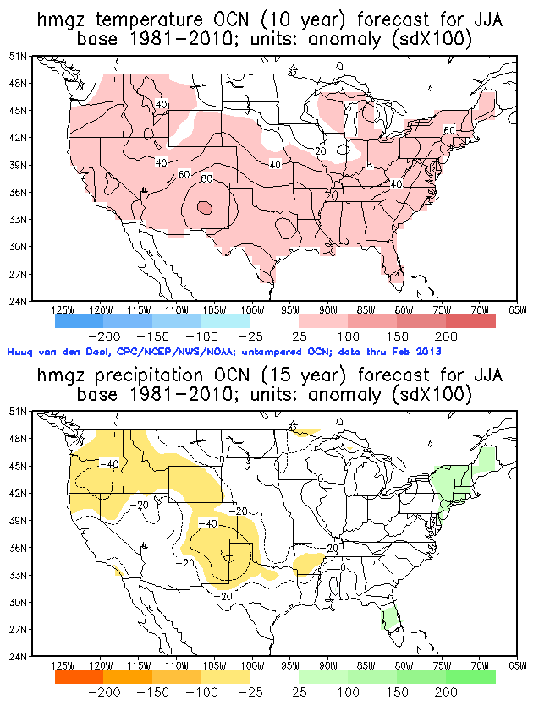
Data thru
early 2013
hmgz

Slide 30
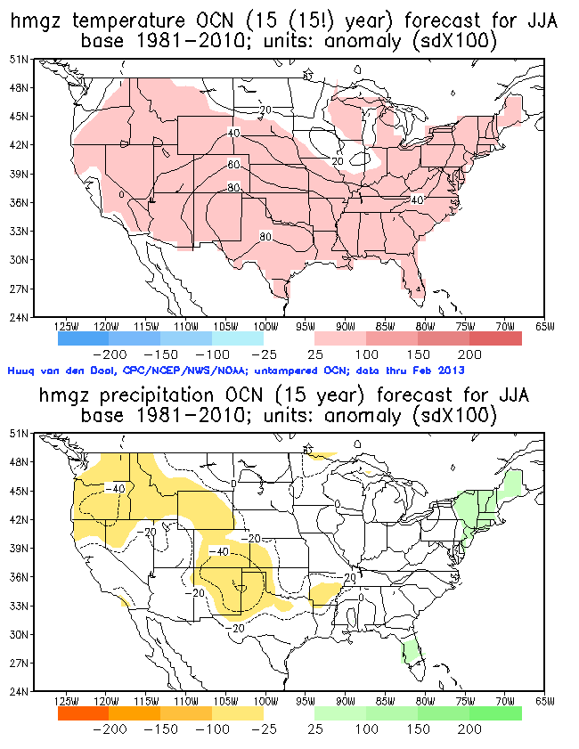
Data thru
early 2013
hmgz and
K=15 for T

Slide 31
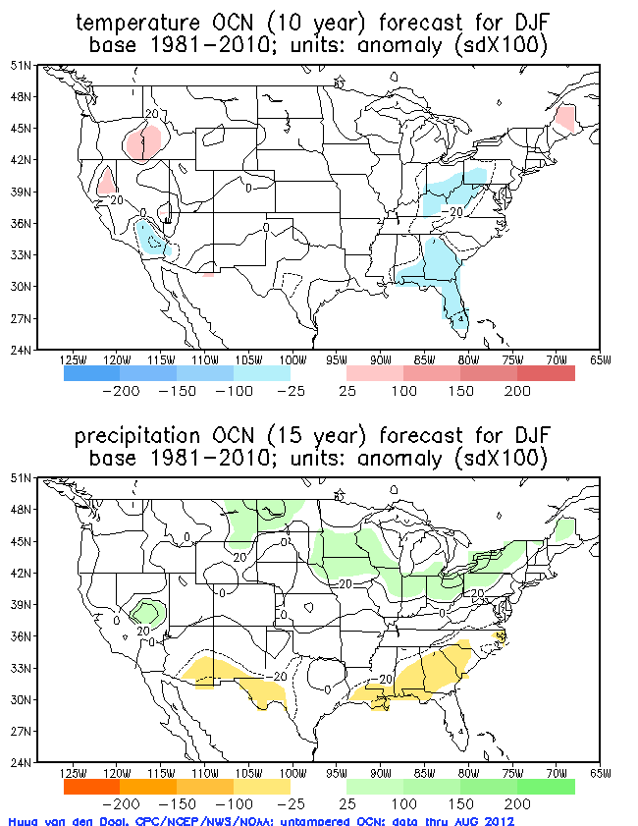
Data thru
early 2012

Slide 32
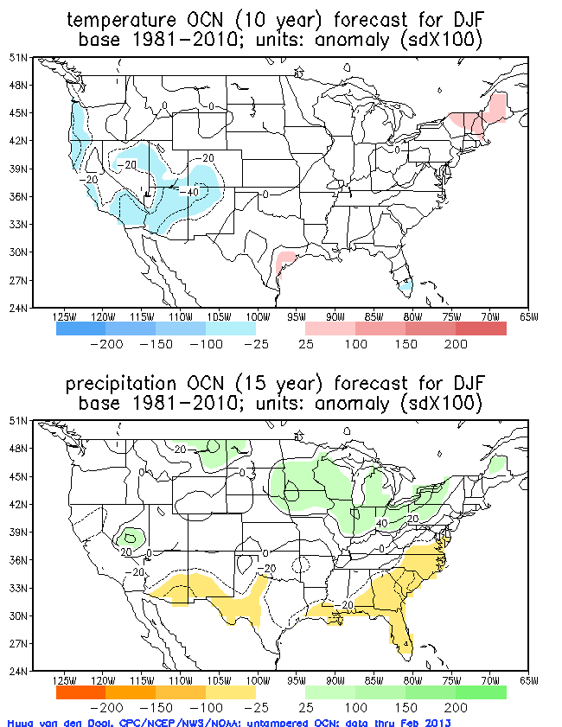
Data thru
early 2013

Slide 33
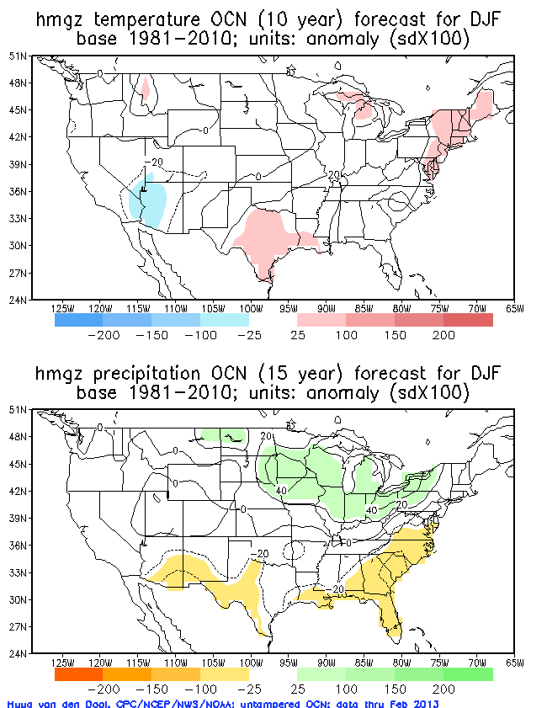
Data thru
early 2013
hmgz

Slide 34
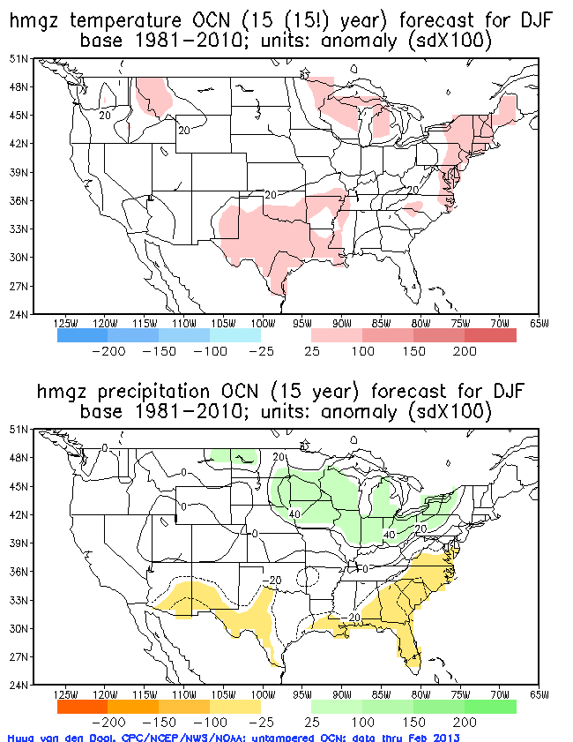
Data thru
early 2013
hmgz and
K=15 for T

Slide 35
NMME? Wait one more day

Slide 36
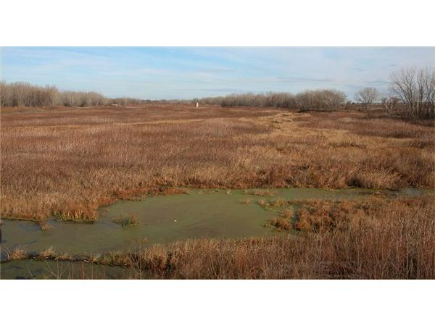
Monthly lagged precip-temperature relationship in NMME
Emily Becker & Huug van den Dool
NMME telecon, May 2

Slide 37
Previously noted negative 1-mon lagged correlation between precipitation and temp
Dry July → warm Aug; Wet July → cool Aug
CD data 1931-1992
Notes:
Reason? Without proof: caused by soil interaction.

Slide 38
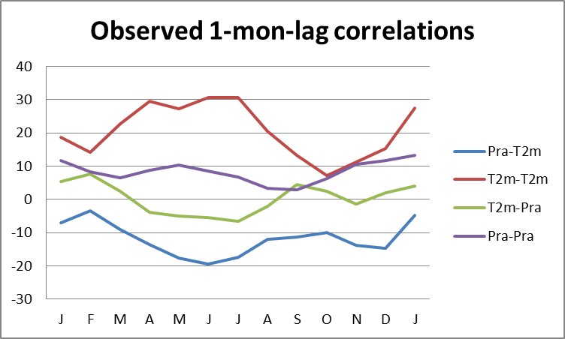
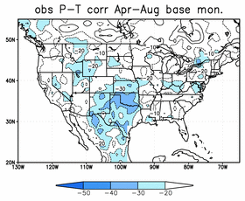
Process
Only 30 years!!
One-month lag correlation:
Standardized anomalies for single members
T2m-T2m 1-mon lag
T2m leading precip
Precip-precip
Precip leading T2m
March IC:
April Precip (lead 1)
May T2m (lead 2)
Notes:
Noisy because only 30 years.
Line graph plotted against BASE month
Map for P-T: negative everywhere, but not strongly so. Max effect Southern Plaines.

Slide 39
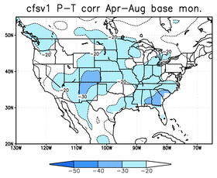
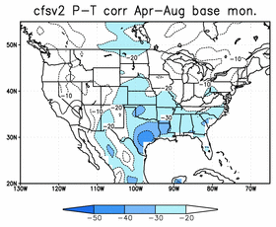





Single member one-month lag Precip-Temp correlation averaged for April – Aug base month (May – Sept temperature)
Notes:
Models generally ‘overdo’ the P-T correlation (have too strong soil interaction).
NCEP models least so; they are in obs ball park.
GFDL seems the most overdone.

Slide 40



Slide 41
Finally: recent cold? why
Six all time record negative AO values 2009-present. Why?.
What causes –ve (N)AO: A list of “reasons”
-) sea-ice disappears in NH (it grows in SH)
-) following a sudden stratospheric warming
-) following volcanic eruption
-) during a quiet sun (indeed we had a very long minimum, and presently a weak cycle 24)
-) audience can pitch in…….please
-) Are there any “causes” for a +ve (N)AO

Slide 42



