Slide 1
Monthly Climate Review
November 2012
Mike Charles

Slide 2
ENSO

Slide 3
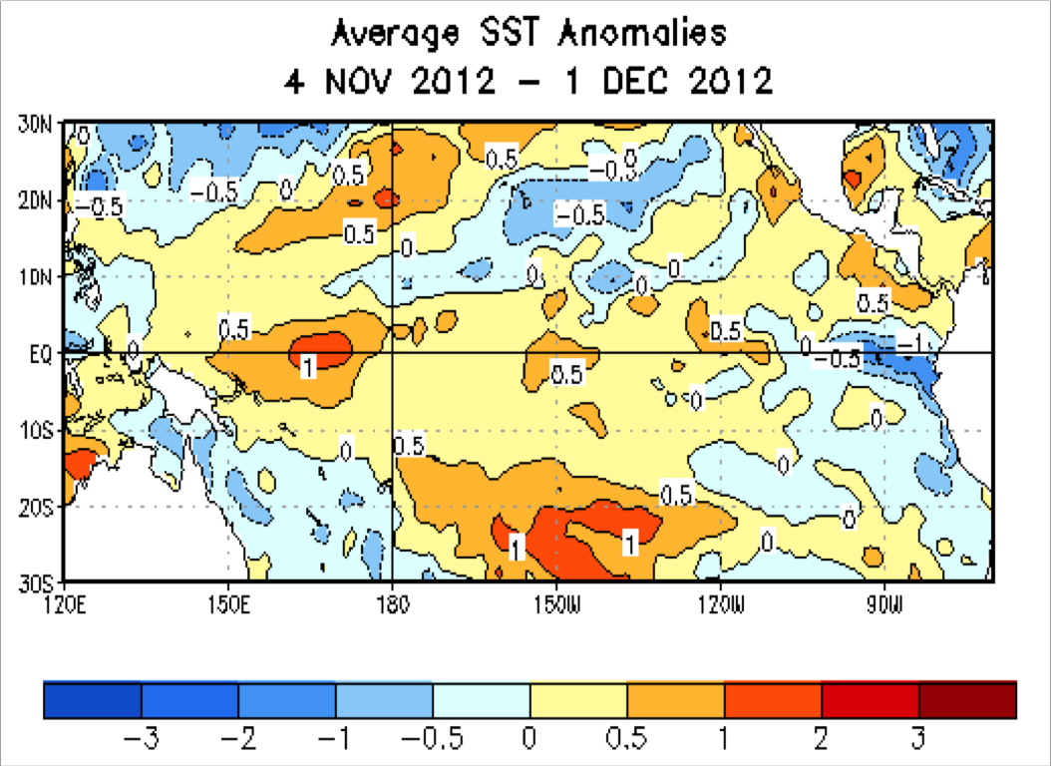
Nov 2012 SST Anomalies
During the last 4-weeks, equatorial SST anomalies were +0.5ºC or above between 150ºE and 180º. SSTs were more than 0.5ºC below average in the eastern Pacific.

Slide 4
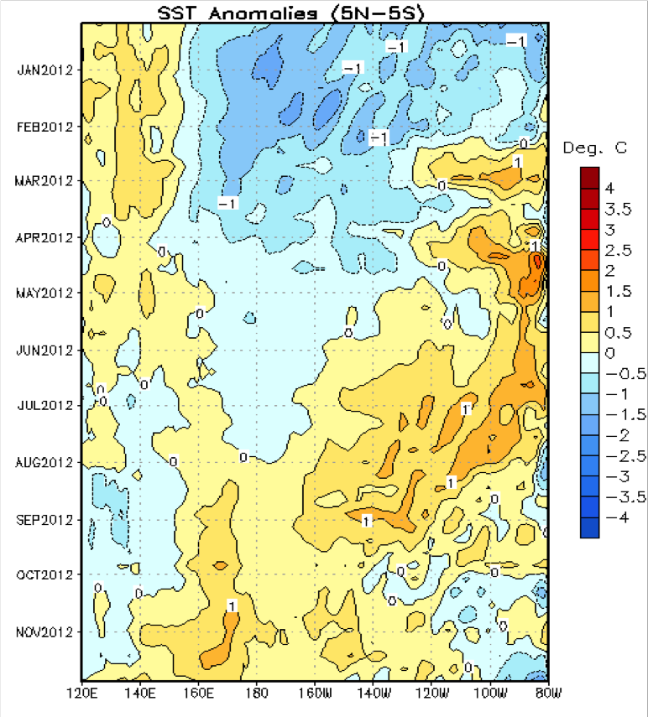
Evolution of Equatorial Pacific SST Anomalies
Time
Until recently, above-average SSTs have been spreading westward through most of the Pacific.
Recently, above-average SSTs have persisted across much of the tropical Pacific, with below-average SSTs in the far eastern Pacific.
Longitude

Slide 5
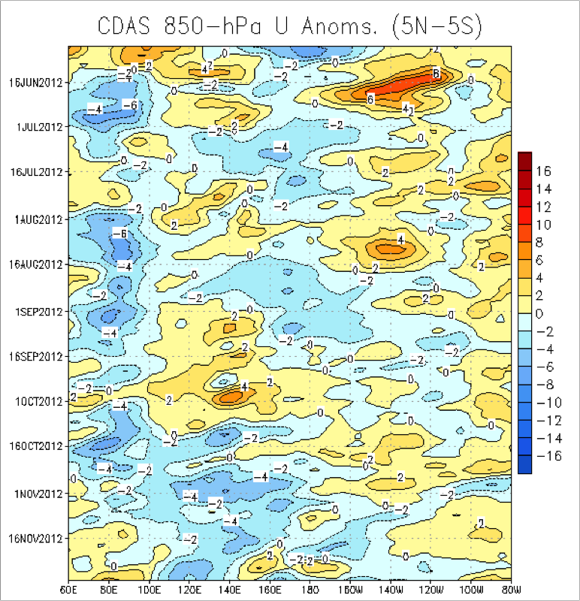
850mb Zonal Wind Anomalies (m/s)
Westerly wind anomalies (orange/red shading).
Easterly wind anomalies (blue shading).
Recently, weak wind anomalies were evident across the equatorial Pacific Ocean.

Slide 6
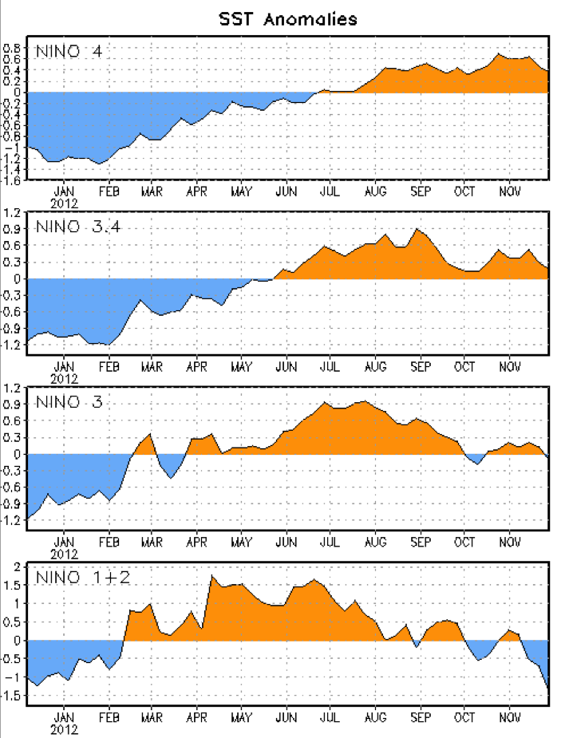
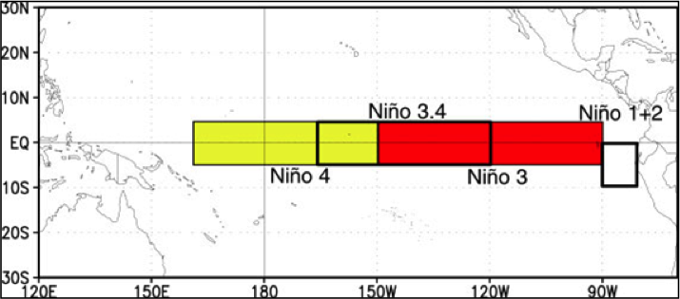
Niño Region SST Departures Evolution
The latest weekly SST departures are:
Niño 4 0.4ºC
Niño 3.4 0.2ºC
Niño 3 -0.1ºC
Niño 1+2 -1.4ºC

Slide 7
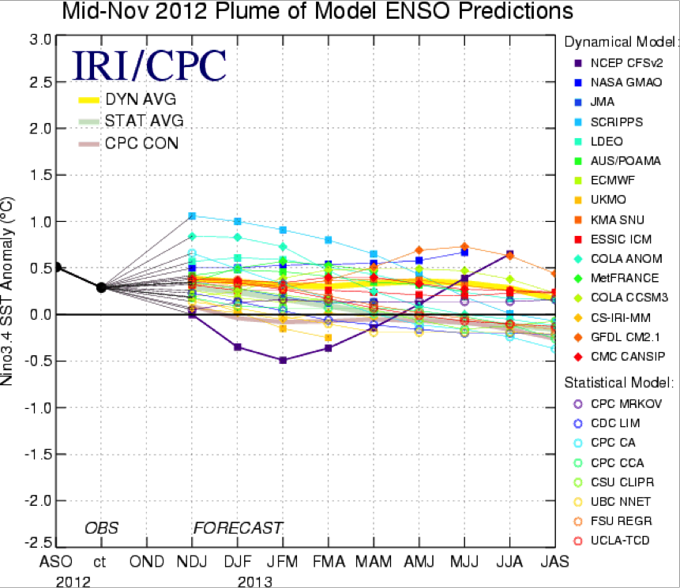
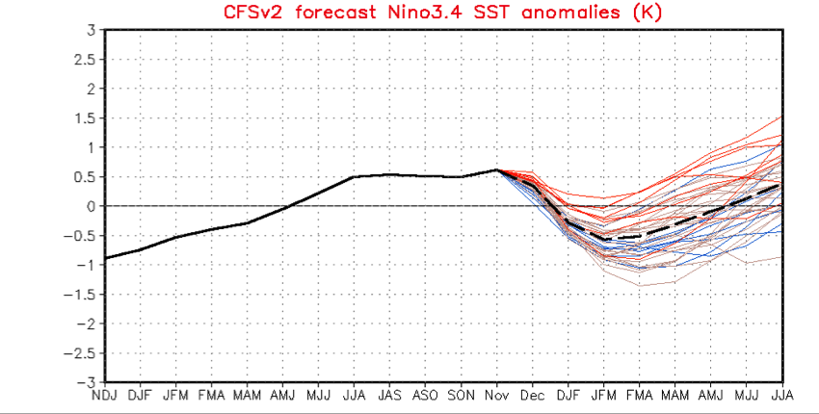
ENSO Outlook
Multi-model
CFS

Slide 8
ENSO Summary
ENSO Alert System Status: Not Active
ENSO-neutral conditions continue.*
Equatorial SSTs remain above average across much of the Pacific Ocean.
The atmospheric circulation over the tropical Pacific is near average.
ENSO-neutral is favored through the Northern Hemisphere winter 2012-13.*

Slide 9
Mean Conditions

Slide 10
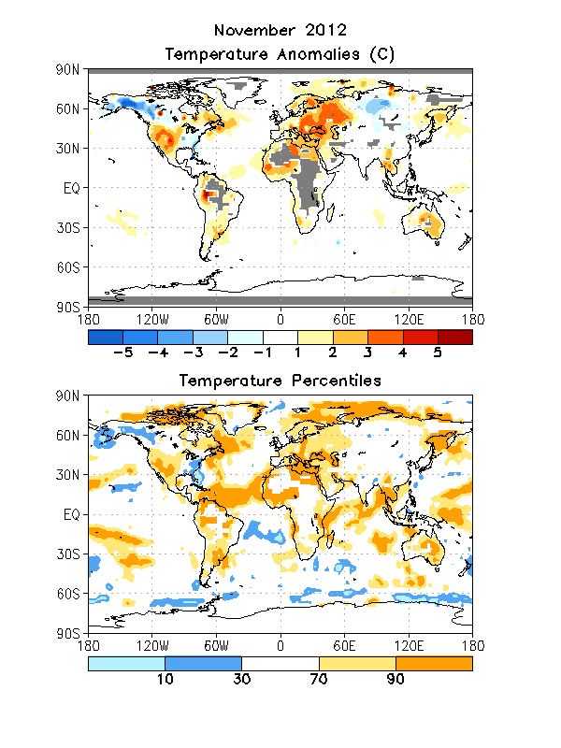
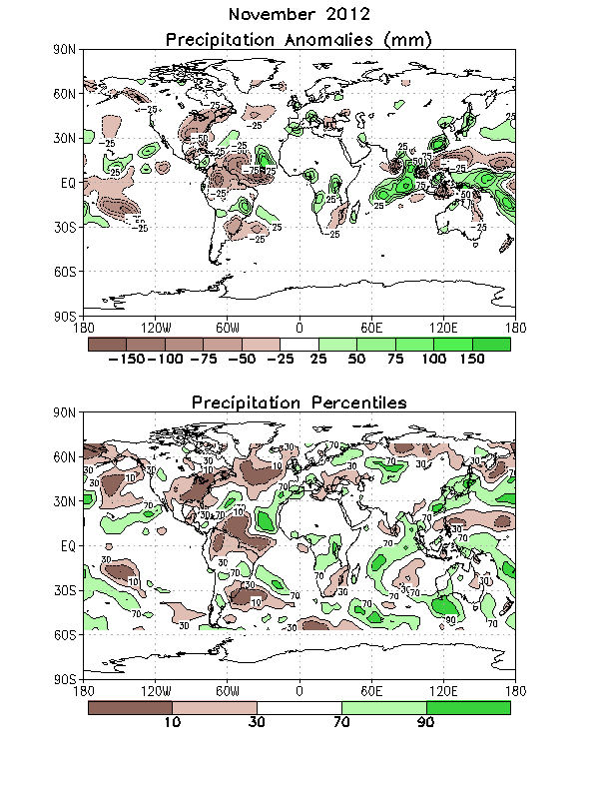
Global Temp and Precip Anomalies
Temp Anomalies
Precip Anomalies

Slide 11
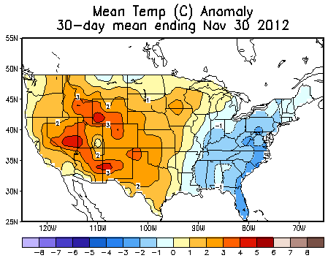
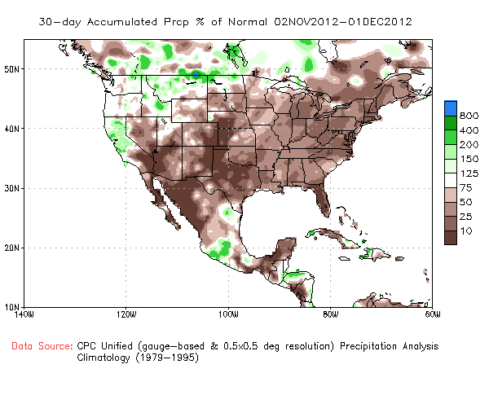
US Temp and Precip Anomalies Past 30 Days
Temp Anomaly
Precip % of Normal

Slide 12
MJO

Slide 13
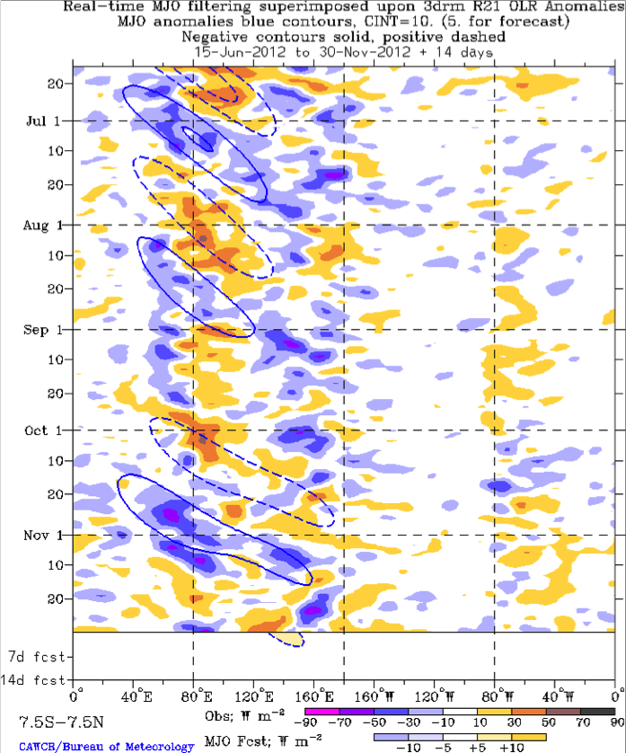
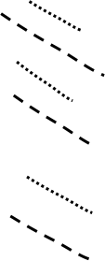
Outgoing Longwave Radiation (OLR) Anomalies
Drier-than-normal conditions, positive OLR anomalies (yellow/red shading)
Wetter-than-normal conditions, negative OLR anomalies (blue shading)
(Courtesy of CAWCR Australia Bureau of Meteorology)
From late May into September, eastward propagation of both enhanced and suppressed convection is evident across the eastern hemisphere (alternating dashed and dotted lines).
The MJO was active during October into November with enhanced convection developing over Africa during mid-October and shifting eastward to the western Pacific by mid-November.
The recent convection near 160oE is due, at least in part, to a strong equatorial Rossby (ER) wave while enhanced convection near 80oE is most likely a superposition of a ER wave and eastward moving Kelvin wave.

Slide 14
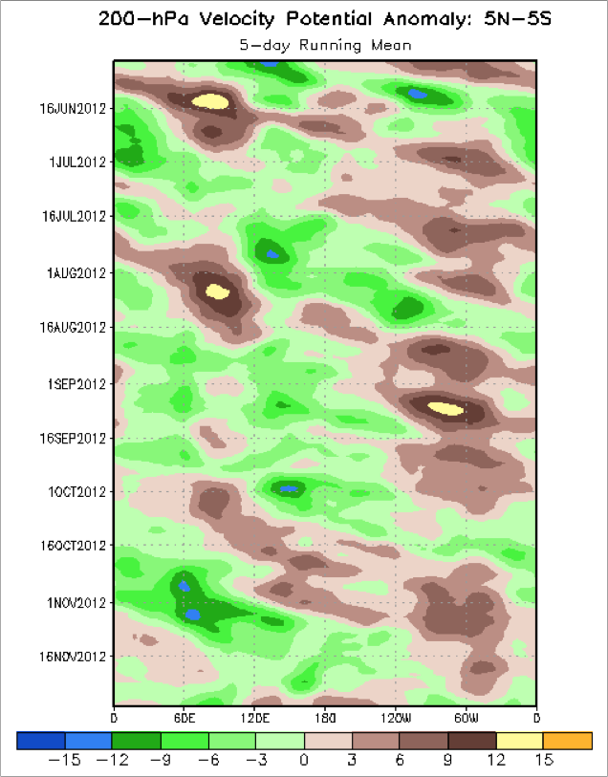
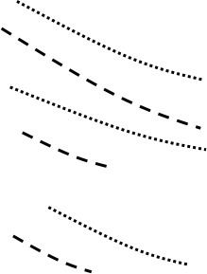
200mb Velocity Potential Anomalies
Positive anomalies (brown shading) indicate unfavorable conditions for precipitation
Negative anomalies (green shading) indicate favorable conditions for precipitation
Eastward propagation was evident from late May into September associated with the MJO (alternating dashed and dotted lines), as well as atmospheric Kelvin wave activity, which at times resulted in fast eastward propagation of observed anomalies.
In mid-September, anomalies decreased and eastward propagation became less clear.
In early October, upper-level divergence (convergence) increased over the Pacific (Indian Ocean) and has shifted eastward throughout October and early November. Anomalies decreased from mid to late November and propagation became less clear.

Slide 15
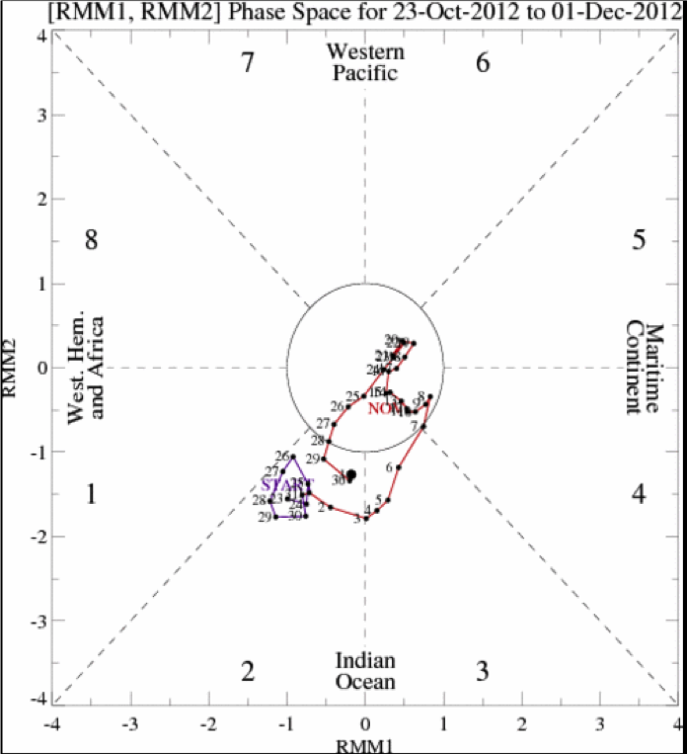
MJO Index – Recent Evolution
The axes (RMM1 and RMM2) represent daily values of the principal components from the two leading modes
The triangular areas indicate the location of the enhanced phase of the MJO
Counter-clockwise motion is indicative of eastward propagation. Large dot most recent observation.
Distance from the origin is proportional to MJO strength
Line colors distinguish different months
The MJO index has increased in amplitude during the past week, but the apparent strengthening is most likely due to both equatorial Rossby wave and atmospheric Kelvin wave activity.

Slide 16
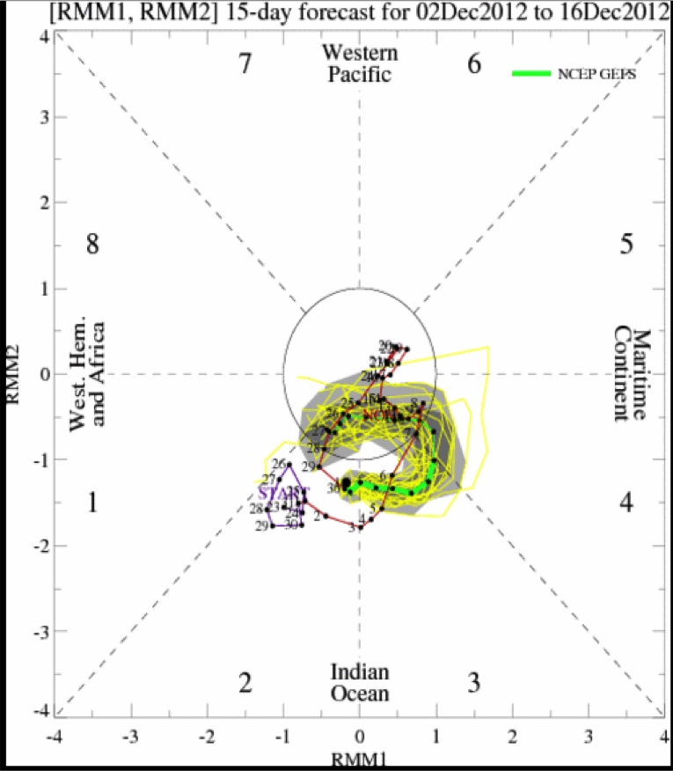
Ensemble GFS (GEFS) MJO Forecast
RMM1 and RMM2 values for the most recent 40 days and forecasts from the ensemble Global Forecast System (GEFS) for the next 15 days
light gray shading: 90% of forecasts dark gray shading: 50% of forecasts
Yellow Lines – 20 Individual Members
Green Line – Ensemble Mean
The bias-corrected ensemble GFS forecasts propagation through Phase 3 during Week-1 with a weakening in the signal during Week-2.

Slide 17
Verification

Slide 18
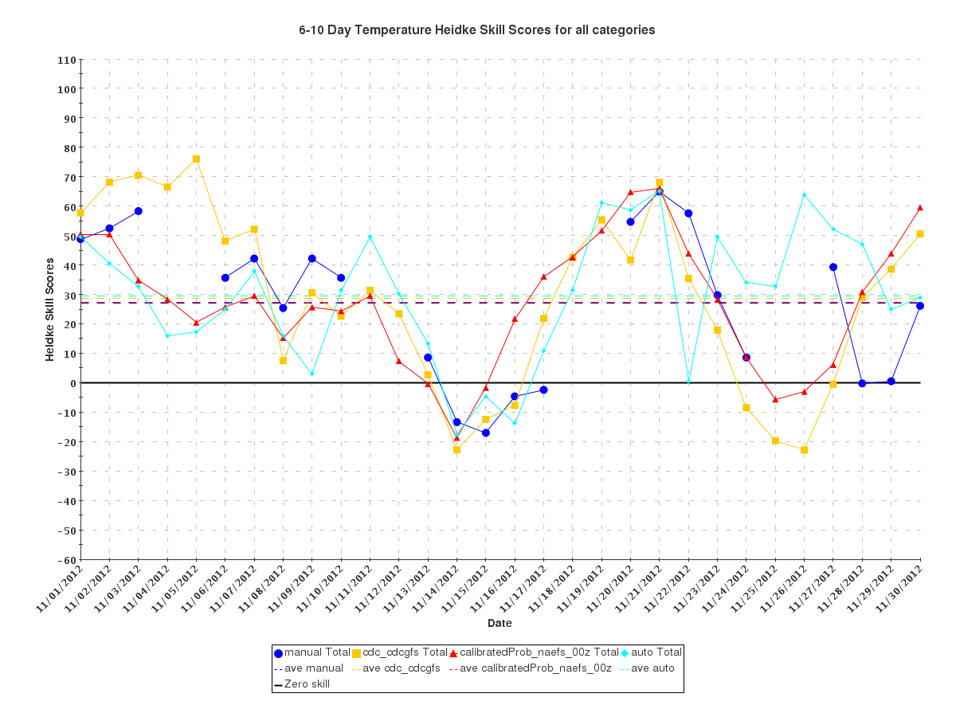
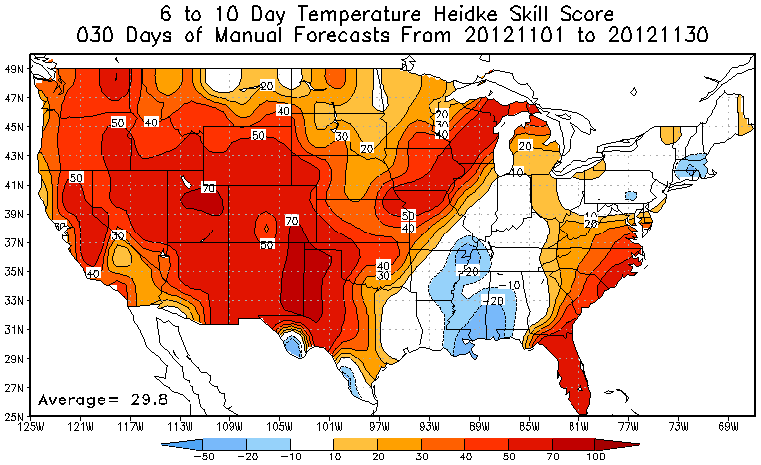
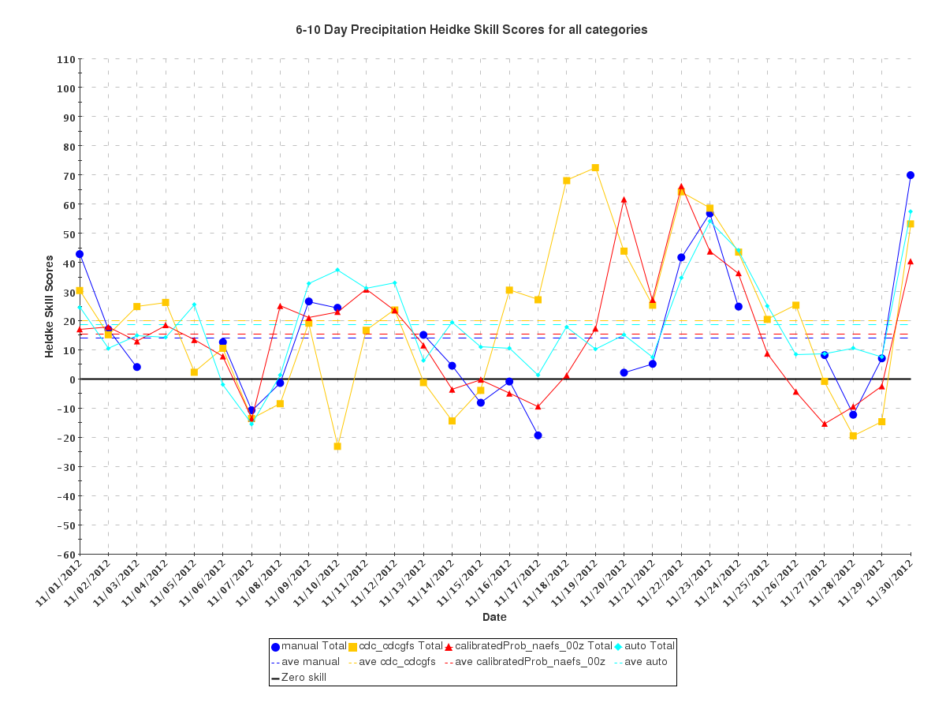
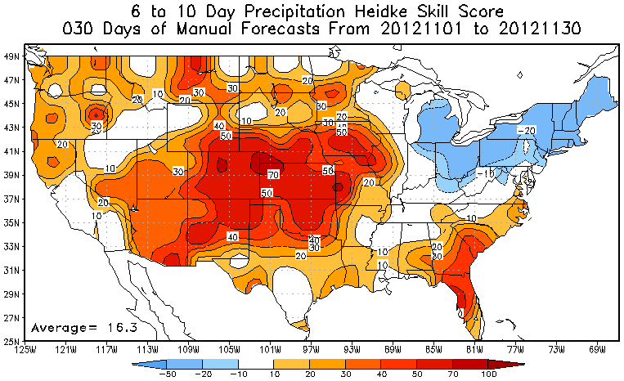
6-10day Verification
Manual | 27 | CDC | 29
NAEFS | 27 | Auto | 30
Manual CDC
NAEFS Auto
Temp
Temp
Manual | 14 | CDC | 20
NAEFS | 15 | Auto | 18
Manual CDC
NAEFS Auto
Precip
Precip

Slide 19
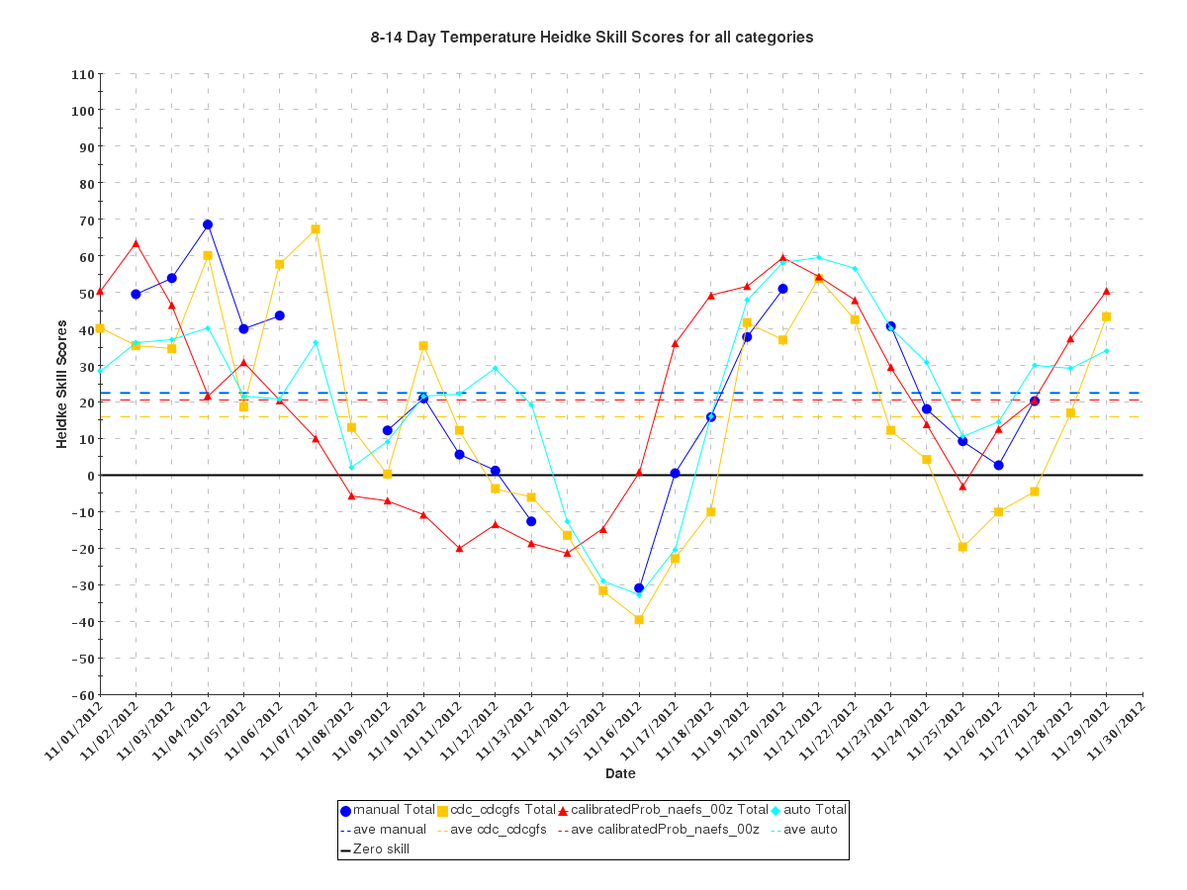
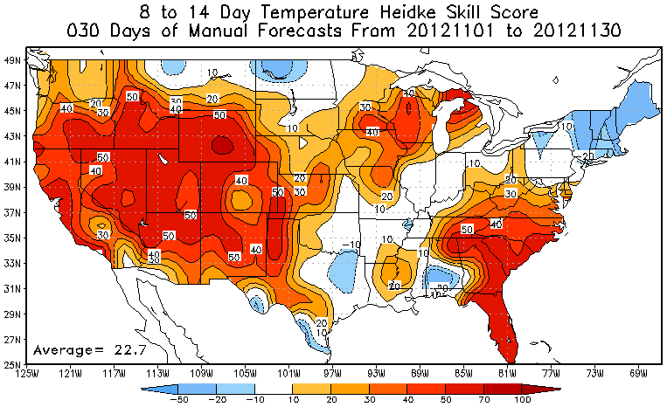
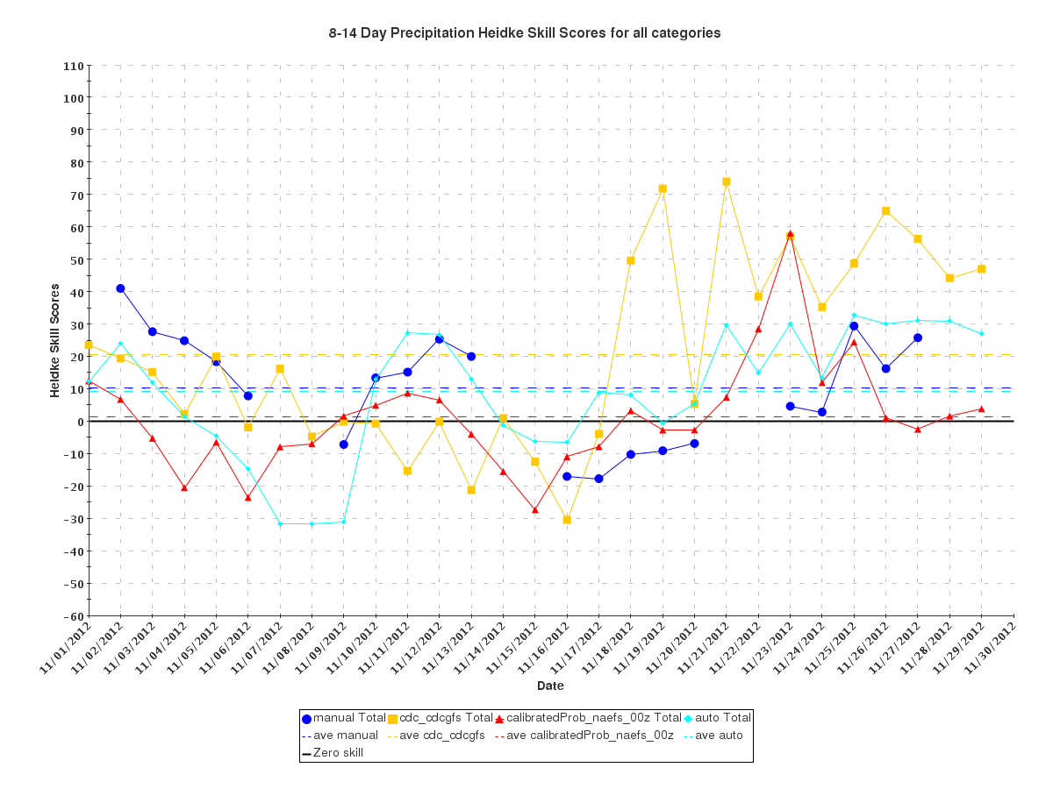
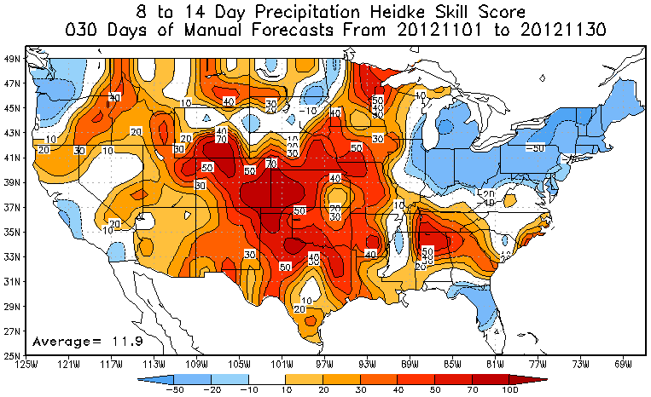
8-14day Verification
Manual | 23 | CDC | 11
NAEFS | 21 | Auto | 23
Temp
Temp
Temp
Manual | 10 | CDC | 21
NAEFS | 2 | Auto | 9
Precip
Precip

Slide 20
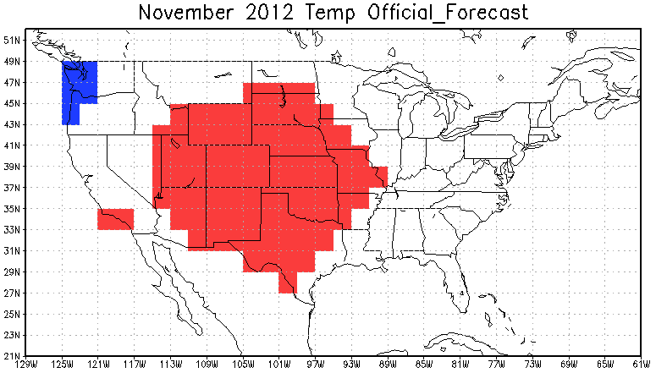
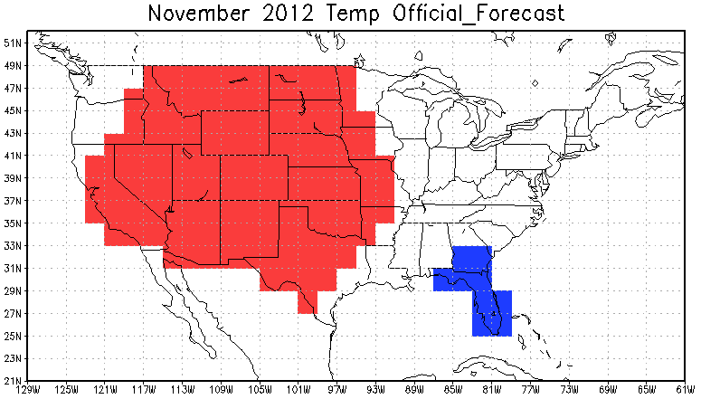
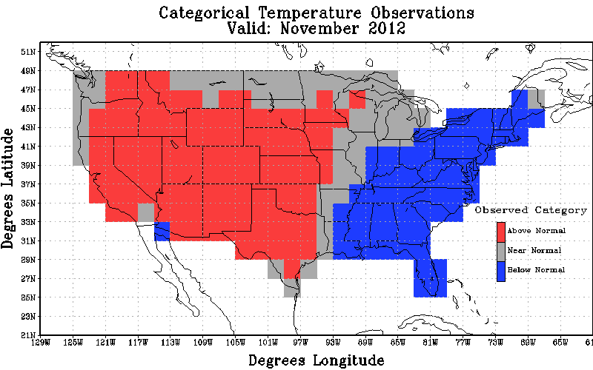
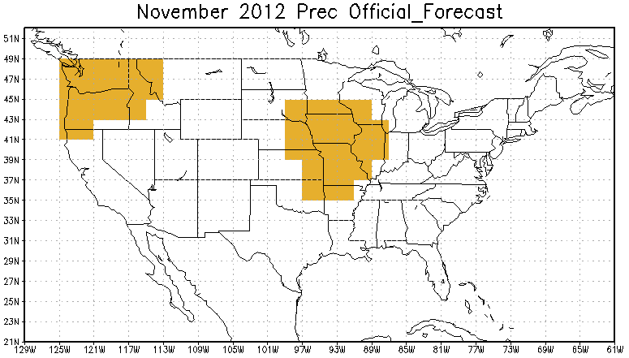
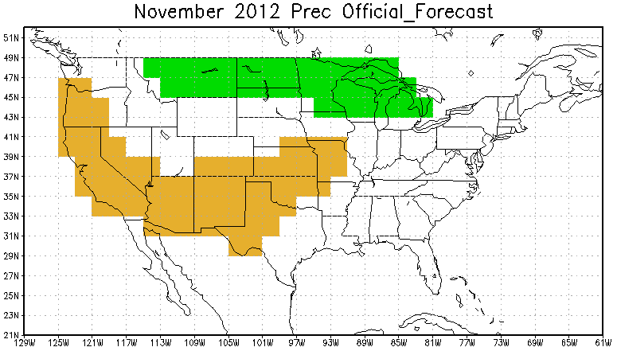
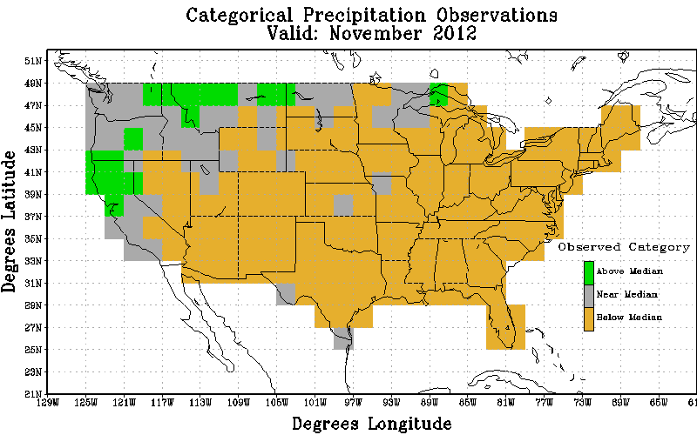
Monthly Verification
Temp
Official
Revised
Obs
Non-Equal Chance(non EC) forecasts: 75.27
All forecasts: 29.53
% coverage not Equal Chance forecasts : 39.22
Non-Equal Chance(non EC) forecasts: 75.74
All forecasts: 44.40
% coverage not Equal Chance forecasts : 58.62
Precip
Official
Revised
Obs
Non-Equal Chance(non EC) forecasts: 30.23
All forecasts: 5.60
% coverage not Equal Chance forecasts : 18.53
Non-Equal Chance(non EC) forecasts: 25.00
All forecasts: 11.21
% coverage not Equal Chance forecasts : 44.83

Slide 21
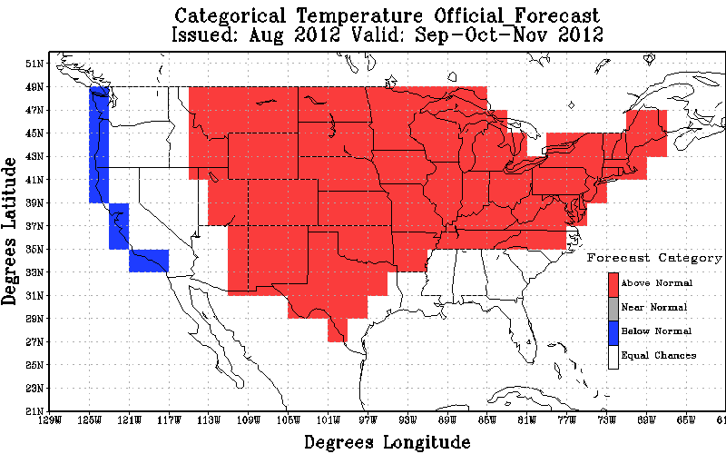
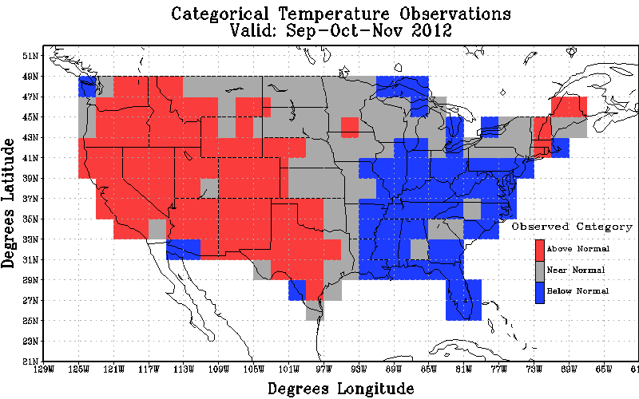
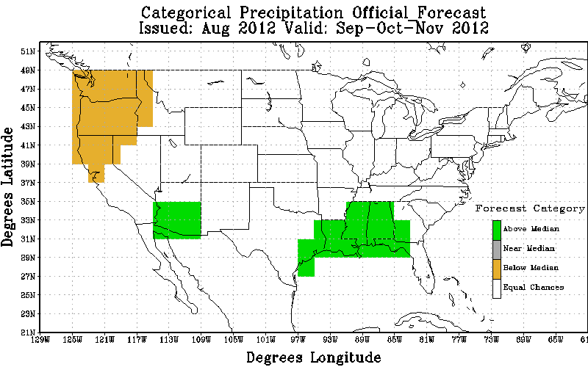
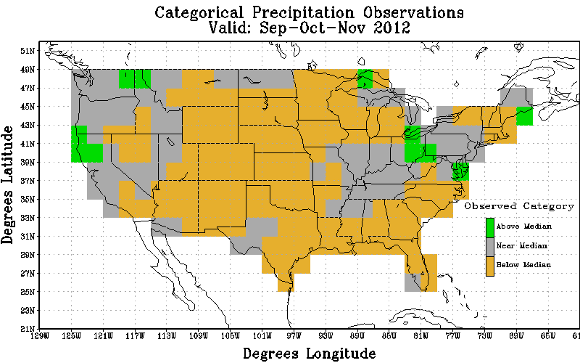
Seasonal Verification
Temp
Fcst
Obs
Non-Equal Chance(non EC) forecasts: 3.89
All forecasts: 2.80
% coverage not Equal Chance forecasts : 71.98
Precip
Fcst
Obs
Non-Equal Chance(non EC) forecasts: -40.22
All forecasts: -7.97
% coverage not Equal Chance forecasts : 19.83

Slide 22
Notable Events

Slide 23
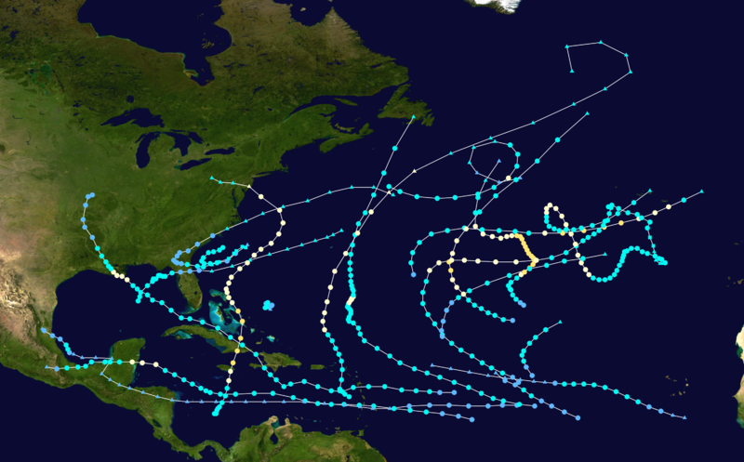
2012 Atlantic Hurricane Season
Tied with 1887, 1995, 2010, and 2011 as the third most active year in recorded history
First storm formed | May 19, 2012
Last storm dissipated | October 29, 2012
Strongest storm | Sandy – 940 mbar (hPa) (27.77 inHg), 110 mph (175 km/h)
Total depressions | 19
Total storms | 19
Hurricanes | 10
Major hurricanes | 1
Total fatalities | 320 direct, 7 indirect
Total damage | at least $68 billion (2012 USD)

Slide 24
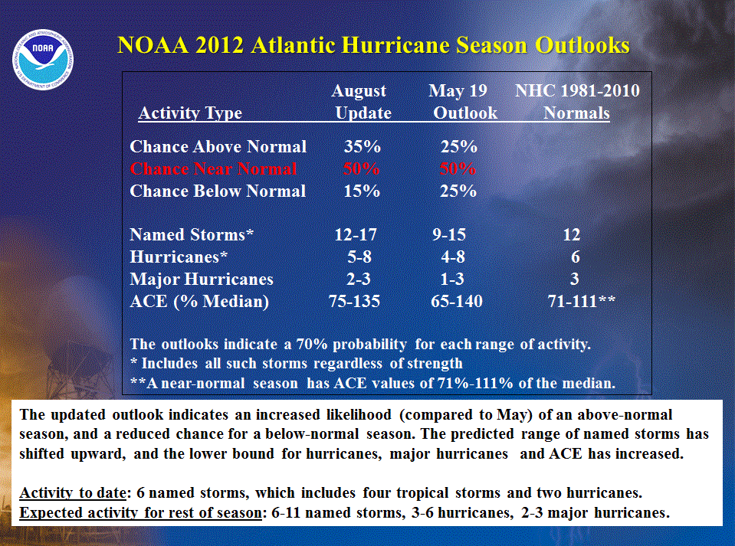
CPC's Official Hurricane Forecast
OBS
19
10
1

