Slide 1
NCEP Climate Test Bed Jin Huang CTB Director
Mission
To accelerate the transition of scientific advances from the climate research community to improved NOAA climate forecast products and services.
Joint NCEP-CPO facility @ NCEP
CTB Science Advisor Board (SAB)
Established in 2005
Serves as conduit between the operational, academic and research communities
CTB embraces the R2O and O2R paradigms
CTB emphasizes high profile science activities
CFS improvements
Multi-model ensembles
Climate forecast products
Competitive Grants Program
CTB Seminar Series
CPC-RISA Program
*CFS – Climate Forecast System

Slide 2
Climate Test Bed Currently Funded Projects
FY09
CFS Stratosphere Improvement, Perlwitz, Long, Alpert & Iredell
Perlwitz, Long, Alpert & Iredell, Ide, Kalnay, Miyoshi & Wang
A GOES THERMAL-BASED DROUGHT EARLY WARNING INDEX FOR NIDIS, Ide, Kalnay, Miyoshi & Wang
FY10
Incorporating Scale and Predictability Information in Multi-model Ensemble Climate Predictions, DelSole, Tippett & van den Dool
Multi-Model Ensemble Forecast of MJO, Wang & Waliser,
Enhancing operational drought monitoring and prediction products through synthesis of N-LDAS and CPPA research results, Wood & Lettenmaeir
Improved Extended Range Prediction through a Bayesian Approach Exploiting the Enhanced Predictability Offered by the Madden-Julian Oscillation. Xie, Johnson, L'Heureux, Collins & Gottschalk
Seasonal Prediction for Ecosystems and Carbon Cycle Using NCEP/CFS and a Dynamic Vegetation Mode, Zeng, Kalnay & Kumar
CPT for Improving the Representation of the Stratocumulus to Cumulus Transition in Climate Models, Bretherton, Mechoso, Park & Teixeira

Slide 3
Climate Test Bed Past Funded Projects
FY06
Using Initial tendency errors to reduce systematic errors, identify model errors, and construct stochastic parameterizations (DelSol) (Transition: FY08)
Development of neural network emulations of model physics components for improving the computational performance of the NCEP seasonal climate forecasts (Fox-Rabinovitz) (FY08)
The Ocean Component of the NCEP ENSO CFS (McPhaden/Xue/Behringer) (FY08)
FY07
System-wide advancement of user-centric climate forecast products (Hartmann/O’Lenic) (FY09)
FY08
Probabilistic forecasts of extreme events and weather hazards over the United States (Jones/Gottschalck) (FY09)
Enabling the Transition of CPC Products to GIS Format (Doty/Silva/Halpert) (FY09)
Generation and Evaluation of Long-Term Retrospective Forecasts with NCEP Climate Forecast System: Predictability of ENSO and Drought (Cane/Wang/Xue) (FY10)
Multi-Model Ensemble Climate Prediction with CCSM and CFS (Kirtman/van den Dool) (FY10)
Development of an Extended and Long-range Precipitation Prediction System over the Pacific Islands (Annamalai/Kumar) (FY10)
New Tools for North American Drought Prediction (Lyon/Kumar) (FY10)

Slide 4
Strategic Priority: CFS Improvements
Goal
To accelerate evaluation of and improvements to the operational Climate Forecast System (CFS) to enhance its use as a skillful tool in providing NCEP’s climate predictions for users to address today’s problems and plan for tomorrow
CFS V1 implemented in 2004
Atmosphere & ocean DA
Real time coupled 9-month forecasts
25 years of hindcasts
CFS V2 (2011)
CFS Reanalysis & Reforecast (CFSRR) project (completed)
Coupled O-A-L-Sea Ice data assimilation 1979-2010
Coupled reforecasts initialized from coupled reanalysis, 1981-2010
CFS V3 ( in planning)
Will engage the external community in planning process
CTB Activities
NCEP Climate Process Team (FY10)
to improve CFS cloud representation
consists of scientists from NCEP NCAR, NASA, DOE and universities.
CFS Stratosphere Improvement (FY09)
Hybrid Data Assimilation and coupled O-A Data Assimilation for Reanalysis (FY09)
Focus areas for CFS Improvements
Dynamics
Physics
Coupled Data Assimilation (Ocean Atmosphere Land Cryosphere)

Slide 5
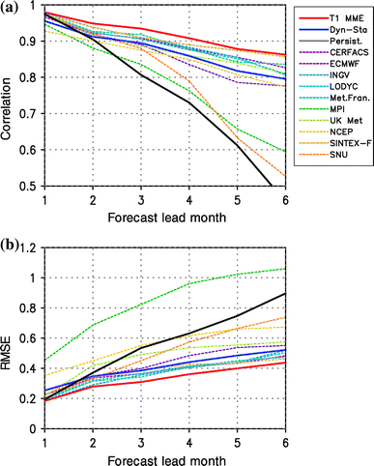
Multi-Model Ensembles
Goal
A multi model ensemble prediction system that leverages the best national and international models for improved predictions on intraseasonal-to-interannual time scales
CTB Activities
Consolidation techniques
Verification
MME Prediction System
MME Forecast of MJO (FY10)
MME Prediction with CFS and CCSM
National MME in planning (NCEP, GFDL,NASA,NCAR) in collaboration with COLA, IRI, ESRL
NMME Meeting on Feb.18, 2011
ENSO Prediction
MME mean outperforms individual models

Slide 6
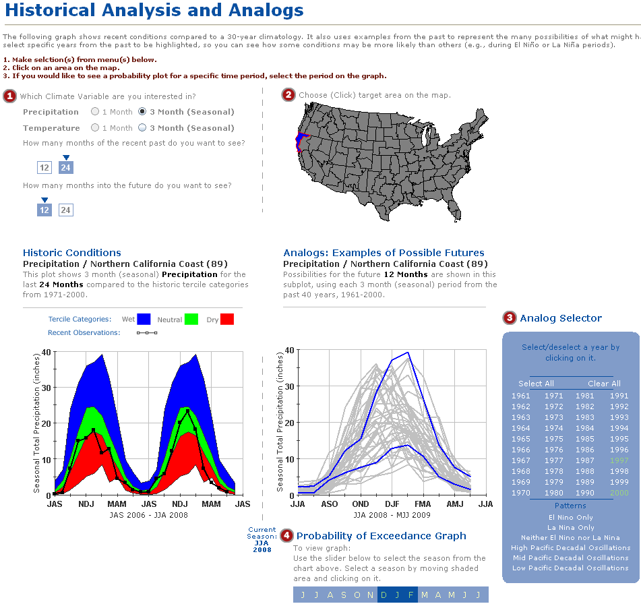
Climate Forecast Products
Goal
To provide reliable climate forecast products that are responsive to the needs of users and incorporate state-of-the-art science and research.
Relationships with partners
Delivery of useful products
Continuous flow of user requirements
Strong research component
CTB Activities
Forecast Evaluation Tool
Development of an Extended and Long-range Precipitation Prediction System over the Pacific Islands
Drought monitoring and prediction products based on land data assimilation
Drought Early Warning Index using satellite data

Slide 7
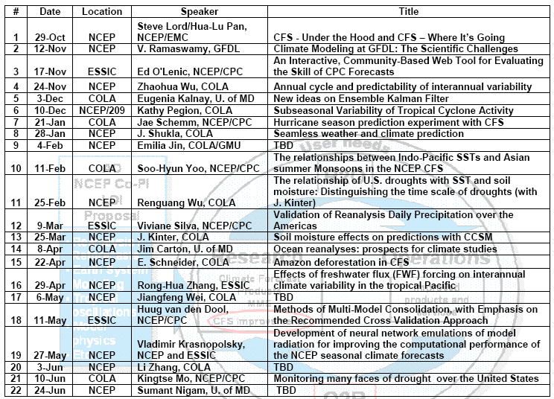
CTB Seminar Series
Schedule of Speakers

Slide 8
CTB Update Since Jan. 3, 2011
CTB Management
Hired a new CTB Director
National MME
Organize a CTB NMME planning meeting with NCEP, GFDL, NASA, NCAR, ESRL, COLA, and IRI to develop a strategy on Feb. 18, 2011
Will produce a “White paper” with operational and research requirements
CTB PIs Meeting
Plan to hold the CTB PIs Meeting and the CTB (SAB) Meeting jointly with the 36th Climate Diagnosis and Prediction Workshop in Oct. 3-6, 2011
Weekly CTB Management Meeting (CPC, EMC, CTB, CPO)
To discuss the CTB scope, strategy and future CTB priorities

Slide 9
CTB Linkage to Regional Climate Services
CTB is aimed at improving NCEP climate products and services by transferring science into NCEP operations
CTB needs to establish/enhance the relationship with Regional Climate Centers to communicate on user requirements on climate products
One mechanism is to sustain the CPC-CTB-RISA Program to enhance RISA engagement in the development, evaluation, testing and access to regional climate information.
CTB grants program is currently sponsored by CPO/MAPP Program
Current one-on-one CPC-RISA relationship (not funded)
A formal CPC-CTB-RISA program will strengthen the interaction between the service providers and users at regional levels.

Slide 10
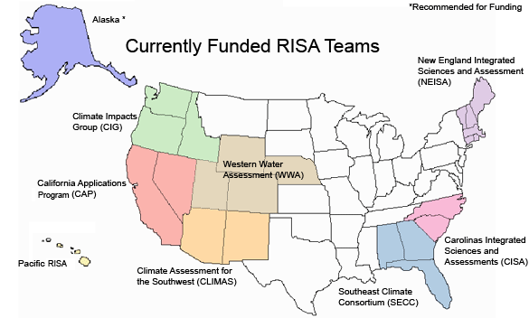
CPC-RISA Program
RISA | Contacts | Areas of Collaboration
Southeast Climate Consortium (SECC) | Muthuvel Chelliah (CPC) Jim Jones, Keith Ingram, Jim O’Brien | Downscaling CPC Outlooks, Regional ENSO Impacts; Crop Yield Forecasting; Applications of high resolution GCM,CFS hindcasts.
Western Water Assessment (WWA) | Michelle L’Heureux (CPC) Andrea Ray | Intraseasonal forecasts and applications; Decision support related to drought mitigation and response; user feedback to enhance CPC products.
Climate Assessments for the Southwest (CLIMAS) | Ed O’Lenic (CPC) Holly Hartmann | Improve users’ ability to access and interact with, and make decisions based upon CPC outlooks.
Alaska Center for Climate Assessment and Policy (ACCAP) | Jon Gottschalck (CPC) Sarah Fleisher Trainor | Development and improved utilization of storminess related products, aid Alaska’s drought / fire related challenges through better application of CPC official outlooks and the use of new precipitation databases.
Pacific Climate Information System (PaCIS) | Luke He (CPC) Eileen Shea, Jim Weyman | Pacific Rainfall Atlas; Climate Teleconferences and User Training, Research for Improving Climate Service and Forecasts for the Pacific region.
California Application Program (CAP) | Kingtse Mo (CPC) Dan Cayan, John Roads | Soil moisture analyses from 4 NLDASs and regional reanalysis, CFS-based drought forecasts, MME applications to SI forecasts, week 1, week 2 E, P, soil moisture relationships from NLDAS.
University of Washington Center for Science in the Earth System (CSES) | Doug LeComte (CPC) Dennis Lettenmaier | Enhancements to U.W. surface water monitor, Improved tools for Drought Monitor and Drought Outlook.
Goal: to meet RISA-customer needs for climate forecast products
Activities: exchanges via CPC & RISA focal points; workplans tailored to customer needs.

