Slide 1
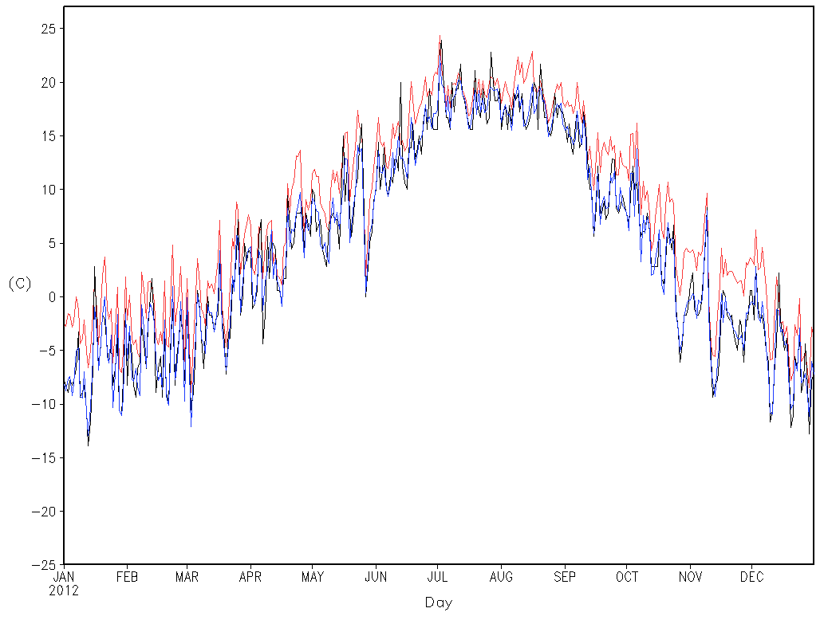
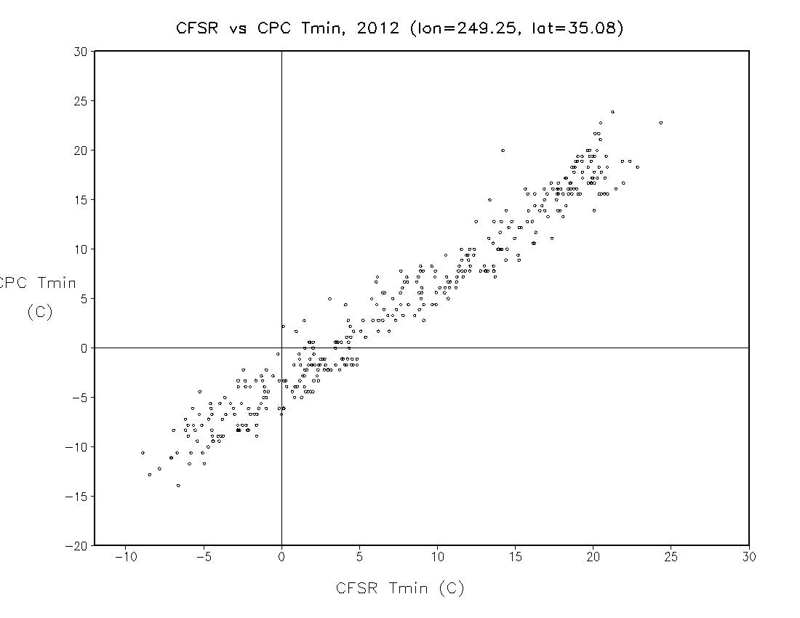
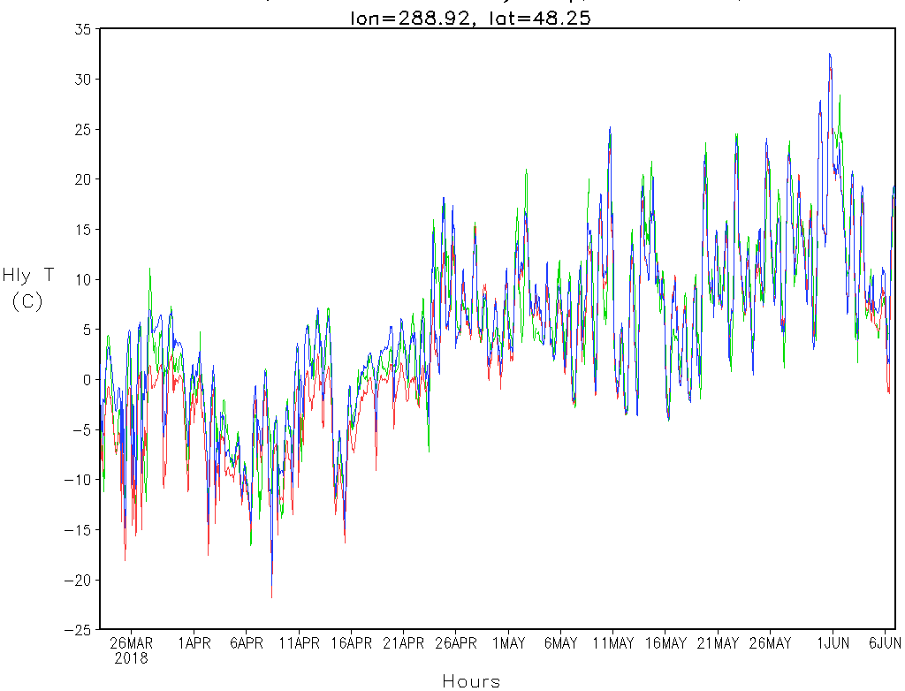
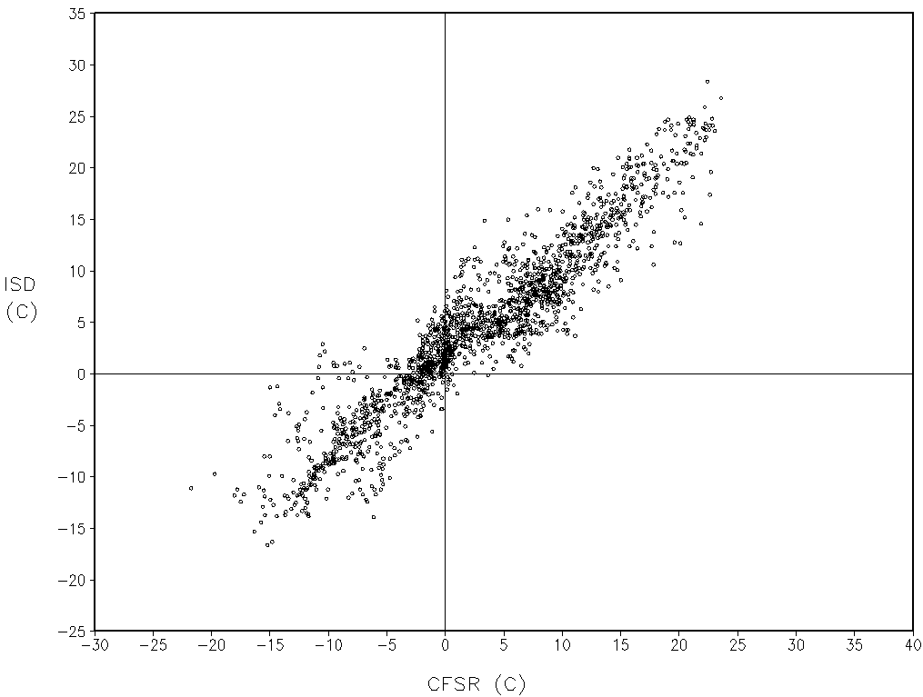
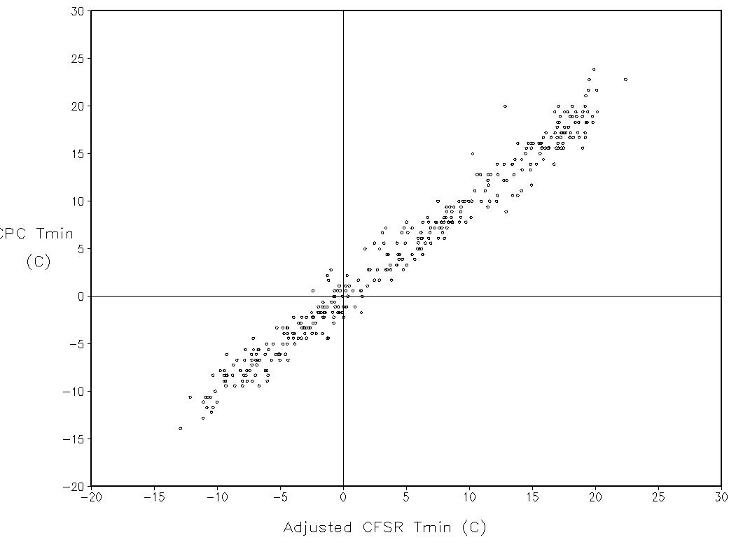
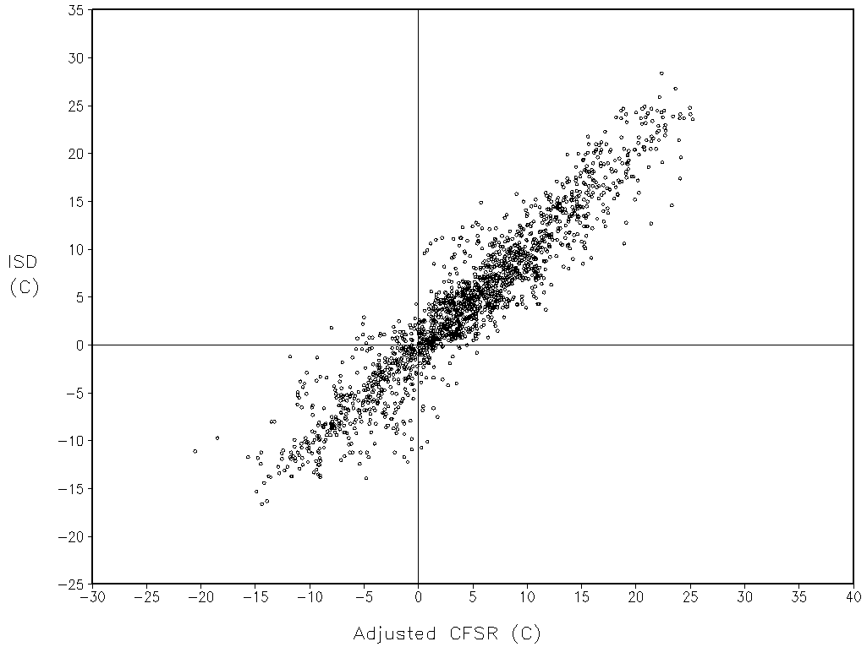
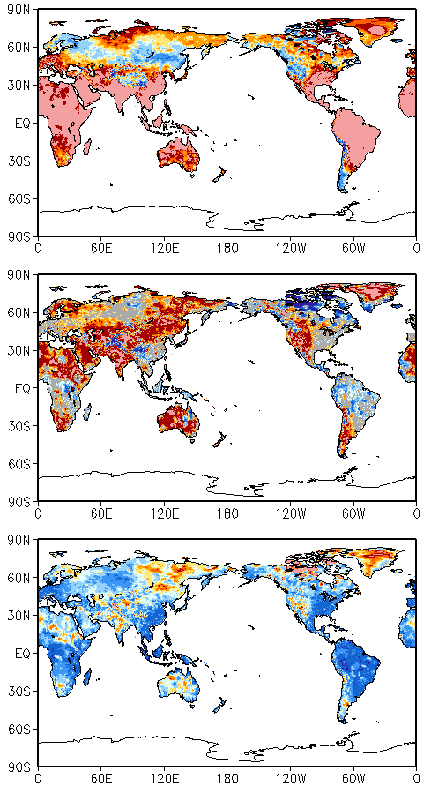
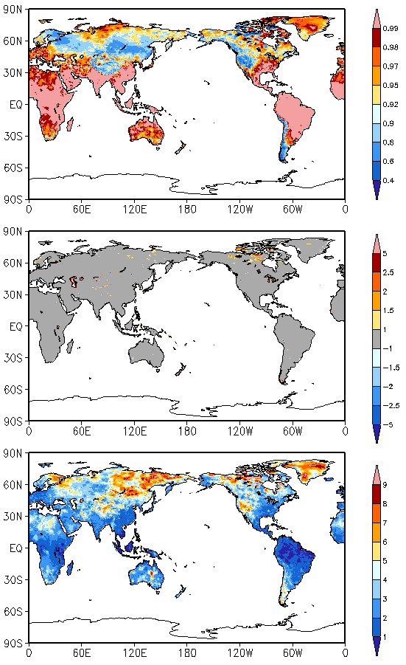
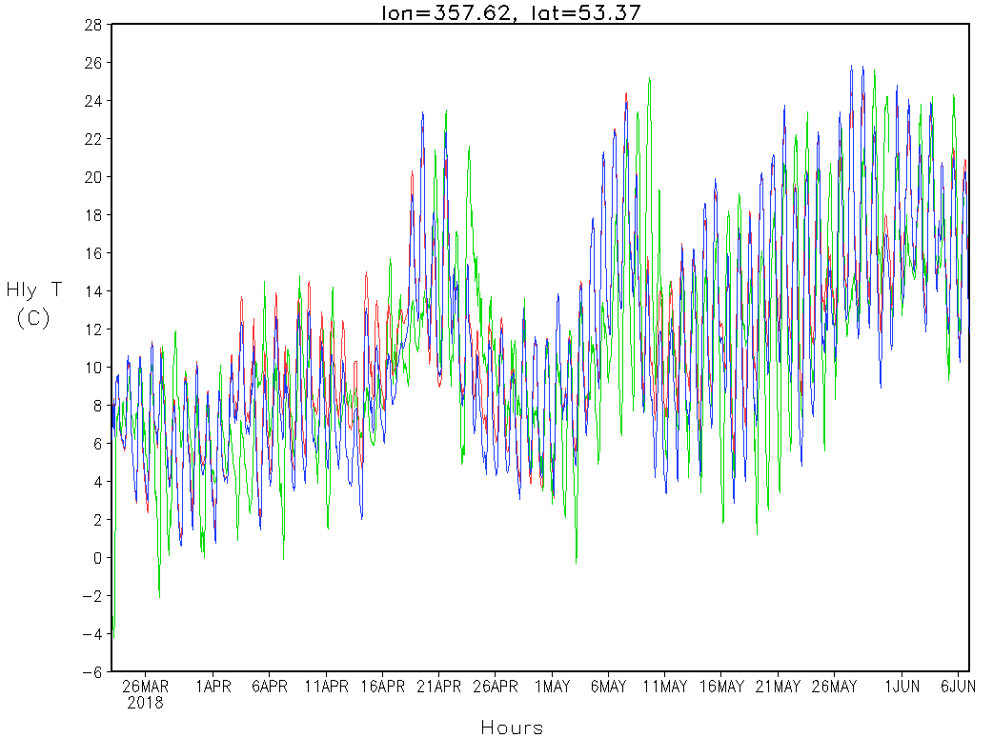
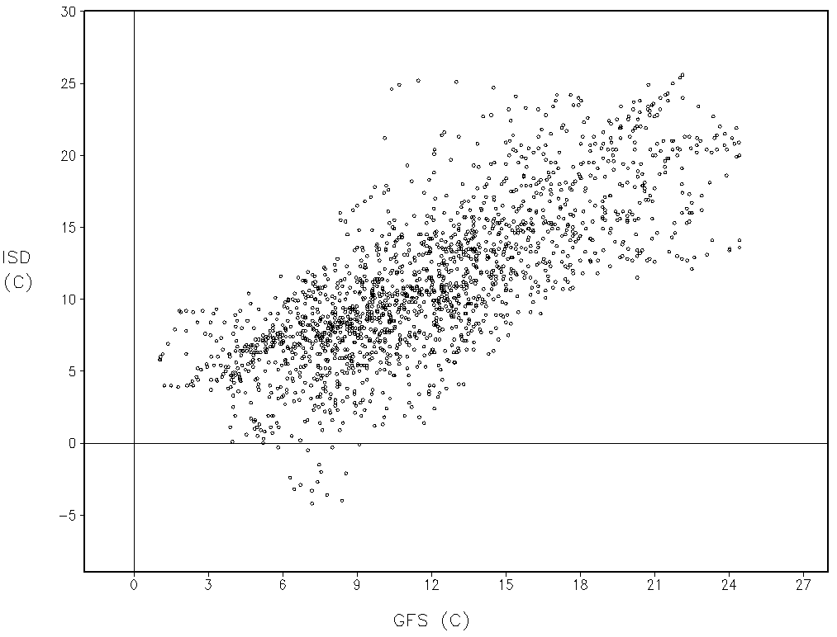
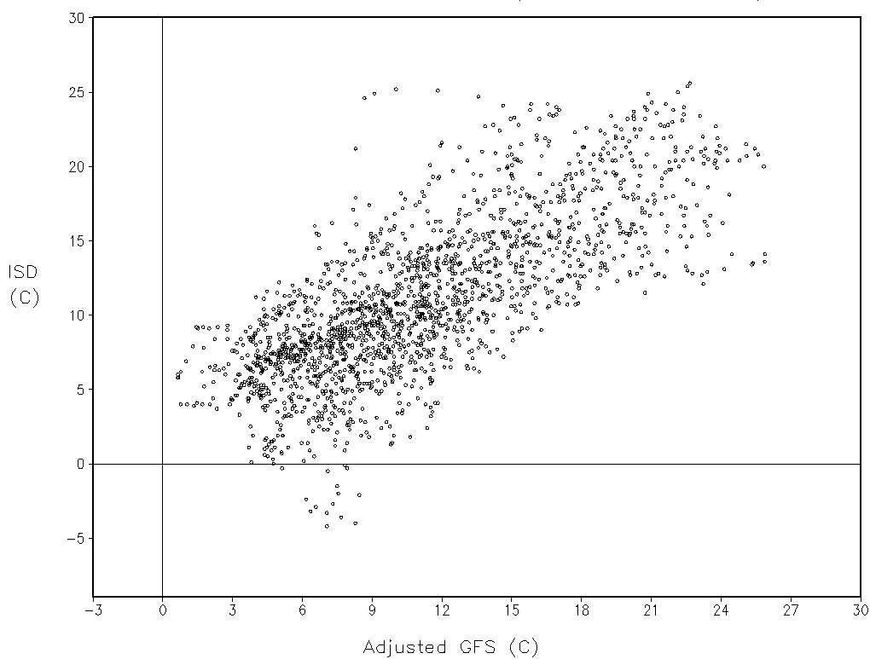
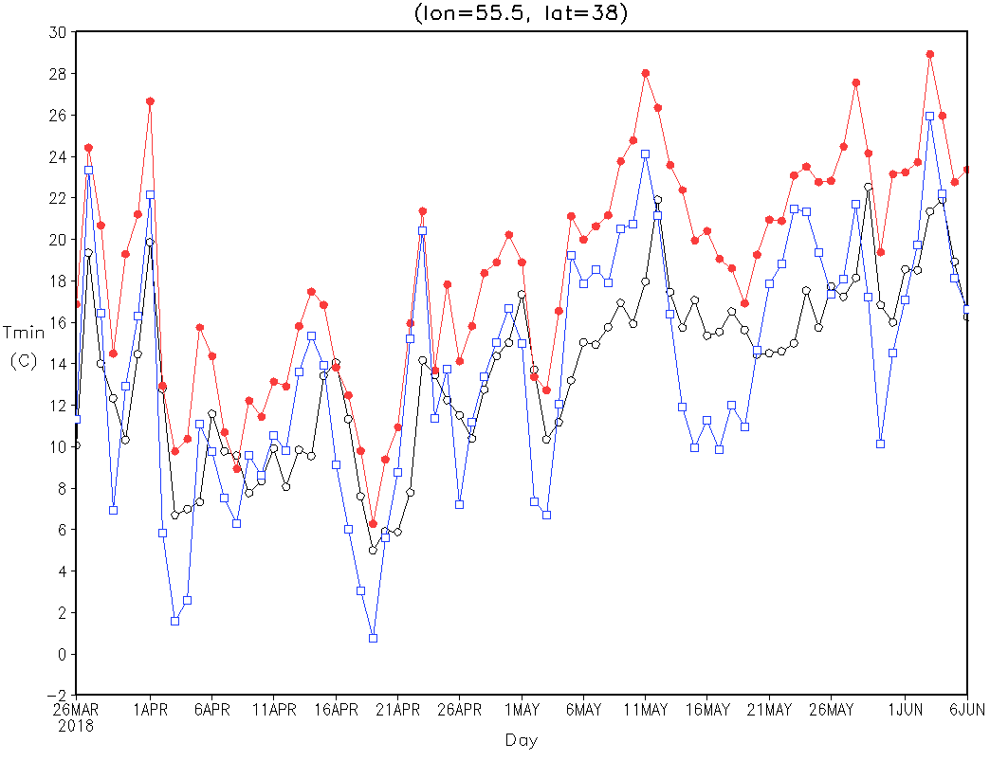
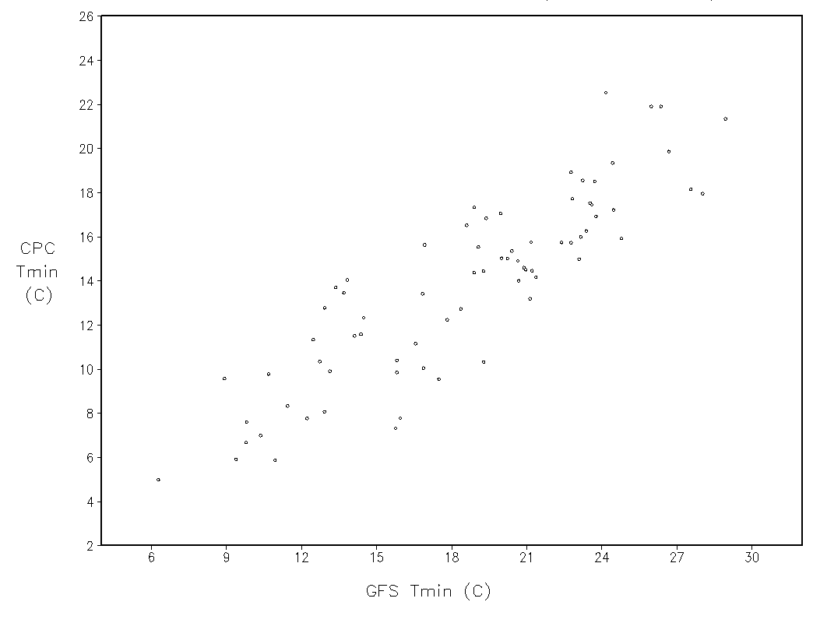
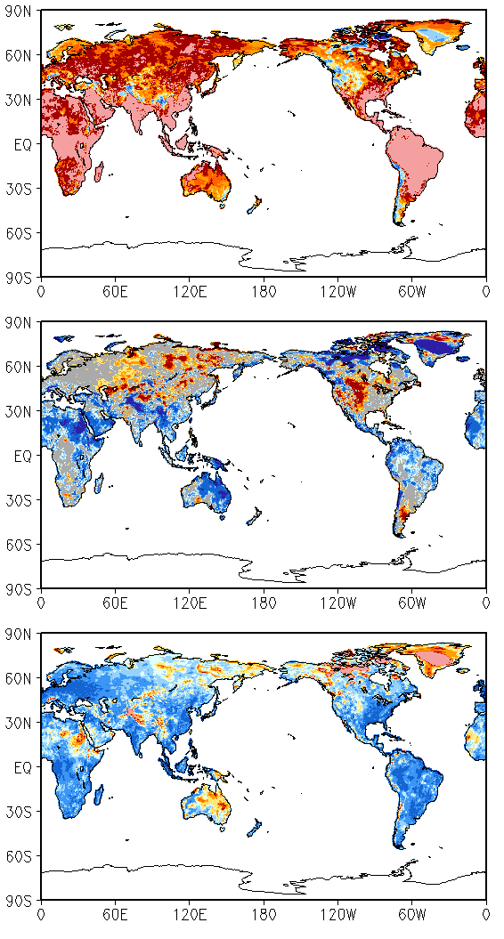
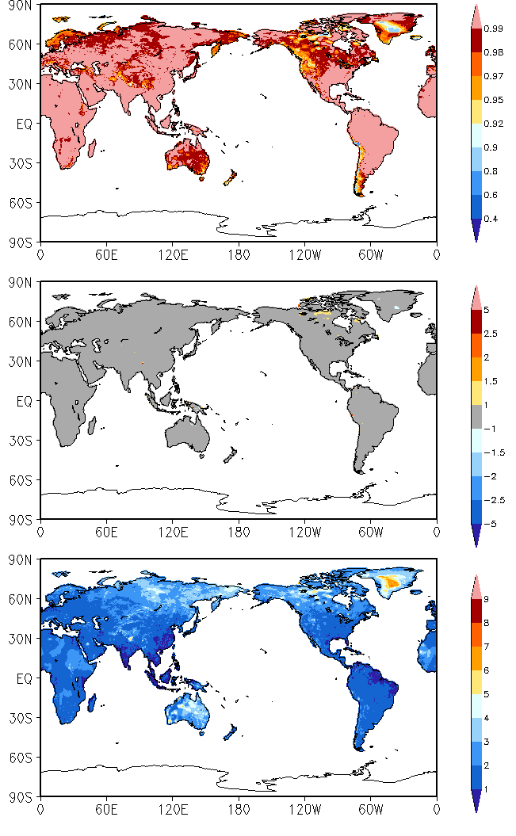
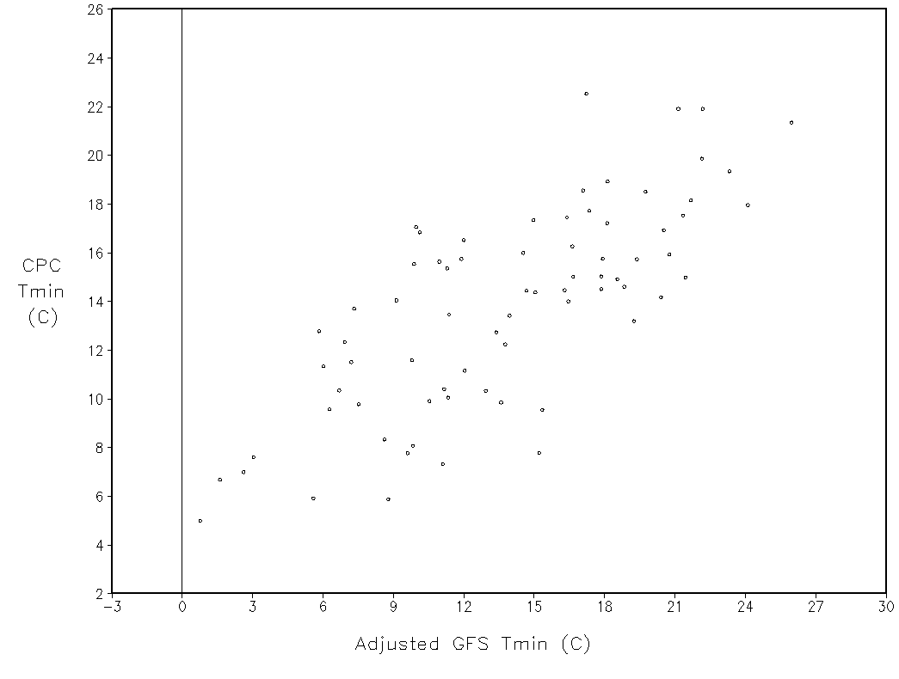


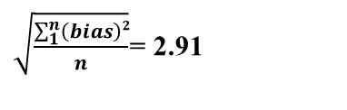




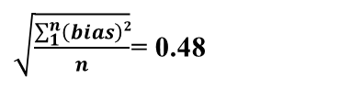
Development an An Hourly Analysis of Surface Air Temperature over the Global Land
Yutong Pan, Pingping Xie
NOAA/NWS/NCEP Climate Prediction Center, College Park, MD 20740
1. Background
Developing an analysis of hourly surface air temperature (T_{2m}) for a 40-year period from 1979 to the present. The hourly T_{2m} generated by the NCEP operational global models, the NCEP CFS Reanalysis (CFSR) and the GFS 6-12 hour forecast (on a 1/6º lat/lon grid and a 0.05º lat/lon grid, respectively), are adjusted against the observation-based CPC global daily maximum (Tmax) and minimum (Tmin) surface air temperature.
CPC Tmin vs CFSR Tmin, 2012 (lon=249.25, lat=35.08)
ISD vs CFSR Hourly T_{2m}, March 23 – June 6, 2018 (lon=288.9, lat=48.2)
Fig. 2. Time series of the CPC and CFSR Tmin at a selected location in the US, 2012 (left) and scatter plots between the CPC and CFSR Tmin (upper right: before adjt; lower right: after adjt). Both bias and RMSE are reduced after adjustment. Similar result in the Tmax (not shown).
corr= 0.950
bias= 3.113
RMSE= 3.703
Before adjustment
Fig. 5. Time series of the ISD and CFSR hourly T_{2m} at a selected location in Canada, from March 23 to June 06, 2018 (left) and scatter plots between the ISD and CFSR (upper right: before adjt; lower right: after adjt). Both bias and RMSE are reduced after adjustment.
Bias= -1.56
RMSE= 3.24
Before Adjustment
---- CPC Tmin
---- CFSR Tmin, before adjustment
---- CFSR Tmin, after adjustment
corr= 0.990
bias= 0.030
RMSE= 1.440
After adjustment
---- ISD Hourly Temp
---- CFSR Hourly Temp before adjustment
---- CFSR Hourly Temp after adjustment
Bias= 0.16
RMSE= 2.70
After Adjustment
2. Data and methodology
Observational data
CPC global daily Tmax and Tmin surface air temperature
ISD (Integrated Surface Database) station hourly air temperature
Model data
CFSR operational hourly T_{2m} (2011–2018, 1/6º resolution, monthly updated) and GFS real-time forecasts (February 2018 - present, 0.05º resolution, 6 hour forecast)
Methodology
Step 1. Synoptic scale bias correction:
Daily Tmax and Tmin of NCEP models are calculated from the hourly T_{2m}. The 5-day running mean of daily mean (arithmetic mean of the Tmax and Tmin) for both the observation and model surface air temperatures are computed.
The difference in daily mean 5-day running mean between the model and the observation is removed from the raw model hourly T_{2m}.
Step 2. Diurnal Adjustment:
The 5-day running mean of diurnal temperature range (Tmax – Tmin) for both the observation and model are calculated.
Ratio between the observation and model based 5-day running mean of diurnal temperature range is computed and applied to correct the model T_{2m} for the target date.
Fig. 2
Fig. 5
CPC Tmin vs GFS Tmin, March 26 – June 06, 2018 (left: before adjt; right: after adjt)
ISD vs GFS Hourly T_{2m}, March 23 – June 6, 2018 (lon=357.6, lat=53.4)
Fig.3. Same panel as Fig. 1, but for CPC and GFS Tmin, from March 26 to June 06, 2018. It shows improvement of the GFS T_{2m} after adjustment. Similar result in the Tmax (not shown).
Fig. 6. Same panel as Fig. 5, but for the ISD and GFS hourly T_{2m} at a location in UK, Both bias and RMSE are reduced after adjustment.
Bias= 0.84
RMSE= 3.65
Before Adjustment
corr
bias
---- ISD Hourly Temp
---- GFS Hourly Temp before adjustment
---- GFS Hourly Temp after adjustment
Bias= 0.07
RMSE= 3.76
After Adjustment
RMSE
Fig. 6
Fig. 3
$\sqrt{\frac{\sum_{1}^{n}{\left(bias\right)2}}{n}}$= 2.91
$\sqrt{\frac{\sum_{1}^{n}{\left(RMSE\right)2}}{n}}$= 4.29
$\sqrt{\frac{\sum_{1}^{n}{\left(bias\right)2}}{n}}$= 0.48
$\sqrt{\frac{\sum_{1}^{n}{\left(RMSE\right)2}}{n}}$= 4.01
4. Summary and conclusions
Examination of Tmax and Tmin against the CPC daily data showed much improved performance of the CFSR/GFS T_{2m} after adjustment.
Examination against independent observations of hourly surface air temperature (the ISD station data) showed improvement of the adjusted CFSR/GFS T_{2m} compared to the unadjusted fields.
In general, improvement in the CFSR hourly T_{2m} is relatively larger than the GFS. Possible reasons are larger forecast error in the GFS model (e.g., phase shift between model and observations) and approximations used in calculating daily mean values in the GFS adjustment.
An automatic system is established at a CPC server to adjust the retrospective production and update the analysis on a real-time basis for the mass production of the entire target period.
CPC Tmin vs GFS Tmin, March 26 – June 06, 2018 (lon=55.5, lat=38)
3. Results
CPC Tmin vs CFSR Tmin, 2012 (left: before adjt; right: after adjt)
Fig. 4. Same panel as Fig. 2, but for CPC and GFS Tmin at a selected location in Iran, from March 26 to June 06, 2018 (left) and scatter plots between the CPC and GFS Tmin (upper right: before adjt; lower right: after adjt). Both bias and RMSE are reduced after adjustment. Similar result in the Tmax (not shown).
corr= 0.990
bias= 4.747
RMSE= 5.381
Before adjustment
Fig.1. Correlation coefficient, bias and RMSE between the CPC and CFSR Tmin, 2012. Statistical analysis shows significant improvement of the CFSR T_{2m} after adjustment. Similar result in the Tmax (not shown).
corr
---- CPC Tmin
---- GFS Tmin before adjustment
---- GFS Tmin after adjustment
corr= 0.968
bias= 0.026
RMSE= 3.776
After adjustment
bias
RMSE
Fig. 4
$\sqrt{\frac{\sum_{1}^{n}{\left(bias\right)2}}{n}}$= 3.105
$\sqrt{\frac{\sum_{1}^{n}{\left(RMSE\right)2}}{n}}$= 4.594
$\sqrt{\frac{\sum_{1}^{n}{\left(bias\right)2}}{n}}$= 0.199
$\sqrt{\frac{\sum_{1}^{n}{\left(RMSE\right)2}}{n}}$= 2.269
Fig. 1

