Slide 1
CCR Program POCs
Briefing to Dan Walker
Chief, CASD
CPO
November 12, 2009

Slide 2
1. Alaska Center for Climate Assessment and Policy (ACCAP) Jon Gottschalck

Slide 3
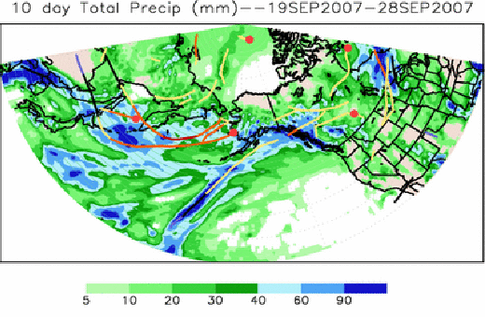
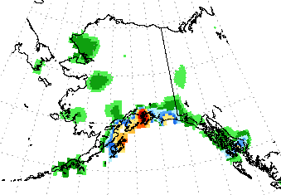
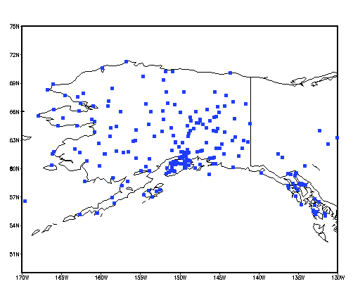
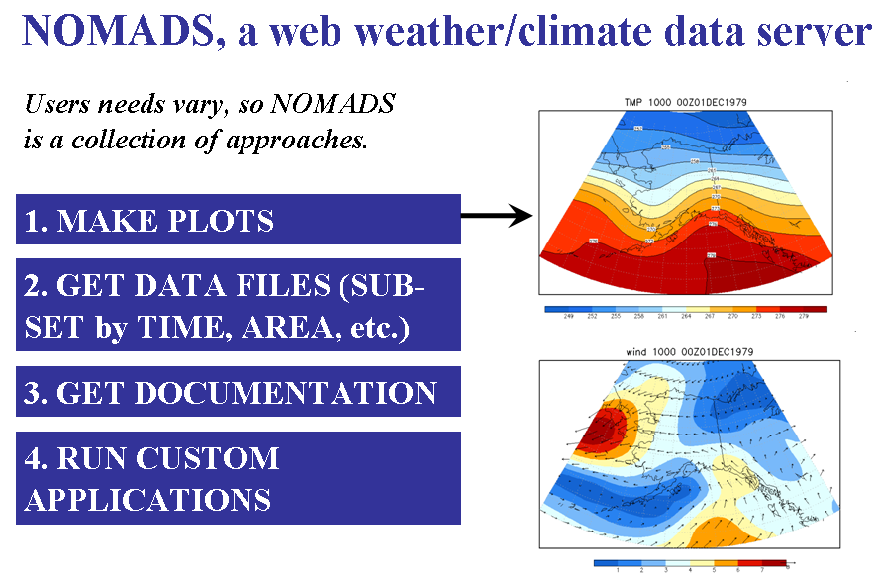
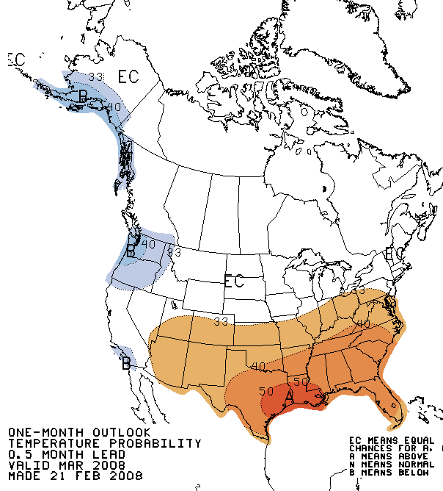
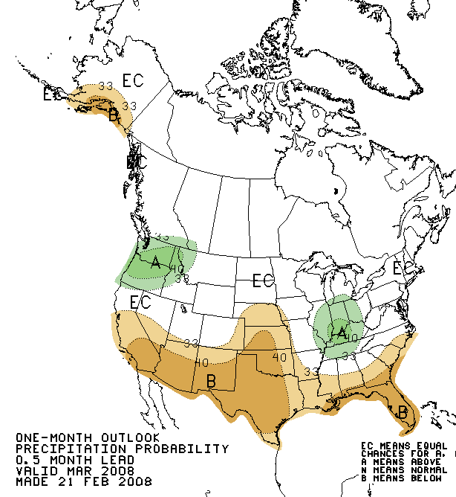
A Collaborative Effort Between CPC and ACCAP
Contacts: CPC: Jon Gottschalck, ACCAP: Sarah Fleisher Trainor (Stakeholder Liaison)
(1) Development and improved use of storminess related products and services
(3) Exchange of information and expertise for enhancing precipitation databases
(2) Aid Alaska’s drought and fire related challenges through better application of CPC official outlooks
(4) Expertise and support with CFSR

Slide 4
Topic Areas
(1) Storminess related products
July 2007 statewide teleconference with stakeholders (overview of products, Q&A session, etc.)
Based on feedback some important points were reinforced, prioritized list of work items identified
Priority should be on downscaling of current products
(2) Aid Alaska’s drought/fire related challenges
June 2008 statewide teleconference with stakeholders (overview of drought products)
Through ACCAP, working with Paul Duffy to evaluate the use of CPC official outlooks in his experimental extended range fire forecast tools
Extension of CPC ensemble drought monitoring and prediction system to Alaska
(3) Exchange of data and expertise for enhancing precipitation databases
ACCAP would like to utilize new CPC gauge dataset as part of their research, outreach
CPC hopes to expand the number of stations included in its analysis and obtain additional historical data
Exchange expertise (database quality control, orographic correction, snow/catchment corrections)
(4) Coordination on the use and applications of CFSR
Aid the development of value-added products, based on CFSR, for needs identified by ACCAP
Climate Index for Tourism, degree days, etc.

Slide 5
September 2009 Visit to ACCAP
Supported by CPO/CTB and included a visit to the NWS WFO Fairbanks
1. CPC overview presentation to ACCAP, IARC and NWS staff
2. Met with 10-15 ACCAP, IARC, NWS staff over 2 days
➔ Discussions with folks related to the work on previous slides
➔ Scott Rupp – Head of Scenarios Network Alaska Planning (SNAP)
➔ Paul Duffy – Discuss plans for moving forward on CTB mini-proposal
➔ Gleb Panteleev – Ocean data assimilation for Alaska waters
➔ Jessie Cherry – Feedback from users in Alaska for CPC products
3. NWS WFO discussion was excellent, good face time and got important feedback
Eric Stevens (SOO)
Rick Thoman (WFO climate focal point)
Joh Lingaas (WCM)
John Dragomir (MIC)

Slide 6
2. Climate Assessment of the Southwest (CLIMAS) Ed O’Lenic

Slide 7
System-wide Advancement of User Centric Climate Forecast Products
Holly Hartmann, Edward O’Lenic
CLIMAS, NOAA-NWS-CPC
Project Description
The primary objective of this project is to improve user access to and understanding of climate forecast products issued by the Climate Prediction Center (CPC). The project has three main areas of activity:
Implement CPC support of web services. This allows dynamic interaction between users and CPC products, and communication of product attributes through the CLIDDSS information portfolio manager and report generator.
Support user-centric forecast evaluation in terms that are meaningful to users.
Improve forecast product formats. This involves field testing of product formats to confirm reliably correct interpretation across application sectors.
Notes:
Full disclosure

Slide 8
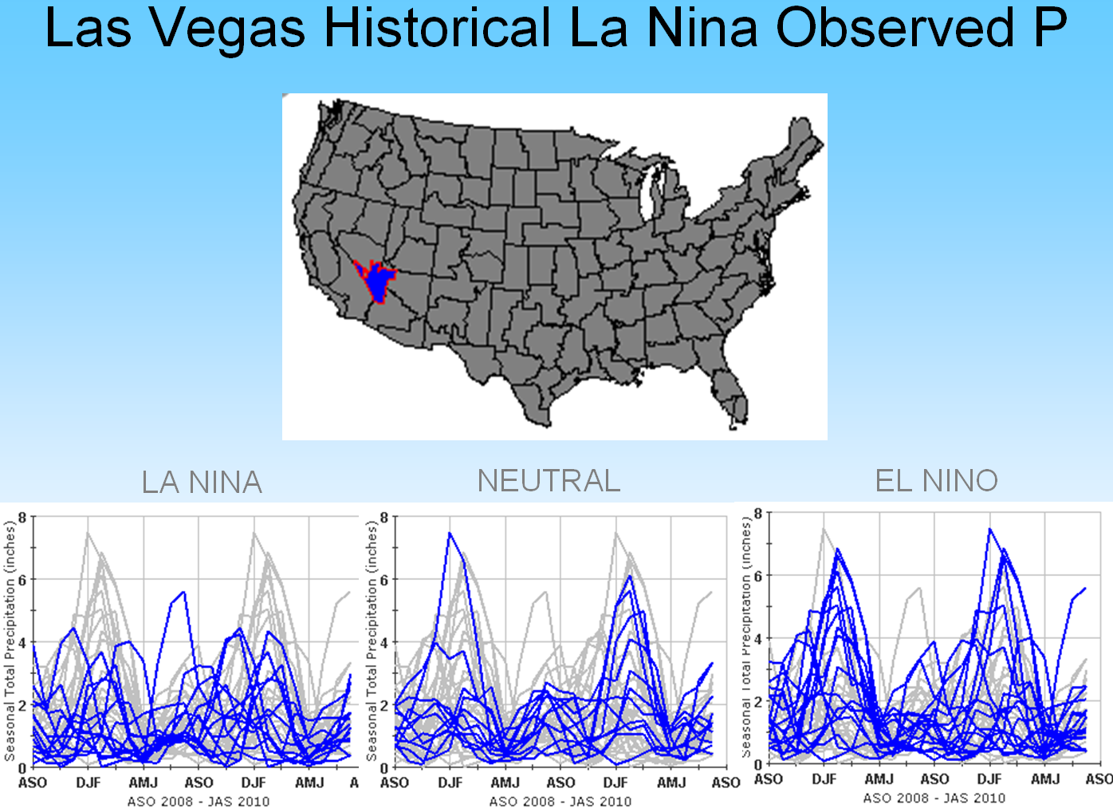
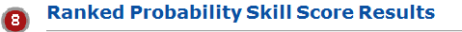
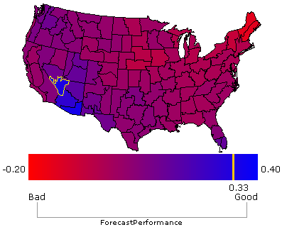
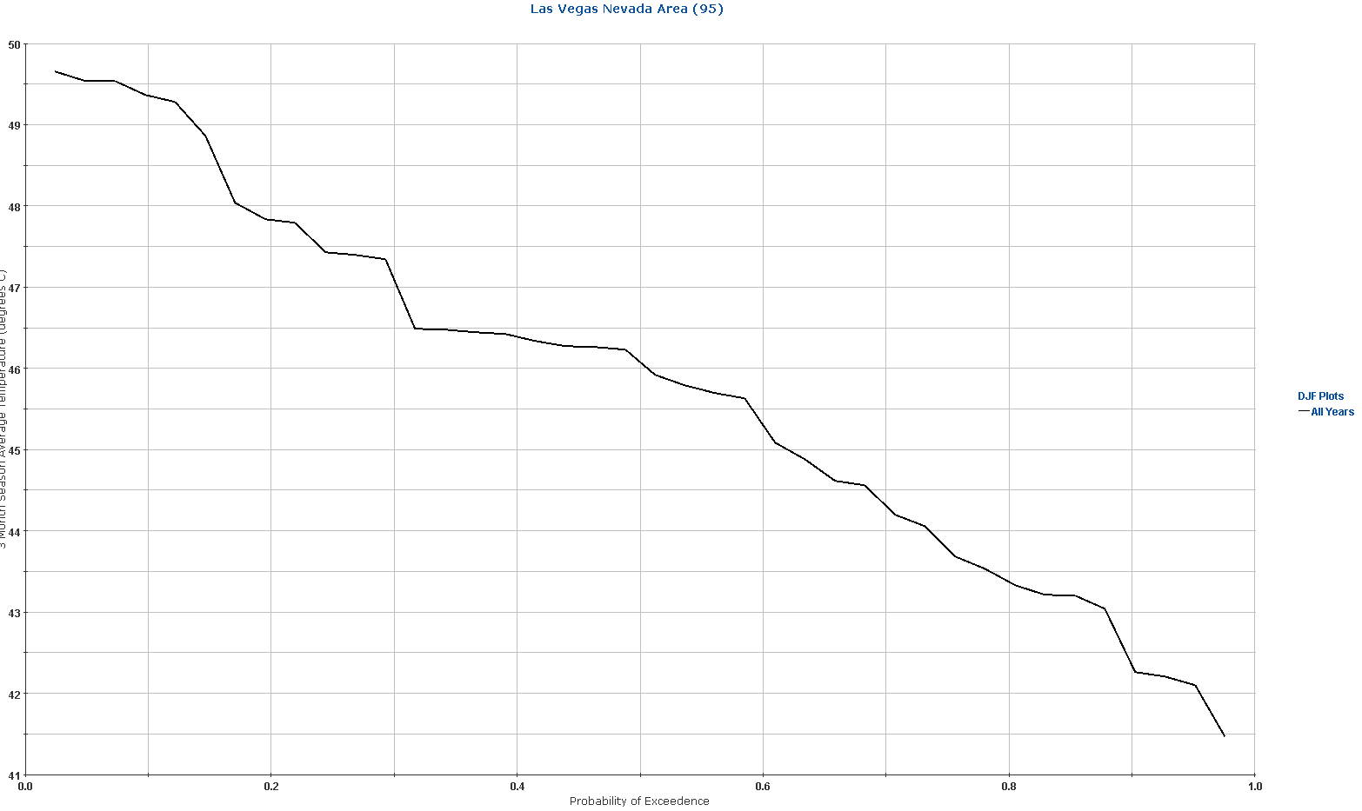
Forecast Evaluation Tool: Interactive Skill and Historical ENSO Impacts Assessment Capability
Details of the observed distributions of temperature and precipitation can be explored for El Nino, La Nina, and other climate regimes.
CPC and CLIMAS will make this interactive.

Slide 9
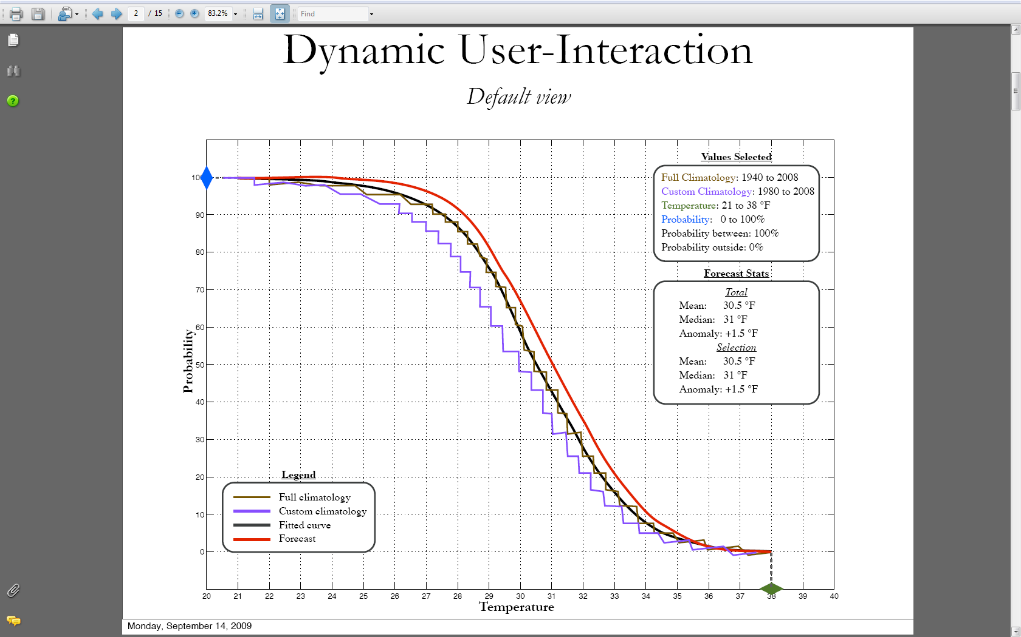

Slide 10
3. California Applications Project (CAP) Kingtse Mo

Slide 11
Cap- California Risa
Issues important to them
Climate change
Monitoring,
analysis,
attribution
adaptation.
Identify two projects:
A)Min temperature has been increasing in JJA, why ?
B) Monitoring snowpack and relationship with spring temperature

Slide 12
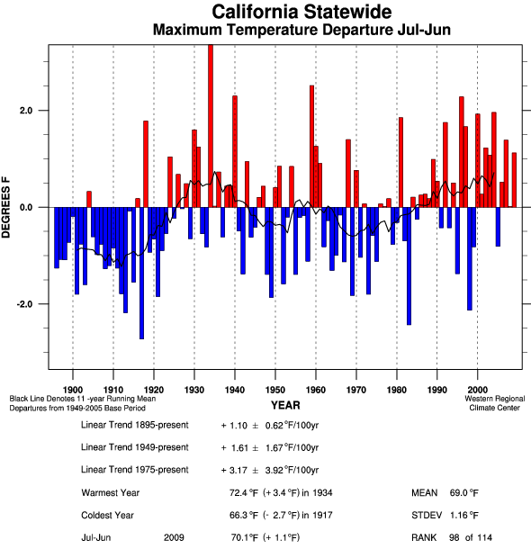
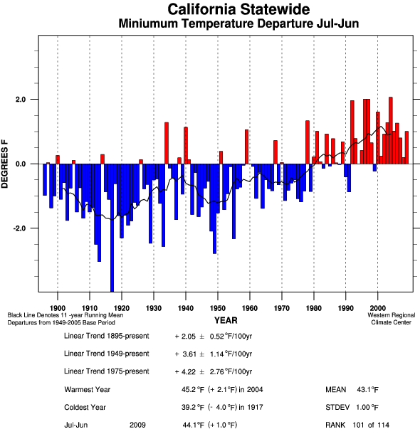
Statewide
Winter-Centered July-June
Mean Max Temperature Mean Min Temperature

Slide 13
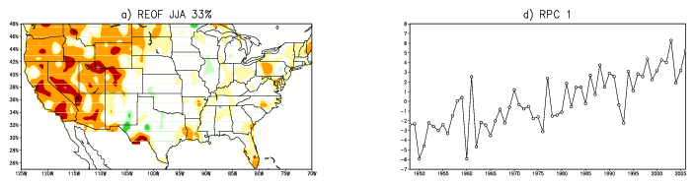
Workplan
The trends in Tmin can be explained by the first REOF in observations.
The CFSR is able to capture the signal.
Physical mechanisms will be examined using CFSR data
Design plan to monitor trends in Tmin and snowpack

Slide 14
4. Western Water Assessment (WWA) Michelle L’Heureux

Slide 15

Partnership between Climate Prediction Center (CPC) and Western Water Assessment (WWA)
(1) Collaboration between CPC and WWA to inform the user community of new and current CPC products and tools.
- van den Dool – CPC Soil Moisture Products (July 2007)
- Unger – Forecast Consolidation for Season Climate Outlooks (June 2008)
O’Lenic – The U.S. Hazards Assessment (Sept. 2007)
Gottschalck – Meet the MJO (May 2008)
L’Heureux – New ENSO Alert System (July 2009)
(2) Collaboration with ESRL/WWA scientists to create downscaled, probabilistic forecast products for Temperature and Precipitation.
submitted proposals to the NOAA Climate Test Bed during FY08 and FY09 to seek funding (additional computing resources + manpower)
made specific recommendations to NCEP on the configuration of re-forecasts for CFSR

Slide 16
Partnership between Climate Prediction Center (CPC) and Western Water Assessment (WWA)
(3) WWA suggested chart for water managers and other local and regional end users. CPC is currently implementing these diagrams (thanks to CPO support).
Based on suggestions from WWA, who surveyed water managers, we have developed these tables for each climate division.
Water managers are used to seeing streamflow forecasts that show exceedence probabilities, so CPC will follow a similar template for temperature and precipitation associated with each tercile for the forecast season.
 | Tercile precipitation (inches)
Location (climate division) | lower | middle | upper
W Colorado
precip range | less than 3.38 | 3.38-4.59 | greater than 4.59
% chance | 33.3% | 33.3% | 33.3%
SW Arizona
precip range | less than 1.46 | 1.46-2.80 | greater than 2.80
% chance | 42.9% | 35.3% | 21.8%

Slide 17
5. Pacific Climate Information System (PaCIS) Luke He / Eileen Shea

Slide 18
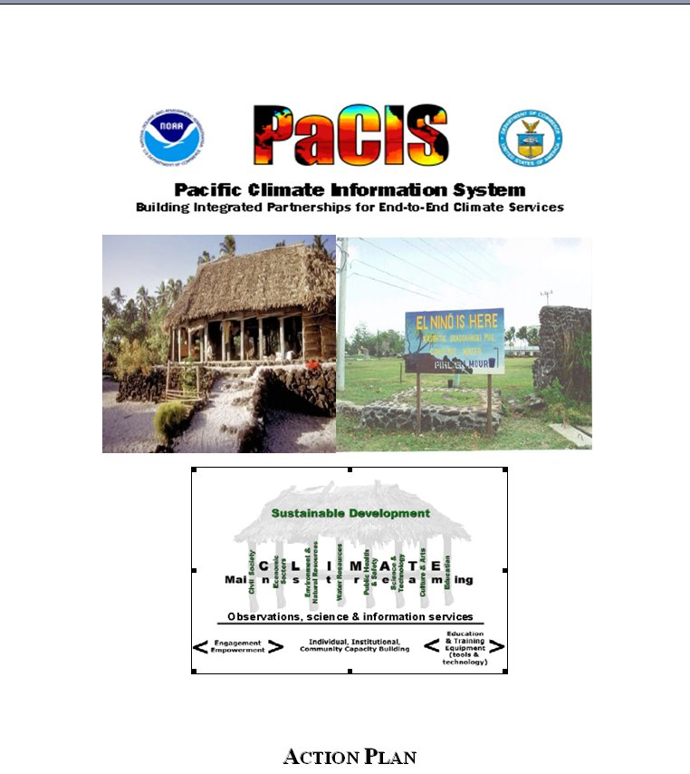
CPC & Pacific Climate Information System (PaCIS)*
PaCIS Vision :
Resilient and sustainable Pacific communities using climate information to manage risks and support practical decision-making in the context of climate variability and change
PaCIS Contacts:
Eileen Shea, Jim Weyman, Melissa Finucane
CPC Contact:
Luke He
Area of Collaboration: Research to improve climate prediction (Temperature, Precipitation Sea Level Outlook), Provide better climate Service, Setup a drought early warning system, Users dialogue and training.
Status: Monthly PEAC Climate Teleconference, Pacific Islands Rainfall Atlas, PEAC Climate Newsletter (Pacific ENSO Update), Pacific Climate Information System (PaCIS), PRIDE Project.
*Pacific-RISA & PEAC are within the context of PaCIS

Slide 19
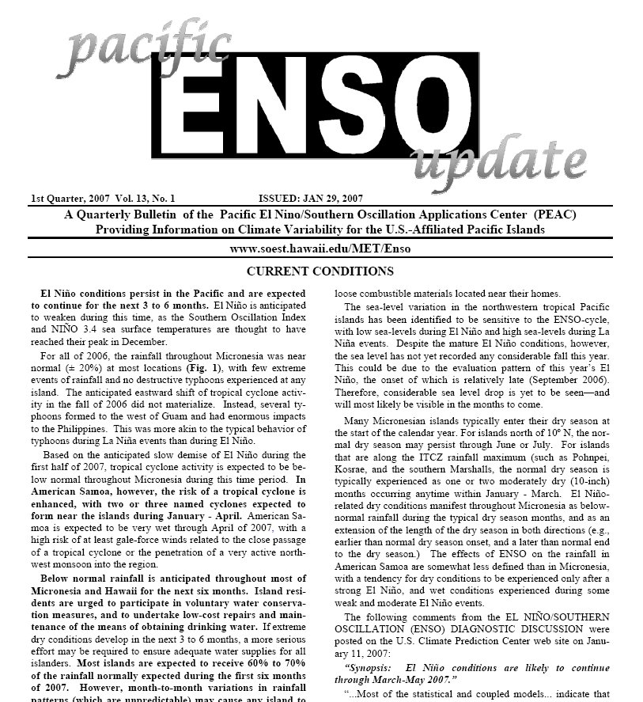
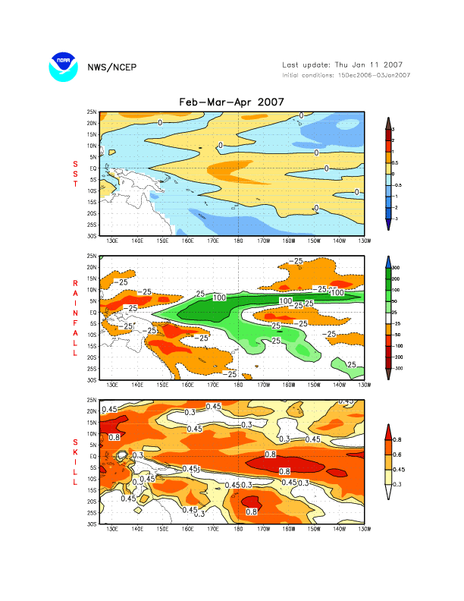
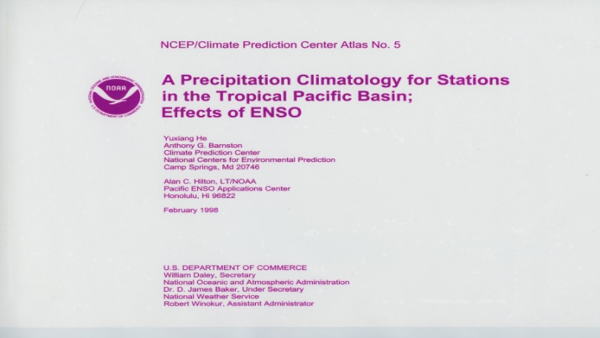
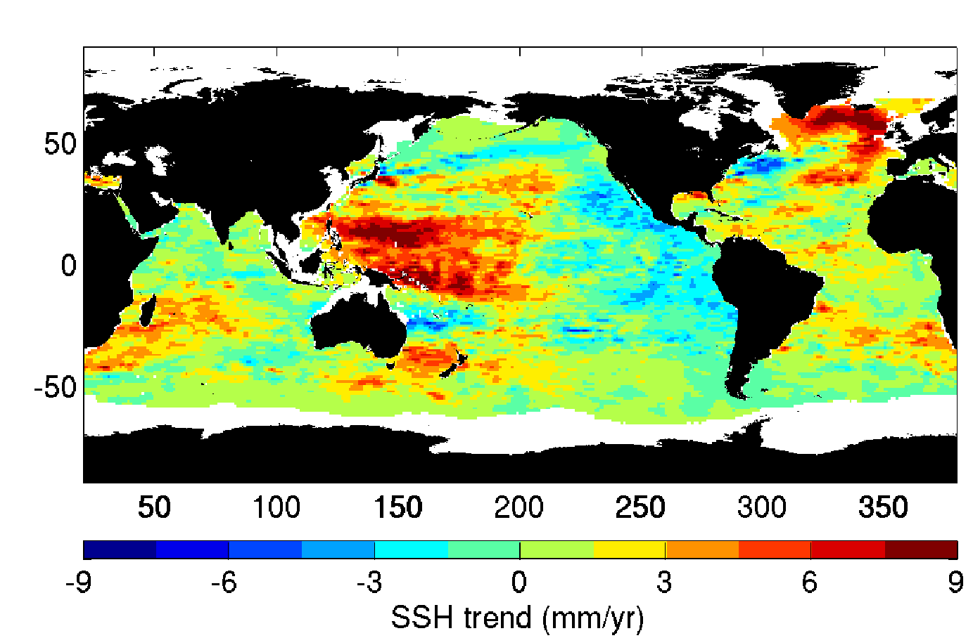
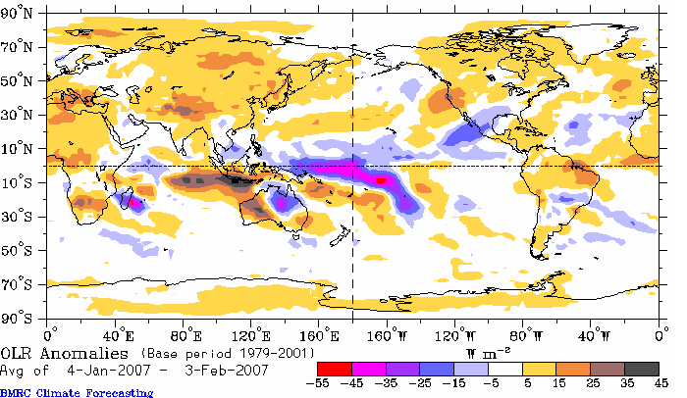
Monthly Pacific ENSO Application Center Climate Teleconference (8:30pm-9:30pm)
Participants: PEAC, CPC, IRI, Pacific-RISA, University of Hawaii, University of Guam, International Pacific Research Center, Hawaii State Climate Office, NWS Climate Service manager for the Pacific region, WSO Climate Service Focal Points for Hawaii and US-affiliated Islands, Federal Emergency Management Agency.
Agenda for the Climate Teleconferences
1. Monthly rainfall report and verification of last season's forecast. 2. Reports from around the region. 3. Sea level discussion. 4. ENSO and climate diagnostic discussion. 5. Forecast discussion and consensus.

Slide 20
Accomplishments and Near-Term & Long-term Tasks Resulting from CPC-PaCIS meeting on July 09
High Res SST/SST images are available (SST past week & past 4 week average), update every Monday
PRIDE Rainfall Model (MME method) is available for seasonal rainfall forecast for Hawaii and US-affiliated islands.
Closely work with PaCIS and participate PaCIS core activities to improve climate forecast and climate service over the Pacific region:
Monthly PEAC Teleconference (provide guidance for the rainfall forecast for the Pacific and PEAC newsletter)
Pacific Rainfall Atlas (expansion of Pacific Rainfall Atlas by including precipitation extremes and tropical cyclone)
Support development of PaCIS portal and regional climate testbed;
(Improve PRIDE rainfall and sea level forecasts, developing decision-support tools for users for the Pacific region)
Users training (One-page on ENSO impacts for Hawaii )

Slide 21
6. Southeastern Climate Consortium (SECC) Muthuvel Chelliah

Slide 22




History and status of partnership between Climate Prediction Center (CPC) and SouthEast Climate Consortium (SECC) RISA.
Summer 2007: First postdoctoral scientist from a RISA on extended stay to visit and work on site at CPC: Dr. Guillermo Baigorria (SECC/University of Florida).
SECC hosts NOAA/CPC’s 32nd Annual Climate Diagnostics and Prediction Workshop, October 22-26, 2007, at Tallahassee Florida: Special session: Application of CPC Climate Outlooks in the Southeast U.S.
Outcome of SECC’s visiting scientist’s collaborative research work with CPC is the following paper:
Forecasting cotton yield in the southeastern USA using coupled global circulation models.
To appear in Agronomy Journal (Baigorria GA, Chelliah M, Mo KC, Romero CC, Jones JW, O'Brien JJ, Higgins RW. 2009)
ABSTRACT: A method of forecasting cotton yields at a county level three months before harvesting season for the states of Alabama and Georgia was evaluated. Cotton yield historical records for 57 counties were obtained from the National Agricultural Statistics Service and detrended using a low-pass spectral filter. A Canonical Correlation Analysis (CCA) regression-based model was annually recalibrated using as input: (i) observed rainfall for the forecasting year during cotton’s vegetative growth (from April to June) and (ii) global-scaled 2-m mean temperatures for years prior to the forecasting year, beginning with 1970. The global data matched the reproductive period of cotton (from July to September). The 0.5-month lead forecast used gridded assimilated observed 2-m mean temperatures obtained from the NCEPNCAR CDAS Reanalysis. The 3-month lead forecast used 2-m mean temperature retrospective forecasts from the operational NOAA/NWS/NCEP Climate Forecasts System coupled circulation model. Short-range near-term forecast skills were measured by leave-one-out cross-validation and retro-active validation, whereas medium-range forecast skills used the previous two validation methods plus a new proposed combined method named coral-reef validation. The agreement between short-range near-term forecast of cotton yield and actual cotton yield was statistically significant at the level of 0.05 in 31 out of 57 counties. For 48% of these 31 counties, the agreement between medium range forecasts of cotton yield and actual cotton yields were statistically significant at a level of 0.05. The goodness-of-fit index for those 15 counties was 0.512 and the RMSE ranged from 13% to 31% of the annual yield.
-Muthuvel Chelliah/CPC

Slide 23


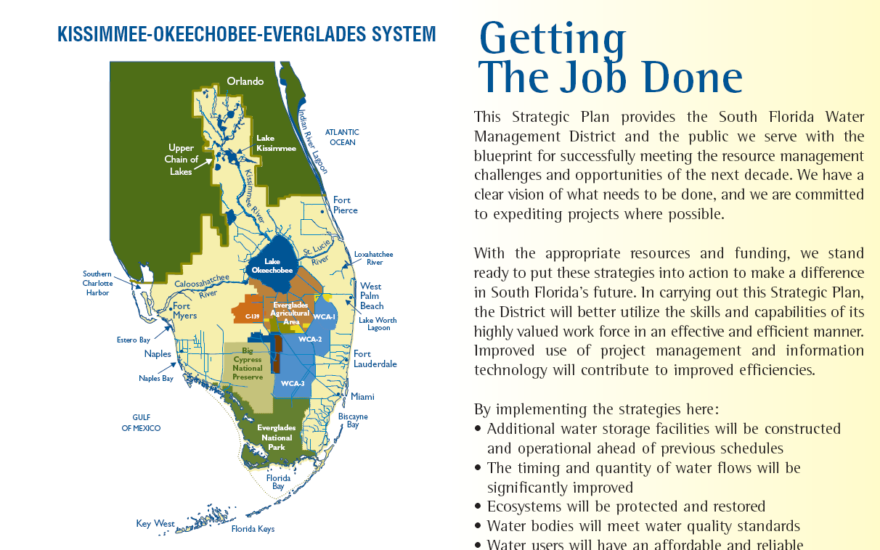
SECC’s
Water Research Activities
seclimate.org
To address Drought and Water management issues in the Southeast, wrote proposals to NOAA CTB and NOAA SARP in 2008 and 2009.
Issue: Integrated Water Resources Planning
For South Florida (Courtesy: Prof. Puneet Srivastava, Auburn University, AL)
South Florida water resources challenges
Population growth and urban expansion
Increasing water demand
Dependence on groundwater for potable supply
Salt water intrusion, Environmental flow to Everglades
Minimum Levels and flows for Lake
Okeechobee and Biscayne aquifer, Climate Variability
Climate Change (sea level rise)
Major effects of climate variability and change on water system
Policies for water management in response to growth and climate change
To address above, as an experimental project, Auburn University/ SECC is currently engaged jointly with CPC in a collaboration/proposal (to NOAA SARP) to develop a Municipal Water Deficit Index (MWDI) for Small- to Mid-Size Cities in Alabama. NOAA CTB has funded a small part of this study (via a mini proposal)
-Muthuvel Chelliah/CPC

Slide 24
7. Climate Impacts Group (CIG) Doug LeComte

Slide 25
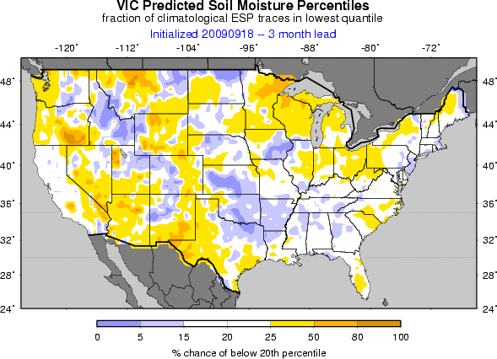
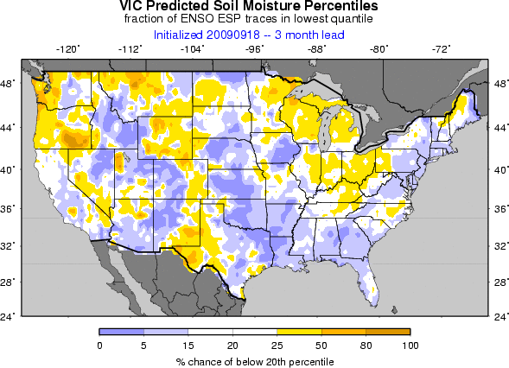
University of Washington RISA: Helping to Develop Probabilistic Drought Forecasts
3-month Soil Moisture Forecast All Years
Forecast Soil Moisture El Nino Years
El Nino reduces drought odds

Slide 26
Selected Near-Term and Long-term Tasks Resulting from August Visit to Seattle
Determine reasons for differences between EMC and WA NLDAS map by looking at forcings
Put total moisture plots on the Web (include snow)
Plot the probability of recovery from drought (count number of ensemble members showing drought recovery)
Verify forecast drought recovery forecasts with active SCAN stations
Determine appropriate soil depth for agricultural drought monitoring
Work on strategy to differentiate between Ag and Hydro drought (compare modeled drought recovery with USGS streamflow anomalies)
Merge short-term weather forecasts with seasonal forecasts to improve prediction skill

