Slide 1
TRAINING SESSION
ON
USING THE IRI CLIMATE PREDICTABILITY TOOL (CPT)
VADLAMANI KUMAR

Slide 2
IN THIS INITIAL SESSION
EMPHASIS IS ON USING THE TOOL
NOT ON DEEP DISCUSSION OF THE RESULTS
FAMILIARISING WITH THE MENUS
SELECTING THE INPUT DATA
RUNNIG THE EXPERIMENTS
RUNNING THE FORECASTS
VIEWING THE RESULTS
SAVING THE PLOTS
FINALLY SAVING THE PROJECT
ALONG WITH THE INPUT DATA AND
THE OUTPUT DATA AND PLOTS

Slide 3
EXPERIMENT 1
GLOBAL TROPICAL OCEAN SST AS PREDICTOR
CPC PRECL MARITIME CONTINENT AS PREDICTAND

Slide 4
PARTICIPANTS ARE ENCOURAGED TO INTERRUPT NOT ONLY TO ASK
QUESTIONS BUT ALSO TO CONTRIBUTE TO THE DISCUSSION AND
THE LEARNING PROCESS
NOW THE SESSION BEGINS !!
PLEASE DO NOT GET TIRED OF CLICKS

Slide 5
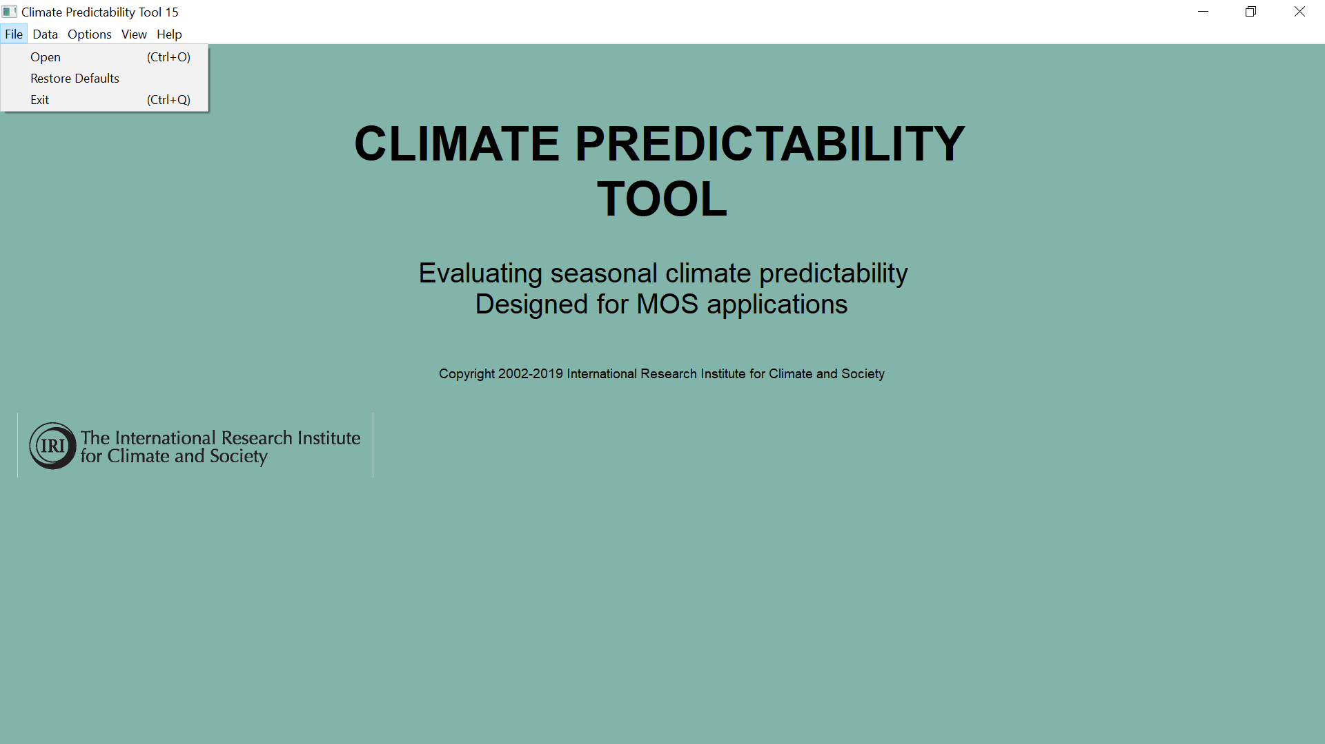

Slide 6
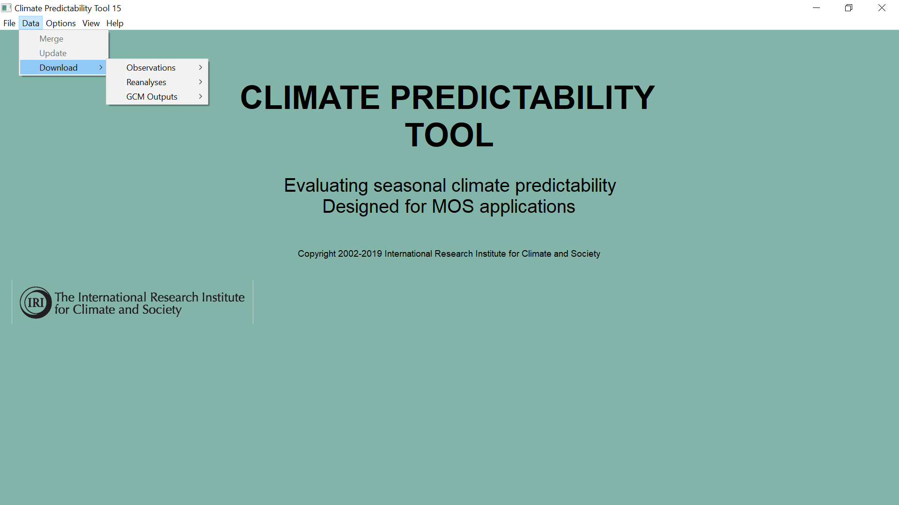

Slide 7
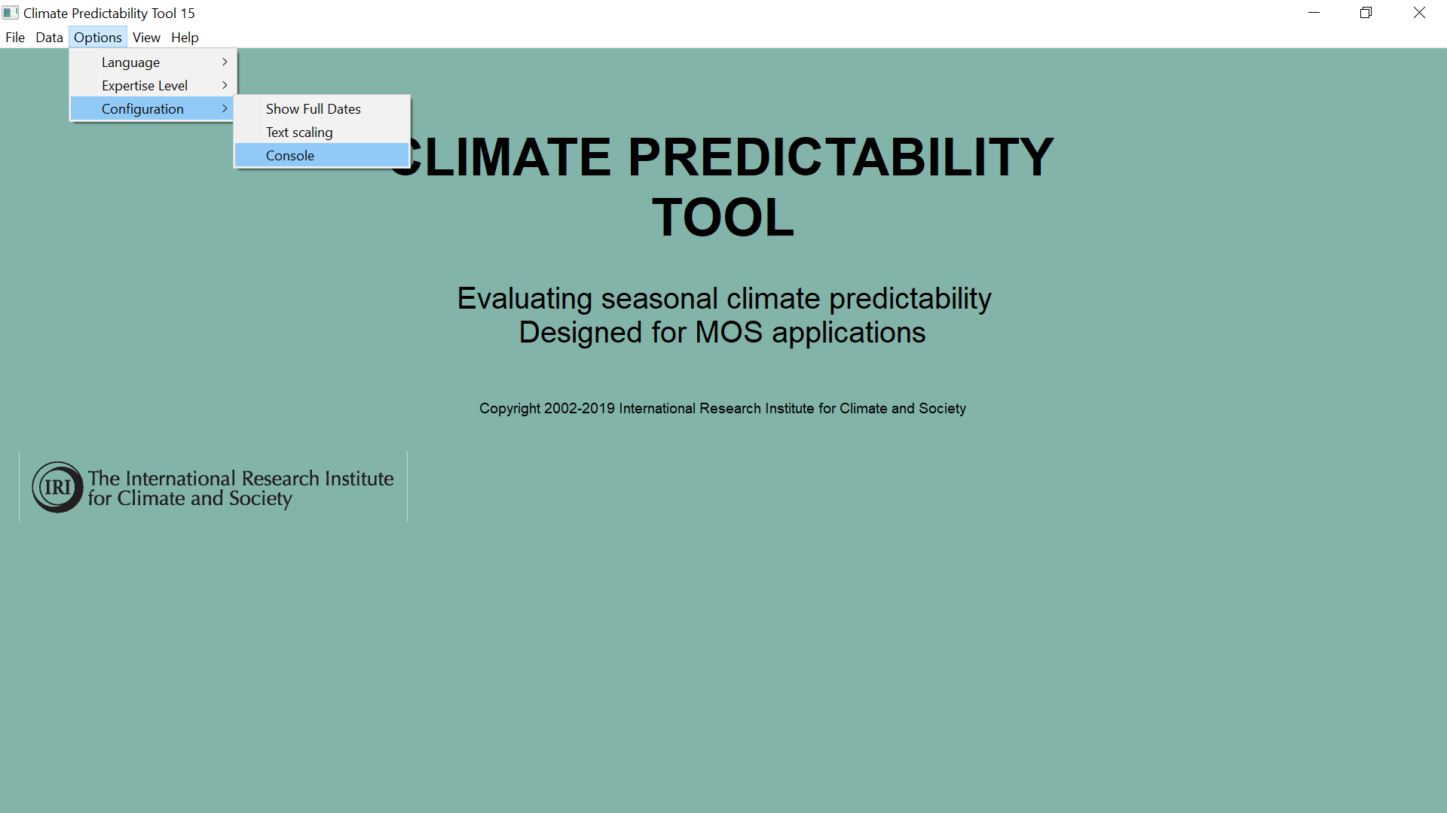

Slide 8
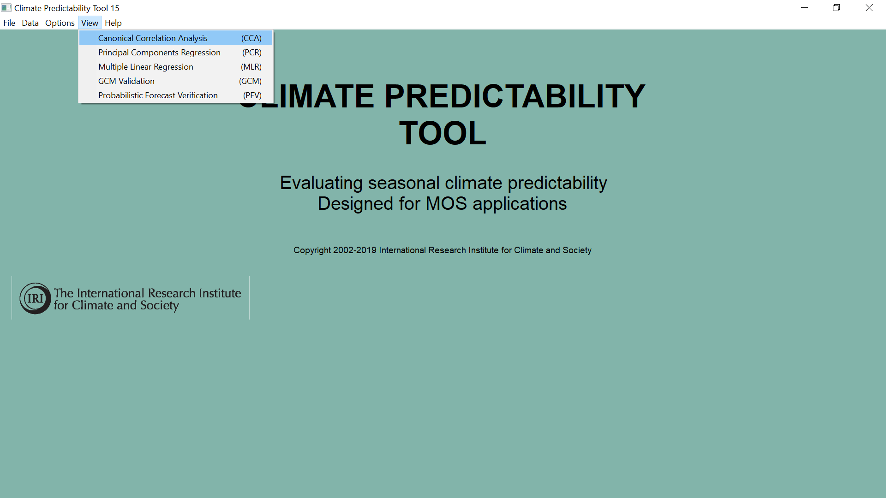

Slide 9
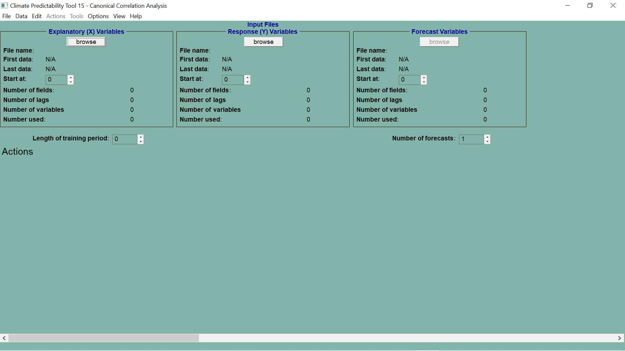
PREDICTOR X
PREDICTAND Y
FORECAST VARIABLE X

Slide 10
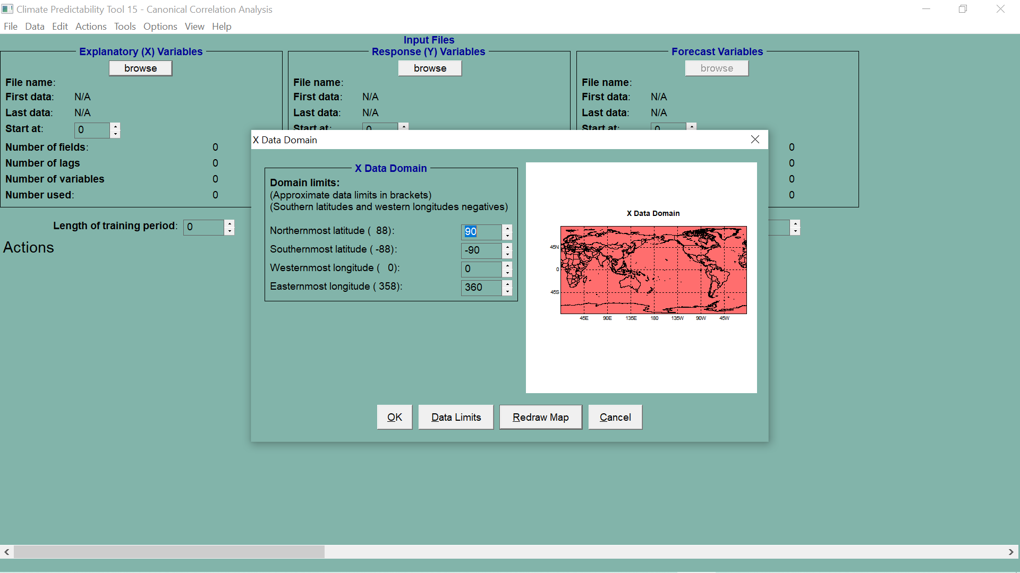

Slide 11
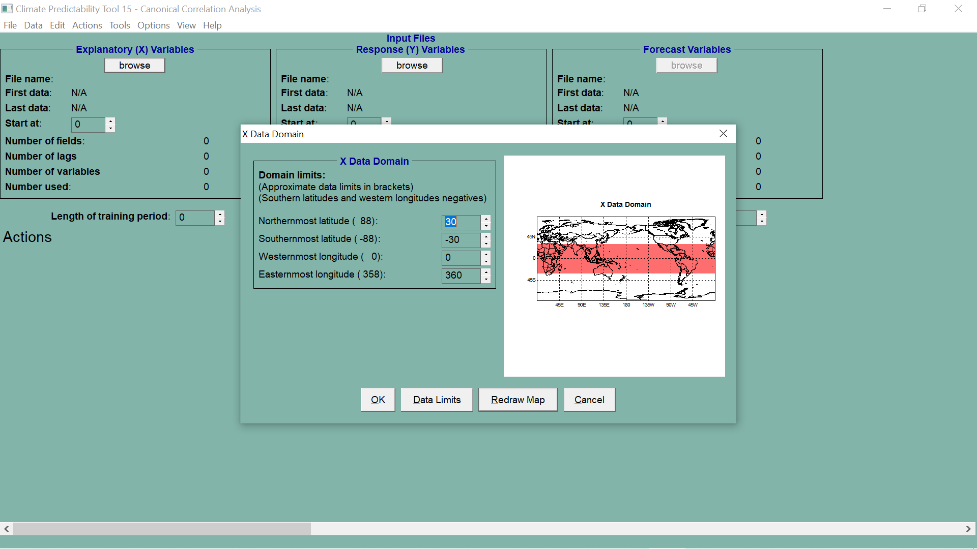

Slide 12
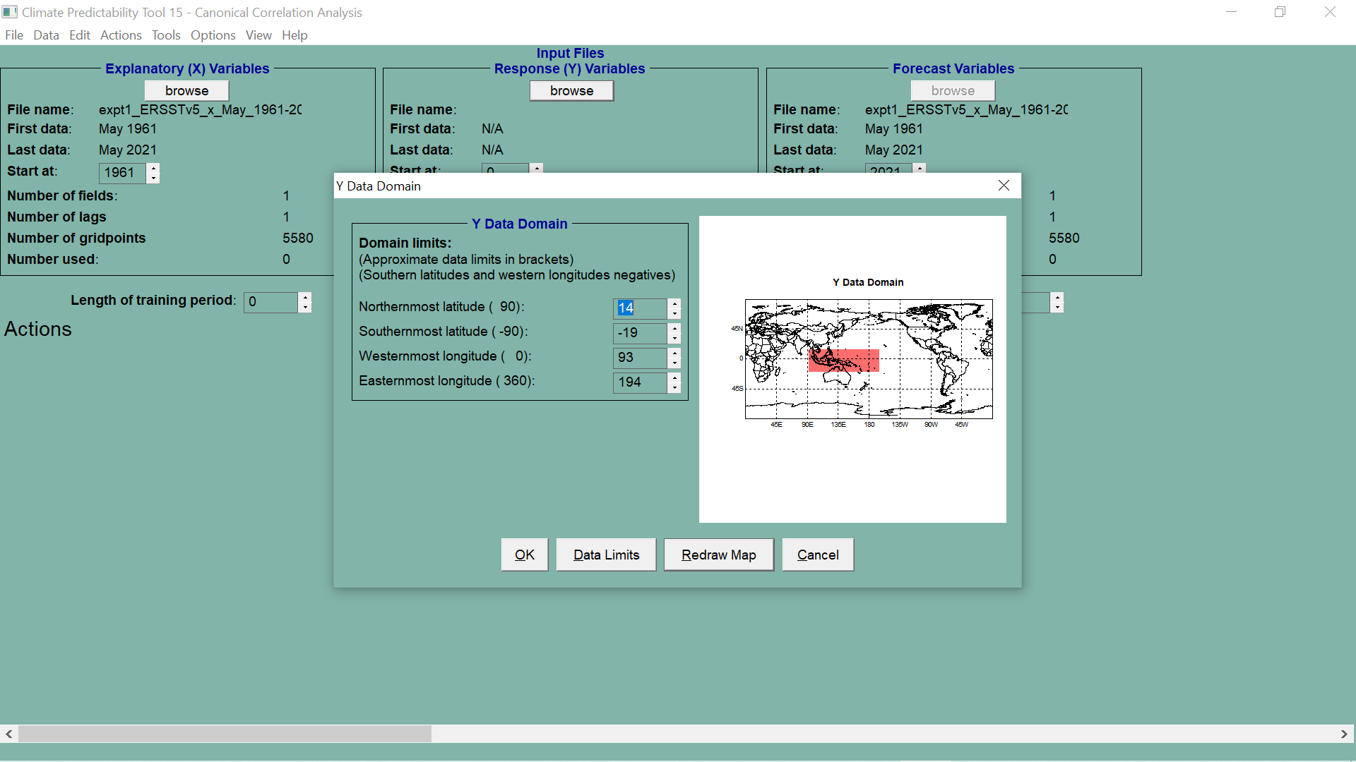

Slide 13
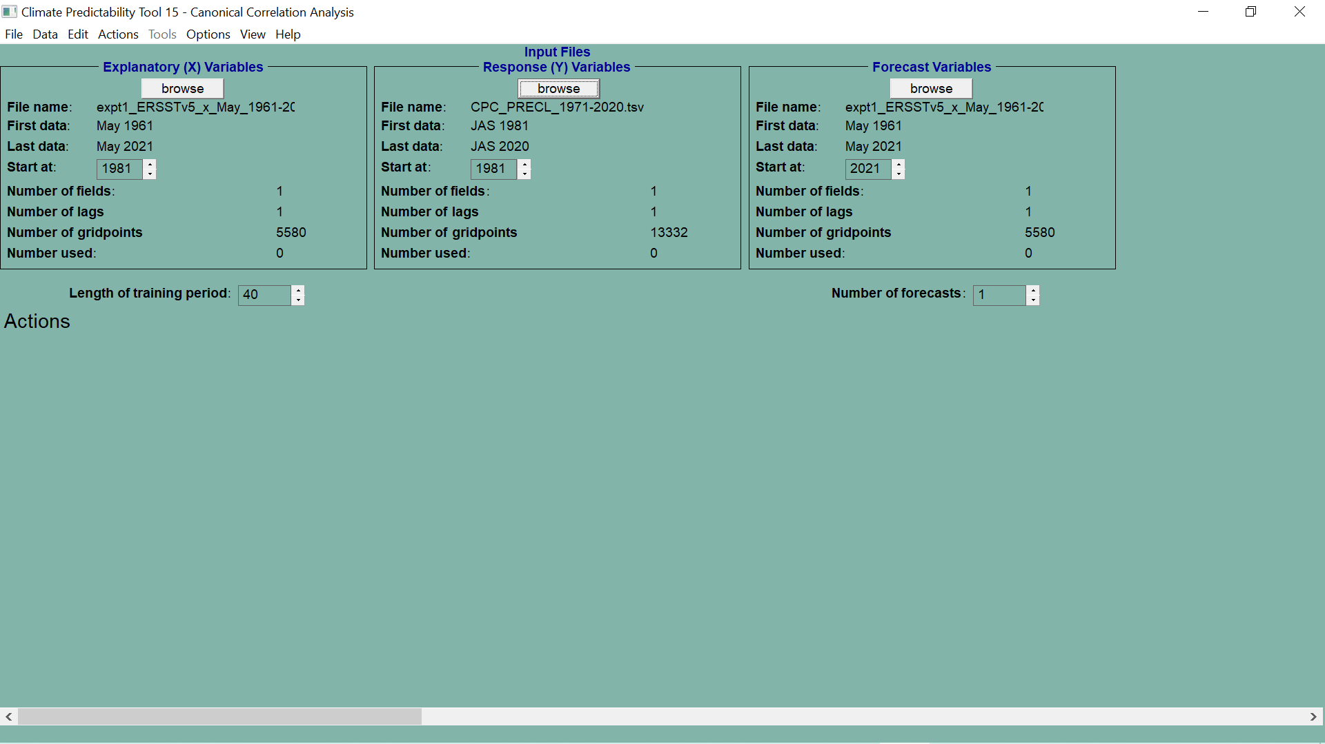

Slide 14
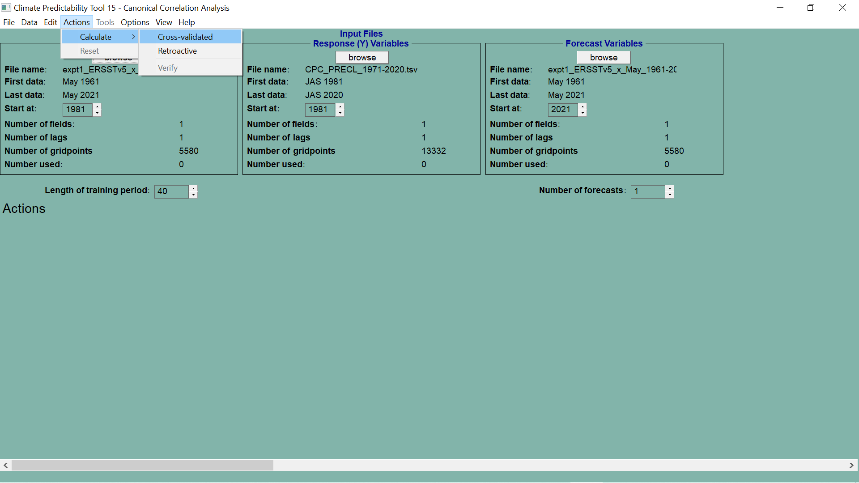

Slide 15
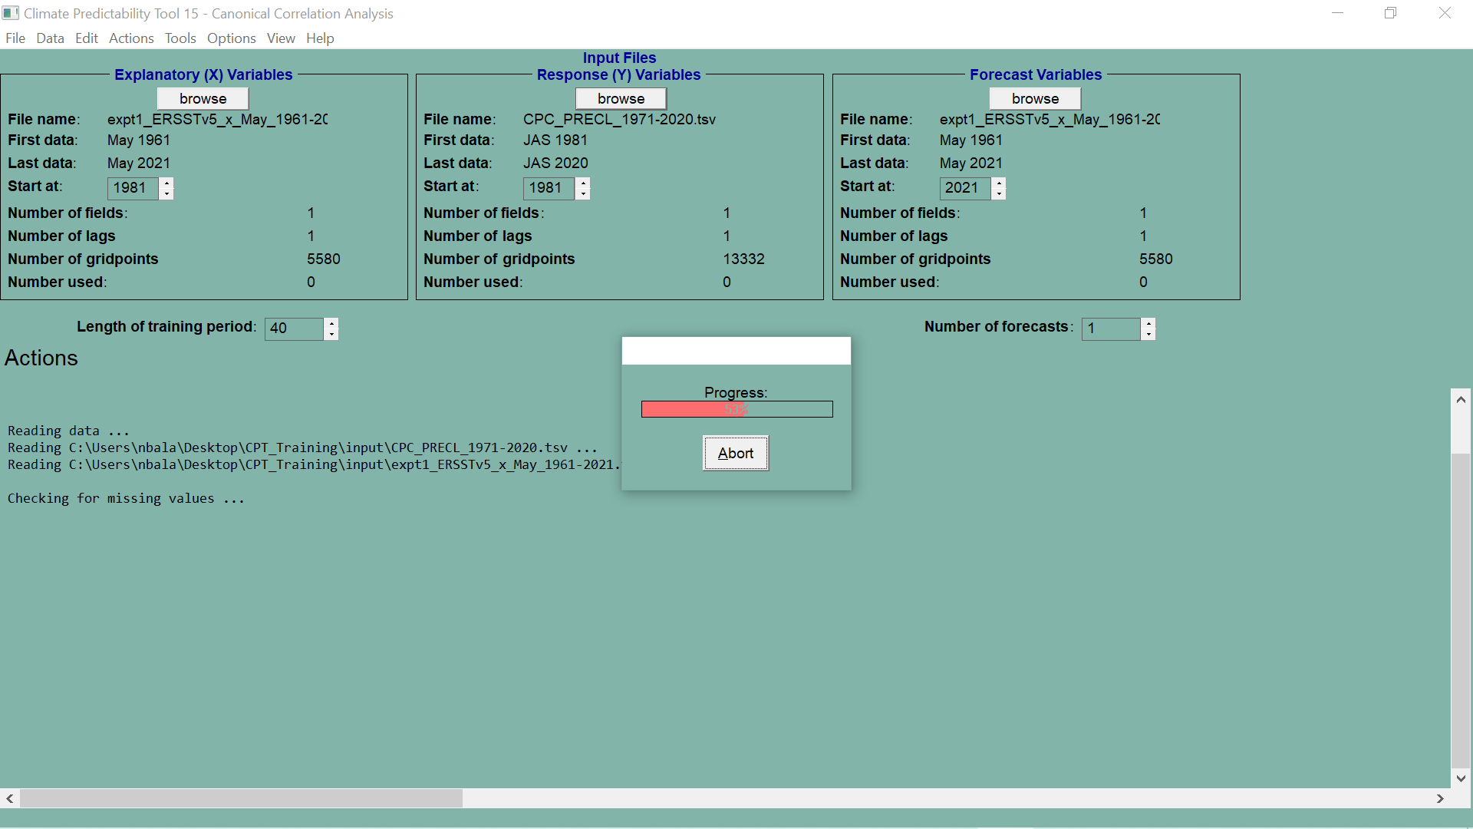

Slide 16
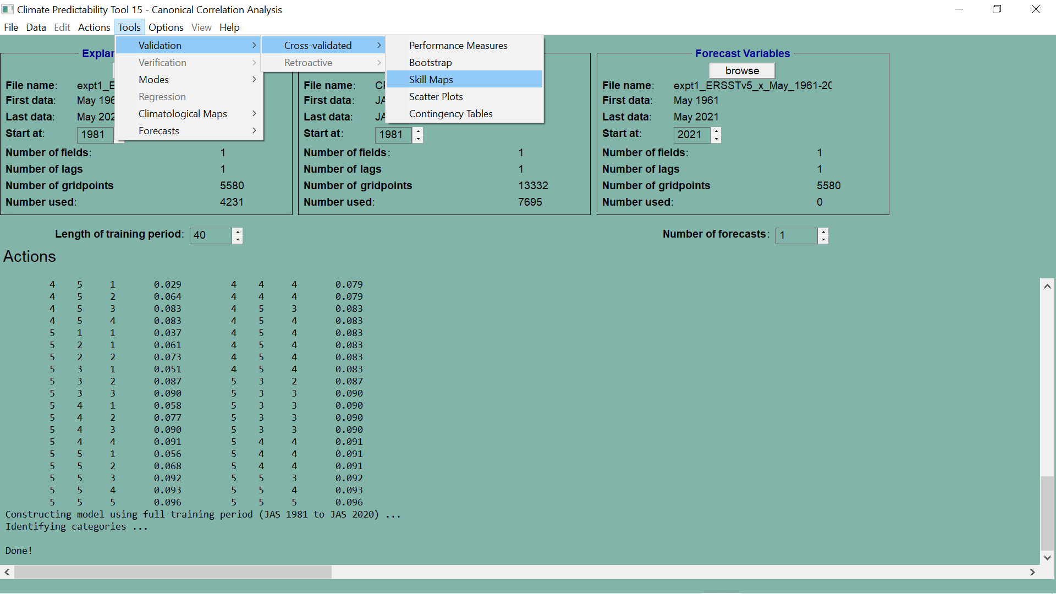

Slide 17
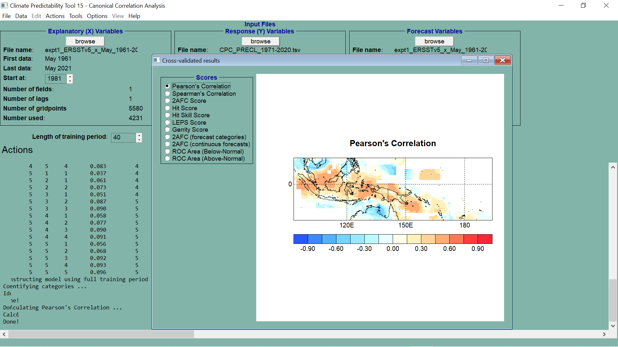

Slide 18
SAVING RESULTS

Slide 19
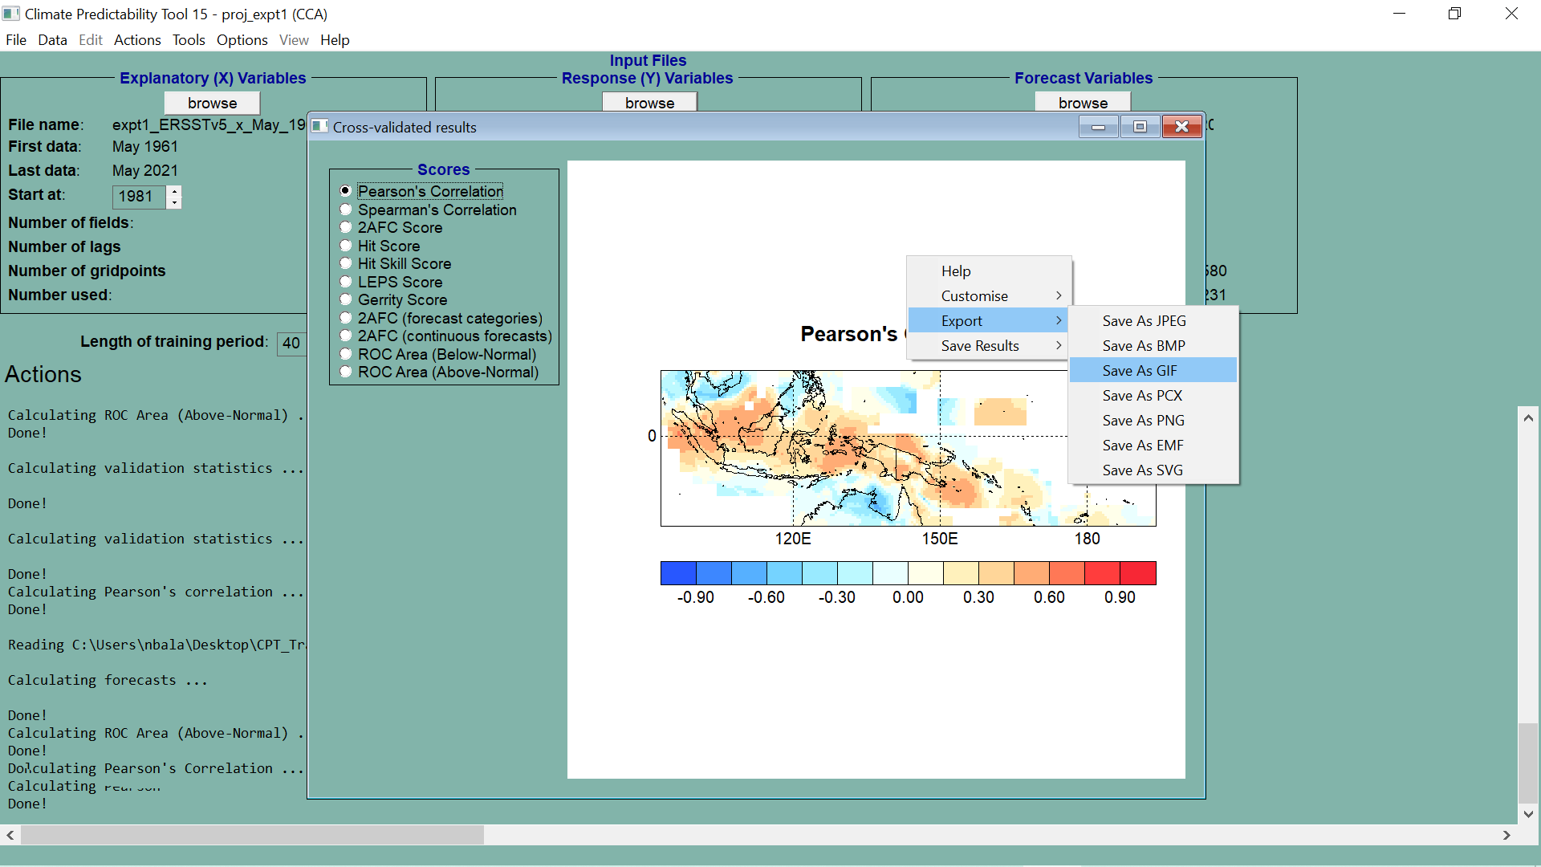

Slide 20
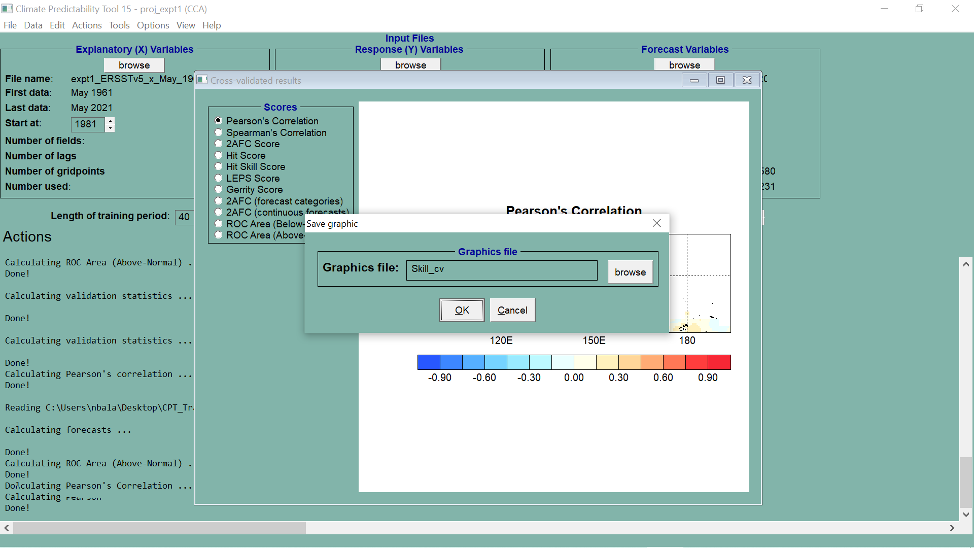

Slide 21
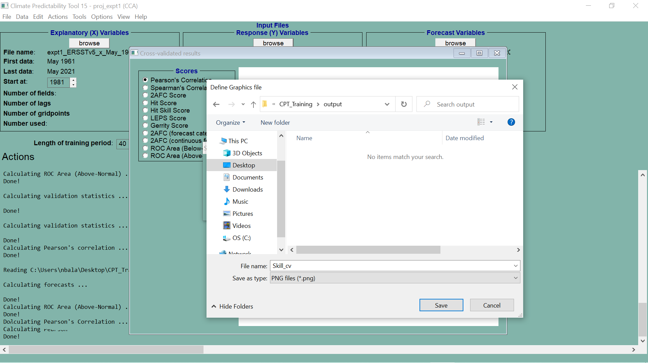

Slide 22


Slide 23
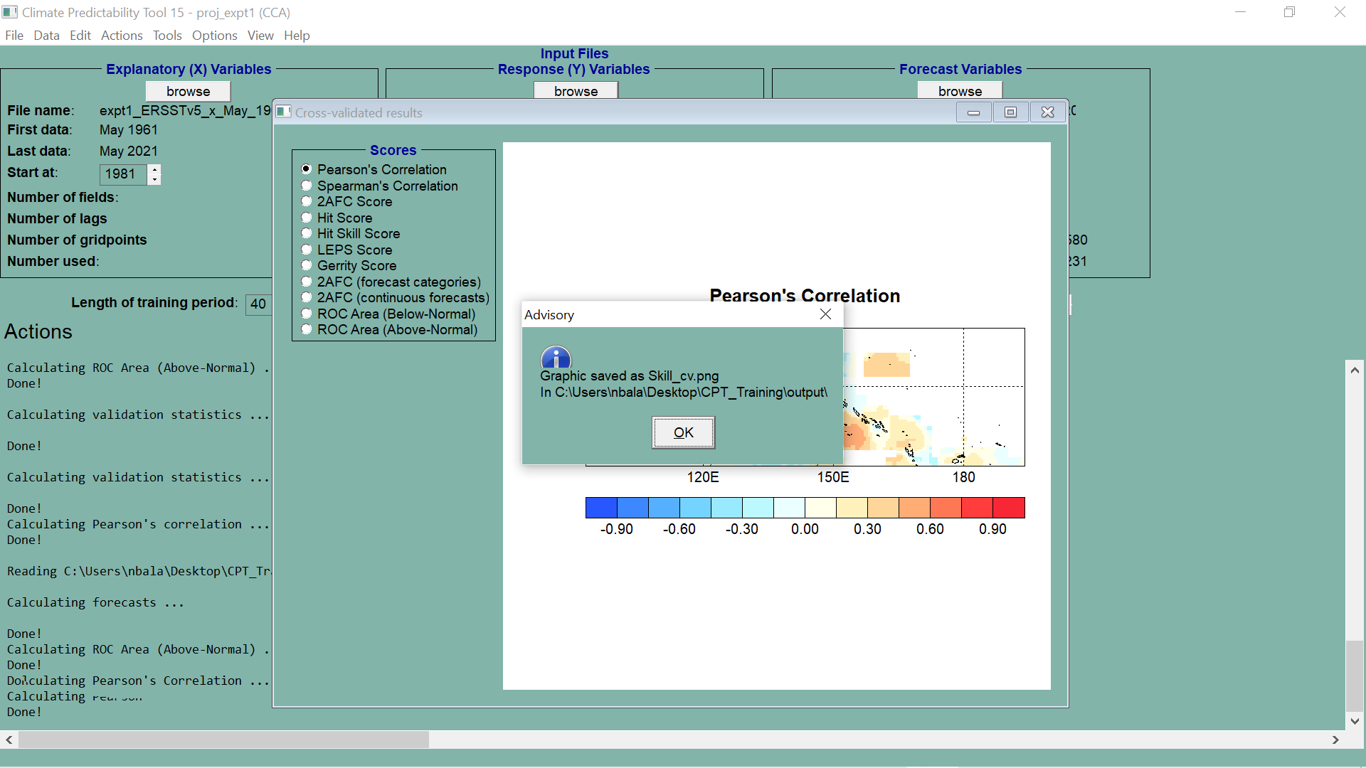

Slide 24
EXPLORE MORE RESULTS

Slide 25


Slide 26
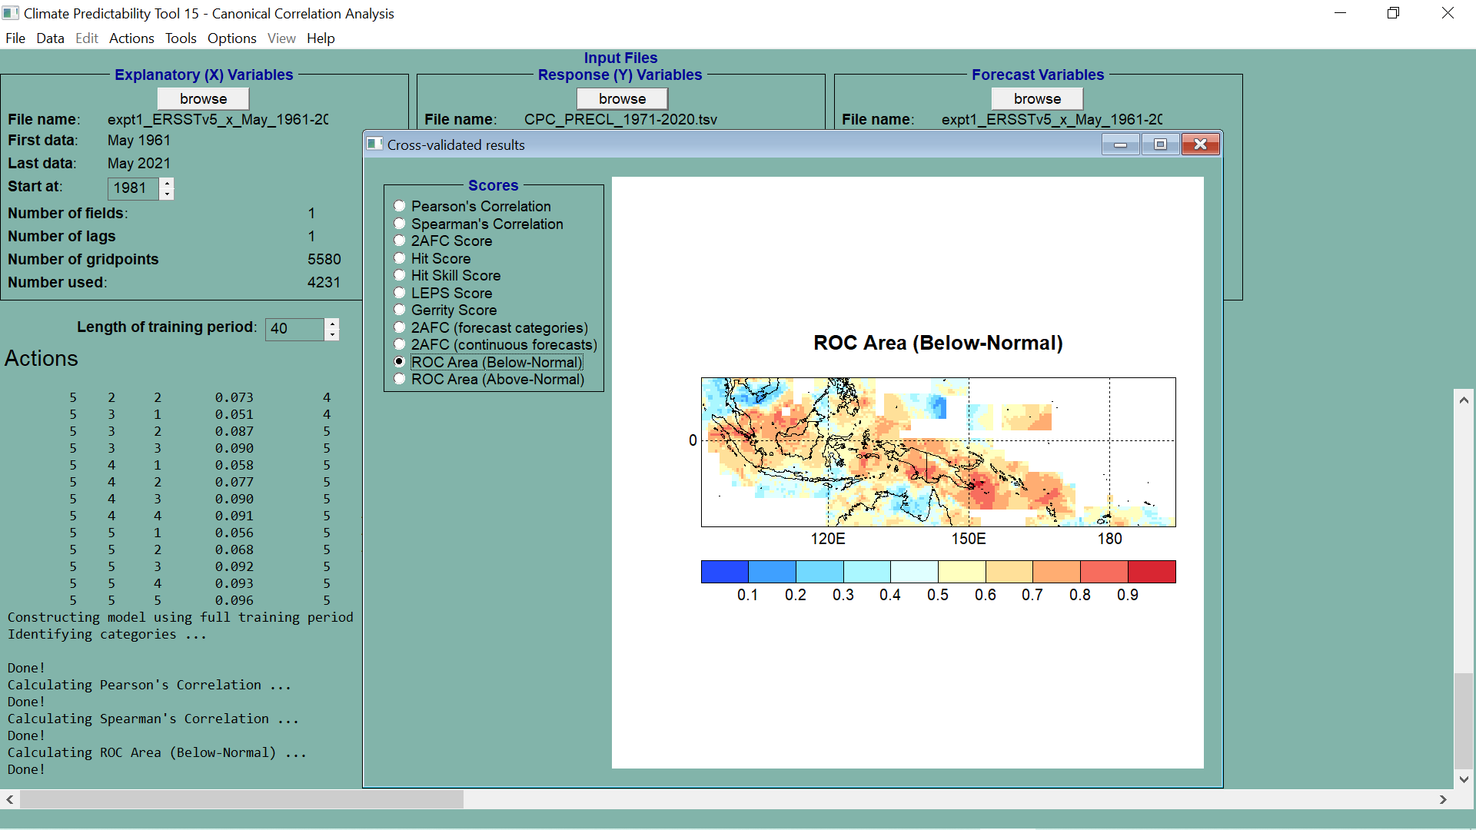
THIS MAP IS CLICKABLE FOR ROC CURVES

Slide 27
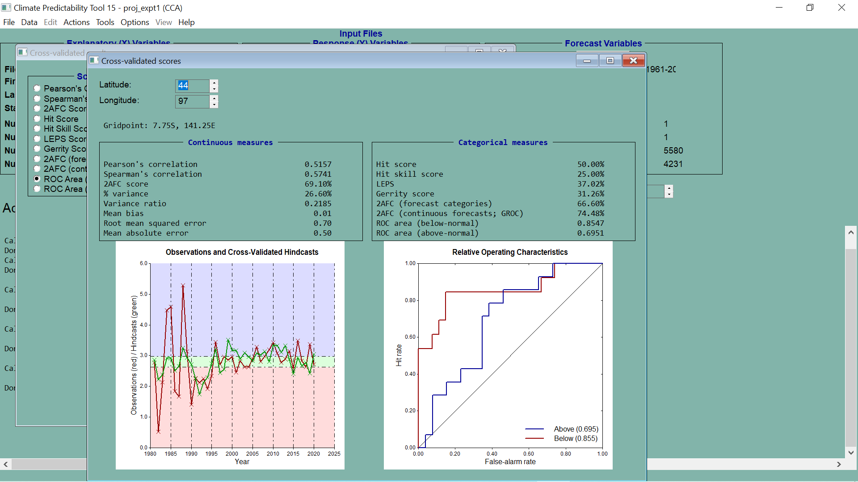

Slide 28


Slide 29
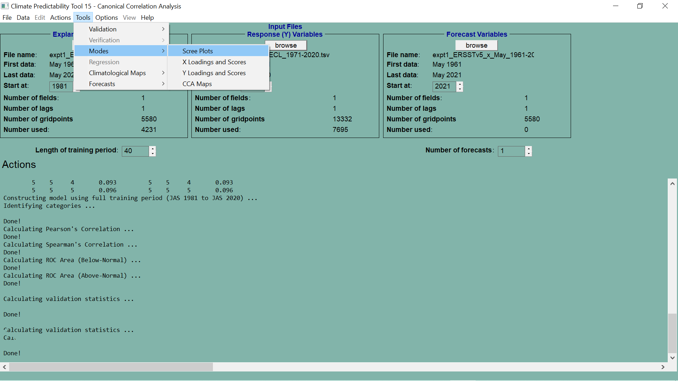

Slide 30
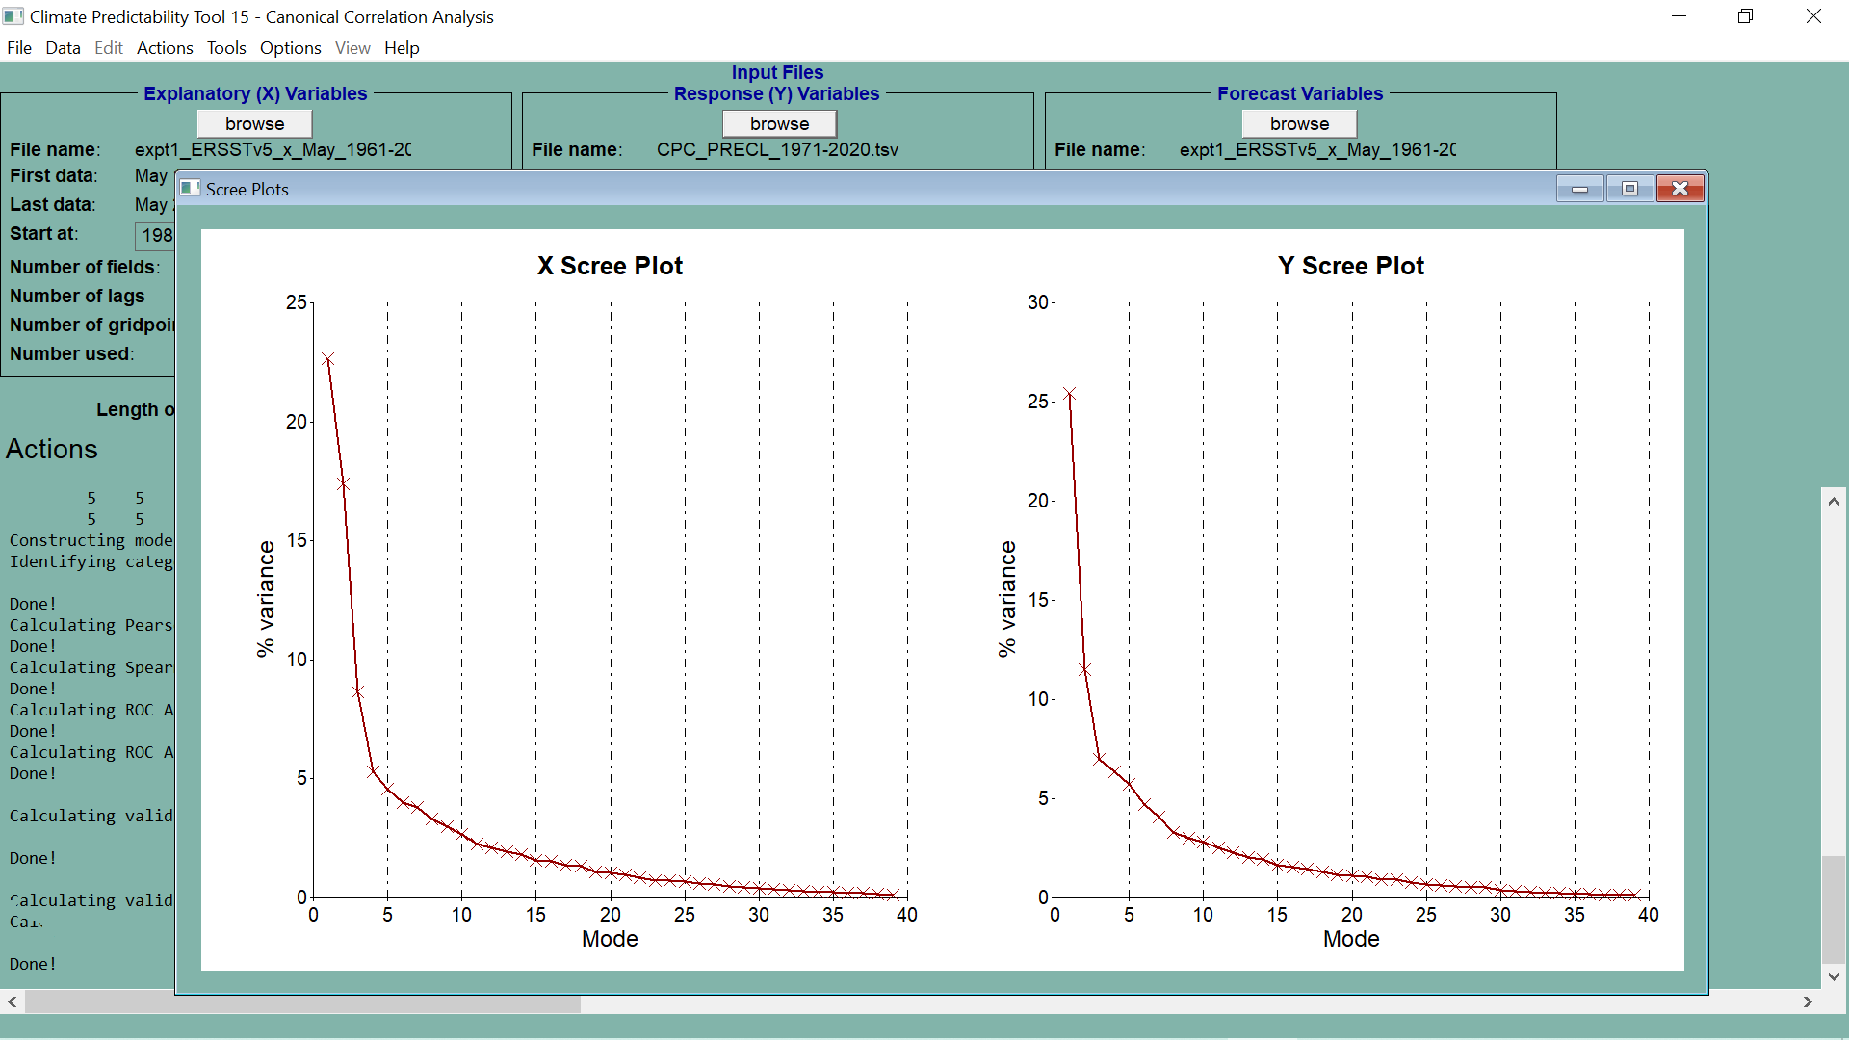

Slide 31
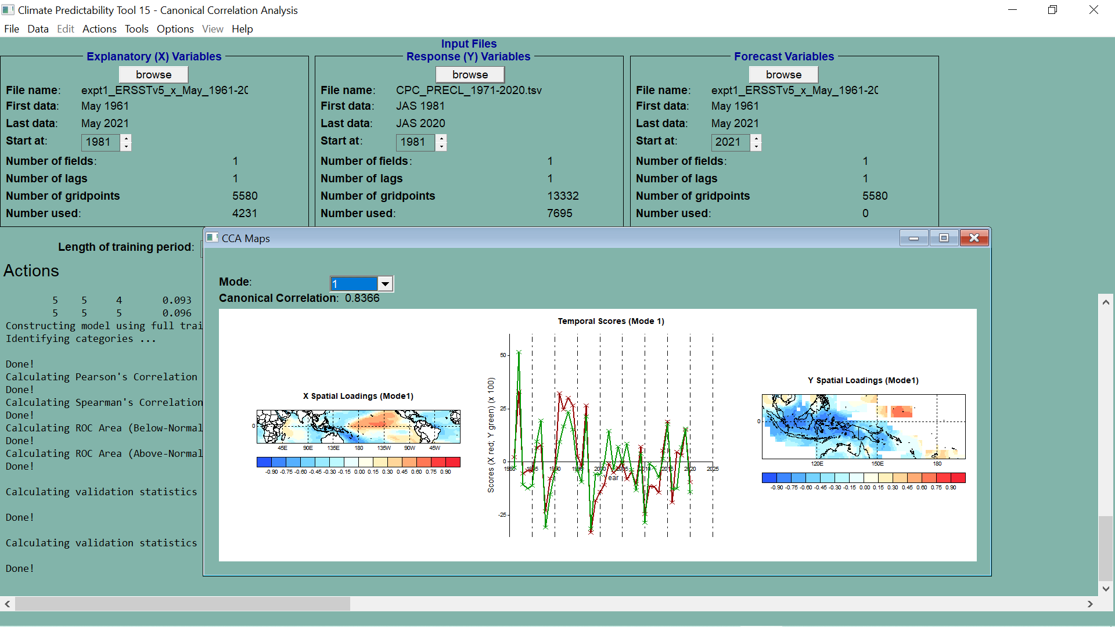

Slide 32
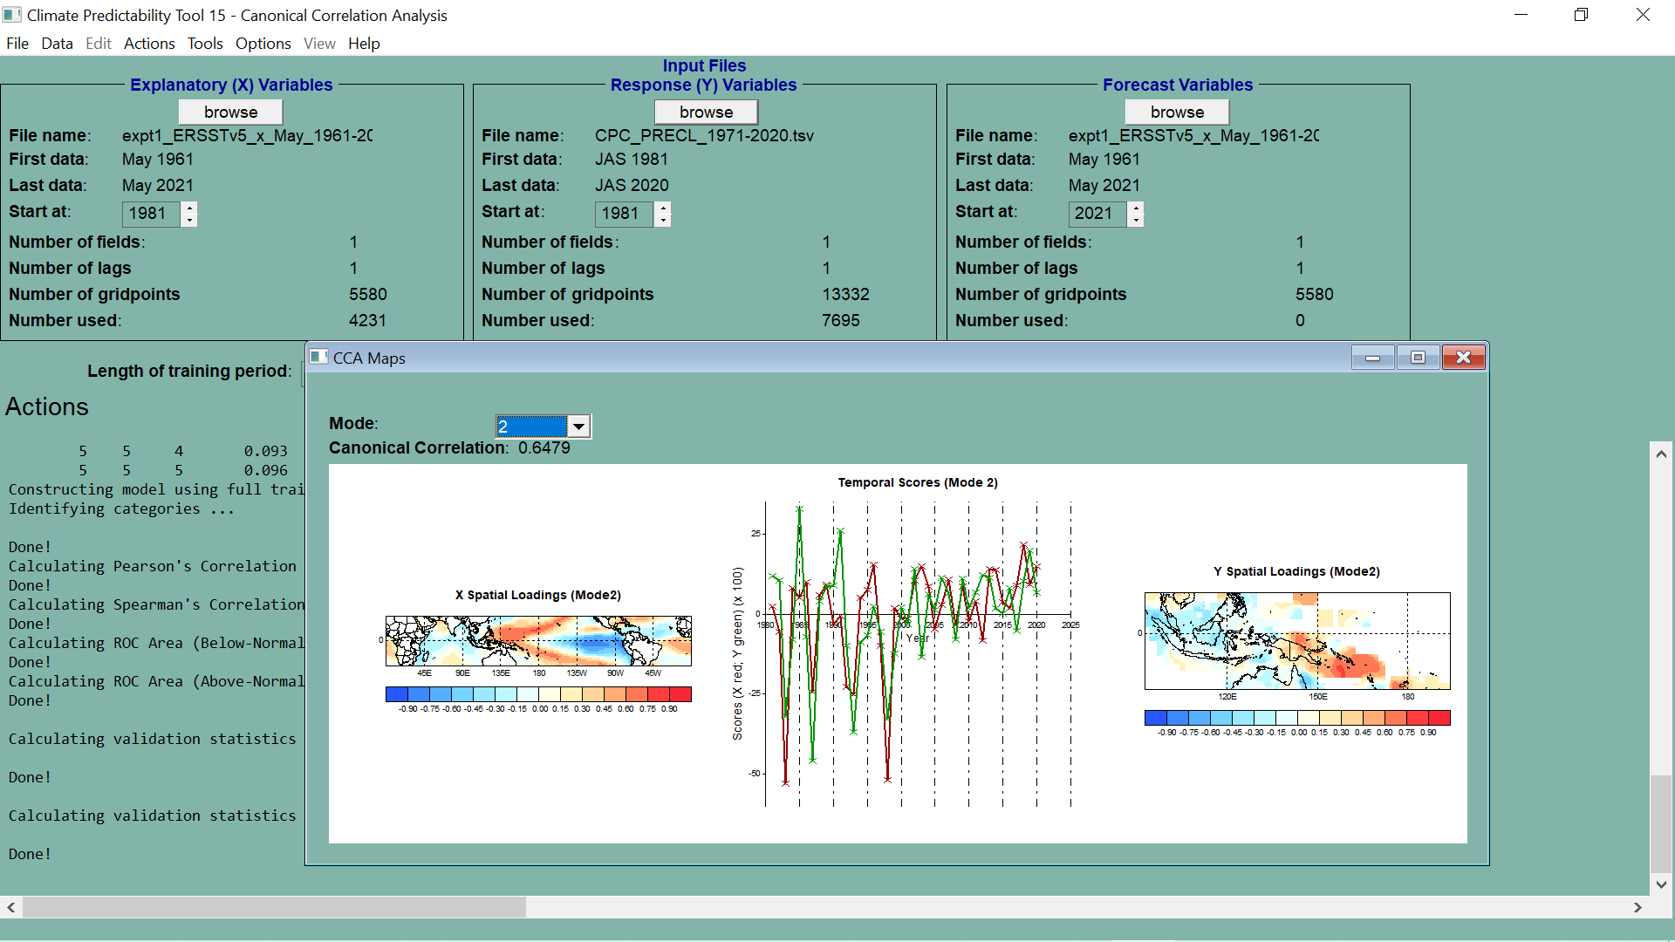

Slide 33
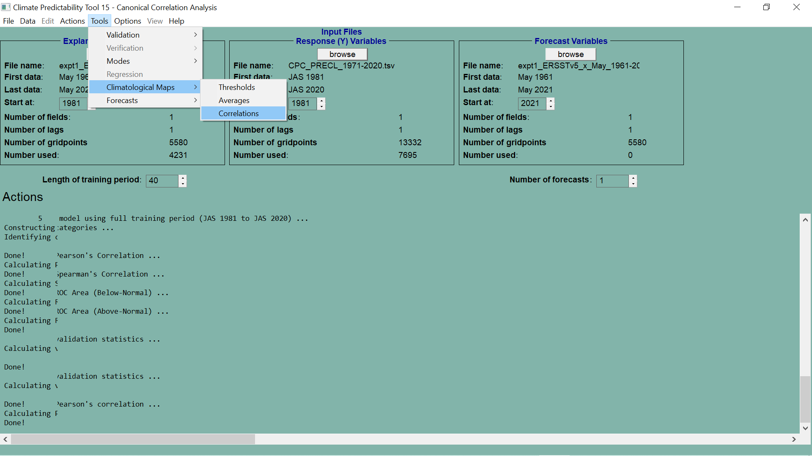

Slide 34
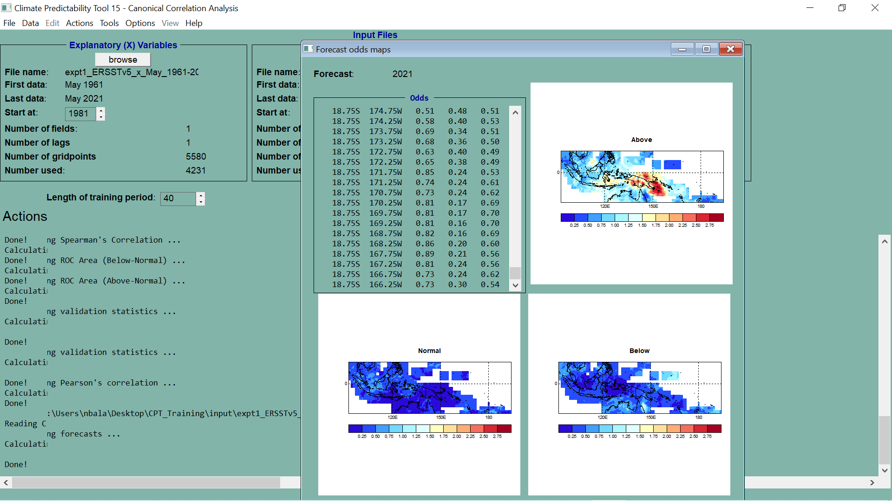

Slide 35
CLIMATOLOGIES
AVERAGES
CORRELATIONS

Slide 36
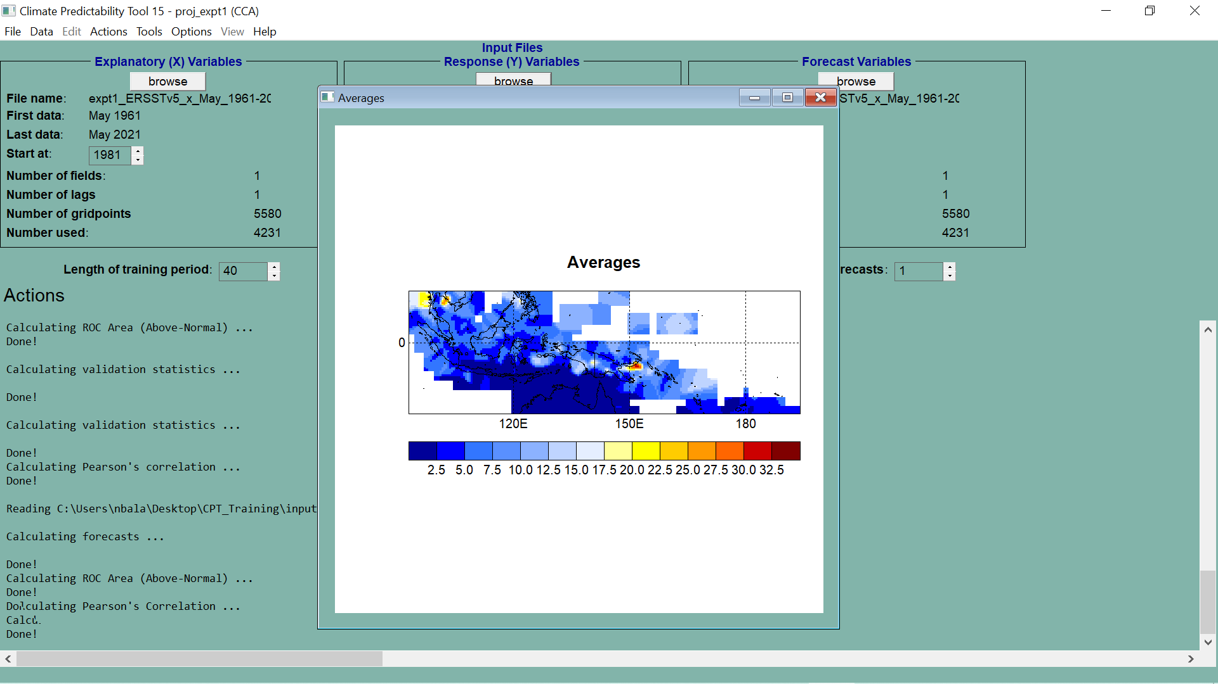

Slide 37
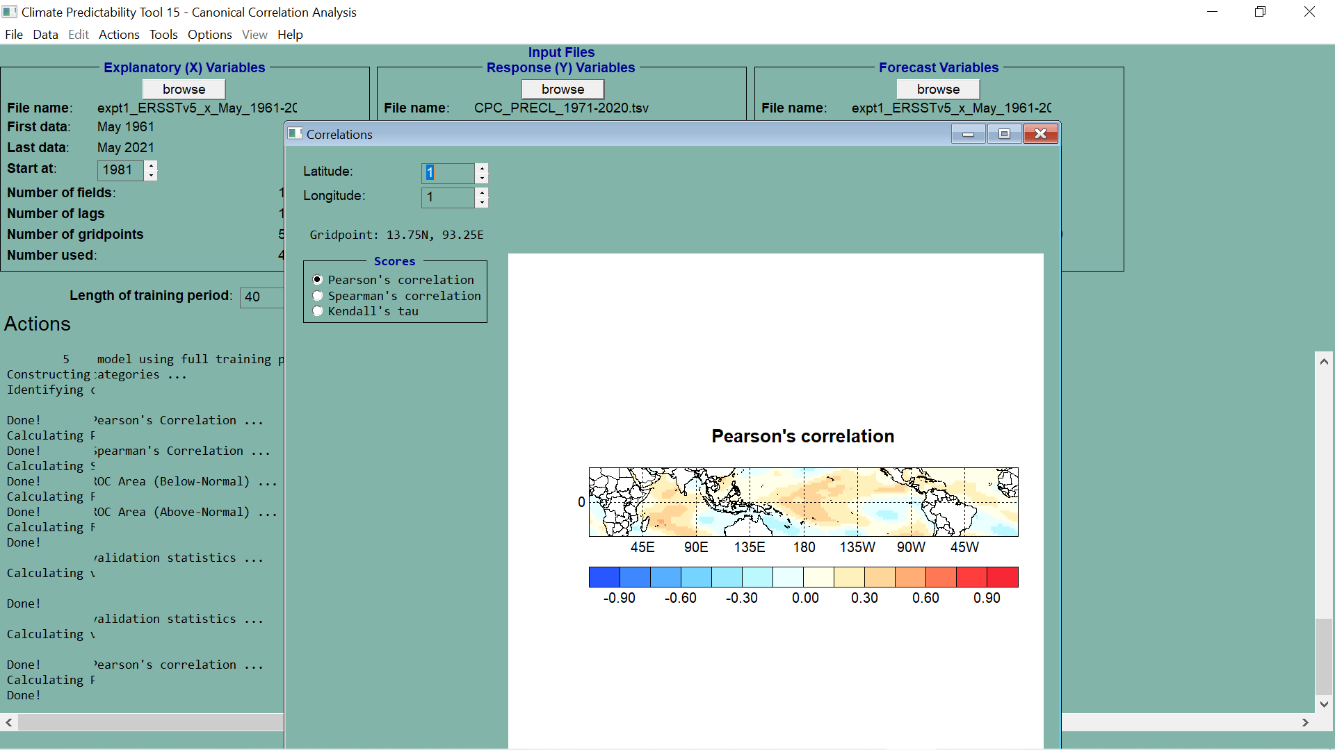

Slide 38
PROBABILISTIC MAPS

Slide 39
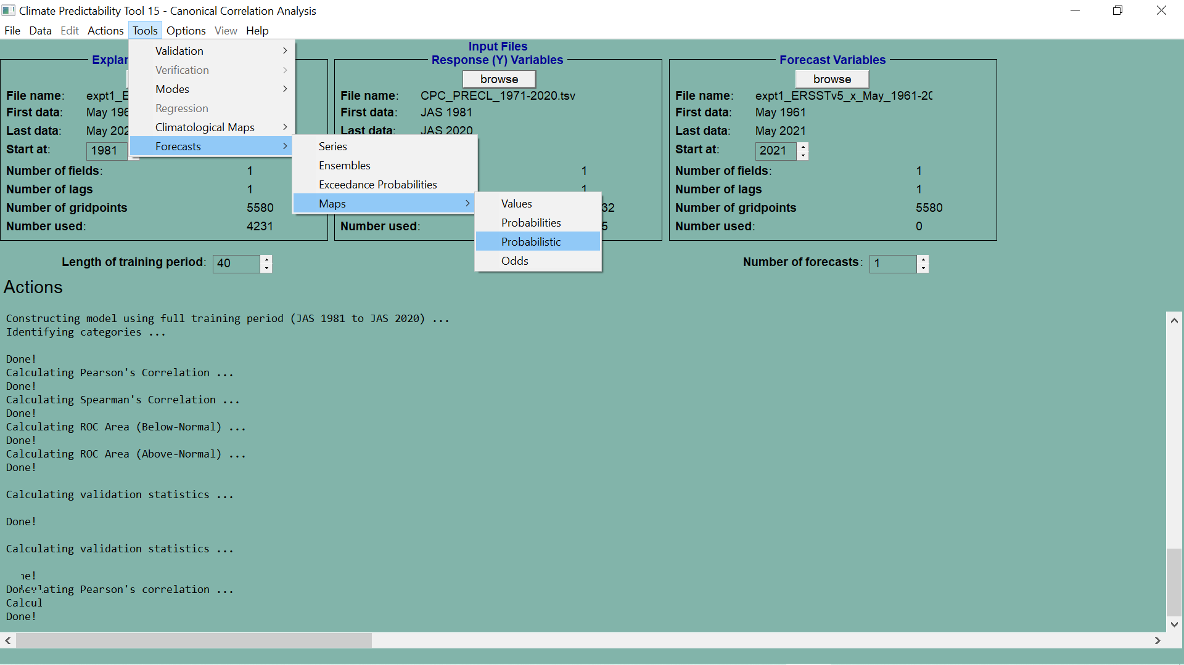

Slide 40
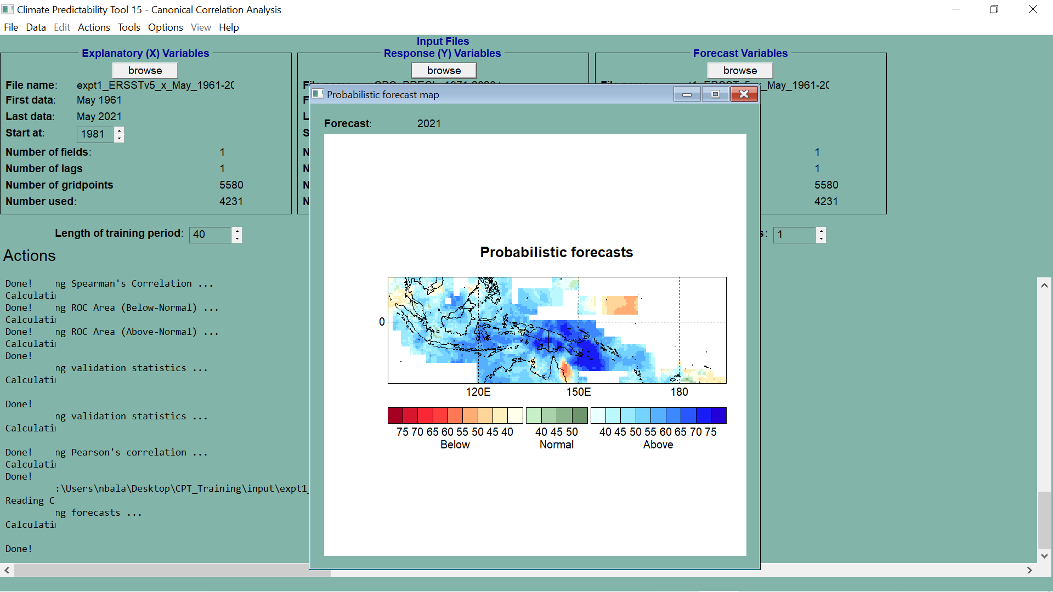

Slide 41
DATA DOWNLOADS

Slide 42
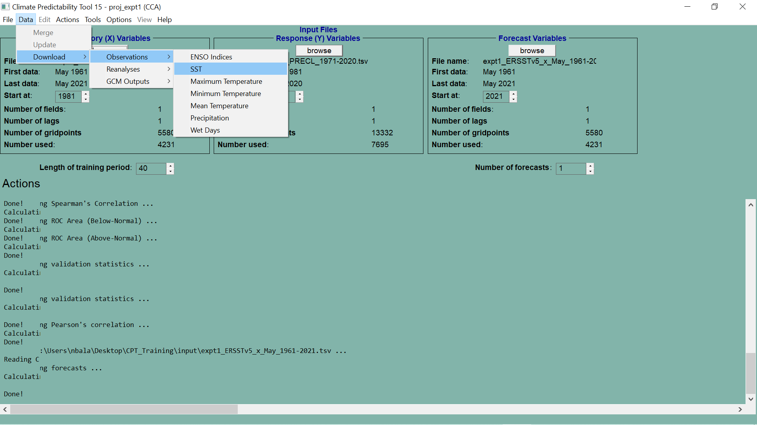

Slide 44
IRI DATA LIBRARY
DATA SELECTION AND SAVING

Slide 45
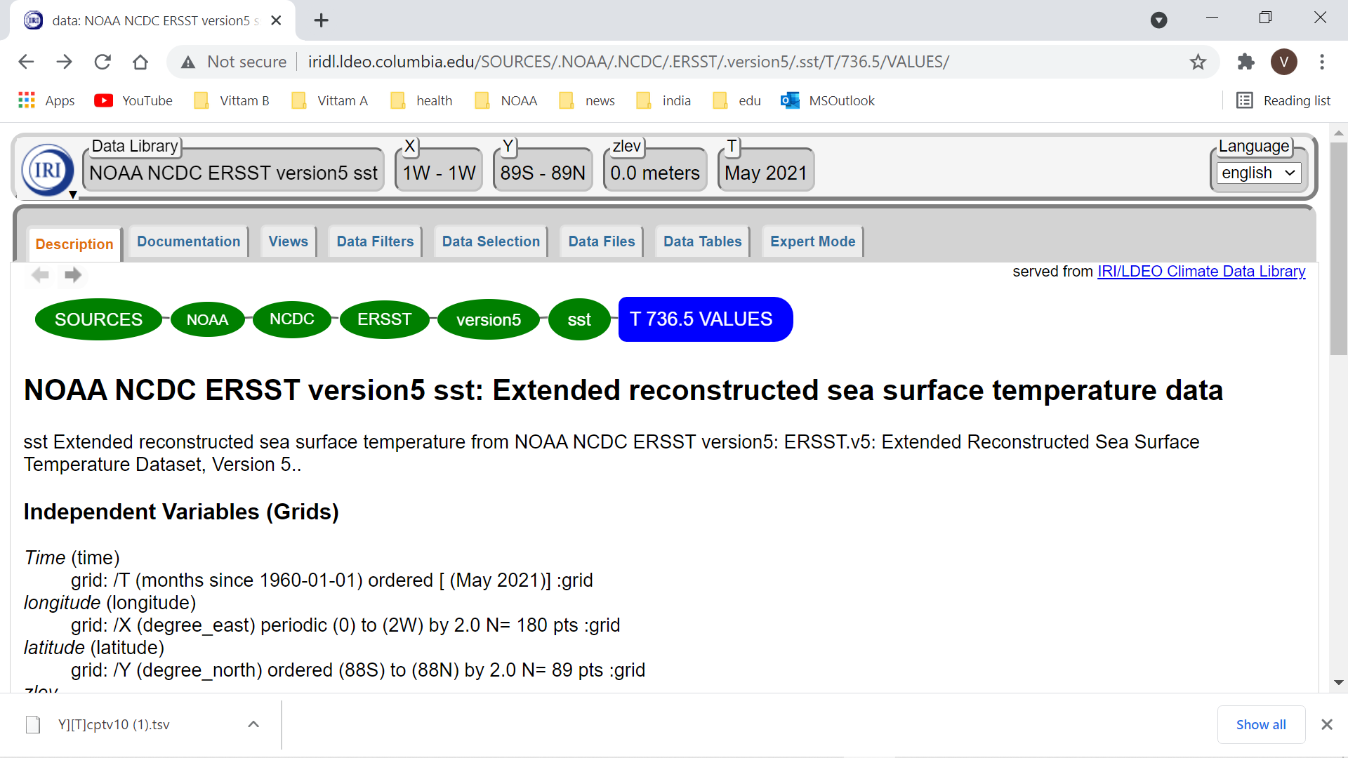

Slide 46
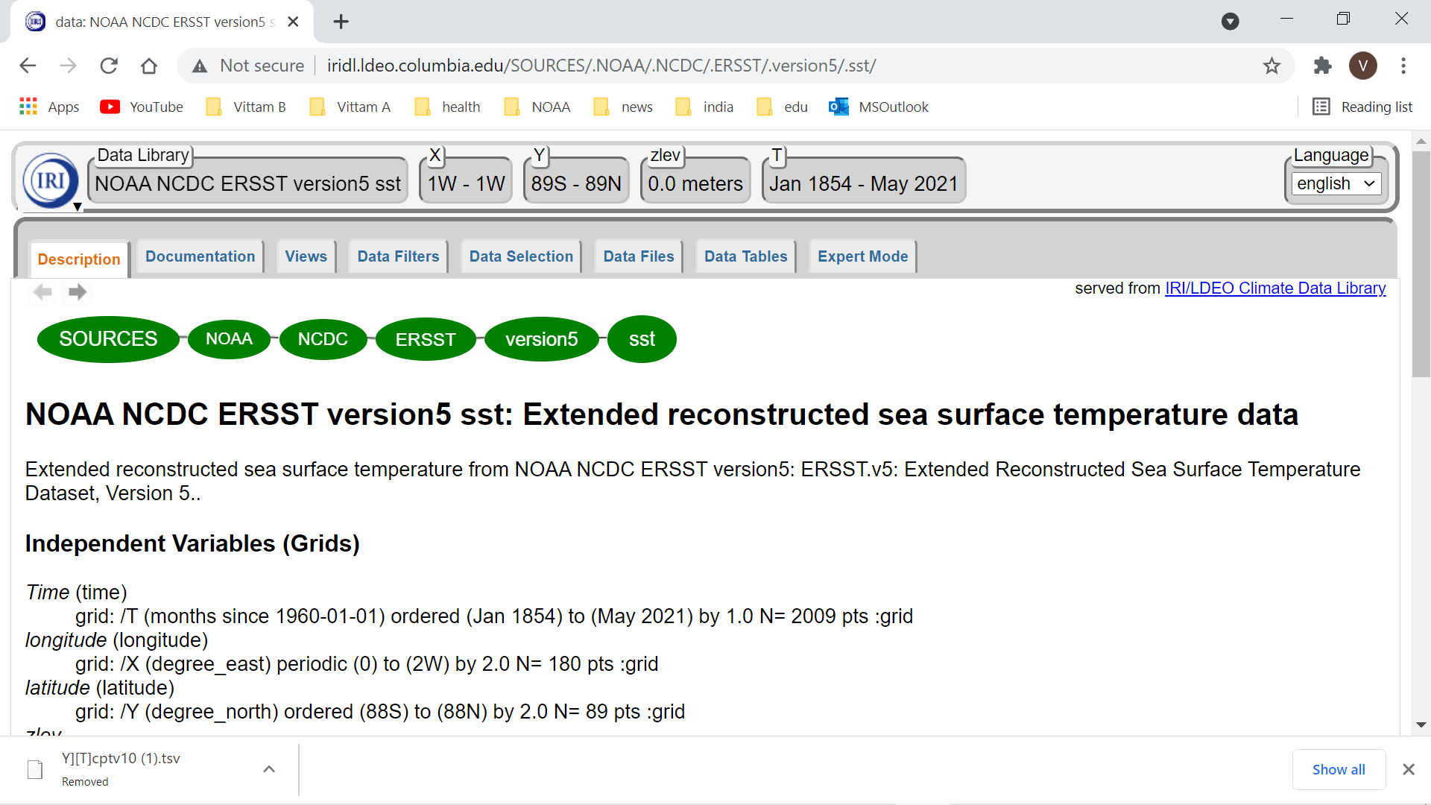

Slide 47
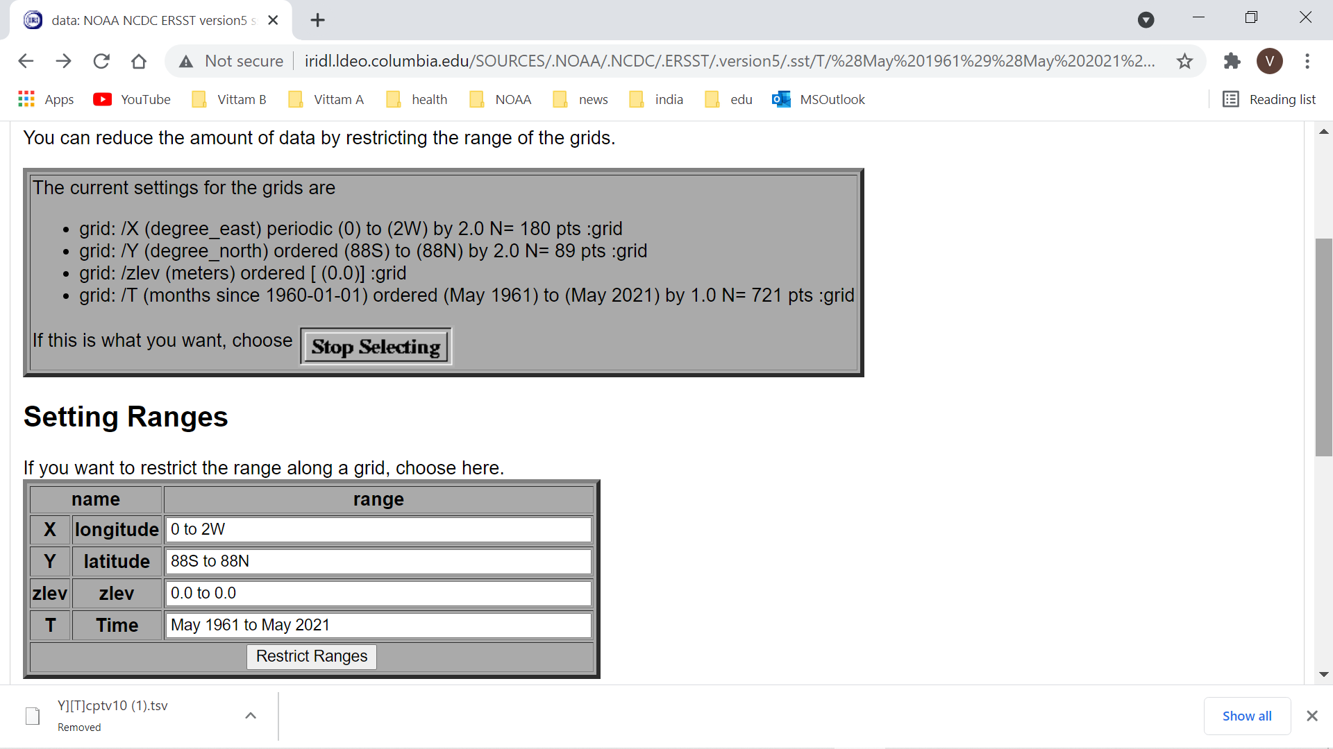

Slide 48
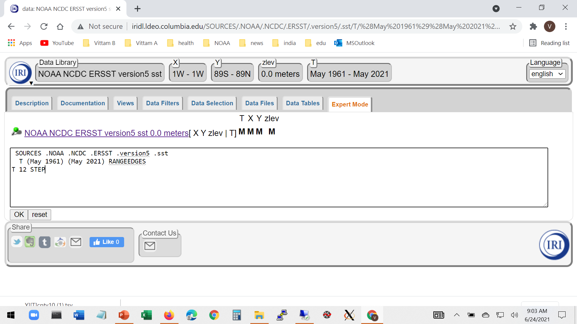

Slide 49
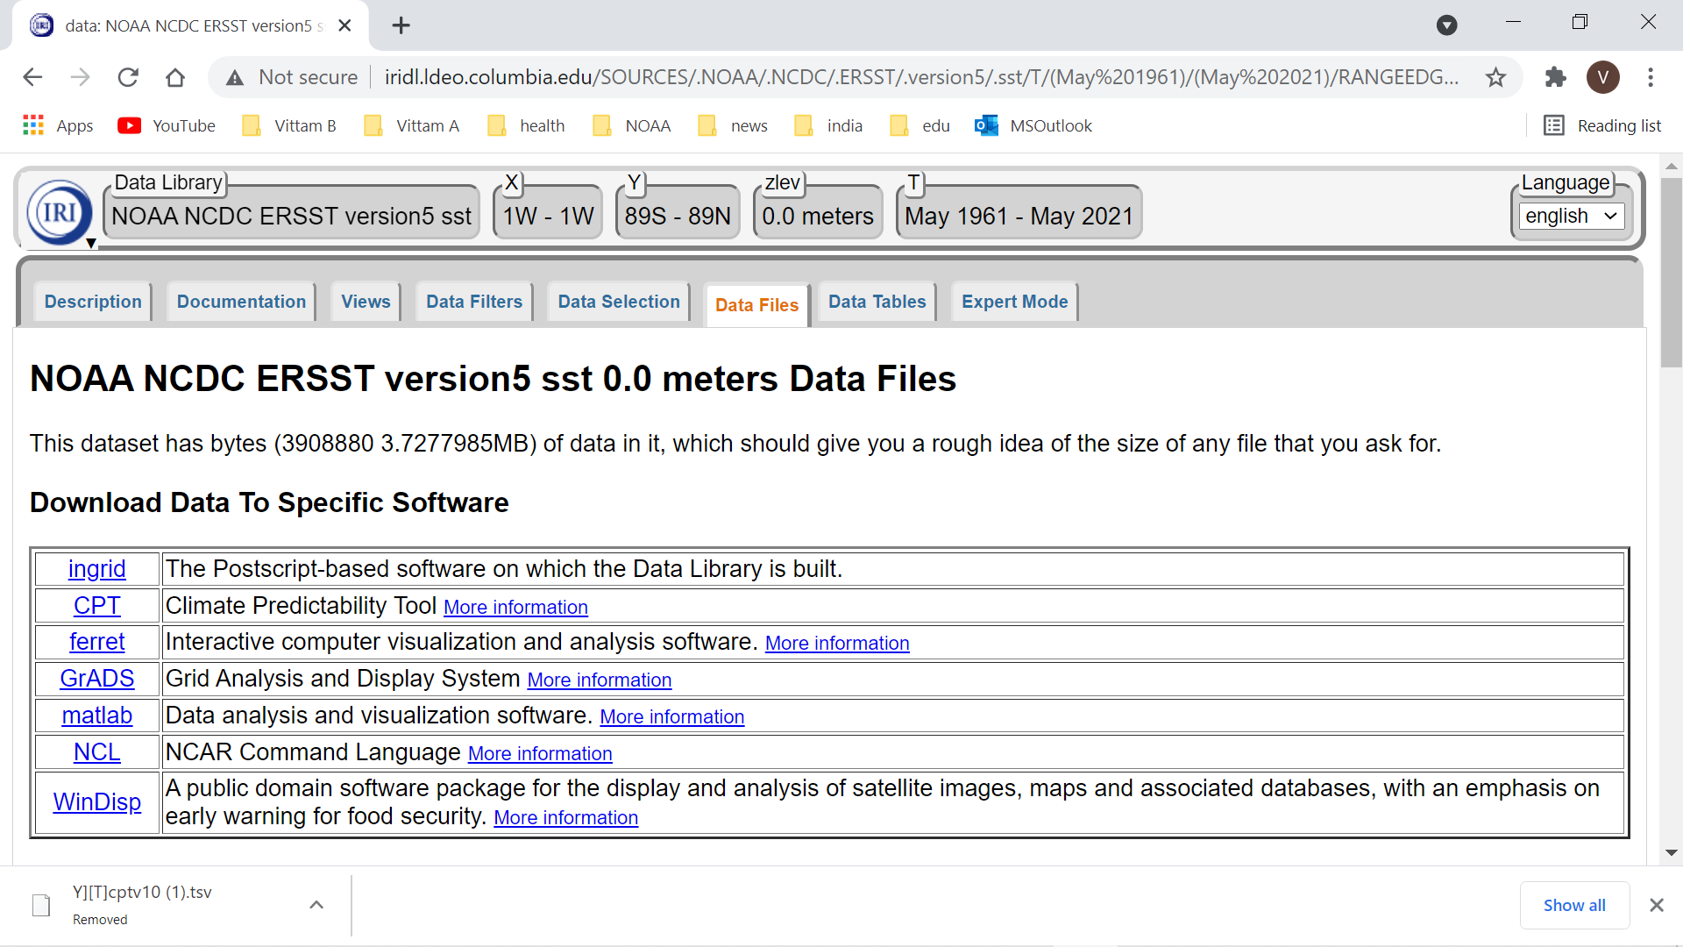

Slide 50
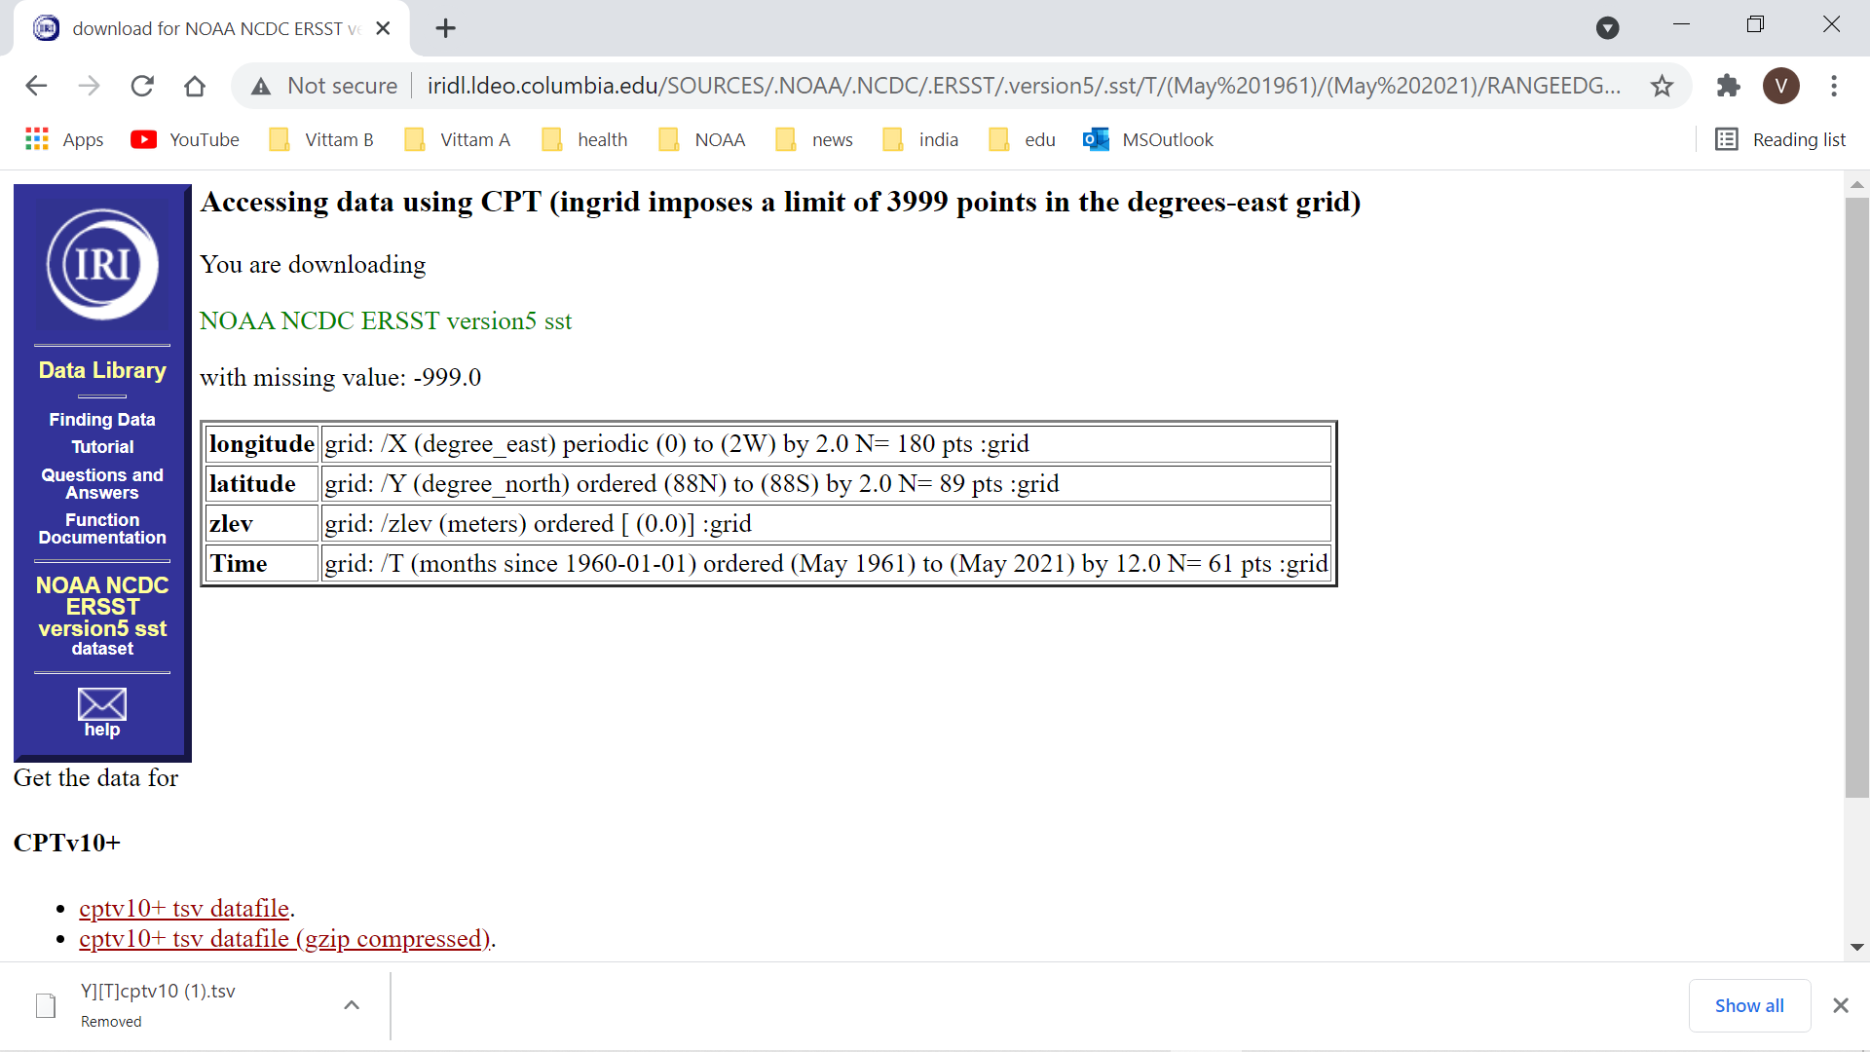

Slide 51
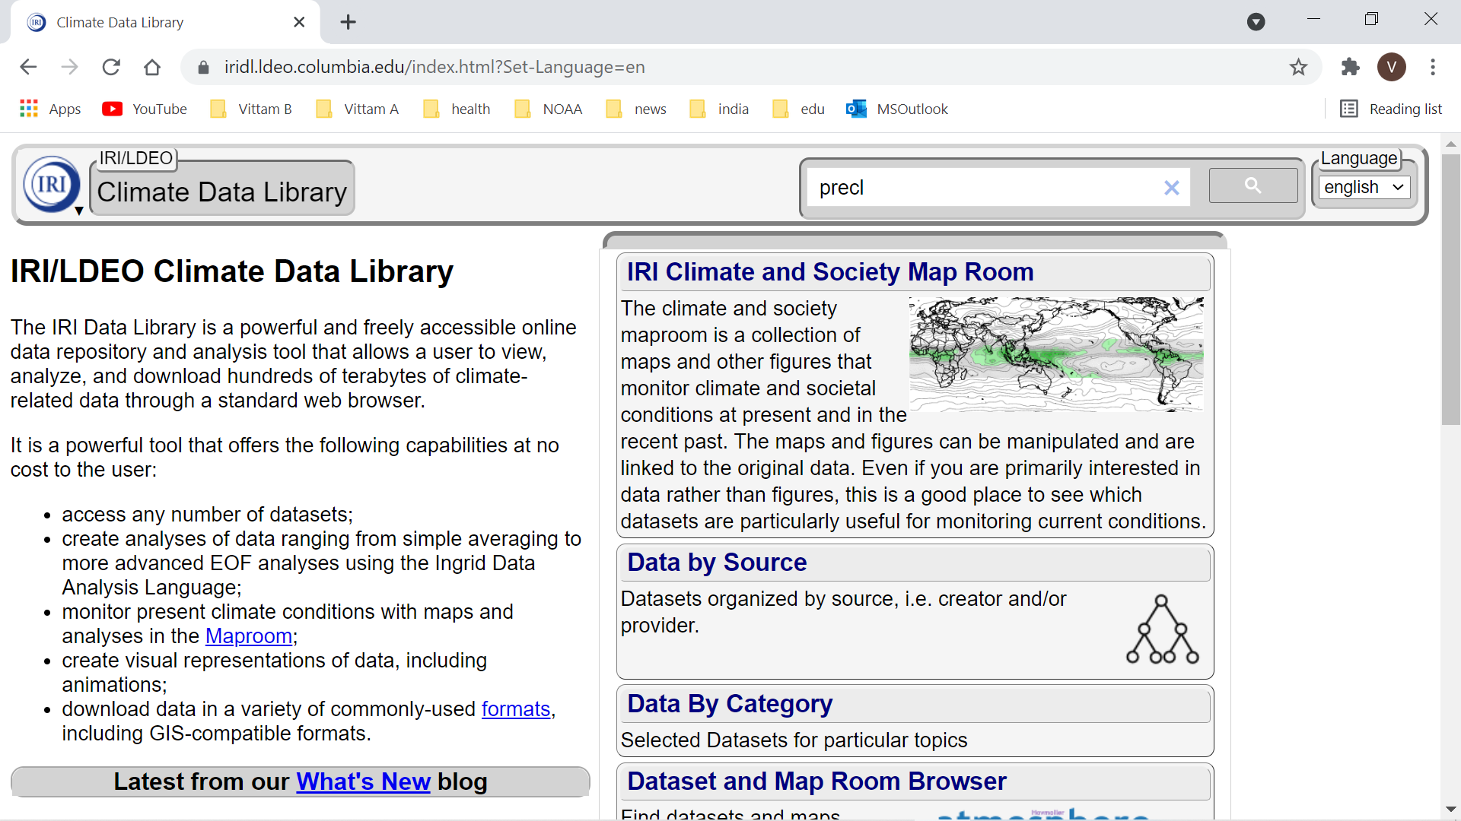

Slide 52
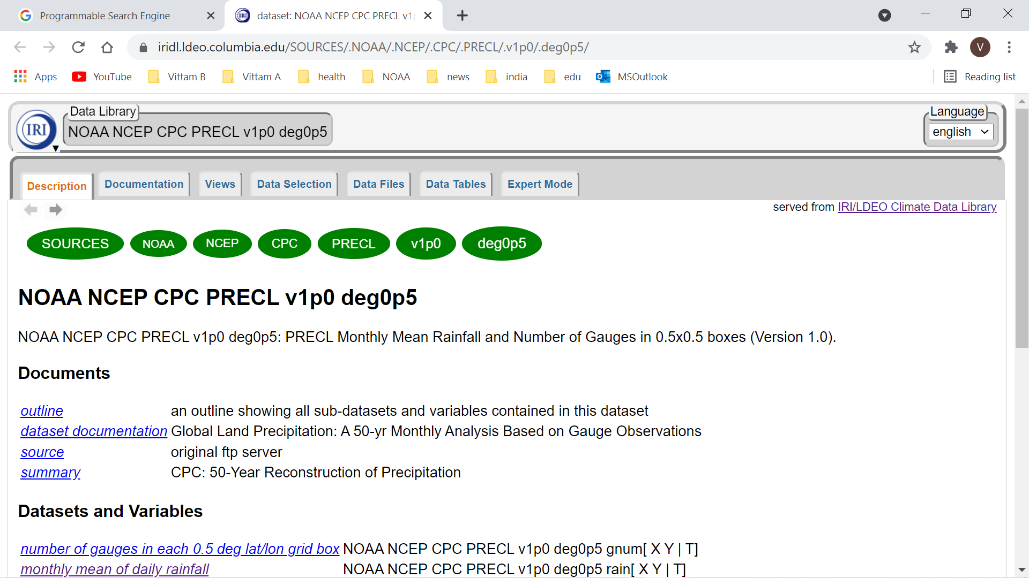

Slide 53
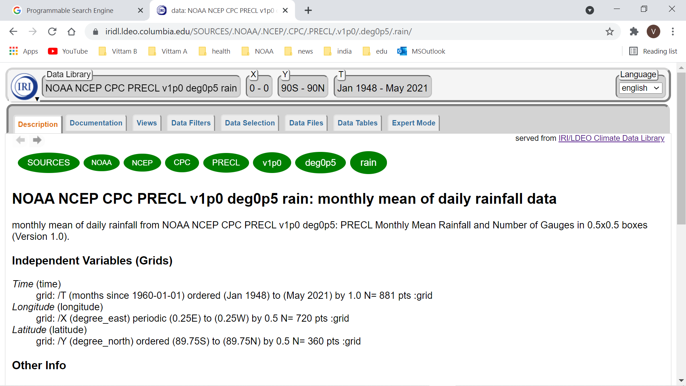

Slide 54
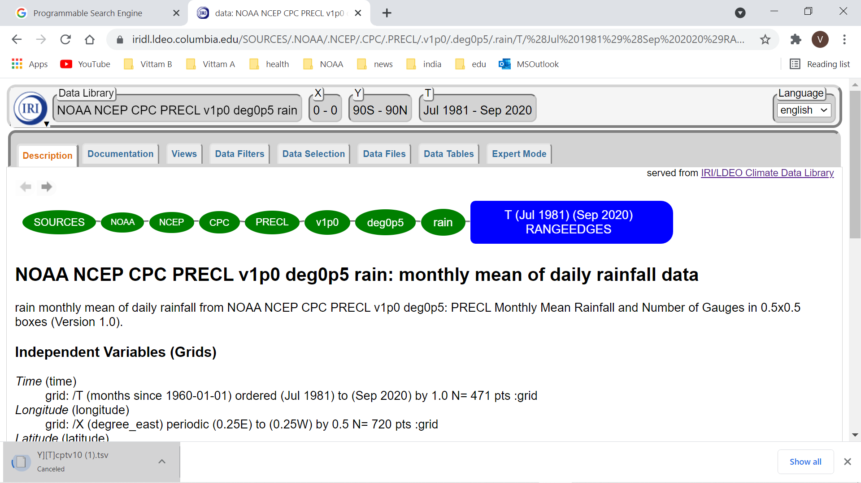

Slide 55
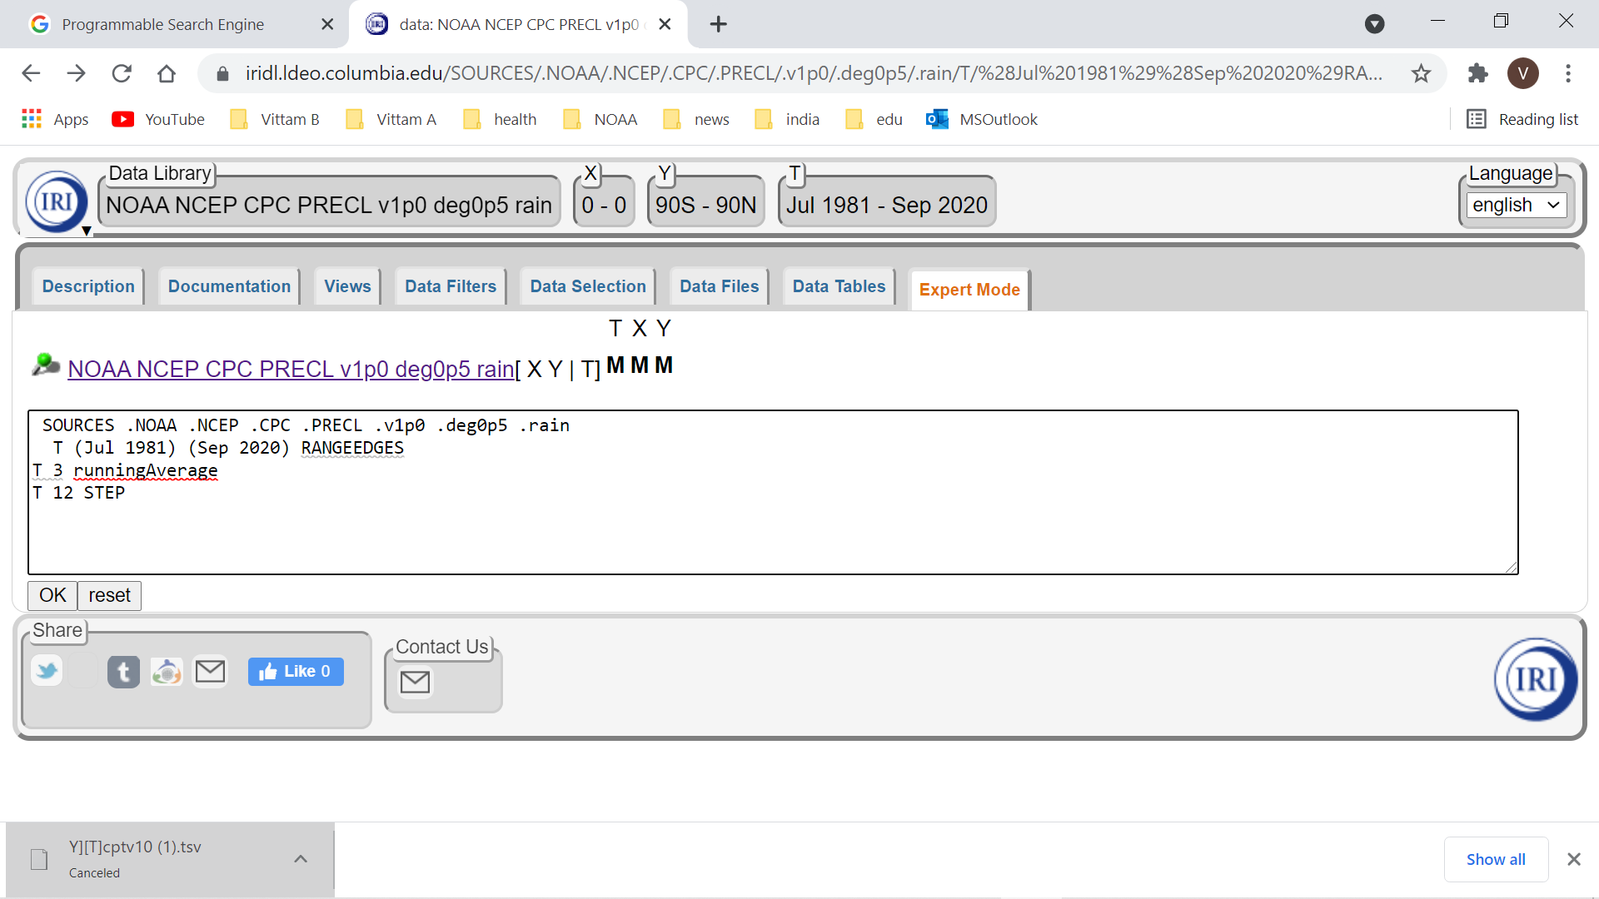

Slide 56
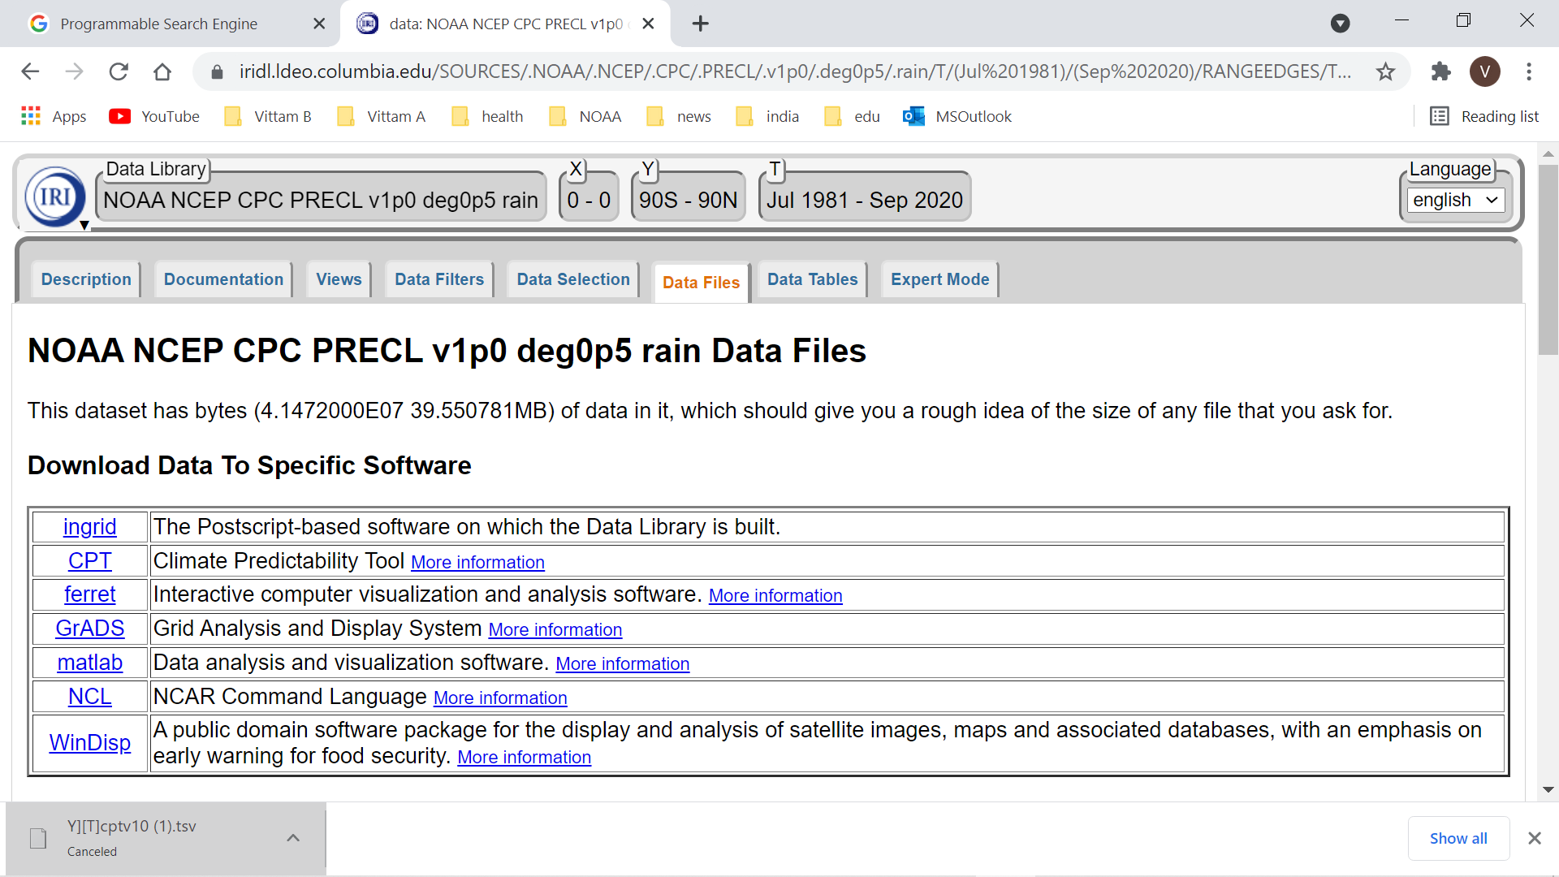

Slide 57
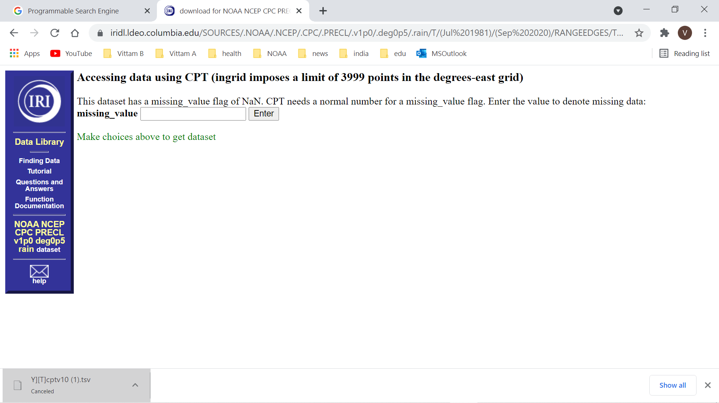

Slide 58
EXPERIMENT 2
GLOBAL TROPICAL OCEAN SST AS PREDICTOR
GHCN USAPI STATION PRECIP AS PREDICTAND

Slide 59
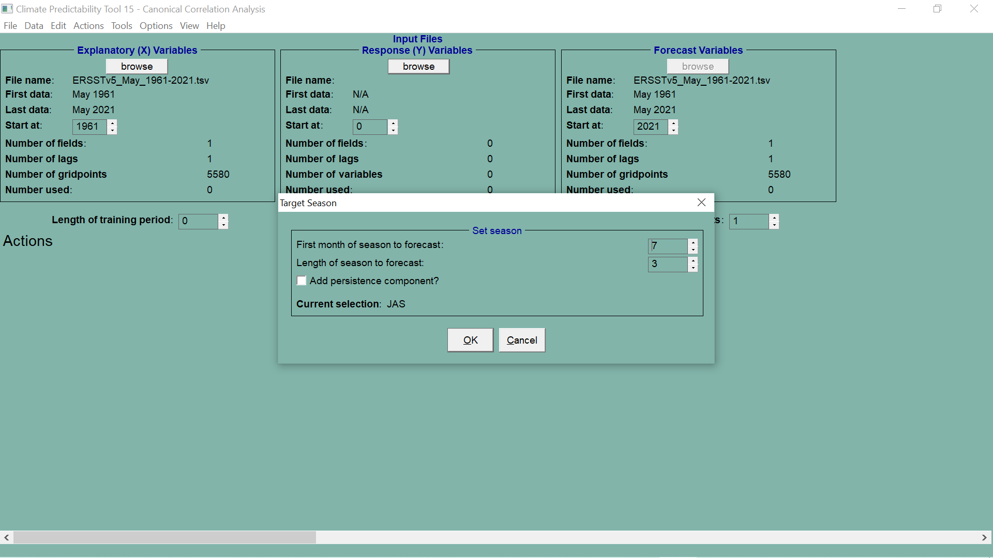

Slide 60
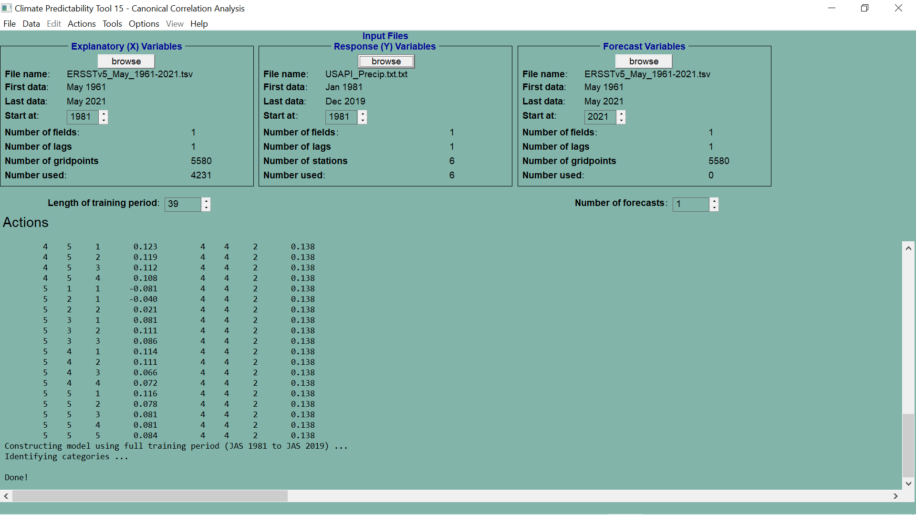

Slide 61
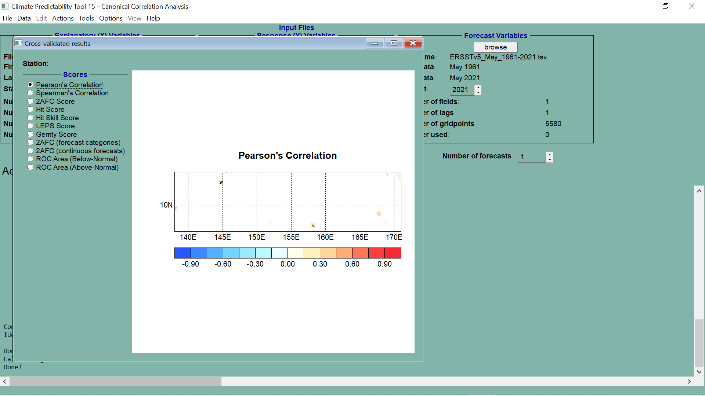

Slide 62


Slide 63

POINTS ARE CLICKABLE FOR ROC PLOT

Slide 64
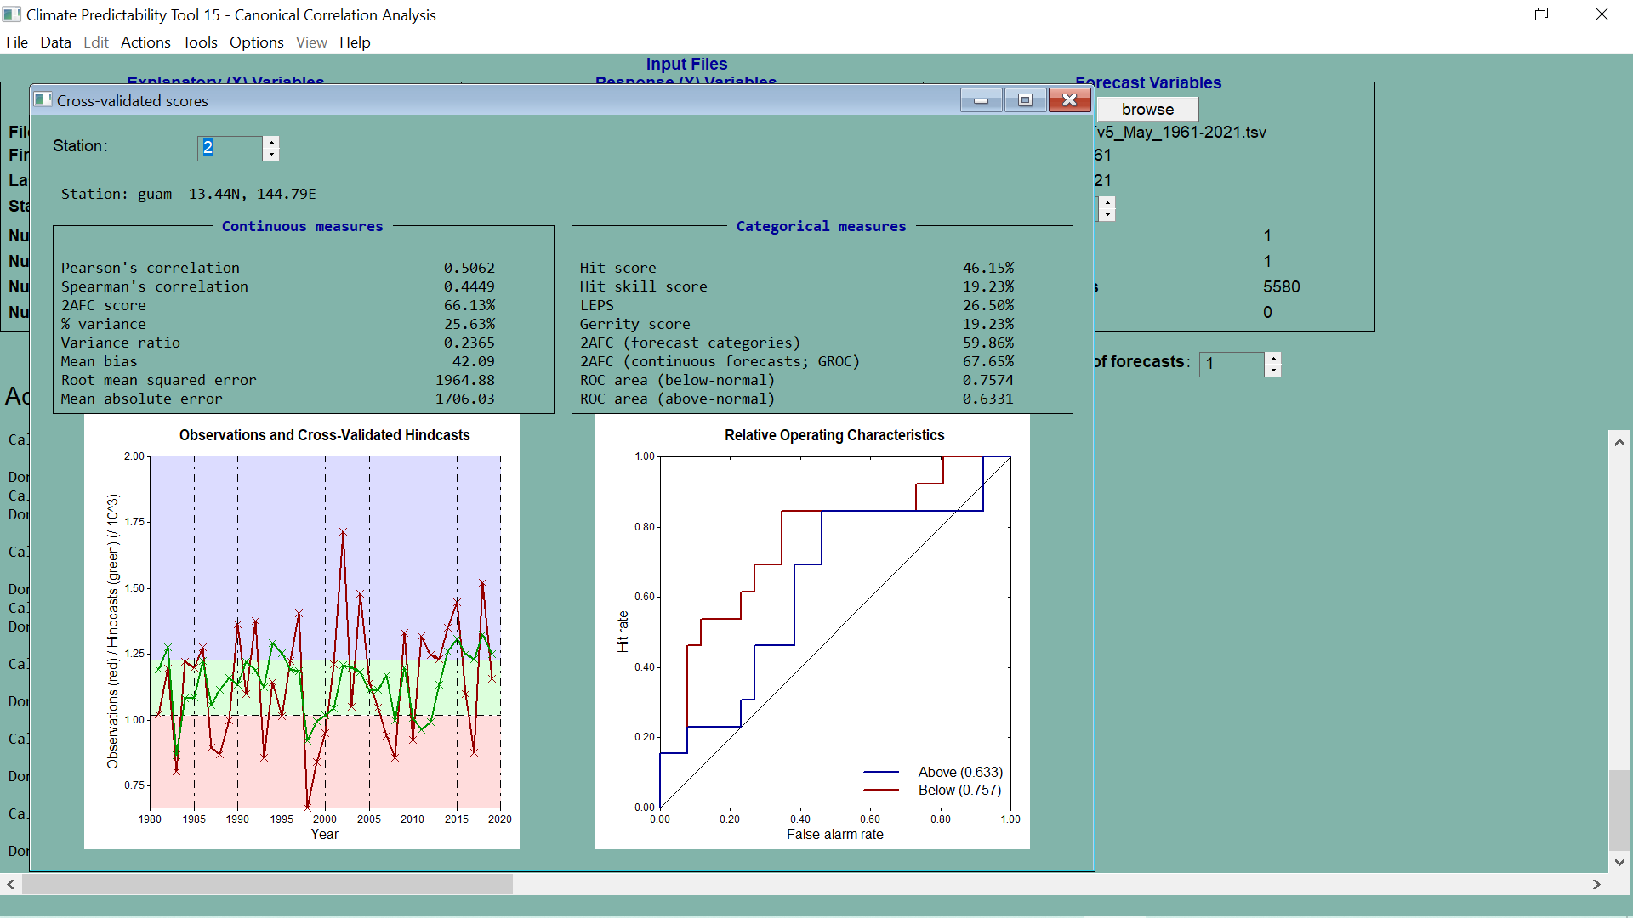

Slide 65


Slide 66


Slide 67
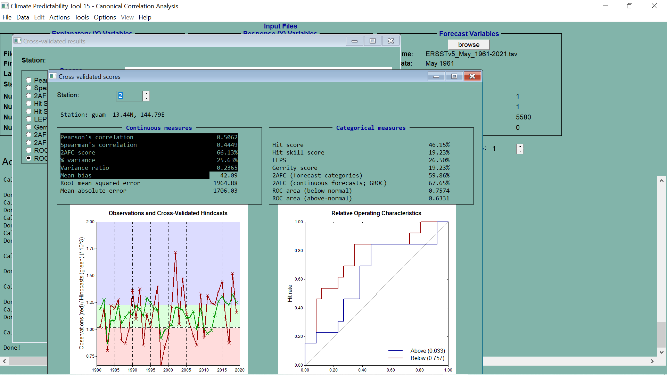

Slide 68
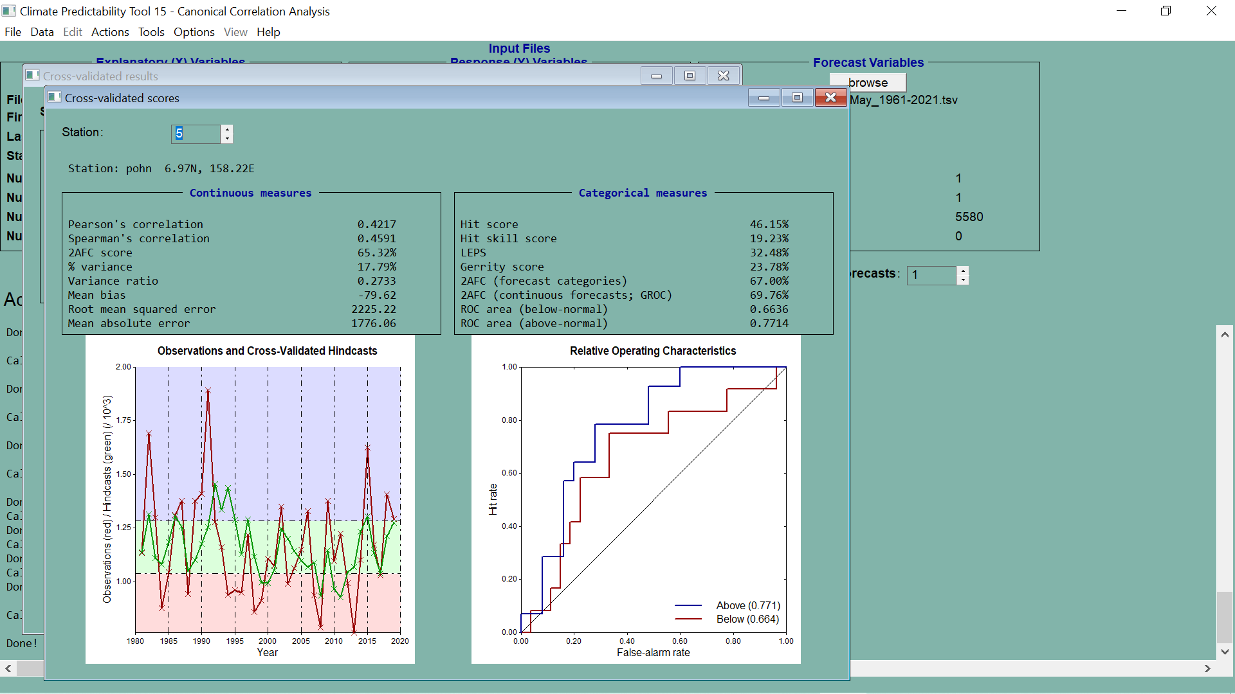

Slide 69
PREPARING THE USAPI STATION PRECIPITATION DATA

Slide 70
THANK YOU

